Slide 1
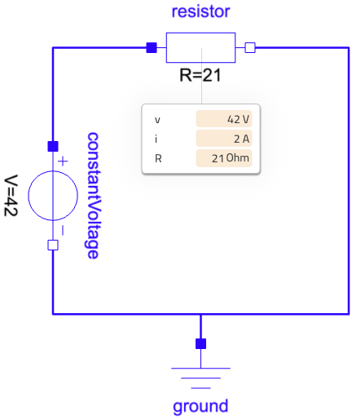
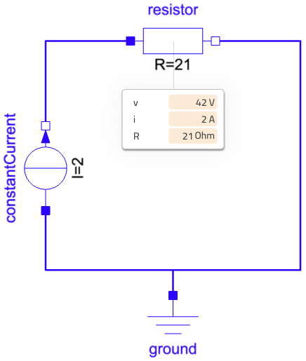
Acausality A single component for all causalities
Same model
Conductor
The resistance R is set
The voltage v is known
→ The current i is the solved for
Resistor
The resistance R is set
The current i is known
→ The voltage v is the solved
The resistor illustrates well the principle of acausality.
And it is true for all models.
It does not mean that all causalities are desired – there are ways to influence the causality selection.

Slide 2
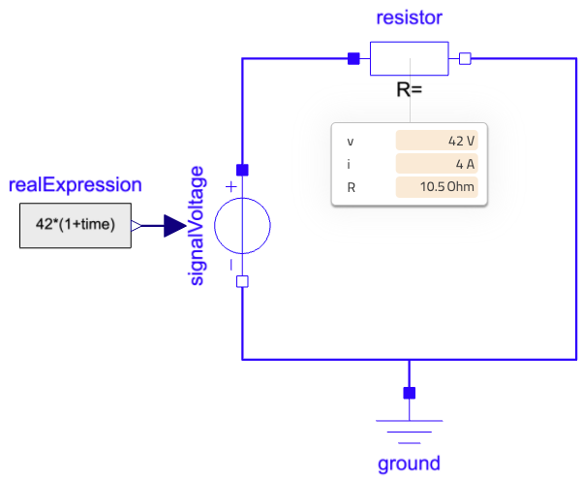
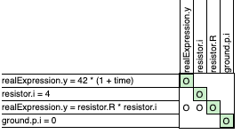

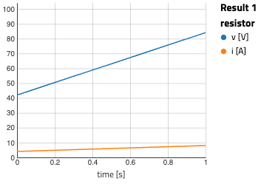
Bi-causality All variables known to compute the parameter value
In Modelica, a model results in two problems to solve: the initialization problem and the time simulation problem.
Here we leverage the former to compute the value of R and reuse the computed value for time simulation.
The current i is set as initial equation
The voltage v is known
→ The resistance R is the solved for
R is the solved for in this equation
For this problem, R is found to be 10,5 Ohm.
This value is used for the time simulation to determine the value of the current trajectory.

