Slide 1
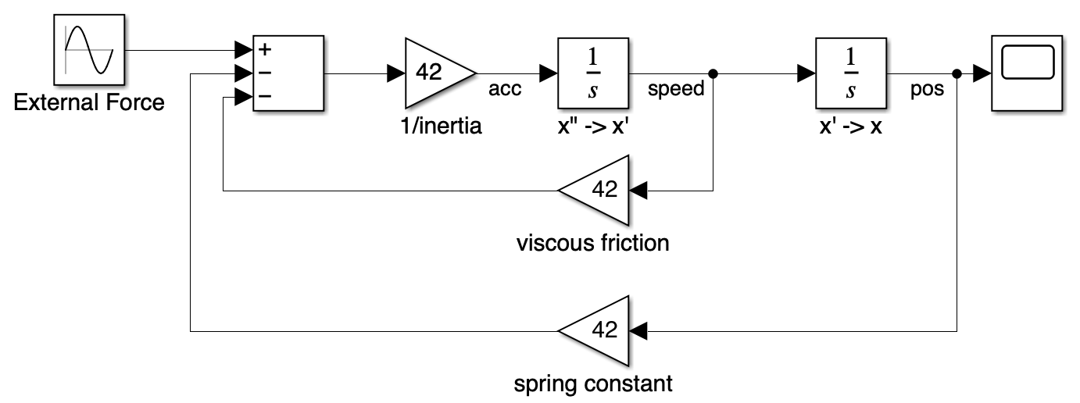
Why aren’t block diagrams well suited for behavioral modeling?
There are already several assumptions in this block diagram. Can you spot them?

Slide 2
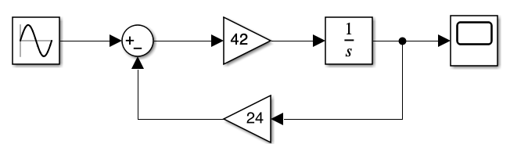
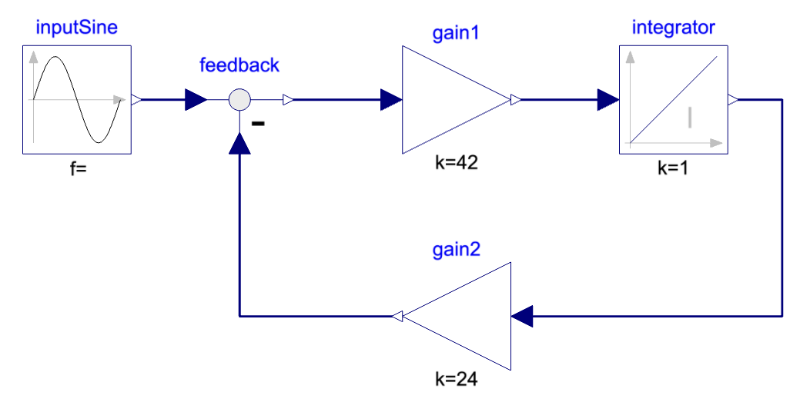
Reminder from last write up – skip if you have read it or know 🙂
What are block diagrams?
Block diagrams are, as the name indicates… diagrams made of blocks.
For the scope of modeling physical systems, the blocks contain usually mathematical expressions – in pure algebraic form, in s-transform (Laplace) or z-transform.
Above is a block diagram from Simulink and below in Modelica.
Each line carries one variable, and the arrow indicates the flow of information for which the block is defined. This means that the output of the gain is equal to the input times the gain.

Slide 3
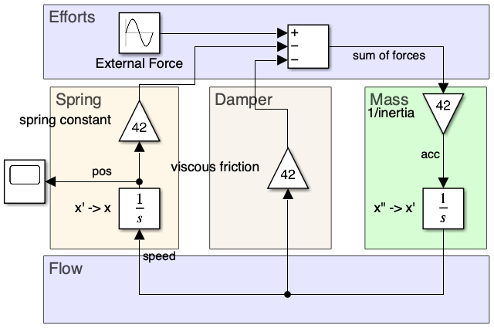
The basic problem of modeling physical systems with block diagrams
When modeling a physical systems, a strong focus shall be made on ensuring energy conservation.
Energy is the time integral of the power and power typically comes from the product between two variables - often referred to as effort and flow.
And here is the basic problem, the arrows in flow diagrams carry only one variable, while power and energy conservation require two variables. And often, I see block diagram models that forget one of the two variables.
However, it is perfectly feasible.
This block diagram below is the same as in the first page, slightly reorganized to show both effort and flow variables. It is a model of a mass suspended with a spring-damper on which an external force applies.

Slide 4
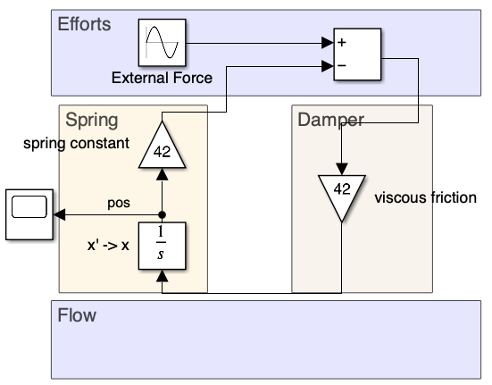
The second issue
Block diagrams represent a given sequencing of the equations modeling a system.
As soon as we add or remove components, the sequencing of the equations for solving can largely differ and requires a (partial) rewriting of the block diagram model.
Below is a simple example where we consider the inertia of the mass of the previous example negligible.
Inertia modeled Inertia neglected
We see that the damper is now the one providing the relationship between effort and flow – i.e. between Force and speed.
Going from one to the other, I made a mistake on purpose. Can you spot it? 🧐
It is easy to make this type of mistakes in practice!

Slide 5
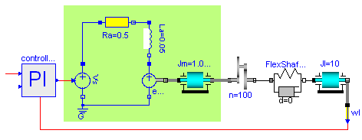
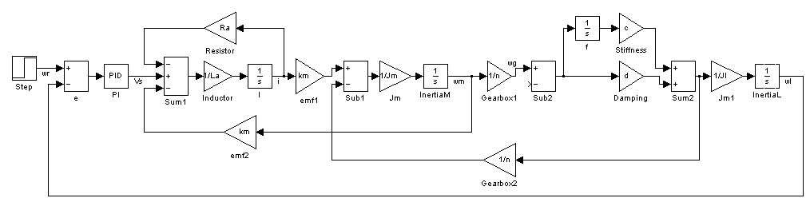
The second issue – a more illustrative example
Only adding flexibility to the shaft…
… leads to large changes on the block diagram model:
- Inertias can no more be lumped
- EMF can no more be lumped with the gear box ratio
- needs to add the new stiffness and damping effects

Slide 6
Why aren’t block diagrams well suited for behavioral modeling?
Block diagram models are more likely to contain errors as:
1. It is easy to forget representing all equations of energy conservation – often visible on “scientific papers”.
2. Doing manually the tedious symbolic manipulation can lead to error - as voluntarily on page 4.
3. A new scenario or adding a physical effect can lead to fundamental rewriting of the model – consider the ask to set the speed and no more the force on the mass in the initial model. How would it change?
However, it is possible and if it is the only choice you have, it is better than nothing!
I always say: “You can do everything with every tool, it is just a matter of time, money and effort.”
(Modeling physical system with block diagram is typical a high effort task.)
❓Can you answer the questions in the different pages? 🧐
…
Comment if you need any further clarifications or insights.
👇

