Slide 1
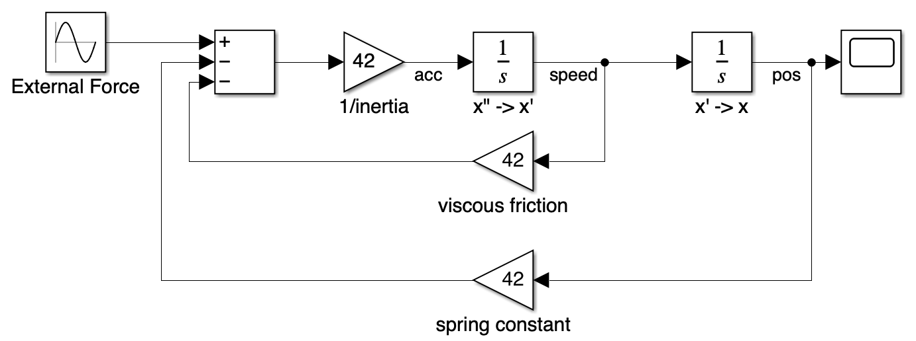
Can you spot the modeling assumptions?

Slide 2
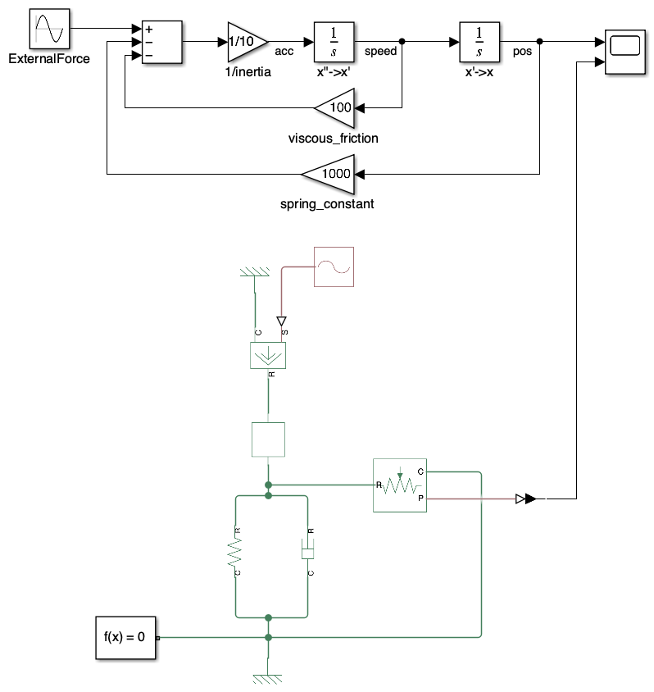
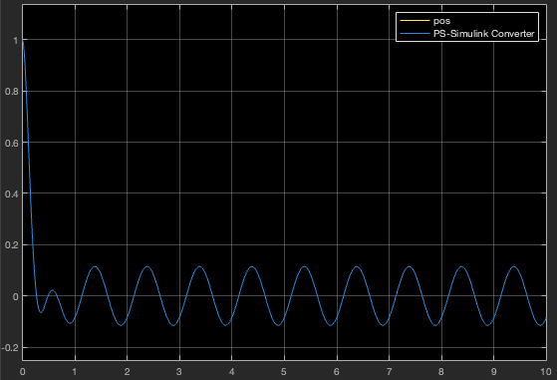
Can you spot the model assumptions?
The model is basically correct. Below is a comparison with a Simscape model and the mass position are identical.
And there are still some strong assumptions.

Slide 3
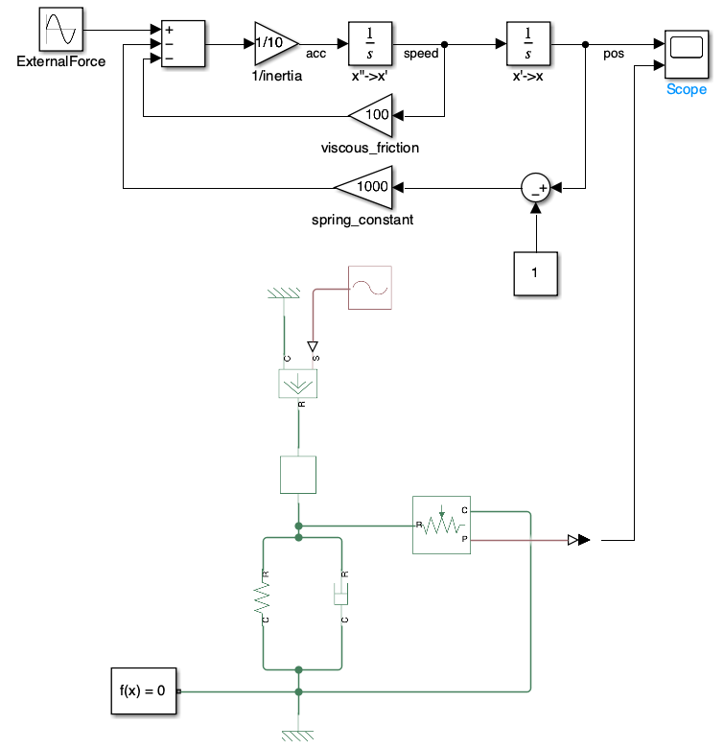
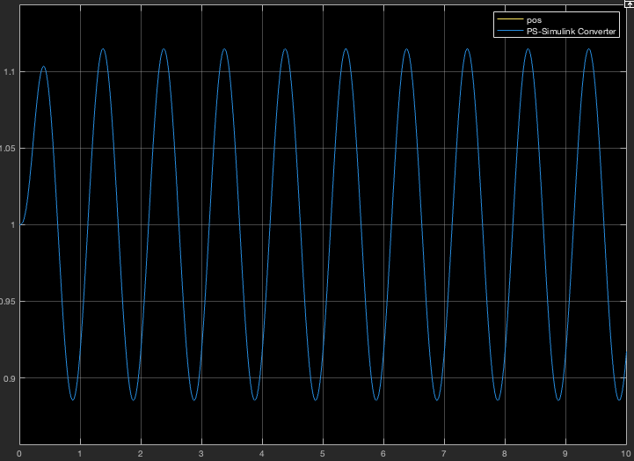
Can you spot the model assumptions?
This is quite an open question so there are many answers… To list only a few: 1. initial elongation of the spring is 0. 2. The mass is suspended to a fixed ground (non-moving) 3. Inertial effect of the mass is modeled but not gravity. 4. There are no end stops to the motion.
Regarding the initial elongation, below would be the model with a spring initial elongation of 1 meter:
This sensor as a different initial position – hence the different Simscape result.

Slide 4
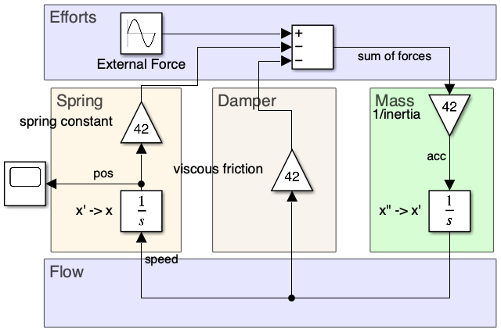
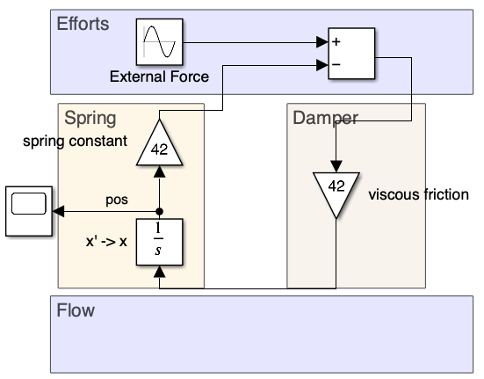
Can you spot the error?
Inertia neglected

Slide 5
Can you spot the error?
Yes! The value of the viscous frictions are not consistent.
When neglecting the inertia, we need to change the causality of the damper characteristic equation to avoid derivation / ensure integration on the spring equation.
The damper characteristic changes from resistance to conductance and should thus be 1/42.
(Analogy with electrical domain going from U=R*I to I=U/R )
Inertia neglected

Slide 6
What’s next?
Let me know which topics are of your interest and that I should cover in the near future.
Also, can you find more assumptions?
Would you know how to implement the block diagram if the listed assumptions should be modeled?
…
Comment if you need any further clarifications or insights.
👇

