Slide 1
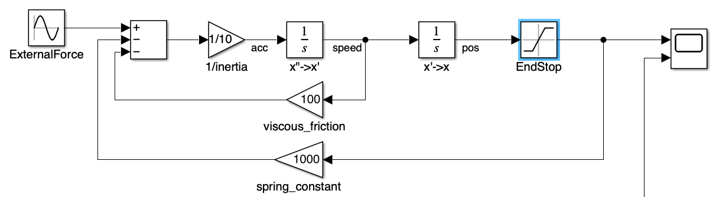
Typical mistakes when modeling end stops with block diagrams

Slide 2
Typical mistake when modeling end stops with block diagrams
I often see in scientific papers the modeling of end stops / hard stops with a saturation of the position signal.
Like this:
The model represents a physical mass on which applies an external force, a viscous friction and a stiffness.
It could typically be a suspended mass-spring-damper system.
And the translation of the mass is limited with a saturation.
Why is this a mistake to model the end stop this way?
Because the integrator keeps winding up even if the position is saturated.

Slide 3
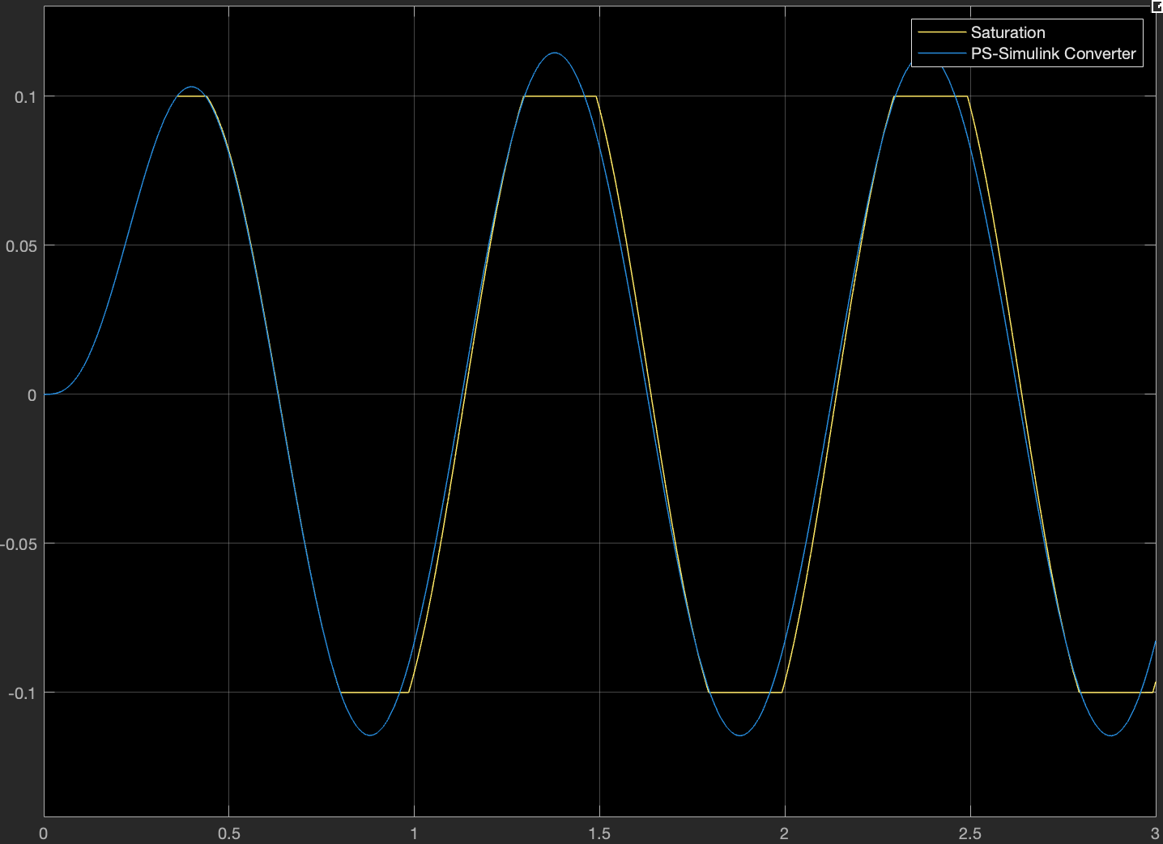
Typical mistake when modeling end stops with block diagrams
The integrator keeps winding up even if the position is saturated.
The forces on the mass might still cause the motion to continue in the same direction and this will be seen on the integrators (speed and position). Only the output of the position is saturated.
It is like if the mass would be continue moving and just the sensor would be blocked at a higher value.
This means that when the sum of forces will start inverting its direction, the mass will have to go back all the way it went further than the saturation before the sensor changes its value.
You see (yellow) how the position of the mass even gets delayed compared to the system without end stops (blue), because of the reduction of counter-acting forces (spring and damper).

Slide 4
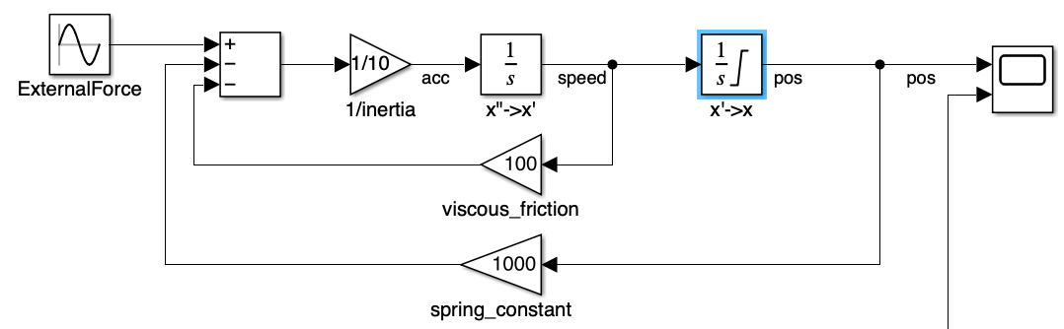
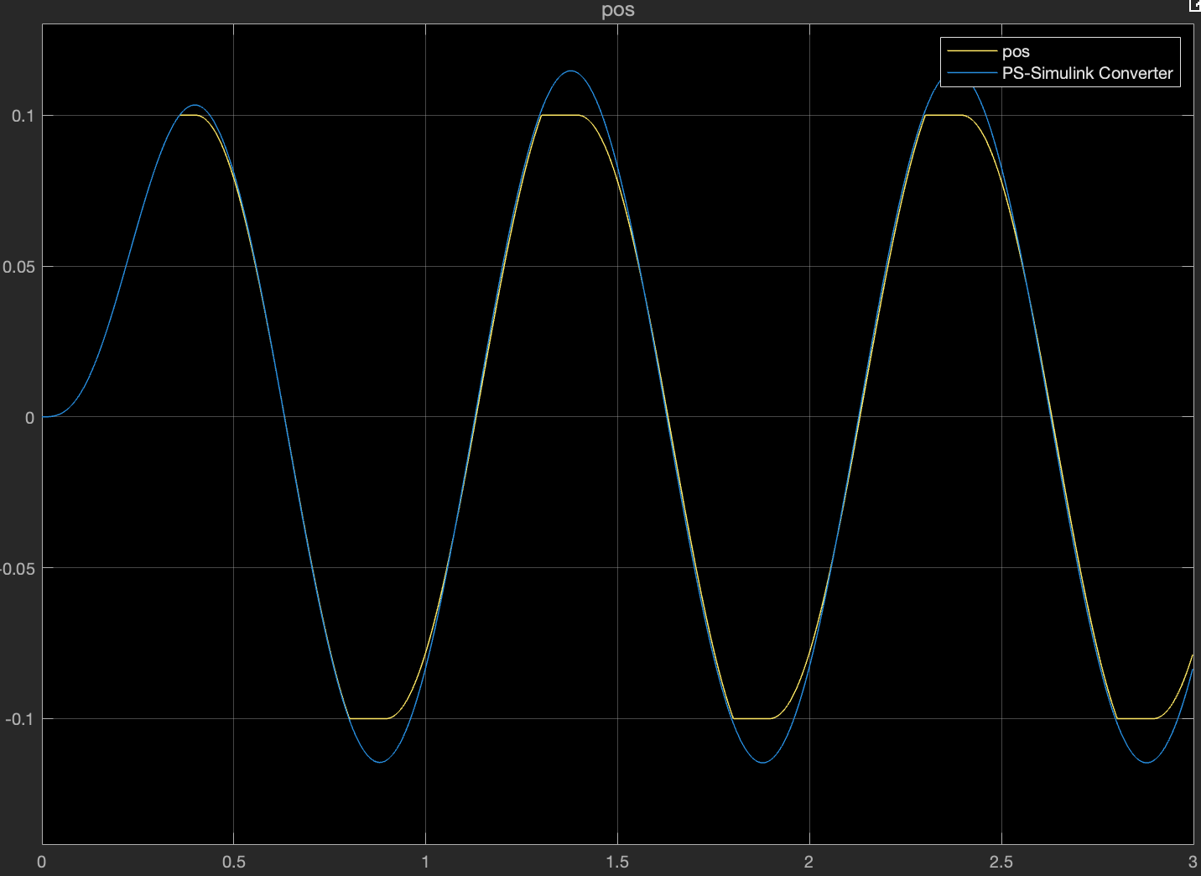
What can I do then?
Well, a first correction could be to use a limited integrator instead of limiting the output of the integrator.
A limited integrator does not wind up when it reaches its limit. If the output is above the limit, the integral action is disabled.

Slide 5
Is the limited integrator the solution?
It is better and yet still very incorrect.
It is better as the behavior (yellow) is already more realistic – motion inverts before the system without end stops (blue).
It is still incorrect because the acceleration and speed are not affected by this modeling of the end stop.
The position is no more the integral of the speed, it is the limited integral of the speed. That is wrong.
And so is the damper force which is function of the speed.

Slide 6
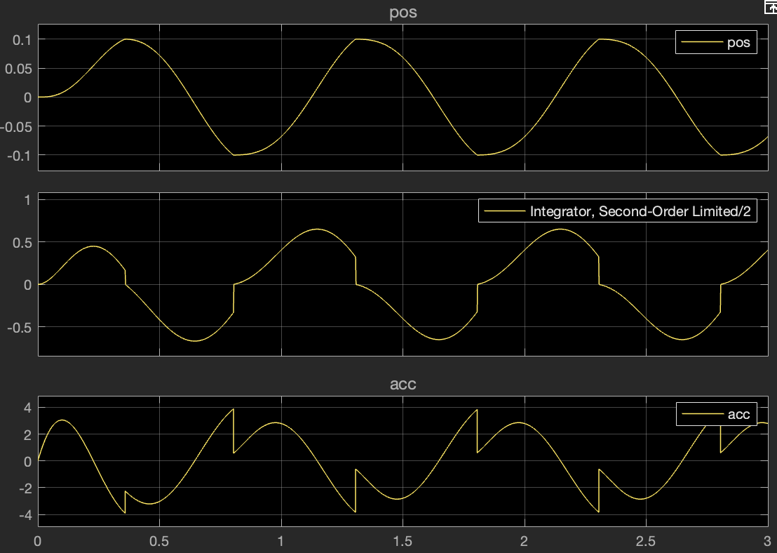
So, what should I do?
It is not that trivial to model end stops with block diagrams:
You might want to limit the first integrator (from acceleration to speed) to 0 when the second one is limited.
If your tool does not have a variable limit integrator, then you will need to code it with blocks yourself.
Matlab Simulink has a Second Order Integrator which allows to limit position and speed and take care of this.
The image below shows how the acceleration, speed and position result with the use of this block.
Abrupt changes of acceleration and speed when the limits in position are reached are expected.

Slide 7
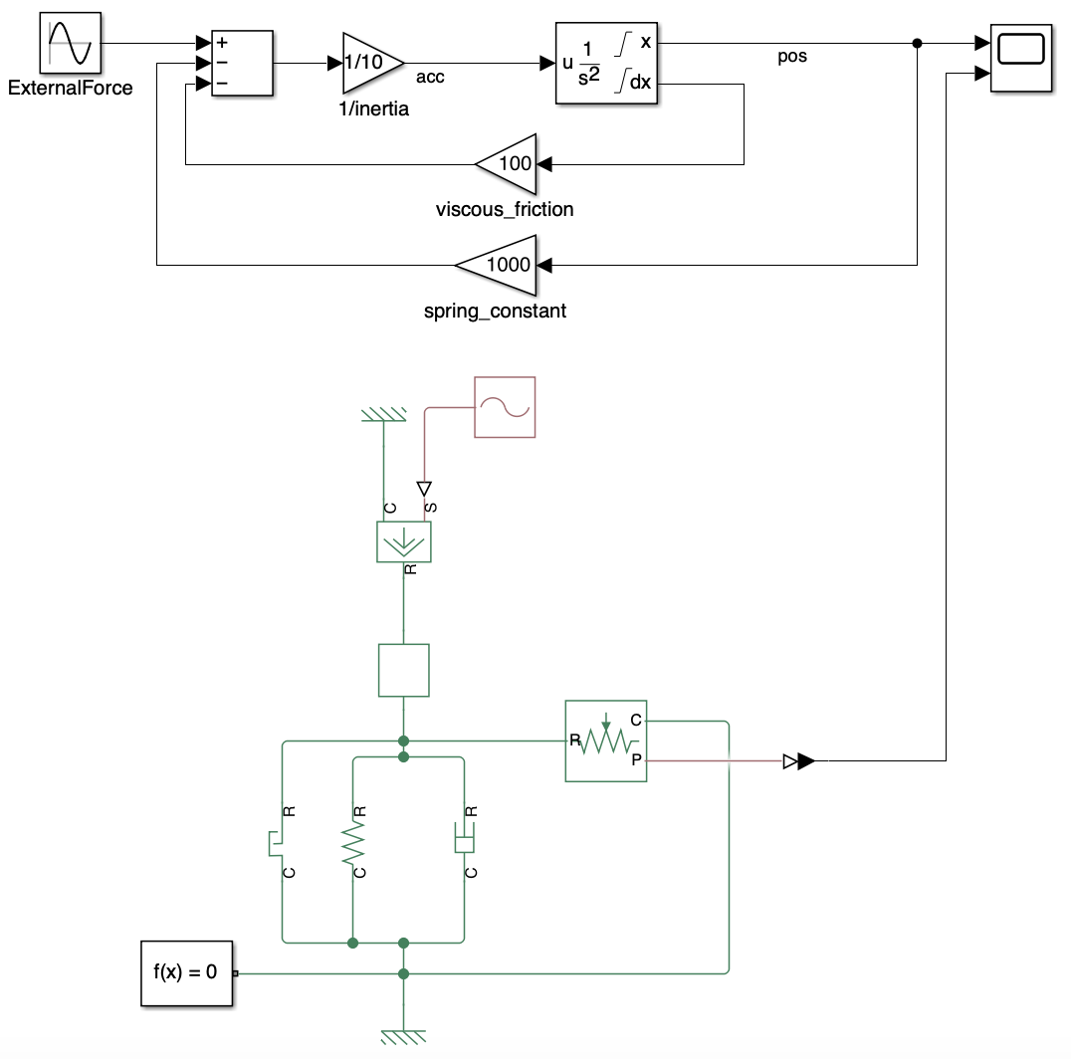
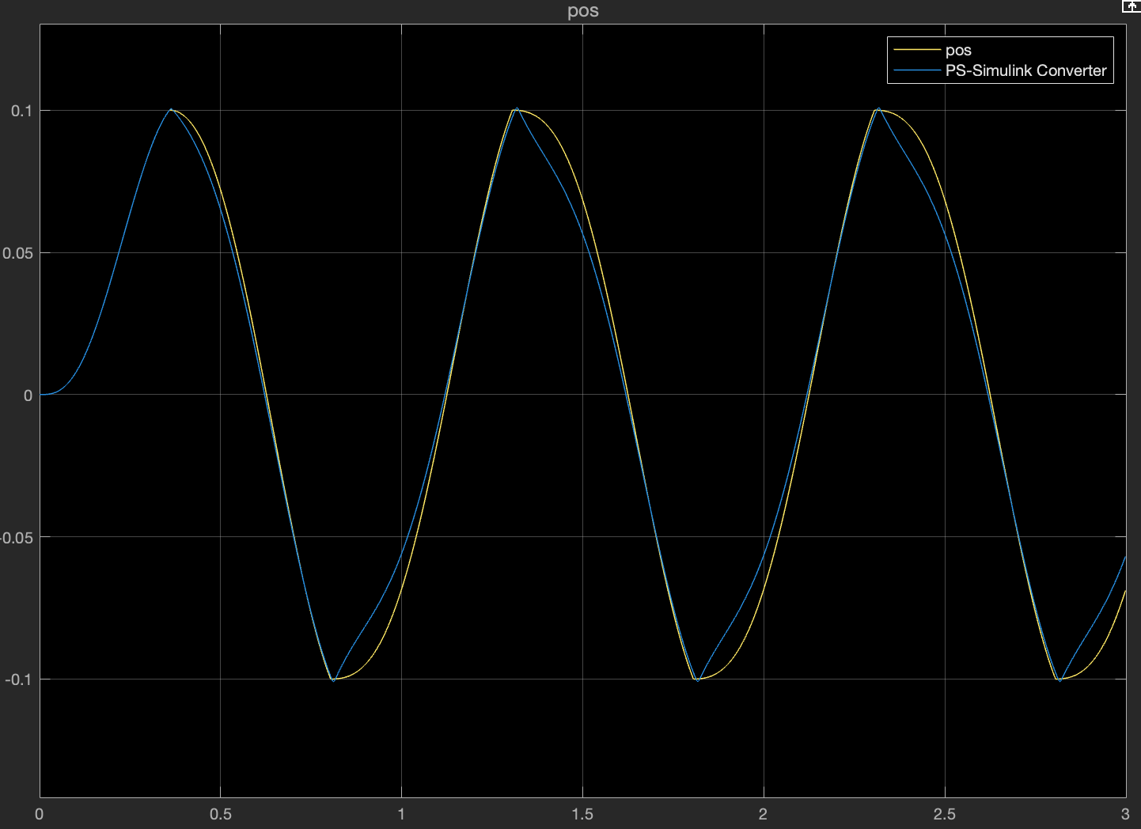
Can I still do better?
Modeling end stops in both a physical and numerical sound manner is almost an art.
It helps to model the stiffness and damping of the end stop. And these apply only when in contact. And it is more even complex 🙂
So, to cut it short, using pre-made components helps a lot. Below is the comparison of the position using both the Second-Order Limited (yellow) and a Simscape model (blue). You see the difference in modeling fidelities.

Slide 8
Summary
Einstein said something along the lines of: “Everything should be as simple as possible, But not simpler”
You should choose the right fidelity when modeling an end stop in a mechanical system. However, limiting the output of the integrator is a bad choice.
Prefer pre-made blocks or, even better, component-based models like in Amesim, Modelica or Simscape.
It is better to leverage the verified models build in tools than re-inventing the wheel.
And again, if you have to use block diagrams for this, take care of these advices. 🙂
…
Let me know if you need any further clarifications or insights.
👇

