Slide 1
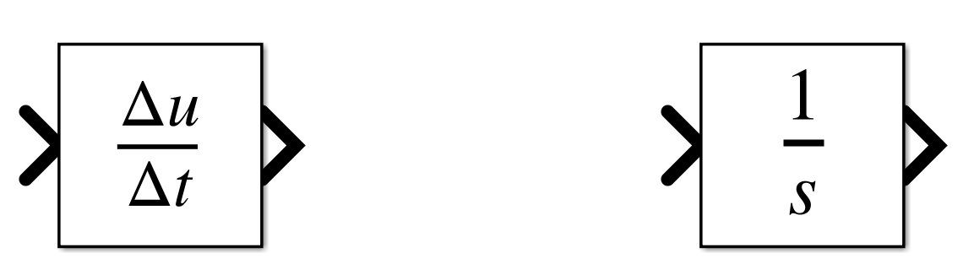
Need a signal derivative? Integrate instead!
Why do we prefer integration to derivation?
How to avoid derivation when you need the derivative of a signal?
vs

Slide 2
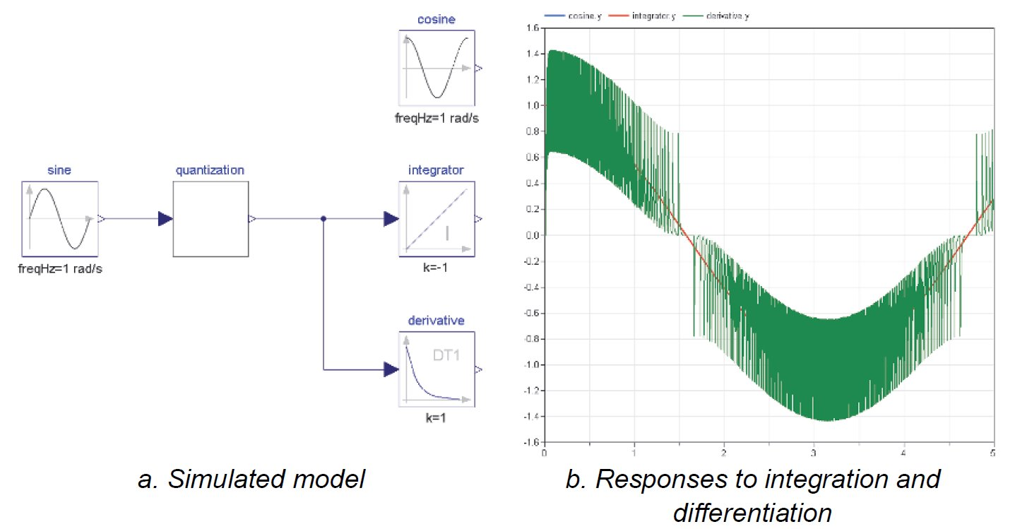
Why do we prefer integration to derivation?
Numerical derivation introduces a lot of noise, especially for numerical signals (discretized through time and value range [quantized])
Consider a quantized sine signal. The analytical integral of the sine with a “-1” gain is a cosine (+ initial condition) and the derivative is also a cosine.
However, the simulation below shows that, while the ideal cosine and integral overlap, the derivative is noisy.
This is due to the steps the quantization introduces for which the numerical derivatives tend to infinite.

Slide 3
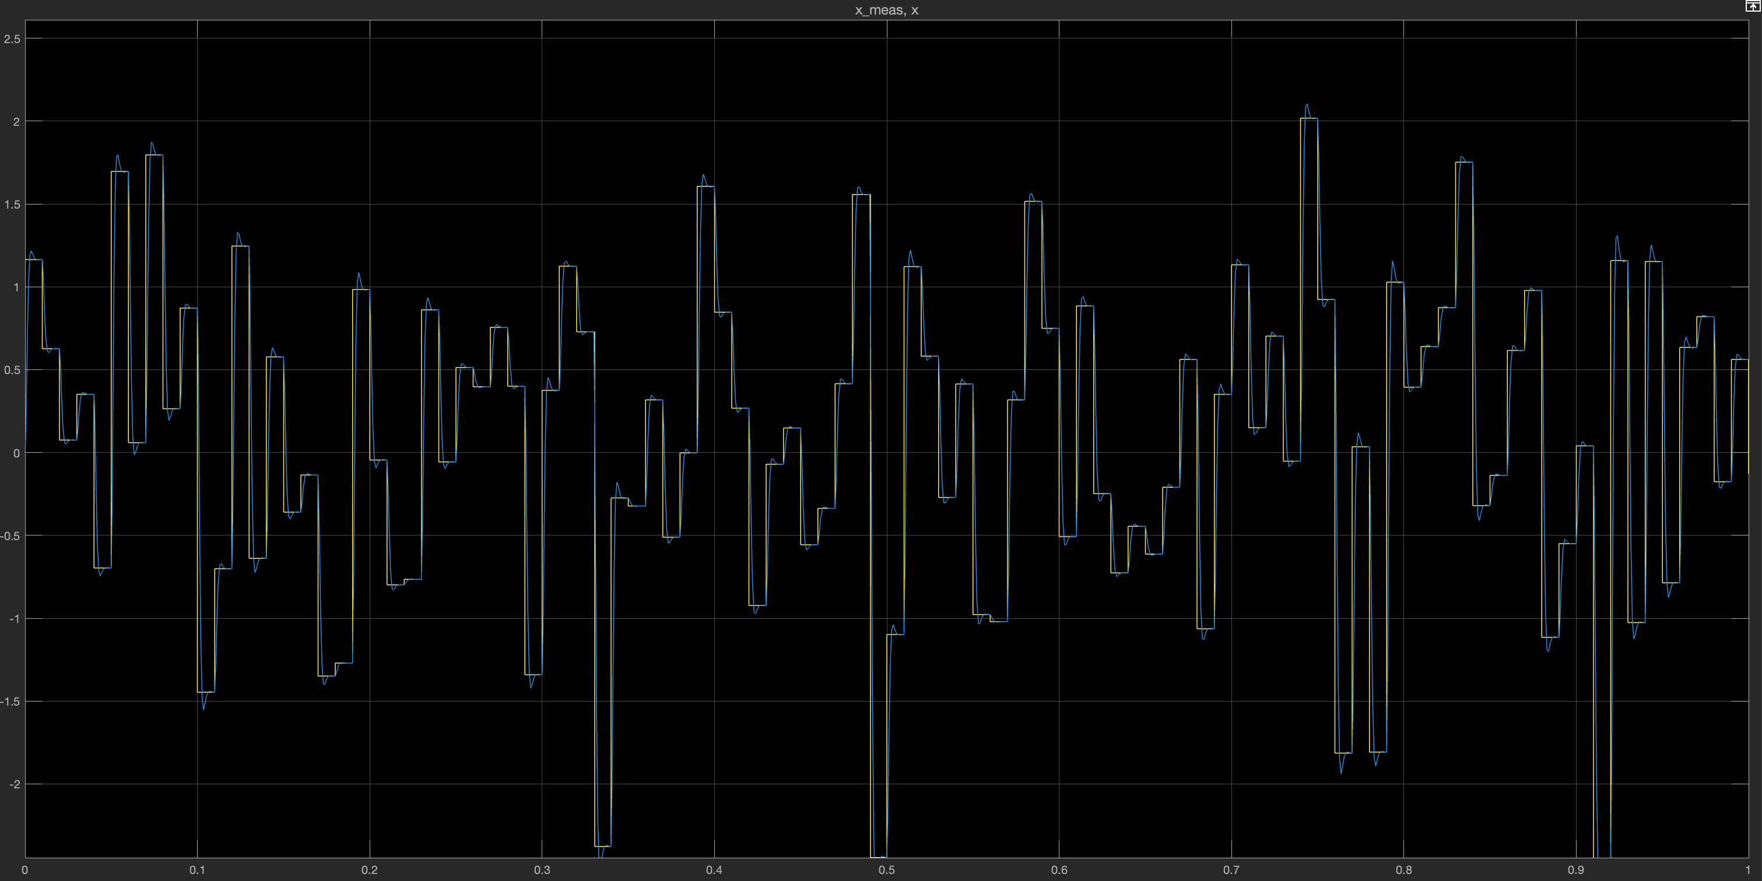
How to avoid derivation when you need the derivative of a signal?
As derivative introduce noise, it will be needed to filter the output for the derivate to be useful.
Apply an acceptable filter to the input instead! You will get the derivative “for free”
Let’s assume you have the values of a position sensor as discretized data, in yellow below. However, you need the acceleration values for your model. Instead of a double derivation, apply a second order filter to your position data. The output of the filter is… the filtered position (in blue)

Slide 4
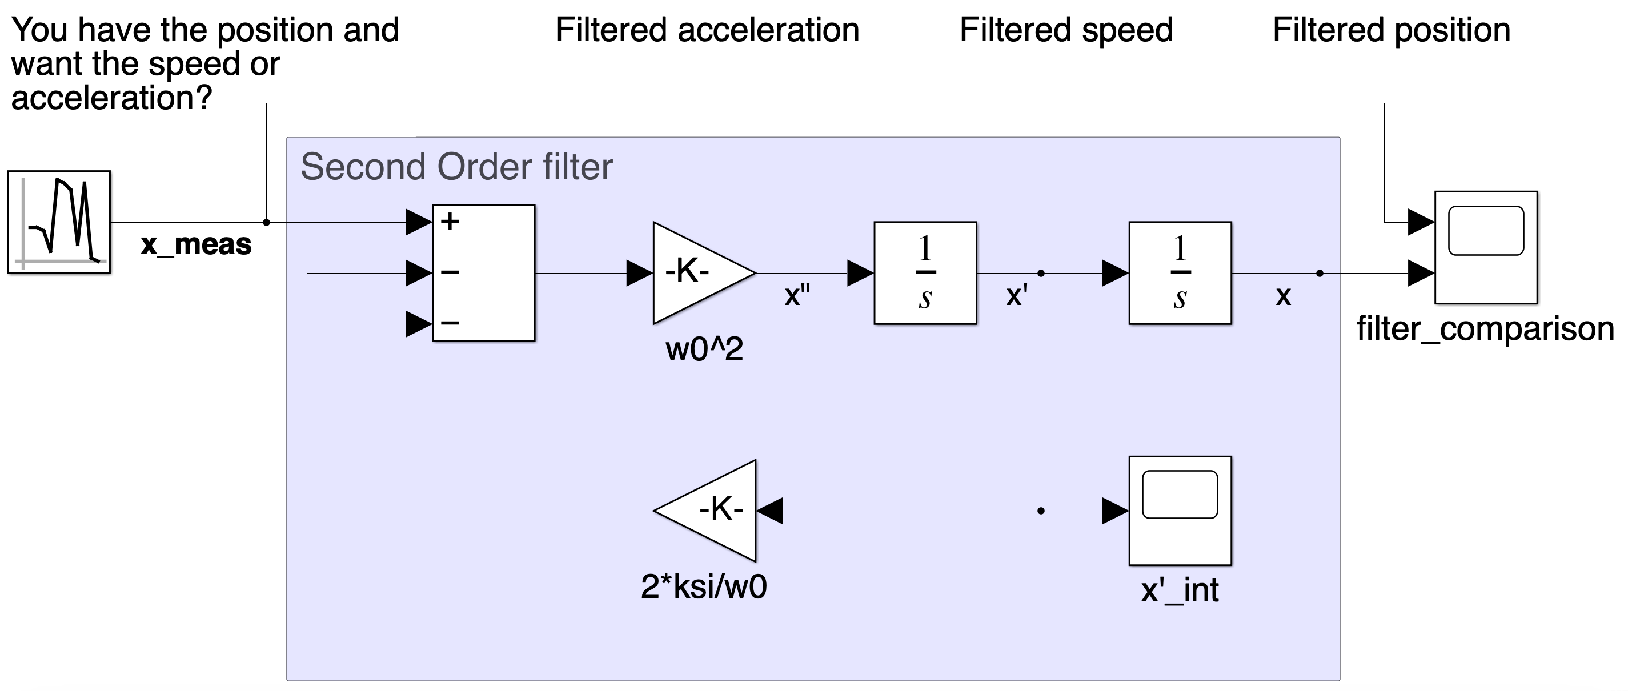
How to avoid derivation when you need the derivative of a signal?
As derivative introduce noise, it will be needed to filter the output for the derivate to be useful.
Apply the filter to the input instead! You will get the derivative “for free”
The output of the filter is the filtered position.
So, going backward on the canonical form of the filter, the input of the integrals are the filtered speed and the filtered acceleration.
You got the second derivative without derivation! 😉
filtered acceleration
filtered speed
filtered position

Slide 5
Need a signal derivative? Integrate instead!
Conclusion
❌ Numerical derivation introduces noise
✅ Numerical integration is preferred, when possible
A step-by-step process to avoid derivation:
Define the order of derivation you need → order N
Understand the dynamics of your signal
Filter your signal to an acceptable dynamics with a N-order filter in canonical form
The output of the filter is your filtered signal
Go backward on the integrators to find the derivative of interest
(Other methods exist!)
Comment if you need any further clarification or insights.
👇
Missing something?

