Slide 1

Understanding FMI CS and ME
Overview, comparison and lessons learned
👉

Slide 2
Understanding FMI – Co-Simulation & Model Exchange
Goal
To enable cross-tool exchange of dynamic simulation models
Mindset
Open and broad adoption while protecting IP (Many tool vendors contributed to the FMI specification – initially during the Modelisar ITEA 2 European project. Anyone can join the project and contribute.)
Bonus
Also used for model export on real-time target
Useful links 🔗
FMI website
Tools support
Specification (3.0.1)
SSP website

Slide 3

Understanding FMI – Co-Simulation & Model Exchange
model packaged complying with
the FMI standard specification
FMU
ZIP
Container
XML
Interface definitions
Model
Source-code or Binary
System assembly
composed of FMUs
and parametrization
SSP
ZIP
Container
XML
System Structure Definition
Model(s)
FMU(s)

Slide 4
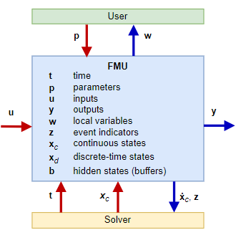
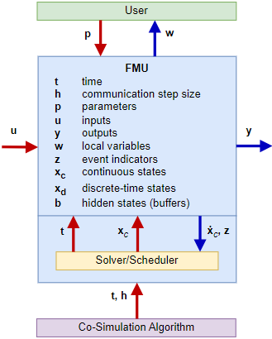
Understanding FMI – Co-Simulation & Model Exchange
Model Exchange (ME)
Solver not include Derivatives at the interfaces
Requires integration
Co-Simulation (CS)
Solver included Can be coupled
Can be directly simulated

Slide 5
Understanding FMI – Co-Simulation & Model Exchange
When to use CS or ME?
Particular cases | ME | CS | Comment
Importing tool support | 🔗Tools support |  | Not all tools support all types of FMU
Solver availability | ❌ | ✅ | E.g. Finite Element solver might not be available in system simulation tool
Model coupling with different dynamics | ❌ | ✅ | It might be preferrable not to make all models run at the highest dynamics
Model numerics require specific solver | ❌ | ✅ | ODE vs DAE, also each solver has its stability region. Locking solver in FMU.
Model includes sample data | ❌ | ✅ | Not ODE so not an exposed interface
Direct feedthrough in model | ✅ | ❌ | Not allowed for CS
Unsure about usage | ✅ | ❌ | ME is more flexible yet let robust

Slide 6
Understanding FMI – Co-Simulation & Model Exchange
Lessons learned. 🔎
Few “Top-Level” parameters can be modified.
In modelDescription.xml, search for causality = parameter and variability = fixed or tunable.
Make sure to propagate the parameters of interest at top level before exporting your model as an FMU.
Some parameters might become Structural, which means you cannot change them anymore after compilation – even if at top-level. Typically, this happens for conditions to if-statements or to structural changes (could be the size of vectors, conditional connect statement, etc.).
Some parameters can be pointing to an external file
Needs to be set up before FMU generation
How to do it
A model in a tool might not give the same result than its FMU in the same tool
Especially true if the inputs are not connected → FMI standard specifies that unconnected inputs are set to 0
Especially true if the inputs are not differentiable → a tool might be able to smoothen inputs while the FMU might not
The solver might not be the same by default when running an FMU versus an embedded model.

Slide 7
Understanding FMI – Co-Simulation & Model Exchange
Lessons learned. 🔎
Different tools can give slightly different results for edge cases
The solver might not be the same by default. And even a given solver might be implemented differently.
A tool might be constrained by its modeling language.
Precision / Accuracy might be different…
Co-Simulation means discretized inputs
FMUs exchange data at each communication step and values are hold in between
The FMU sees steps at every changing input, hence discontinuous.
Be cautious that your model does not require a derivative of the input.
FMUs can require tool-vendor license calls
Based on vendor implementation, it could also require an installation of the tool on the target
Based on the vendor, the license call can be removed for a fee
Some vendors do not require a license, and some add legal (EULA) limitation

Slide 8
Understanding FMI – Co-Simulation & Model Exchange
Lessons learned. 🔎
FMUs is not the response to everything
The model is compiled or in source code
The model causality is fixed (You would need two different FMUs for V=R*I and I=V/R)
Hard or impossible to modify with the model afterwards
Hard to understand what a model does (correlation used, fidelity, etc.) as it is not necessarily possible to look inside
No structural changes can be done, e.g. add a friction between two elements.
An assembly of FMUs has its limitations
The model structure level cannot be optimized (e.g. two resistances in a row cannot be lumped into one equivalent)
Algebraic FMUs can create numerical issues (requiring additional non-linear solvers)
Communication between FMUs can create discontinuities
Recommendations
Stay in modeling tool as long as possible to benefit from the tool flexibility and features
Export in the right format (CS/ME) when needed to interface with other models from another tool or dynamics
When possible, stick to one FMU imported in another environment rather than integrating two FMUs together.

Slide 9
Understanding FMI – Co-Simulation & Model Exchange
Conclusion
FMI is great:
For coupling models that are coming from different tools
For coupling models that have different dynamics
For sharing models as “black-box”
FMI brings some limitations:
On model usage – acausal vs. causal
On model evolution – such as structure or parametrization
On model coupling stability
Comment if you need any further clarification or insights.
👇
Missing something?

