Slide 1
Antopia: Final Report
Alex, Ben, Triet, Xander
Your gateway into the ant kingdom
A wiki covering various ant species

Slide 2
User Uploading and Downloading
Requirements finished:
As a user, I want to be able to press an upload button on the page so I can import various file types that I see necessary
As a user, I want to be able to press the download button on the page so i can download the page in various file types
Cloc: total LoC 81
Loc added in base.html 5 Tests:
LoC added in routes.py 57 upload 7/7
LoC added in page.html 9 download 7/7
LoC added in forms.html 7
LoC added in search.html 3
Requirements:
Upload 8/8
Download 8/8
Burndown rate: 100%

Slide 3
User Creation and Authentication
Requirements finished (5 / 5):
As a User, I want to change my username and password, so that I can change it over time to make it more secure.
As a User, I want to change my personal information in the profile page, so that I can keep my information up to date.
Burndown rate: 100%
LoC: total LoC 122
LoC add to forms.py = 15
LoC add to routes.py = 26
LoC add to user.html = 11
LoC add to user.py = 2
LoC add to edit_profile.html = 68
Tests:
User Register: 5/5 tests.
User Login: 5/5 tests.
User Profile: 3/3 test.
Edit User's Profile: 10/10 tests.

Slide 4
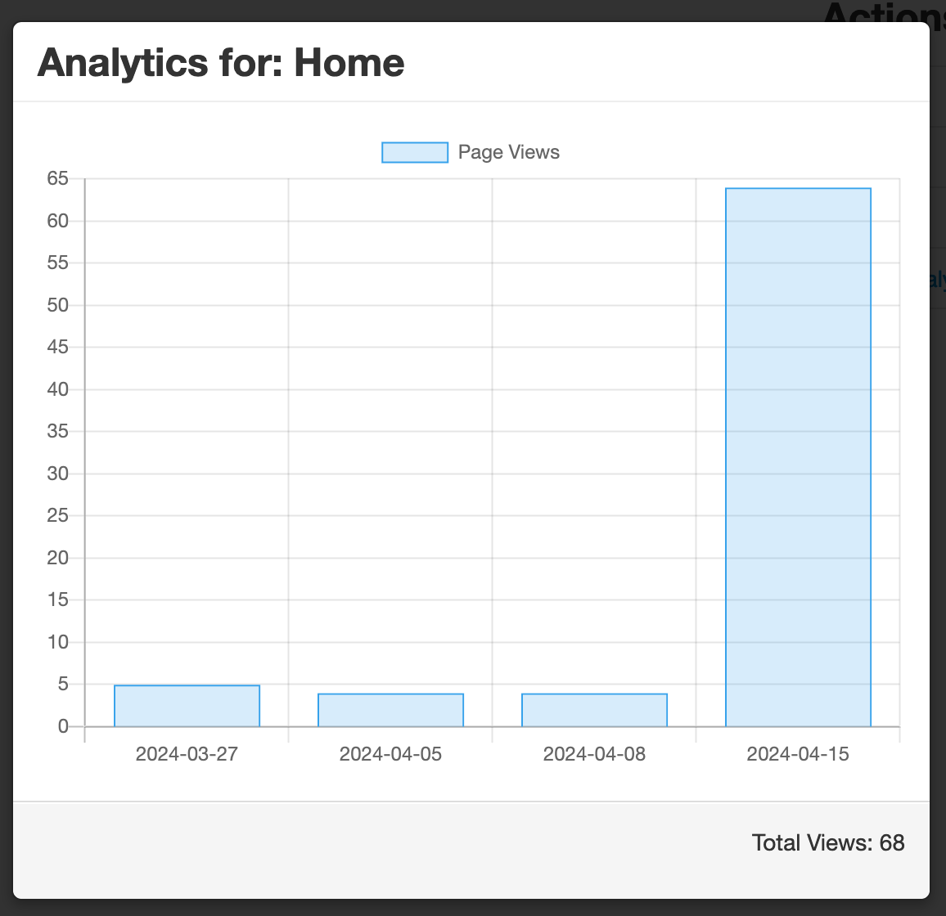
Analytics
Requirements finished:
As a user, I want to be able to see how many times this page has been viewed, edited, appeared in searches, and a visual summary of when these events occurred, so that I can stay informed on how popular my page is.
Cloc: total LoC 71
LoC added in routes.py 33
LoC added in page.html 9
LoC added in forms.html 15
LoC added in search.html 14
Requirements:
5/5
Tests
5/5
Burndown rate: 100%

Slide 5
Search / Advanced Search
Skeleton code has been started, it has been decently filled. Working on adding more abilities to search by
Cloc: total LoC 71
Tests:
LoC added in routes.py 36 test 10/10
LoC added in page.html 9
LoC added in forms.html 14
LoC added in search.html 12
Requirements:
Search 12/12
Burndown rate: 100%
Milestone: able to use advanced search for a few different ways

Slide 6
Milestones &
Risk Analysis
MILESTONE: Finished project

Slide 7
100%
Burndown rate for the week
350 LoC written

Slide 8
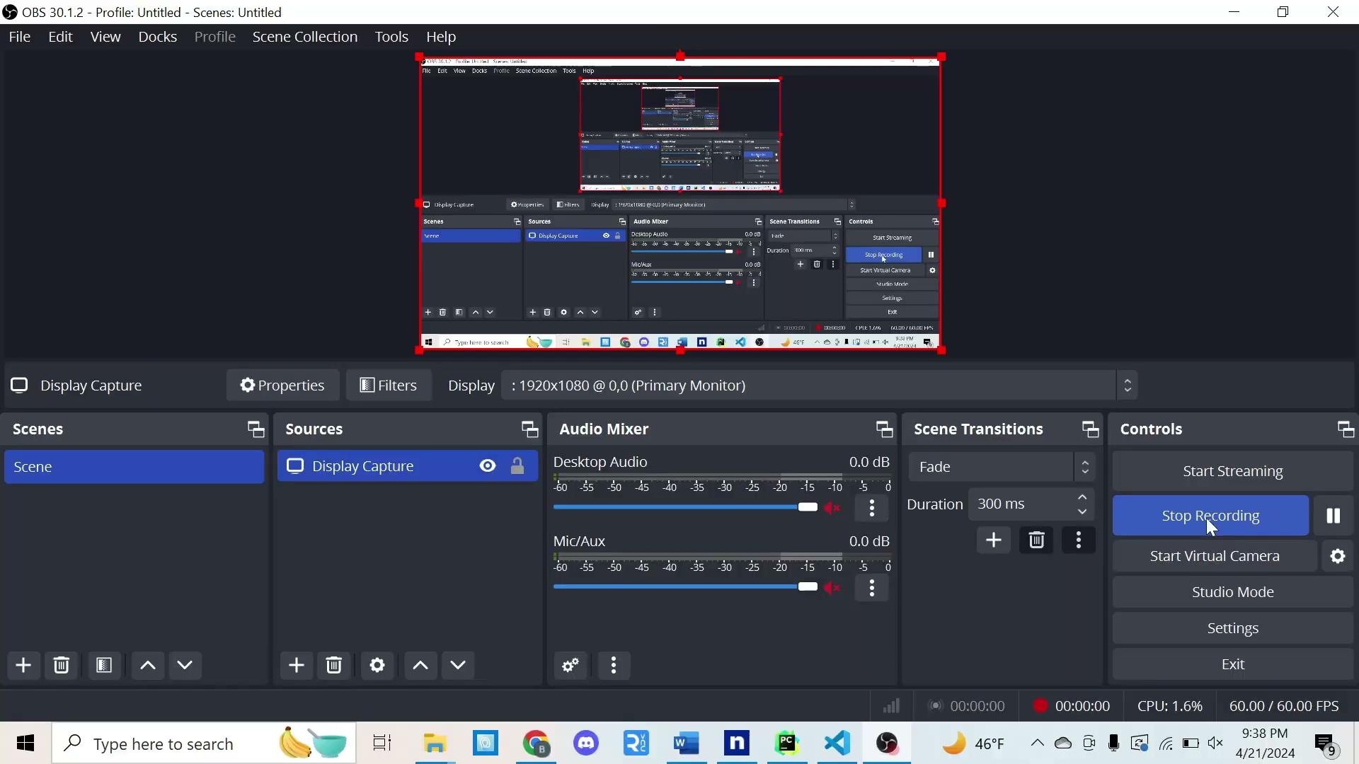
Demo

Slide 9
Questions?

