Slide 1
Antopia
Alex, Ben, Triet, Xander
Your gateway into the ant kingdom
A wiki covering various ant species

Slide 2
Outline
This site will provide the following features for ease of access
Analytics
Search/Advanced Search
Upload/Download files
User profile creation
They will be discussed in more detail on the following slides
3/31 | Individual features completed Individual unit testing completed
4/7 | Integration and Regression Tests Feedback to team members Commit code to main branch
4/14 | Acceptance testing Team review to ensure requirements met
4/17 | Design of final presentations

Slide 3
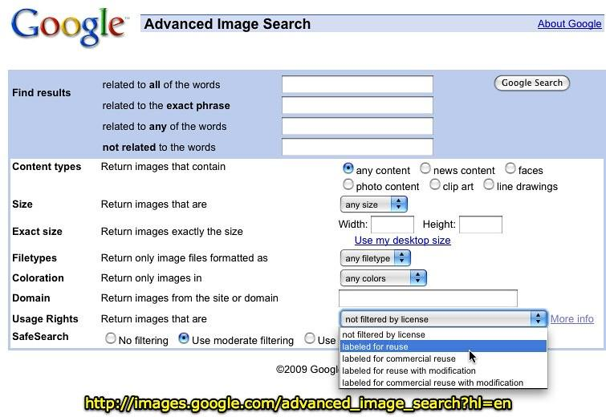
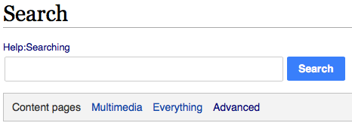
Search / Advanced Search
Users will be able to search for content via a search bar
Provides a very generalized search function
Users will also be able to search via an advanced search page
This page will provide more specific search functionality to allow users to search for specific content
Inspiration and examples of what these features may look like

Slide 4
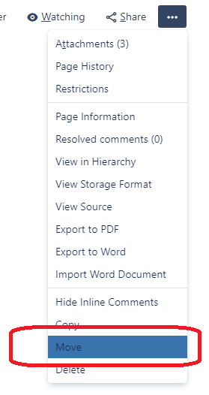
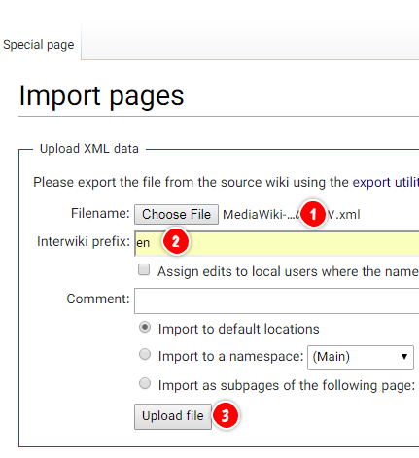
User Uploading and Downloading
Users Uploading of files and pages:
Ability to import pages directly into the Riki system
Upload images and other files onto the page wherever
Users Downloading of files and pages:
Downloading of pages and files
Access to entire pages and photos in different formats (pdf, jpeg, doc, etc)

Slide 5
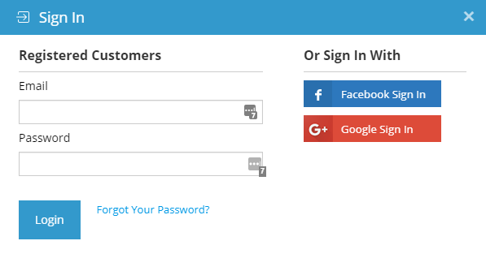
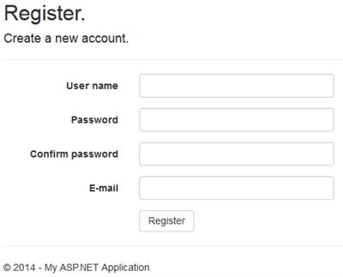

User Creation and Authentication
User can create an account or login with:
Username/Email.
Password.
If we still have time, we can implement the sign in with:
Google Account.
Facebook Account.
GitHub Account.

Slide 6
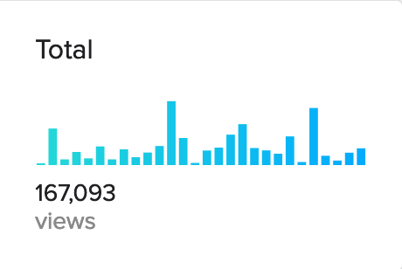
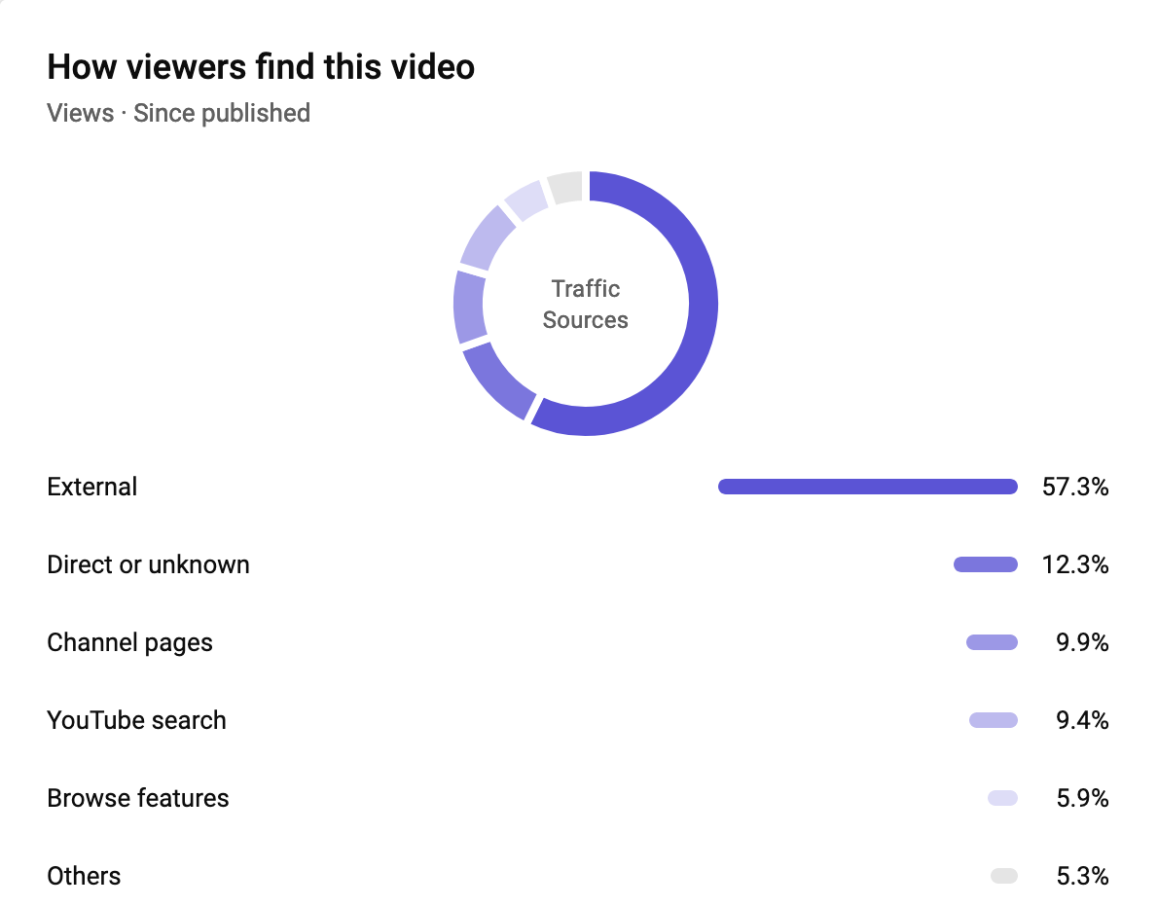
Analytics
Users of can view important statistics
Views
Search results
Great for improving pages (constant feedback)
Notes:
Users of the wiki can view important statistics like how many users view a specific page or are searching for any specific keywords.
Some statistics can be viewed in a visual format (bar graphs, etc.)
The information from this can be used to find out what wiki pages are not as useful or to improve traffic to important pages.

