Slide 1

OOP-Python
Some people consider OOP to be a modern programming paradigm, the roots go back to 1960s. The first programming language to use objects was Simula 67.
There are those who glorify OOP and think that anything which is not programmed in an object oriented way can't be good. On the other hand there are well known computer scientists and specialists who criticize OOP.

Slide 2
Object Oriented Programming
An object oriented program is based on classes and there exists a collection of interacting objects, as opposed to the conventional model, in which a program consists of functions and routines.
In OOP, each object can receive messages, process data, and send messages to other objects.

Slide 3
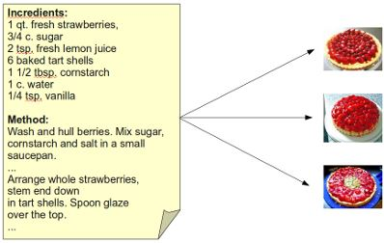
Analogy: The Cake Class
A class definition can be compared to the recipe to bake a cake.
A cake can be eaten when it is baked, but you can't eat a recipe, unless you like the taste of printed paper.
Like baking a cake, an OOP program constructs objects according to the class definitions of the program.
A class contains variables and methods.
A class also has to define all the necessary methods, which are needed to access the data.
Notes:
A recipe is needed to bake a cake.
The main difference between a recipe (class) and a cake (an instance or an object of this class) is obvious.
If you bake a cake you need ingredients and instructions to bake the cake.

Slide 4
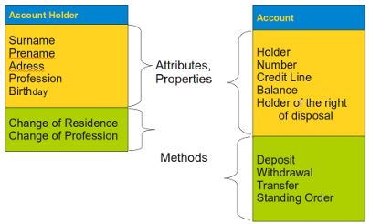
Classes, Objects, Instances
A class defines a data type, which contains variables, properties and methods.
A class describes the abstract characteristics of a real-life thing.
There can be instances and objects of classes. An instance is an object of a class created at run-time.
Notes:
We avoided the expression "object" in the previous sentence and used "thing" instead, because an object is used as an expression in OOP as well as to denote an instance of a class.
With the expression "real-life" thing we have concepts (classes) like "bank account" or "account holder" in mind. The abstract characteristics of a "thing" include its attributes and properties and the thing's behaviour, i.e. the methods and operations of this thing.
In our illustration we show an example of two classes "Account" and "Account Holder". The data of the "Account Holder" consists for example of the Holder Surname and Prename, Adress, Profession, and Birthday. Methods are "Change of Residence" and "Change of Profession". This model is not complete, because we need more data and above all more methods like e.g. setting and getting the birthday of an account holder.

Slide 5
Encapsulation of Data
An important advantage of OOP consists in the encapsulation of data.
The terms encapsulation and abstraction (also data hiding) are often used as synonyms.
Encapsulation is the mechanism for restricting the access to some of an object's components, this means that the internal representation of an object can't be seen from outside of the objects definition.
It’s always possible to circumvent this protection mechanism: E.g. in C++ by the "friends" mechanism, in Java and Ruby via reflection API or in Python by name mangling.
Notes:
They are nearly synonymous, i.e. abstraction is achieved though encapsulation.
Access to this data is typically only achieved through special methods: Getters and Setters. By using solely get() and set() methods, we can make sure that the internal data cannot be accidentally set into an inconsistent or invalid state.

Slide 6
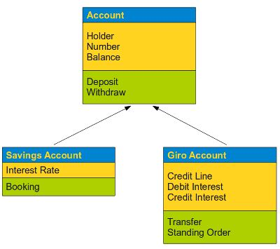
Inheritance
A class can inherit attributes and behaviour (methods) from other classes, called super-classes.
A class which inherits from super-classes is called a Sub-class. Super-classes are sometimes called ancestors as well. There exists a hierarchy relationship between classes.
Notes:
Classes can inherit other classes.
If we have a closer look at our previous example about the class account, we can see that this model can satisfy the needs of a real bank. Banks have normally different kinds of accounts, e.g. Savings Accounts, Giro Accounts and others. Though these different account types are quite different, they have nevertheless many properties and methods in common. E.g. each account has and needs an account number, a holder and a balance. Furthermore it mus be possible for each of them to deposit or withdraw money.
class Account(object):
pass

Slide 7
Definition of Methods
A method differs from a function only in two aspects:
It belongs to a class and it is defined within a class
The first parameter in the definition of a method has to be a reference "self" to the instance of the class
A method is called without this parameter "self"
We extend our class by defining some methods.
Notes:
class Account(object):
def transfer(self, target, amount):
pass
def deposit(self, amount):
pass
def withdraw(self, amount):
pass
def balance(self):
pass

Slide 8
Constructor
Python doesn't have explicit constructors like C++ or Java, but the __init__() method in Python is something similar, though it is strictly speaking not a constructor.
It behaves in many ways like a constructor, e.g. it is the first code which is executed, when a new instance of a class is created.
the __init__ method is used - like constructors in other object oriented programming languages - to initialize the instance variables of an object.
Notes:
The name sounds also like a constructor "__init__". But strictly speaking it would be wrong to call it a constructor, because a new instance is already "constructed" by the time the method __init__ is called.
def __init__(self, holder, number, balance,credit_line=1500):
self.Holder = holder
self.Number = number
self.Balance = balance
self.CreditLine = credit_line

Slide 9
Destructor
There is no "real" destructor, but something similiar, i.e. the method __del__. It is called when the instance is about to be destroyed.
If a base class has a __del__() method, the derived class's __del__() method, if any, must explicitly call it to ensure proper deletion of the base class part of the instance.
Notes:
class Greeting:
def __init__(self, name):
self.name = name
def __del__(self):
print "Destructor started"
def SayHello(self):
print "Hello", self.name

Slide 10
Data Encapsulation
If an identifier doesn't start with an underscore character "_" it can be accessed from outside, i.e. the value can be read and changed.
Data can be protected by making members private or protected.
Instance variable names starting with two underscore characters cannot be accessed from outside of the class.
Ther private data __A can be accessed by the following name construct: instance_name._classname__A.
If an identifier is only preceded by one underscore character, it is a protected member. Protected members can be accessed like public members from outside of class.
Notes:
At least not directly, but they can be accessed through private name mangling.
class Encapsulation(object):
def __init__(self, a, b, c):
self.public = a
self._protected = b
self.__private = c

Slide 11

Data Encapsulation..
The following table shows the different behaviour:

Slide 12
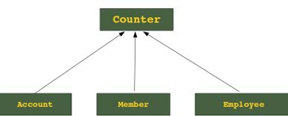
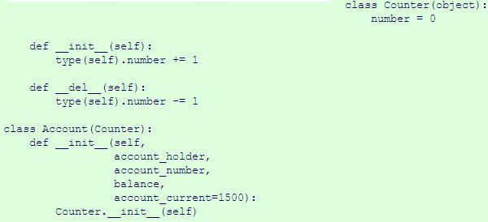
Inheritance
The syntax for defining the classes (super-classes) from which a class inherits is very simple. The super-class is put in parenthesis behind the class name.

Slide 13
Next Topic……
Polymorphism

