Slide 1



Setting up your Raspberry Pi
The guide to setting up your Raspberry pi for smooth experience.
Copyright Robosapiens Technology Pvt. Ltd.

Slide 2
Operation Procedure.
Connect the wires in the correct order
Always connect all the Peripherals before powering on.
Keep Raspberry Pi in a Protective Enclosure.
Use casing to prevent short circuit.
Use good quality power supply.
Essential Components:
A USB Keyboard.
A USB Mouse
HDMI display.
LAN Connection.
Copyright Robosapiens Technology Pvt. Ltd.

Slide 3
Do’s and Dont’s
Never short circuit any terminal of the GPIO
Never use non standard Power supplies.
Always keep the Raspberry Pi’s Circuit Board Dry.
Never connect power directly to GPIO
The GPIO is only 3.3v 80mA tolerant.
Read the Product documentation properly before connecting
Do not touch the powered on Circuit board of the Raspberry pi.
Use only standard quality USB devices, as some products may even harm your Pi.
Double check wire connections before powering on the Board.
Copyright Robosapiens Technology Pvt. Ltd.

Slide 4
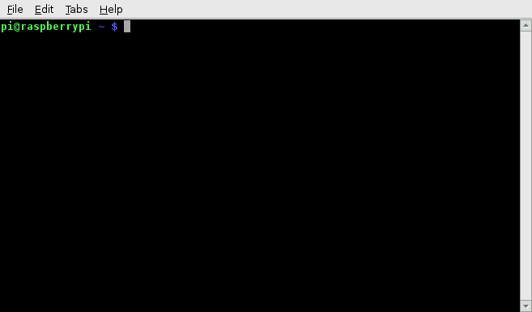
Updating raspbian to the latest Sources
Open lxterminal on Raspbian GUI
Type the following commands to update the sources catalogue in linux:
sudo apt-get update
Type the following commands to upgrade the current OS system’s softwares to the latest versions:
sudo apt-get upgrade
Copyright Robosapiens Technology Pvt. Ltd.

Slide 5
The Linux terminal and Shell Scripting
Like the dos prompt in windows the linux OS also has a terminal called as the Linux Shell.
Raspbian also has a command shell called LXTerminal.
The terminal is used to implement and access various super user functions via the interface.
The Linux terminal is a CLI like Ms DOS.
The term Shell Scripting means writing Scripts for the Linux terminal.
The shell scripts are usually universal for all the linux versions.
The shell scripts are syntax dependent and require skills to write.
Copyright Robosapiens Technology Pvt. Ltd.

Slide 6
Some Shell commands
sudo: Grants super user access
reboot: helps to reboot OS
shutdown: Shuts down raspberry pi
apt-get update: Updates sources list from Github servers
apt-get upgrade: Updates all the softwares to the latest versions.
mkdir: Creates a new Directory
rmdir: Removes a Directory.
ls: Lists files.
Copyright Robosapiens Technology Pvt. Ltd.

Slide 7
GPIO of Raspberry Pi
The Raspberry Pi board has different GPIO configurations for different models.
The GPIO pins are used for multiple device connectivity
It is also used for making the board usable as an embedded platform.
Raspberry pi’s GPIO are also multiplexed as the other controller’s pins.
Multiplexed GPIO means that a Pin of the GPIO is capable of performing many functions.
The pins are all 3.3 v compatible and the current availability of the pins are very low.
Always use resistances for matching the impedance of the device being connected.
The GPIO are controlled via Python Programming Language as well as the linux shell.
Copyright Robosapiens Technology Pvt. Ltd.

Slide 8
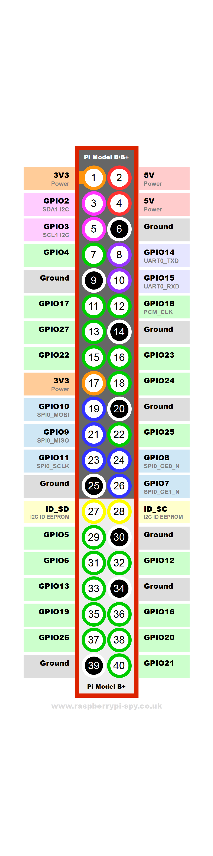
Raspberry Pi B+ GPIO pins
40 Pins header
17 Pins having Only I/O functions.
10 Multiplexed Pins
8 Ground Pins
Onboard Regulated 5V and 3V3 power supply.
UART Tx/Rx pins
Copyright Robosapiens Technology Pvt. Ltd.

