Slide 1



Using Raspberry Pi over the Remote Terminal
This advanced guide will take the Raspberry pi Experience to a whole new level.
Copyright Robosapiens Technology Pvt. Ltd.

Slide 2

Getting what you need
To let your laptop/desktop remotely connect to the Raspberry Pi you will need the following softwares:
Putty
Xming
These are free and opensource softwares and are freely downloadable from the internet.
Copyright Robosapiens Technology Pvt. Ltd.

Slide 3
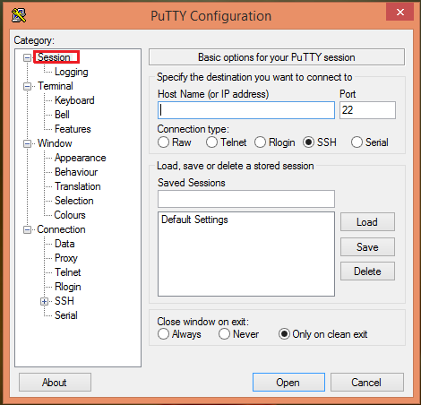
Putty
Open Putty
Enter I.P. Address of the Raspberry Pi.
Copyright Robosapiens Technology Pvt. Ltd.

Slide 4
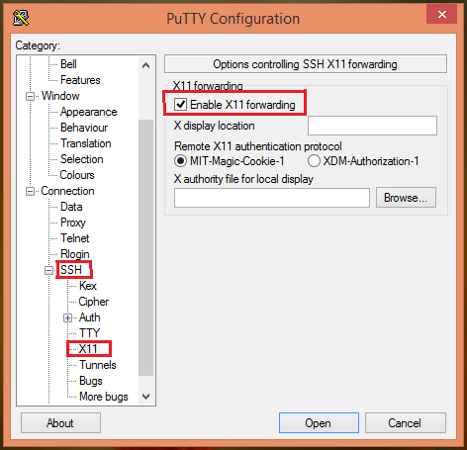
Putty
Enable X11 forwarding in SSH>X11 in categories .
Press open
This will open a terminal
Copyright Robosapiens Technology Pvt. Ltd.

Slide 5
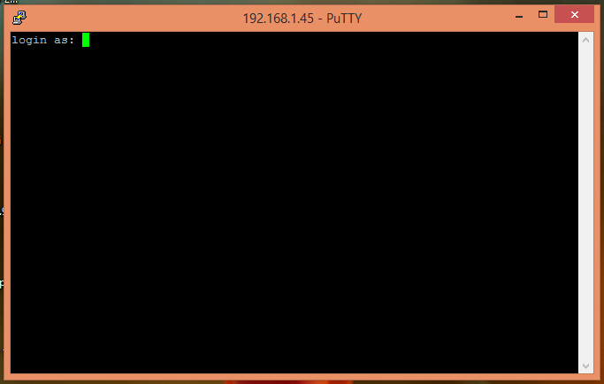
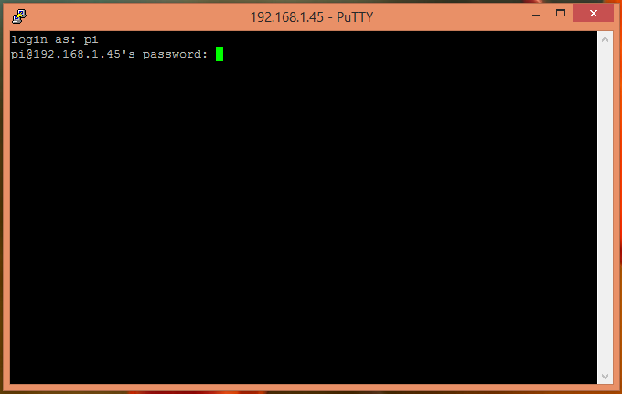
Putty Terminal
Use Username: pi
Password: raspberry
To log in.
Copyright Robosapiens Technology Pvt. Ltd.

Slide 6

Open Xming
Double click on Xming icon on Desktop to start Xming.
Copyright Robosapiens Technology Pvt. Ltd.

Slide 7
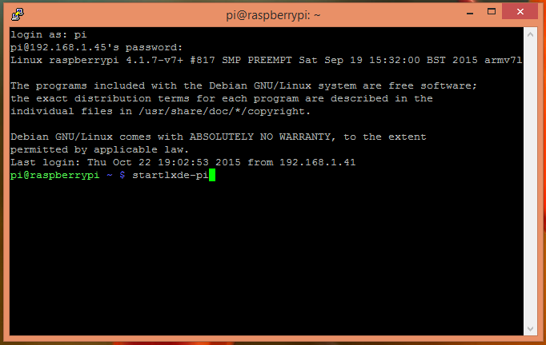
Back to Putty
Type the following to start
Remote Desktop:
startlxde-pi
Copyright Robosapiens Technology Pvt. Ltd.

Slide 8
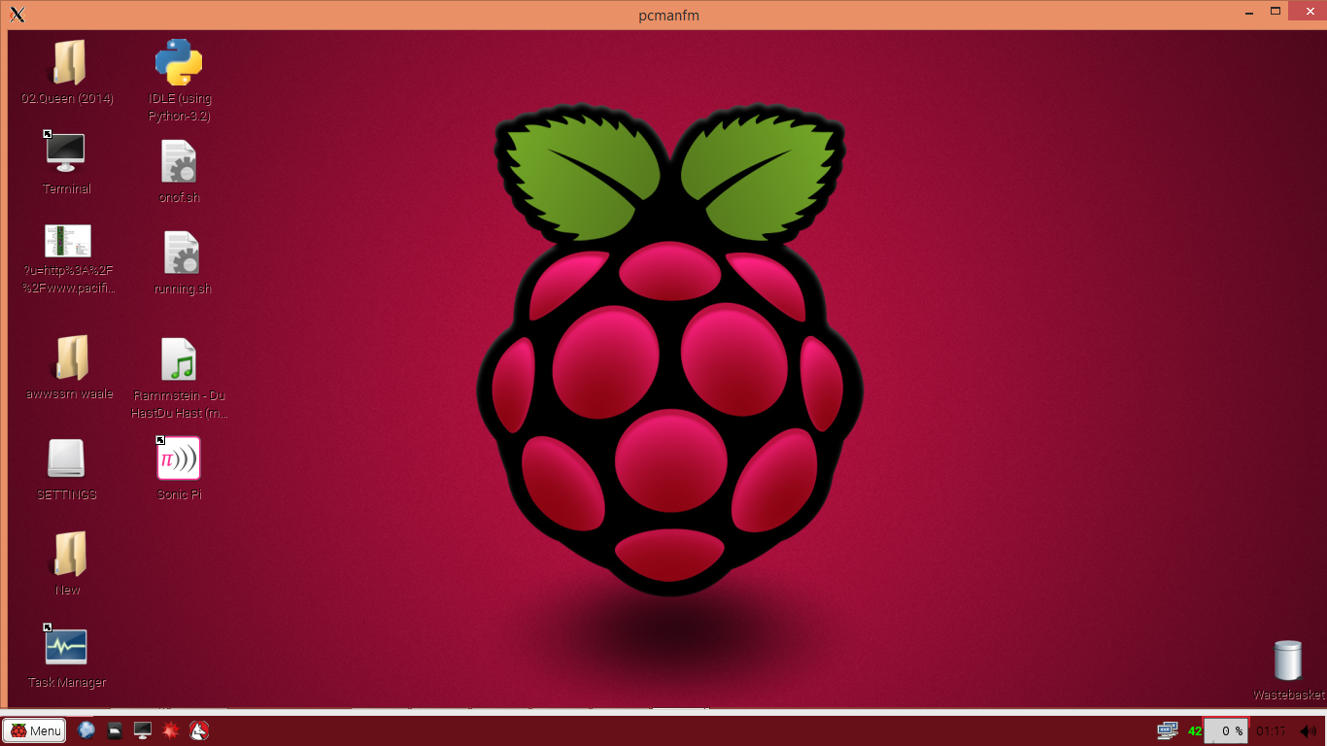
The remote Raspberry Pi desktop
Copyright Robosapiens Technology Pvt. Ltd.

