Slide 1
5-A-DAY: Knowledge Recall
STARTER
Question
Answer
What is a pixel?
One tiny square of colour in a picture
1
What do the letters RGB stand for?
Red, green, blue
2
What is the biggest number 8 bits can store?
255 (0 to 255 is 256 values)
3
Which keyword sends a value back out of a function?
return
4
What does % do in Python?
Gives the remainder after dividing
5
Notes:
Pupils write answers while the register is taken (about 4 minutes), then feed back. Click to reveal each answer. Links forward: pixels and RGB (whole lesson), 0 to 255 (channels), return (total_red), % (the puzzle rule).

Slide 2
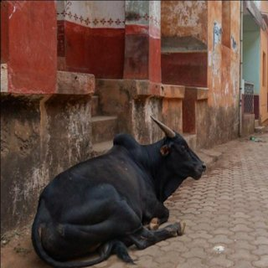

What Do You See?
10 min talk
Notes:
T+00 to T+10 (10 min): Talk. Show the cow photo. Ask: what do you see? Take two answers.

Slide 3
You See a Cow. Python Sees...
Python has never met a cow.
It does not know what a "photo" is.
All Python ever sees is numbers.
So how does a program use pictures at all?
Think, pair, share: how many numbers is one photo?
Notes:
T+00 to T+10. Click through the bullets one at a time. Python has never met a cow. Ask: how many numbers do you think are in a photo? Think, pair, share, then move on.

Slide 4
Predict: What Numbers?
THINK PAIR SHARE
If a picture is just numbers, how many numbers? Which numbers: big ones or small ones? Think 320x320 pixels, what about 4k resolution?
320 x 320 = 102,400 tiny squares (pixels)
3 numbers per pixel: red, green, blue
each number is between 0 and 255
307,200 numbers for one small photo
(a 4k photo is 3840 × 2160 pixels)
Notes:
T+00 to T+10. Give 1 minute. Take a few guesses before clicking. Reveal: 320 x 320 pixels, 3 numbers each, each 0 to 255, so 307,200 numbers.

Slide 5
Image Analysis
https://tinyurl.com/35yufbbb <- Download in preparation
Dr. Hughes
Notes:
T+00 to T+10. Title: what a picture is to a computer, what we can do with it, and a puzzle at the end.

Slide 6
Explore a Picture
PART 1
open
one pixel
crop
colour
channels
switch off
grey
count
histogram
8 short tasks in Spyder, then Part 2: the puzzle
Notes:
T+00 to T+10. Part 1: eight short tasks in Spyder in image_explore.py, then Part 2: the puzzle.

Slide 7
Nobody Writes It All
variables
functions
if / else
loops
NOTE A library is a bunch of functions someone else wrote, ready to use.
>>> import math
>>> math.sqrt(16)
4.0
Notes:
T+00 to T+10. Recap: variables, functions, if/else, loops. A library is code other people wrote. Show import math then math.sqrt(16).

Slide 8
A Library for Pictures
TIP PIL (short for Pillow) opens, edits and reads images.
>>> from PIL import Image
from X import Y = "just give me Y out of library X"
Notes:
T+00 to T+10. PIL (Pillow) opens, edits and reads images. Show the import line. from X import Y means just give me Y out of library X.

Slide 9
Open It, Check It
>>> img = Image.open("cow-demo.jpg")
>>> img.size
(320, 320)
>>> img.mode
'RGB'
one line opens the whole picture: 320 pixels wide, 320 tall
Notes:
T+00 to T+10. Open the photo and check its size. Pupils open Spyder and image_explore.py now.

Slide 10
A Picture Is a Grid of Numbers
NOTE One small group of numbers per pixel. NumPy does maths on huge grids, fast.
>>> import numpy as np
>>> pixels = np.array(img)
pixels is now the whole picture as a grid
Notes:
T+00 to T+10. A picture is a grid of numbers. NumPy does maths on huge grids, fast. Hand over to Task 1.

Slide 11
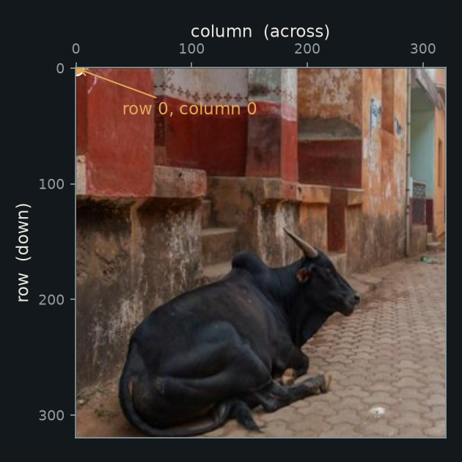
Rows and Columns
4 MIN TALK
Rows count down. Columns count across.
Counting starts at 0, top left.
Row first, then column.
>>> print(pixels[0, 0])
[16 0 0]
red 16, green 0, blue 0: almost black
Notes:
T+10 to T+14 (chunk 1 talk, 4 min). Rows count down, columns count across, counting starts at 0 top left. Row first, then column. pixels[0, 0] is [16 0 0]: red 16, green 0, blue 0, almost black.

Slide 12
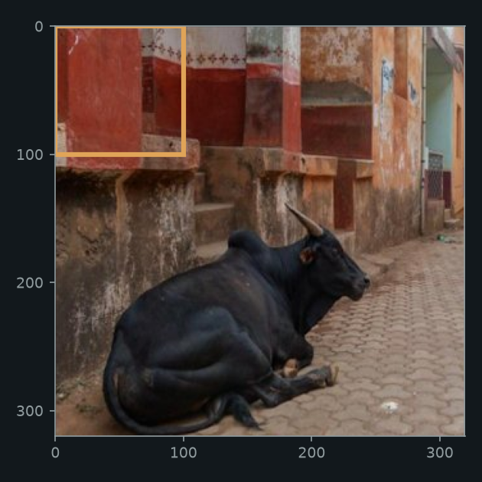
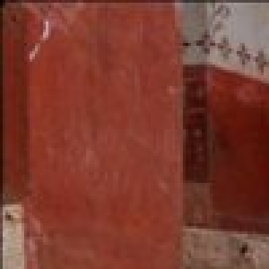
Crop: a Block of Pixels
>>> corner = pixels[0:100, 0:100]
rows 0 to 99, columns 0 to 99
show(corner): just that box
Notes:
T+10 to T+14 (chunk 1 talk, 4 min). Crop is a slice: [start:stop] for rows, a comma, [start:stop] for columns. It stops before the last number.

Slide 13
Look Inside a Picture
TASKS 1 TO 3
Booklet Tasks 1, 2 and 3. Open it, find a pixel, crop a corner. We review together after. (Don’t worry about writing answers, discuss with your partner as you go – do run the code)
8 min
Notes:
T+14 to T+22 (8 min). Booklet Tasks 1, 2 and 3 in image_explore.py. Task 1: open the photo and predict the shape. Task 2: find the pixel in row 100, column 200 (row first). Task 3: crop a corner, then try the cow's head. Fast pupils carry on. At T+22 stop and review with the next three slides. Hints: pixels[row, column]; keep the colon and the comma in the crop.

Slide 14
Task 1: Check
ANSWERS
(320, 320, 3)
rows x columns x 3 colour numbers
Notes:
T+22 to T+25 (chunk 1 review, 3 min). Compare answers, hold up the solutions. Check: (320, 320, 3) means rows x columns x 3 colour numbers.

Slide 15
Task 2: Check
ANSWERS
[94 50 37]
a reddish brown: red is the biggest number
Notes:
T+22 to T+25 (chunk 1 review, 3 min). Compare answers, hold up the solutions. Check: [94 50 37], a reddish brown. Red is biggest.

Slide 16
Solutions: Tasks 2 and 3
ANSWERS
print(pixels[100, 200]) # [94 50 37]
square = pixels[100:200, 100:200]
show(square) # any 100 x 100 square works
Notes:
T+22 to T+25 (chunk 1 review, 3 min). Compare answers, hold up the solutions. Solutions to hold up for anyone who is stuck on Tasks 2 and 3. Row first, then column. A crop is rows start:stop, columns start:stop, and stops before the stop number. Any 100 by 100 square is fine.

Slide 17
Every Pixel: 3 Numbers
5 MIN TALK
R = red
G = green
B = blue
TIP Each one is a brightness: 0 (none of that colour) to 255 (as much as possible).
Notes:
T+25 to T+30 (chunk 2 talk, 5 min). Every pixel is three numbers: red, green, blue. Each is a brightness from 0 (none of that colour) to 255 (as much as possible).

Slide 18

A 4 x 4 Crop in Numbers
113, 73, 63
123, 80, 71
136, 92, 81
141, 95, 80
125, 83, 71
139, 95, 84
150, 104, 91
147, 99, 85
132, 88, 77
140, 93, 83
145, 97, 85
142, 93, 78
125, 81, 68
130, 82, 70
138, 89, 75
144, 92, 78
pixels[100:104, 100:104]
Notes:
T+25 to T+30 (chunk 2 talk, 5 min). Real numbers from a 4 x 4 crop, pixels[100:104, 100:104]. Do not spend long here.

Slide 19
Take One Pixel: (113, 73, 63)
R 113
G 73
B 63
= the pixel
TIP Change the numbers, change the picture. That is all a photo is.
Notes:
T+25 to T+30 (chunk 2 talk, 5 min). One pixel is R + G + B. Take one pixel apart: change the numbers, change the picture. That is all a photo is.

Slide 20
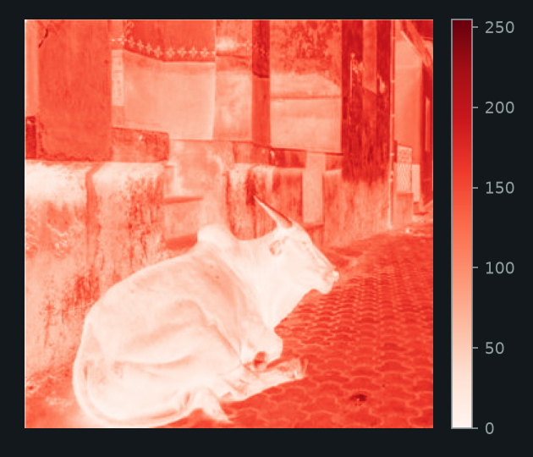
Split Into Three Pictures
>>> red = pixels[:, :, 0]
Channel 0 is red.
Big number = deep red.
Wall: lots of red. Cow: almost none.
Notes:
T+25 to T+30 (chunk 2 talk, 5 min). pixels[:, :, 0] is every row, every column, just channel 0: red. Deep red means a big number, pale a small one. The wall has lots of red, the cow almost none.

Slide 21
Switch Red Off
1 no_red = pixels.copy()
2 no_red[:, :, 0] = 0
3 show(no_red)
.copy() makes a second picture, so the original stays safe.
Line 2 sets every red number to 0.
Notes:
T+25 to T+30 (chunk 2 talk, 5 min). .copy() makes a second picture so the original stays safe. Line 2 sets every red number to 0.

Slide 22
Colours and Channels
TRY IT AND TASKS 4 AND 5
Booklet: Try it, Task 4 and Task 5. Mix a colour, split the channels, switch them off.
8 min
Notes:
T+30 to T+38 (8 min). Booklet Try it, Task 4 and Task 5. Mix yellow and a grey with show_colour. Split the channels (green is 1, blue is 2). Switch channels off: predict first. At T+38 review with the three slides after this one.

Slide 23
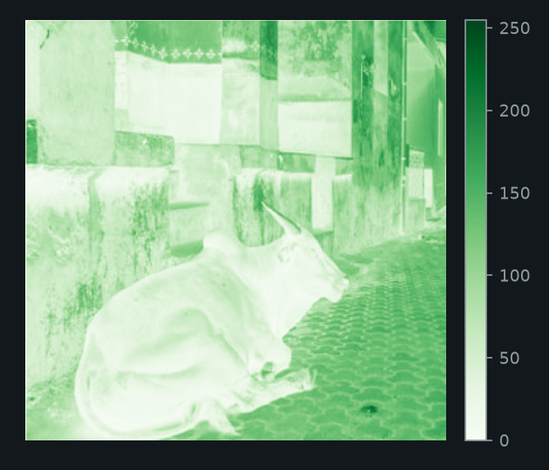
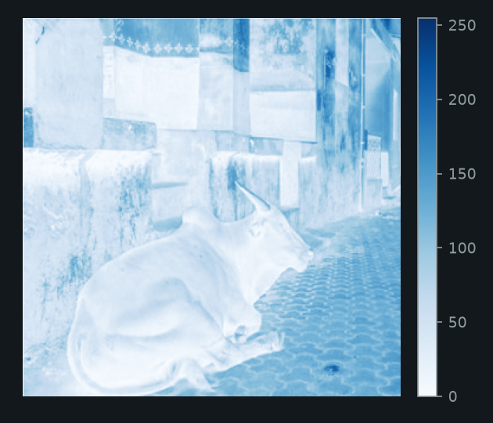
Task 4: All Three Channels
ANSWERS
red
green
blue
TIP Wall = bright in red. Cow = dark in every channel.
Notes:
T+38 to T+41 (chunk 2 review, 3 min). Compare answers, hold up the solutions. Reveal all three channels together if time allows. Wall is bright in red. Cow is dark in every channel. Move on at T+38.

Slide 24
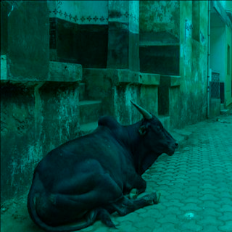
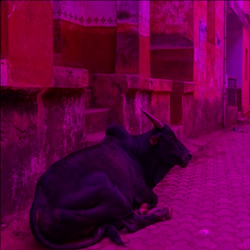
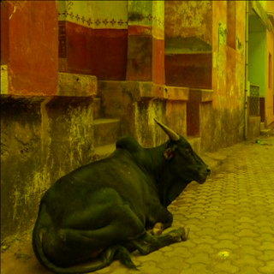
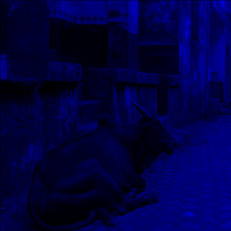
Task 5: Check Your Pictures
ANSWERS
no red
no green
no blue
only blue
NOTE red + blue light = magenta. red + green light = yellow.
Notes:
T+38 to T+41 (chunk 2 review, 3 min). Compare answers, hold up the solutions. Show the check pictures. Red + blue light = magenta. Red + green light = yellow. Move on at T+43.

Slide 25
Solutions: Colour and Channels
ANSWERS
show_colour(255, 255, 0) # yellow
show_colour(128, 128, 128) # grey
green = pixels[:, :, 1]
show_channel(green, "Greens")
blue = pixels[:, :, 2]
show_channel(blue, "Blues")
no_green = pixels.copy()
no_green[:, :, 1] = 0 # no_blue: same, channel 2
only_blue = pixels.copy()
only_blue[:, :, 0] = 0
only_blue[:, :, 1] = 0
Notes:
T+38 to T+41 (chunk 2 review, 3 min). Compare answers, hold up the solutions. Solutions to hold up: Try It, Task 4 and Task 5. Yellow is high red and green, no blue. Grey is three equal numbers. Channel 1 is green, channel 2 is blue. no_blue is the same as no_green with channel 2.

Slide 26
Grey and Negative
4 MIN TALK
1 grey = np.array(img.convert("L"))
2 show_channel(grey, "gray")
3 negative = 255 - pixels
"L" = one brightness number per pixel: 0 black, 255 white.
255 - pixels flips every number: 0 becomes 255.
Notes:
T+41 to T+45 (chunk 3 talk, 4 min). "L" means one brightness number per pixel: 0 black, 255 white. 255 - pixels flips every number: 0 becomes 255.

Slide 27
Maths on the Whole Picture
>>> print(grey.mean())
81.449951171875
>>> print((grey < 50).sum())
28501
the average brightness: a fairly dark grey (0 is black, 255 is white)
28,501 pixels are darker than 50, out of 102,400. grey < 50 is True or False for every pixel; .sum() counts the Trues.
Notes:
T+41 to T+45 (chunk 3 talk, 4 min). mean() gives the average brightness (a fairly dark grey). grey < 50 is True or False for every pixel, and .sum() counts the Trues.

Slide 28
A Different Question
NOTE Not "what is the average?" but: how many pixels are dark, how many bright, how many in between?
TIP A histogram: split brightness into buckets. Count how many pixels land in each.
one bar per bucket. Tall bar = lots of pixels with that brightness.
Notes:
T+41 to T+45 (chunk 3 talk, 4 min). Not what is the average, but how many pixels are dark, how many bright, how many in between? A histogram splits brightness into buckets and counts the pixels in each.

Slide 29
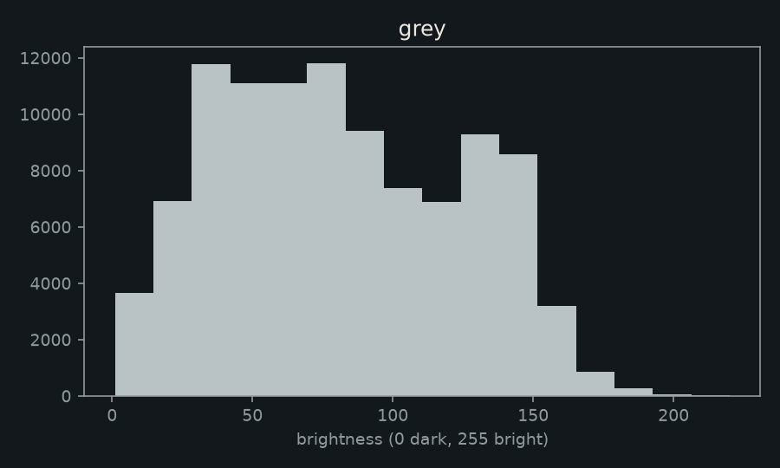
Our Photo, in 16 Buckets
1 plt.hist(grey.flatten(), bins=16)
2 plt.show()
.flatten(): grid to one long list
Left = dark, right = bright
Notes:
T+41 to T+45 (chunk 3 talk, 4 min). .flatten() turns the grid into one long list. Left is dark, right is bright. Two humps: the dark cow and street, and the brighter wall.

Slide 30
Grey, Count, Histogram
TASKS 6 TO 8
Booklet Tasks 6, 7 and 8. Grey and negative, count and average, draw a histogram.
9 min
Notes:
T+45 to T+54 (9 min). Booklet Tasks 6, 7 and 8. Grey and negative: predict the negative of [16 0 0]. Count and average: how many pixels are brighter than 100, and what fraction. Histogram: red, green and blue. At T+54 review with the slides after this one.

Slide 31
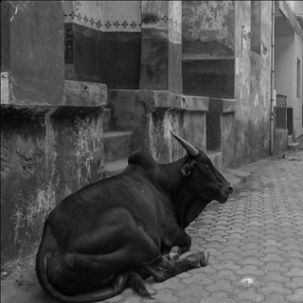
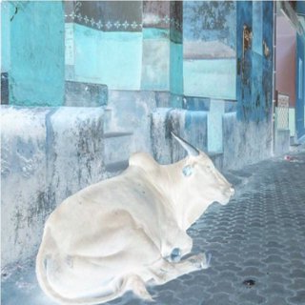
Task 6: Check
ANSWERS
original
grey
negative: [239 255 255]
Notes:
T+54 to T+57 (chunk 3 review, 3 min). Compare answers, hold up the solutions. The negative of [16 0 0] is [239 255 255]. The black cow turns light.

Slide 32
Task 7: Check
ANSWERS
34315
pixels brighter than 100
102400
grey.size, all the pixels
0.335...
about a third
Notes:
T+54 to T+57 (chunk 3 review, 3 min). Compare answers, hold up the solutions. 34315 pixels brighter than 100, grey.size is 102400, fraction 0.335107421875. About a third.

Slide 33
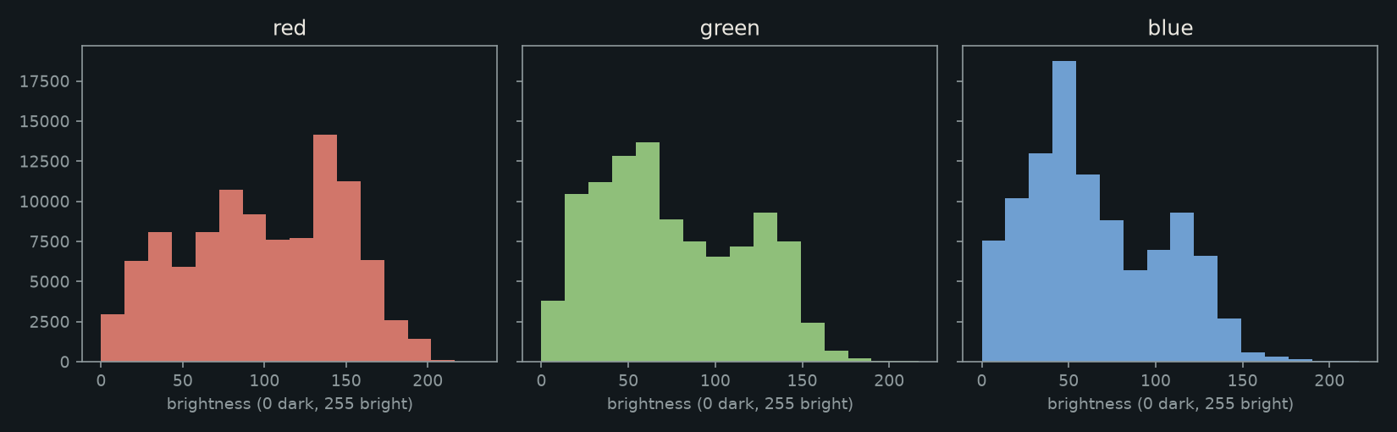
Task 8: Red, Green and Blue
ANSWERS
TIP Red: tall bar middle-right (the wall). Green and blue: tallest on the left.
Notes:
T+54 to T+57 (chunk 3 review, 3 min). Compare answers, hold up the solutions. Red has a tall bar in the middle-right (the wall). Green and blue are tallest on the left. Part 1 ends here at T+58.

Slide 34
Solutions: Tasks 7 and 8
ANSWERS
bright = (grey > 100).sum()
print(bright) # 34315
print(bright / grey.size) # 0.335...
plt.hist(red.flatten(), bins=16)
plt.show() # same idea for green and blue
Notes:
T+54 to T+57 (chunk 3 review, 3 min). Compare answers, hold up the solutions. Solutions to hold up: Task 7 and Task 8. Brighter than 100 is grey > 100 then .sum(). The fraction divides by grey.size. For the histogram use the red picture from Task 4; green and blue work the same way.

Slide 35
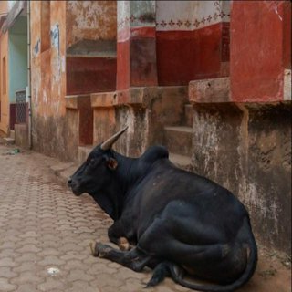
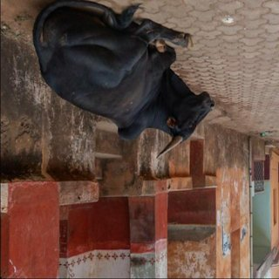
Go Backwards: ::-1
STRETCH
1 show(pixels[:, ::-1]) # mirror
2 show(pixels[::-1]) # upside down
mirror: columns backwards
upside down: rows backwards
Notes:
SKIP IN CLASS. Stretch only. Show it to anyone who finishes Task 8 early. ::-1 means go backwards.

Slide 36
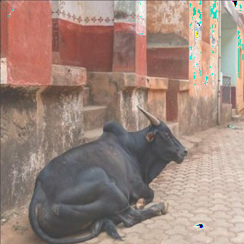
Finished Part 1?
STRETCH
Try both ::-1 lines. Brighten the picture: add 60 to every number. Careful, what happens above 255? Predict first.
+ 60 (200 + 60 wraps to 4)
Notes:
SKIP IN CLASS. Stretch only. Early finishers try ::-1, then brighten by adding 60 and think about what happens above 255 (200 + 60 wraps to 4). Booklet stretch tasks.

Slide 37
Messages Hidden in Pictures
Cryptography hides what a message says.
Steganography hides that there is a message at all.
R 200 G 80 B 60
R 201 G 80 B 60
TIP One number changed by 1. You cannot see it. A program can read it.
Notes:
T+57 to T+61 (4 min for these four context slides). Two ideas: cryptography hides what a message says, steganography hides that there is a message at all. Then the key link to this lesson: a pixel is three numbers, so a change of 1 in one number is invisible to us but a program can read it. Ask: which of the two squares is changed? Pupils cannot tell.

Slide 38
People Really Do This
Russian agents living in the USA hid messages inside ordinary pictures on public websites. The FBI found out.
2010
A Russian hacking group, Turla, hid instructions in the comments under a pop star's Instagram photo. Security researchers at ESET worked out the trick.
2017
Malware was hidden inside a real picture from the James Webb Space Telescope. Security researchers at Securonix spotted it.
2022
Hidden in plain sight: nobody looks twice at a photo.
Notes:
T+57 to T+61. Real cases of messages hidden in ordinary-looking things online. One card per click. 2010: the FBI said Russian agents living in the USA hid messages in images on public websites (the 'Illegals Program' arrests). 2017: security company ESET found the Turla group using comments under a pop star's Instagram photo to hide the address of their control server. 2022: security company Securonix found malware hidden in a picture from the James Webb Space Telescope. Point: nobody looks twice at a photo. Check these against the sources before quoting extra detail.

Slide 39
How Researchers Find Them
• Look at the numbers. A normal photo has a pattern in its histogram. Hidden data can make it look odd.
• Compare with the original. Subtract one picture from the other. Any change shows up.
• UK research. Cambridge University's Computer Laboratory wrote some of the first papers on hiding information, and showed messages can hide inside ordinary internet traffic.
• UK defence. The National Cyber Security Centre, part of GCHQ, helps protect the UK from hidden threats.
• History. In World War 2, British censors checked letters for invisible ink and hidden writing.
Notes:
T+57 to T+61. How hidden messages get discovered. Steganalysis means looking for numbers that do not behave like a normal photo: a histogram (Task 8) or a comparison with the original shows the odd ones out. UK examples: Cambridge Computer Laboratory researchers (Ross Anderson, Fabien Petitcolas) wrote some of the first research papers on information hiding in the late 1990s; Steven Murdoch and Stephen Lewis at Cambridge showed in 2005 how to hide messages inside ordinary internet traffic. The National Cyber Security Centre, part of GCHQ, is the UK body that helps defend against hidden threats. History: in WWII British censors checked mail for invisible ink and hidden writing. NOTE for the teacher: I could not confirm a public, named NCSC case of image steganography, so the slide names research groups and the role of NCSC rather than inventing a case. Check before adding more.

Slide 40
You Are the Analyst
Imagine you work for a security team.
A website is posting 37 photos of cows. Nobody needs 37 cow photos... unless they are a message.
Each photo hides one letter in its pixel numbers.
Your job: work out the rule, then decode all 37 letters.
Notes:
T+57 to T+61. The story for Part 2. Read it out, one card per click. It is a made-up scenario, but the method is real: spot the odd thing, find the hidden rule, decode it. Then go to the next slide for the task and the rule.

Slide 41
The Puzzle
PART 2
37 photos. One letter is hidden in each. Together they spell a sentence.
7 min talk
Notes:
T+61 to T+68 (chunk 4 talk, 7 min). Part 2: 37 photos, one hidden letter each. Together they spell a message.

Slide 42
The Rule
1
Open a photo.
2
Add up every red value in it.
3
Take that total % 26.
4
Use the result to pick a letter: A=0, B=1, ... Z=25.
TIP Do it for every photo, in order.
Notes:
T+61 to T+68 (chunk 4 talk, 7 min). The rule: open a photo, add up every red value, take the total % 26, use the result to pick a letter (A=0 to Z=25). Do it for every photo, in order.

Slide 43
Adding Them All Up
>>> red = pixels[:, :, 0]
>>> red.sum()
10218857
one number: the total "redness" of all 102,400 pixels of cow-demo.jpg
Notes:
T+61 to T+68 (chunk 4 talk, 7 min). red.sum() adds up all the red: one number, the total redness of all 102,400 pixels of cow-demo.jpg.

Slide 44
% and Letters
>>> 10218857 % 26
25
>>> alphabet = "ABCDEFGHIJKLMNOPQRSTUVWXYZ"
>>> alphabet[2]
'C'
TIP Our cow gave 25. Which letter is that?
>>> alphabet[25]
'Z'
Notes:
T+61 to T+68 (chunk 4 talk, 7 min). % gives the remainder: 10218857 % 26 is 25. alphabet[2] is C. So which letter is 25? Z.

Slide 45
Oh no.
Imagine adding up the red by hand.
3 x 3: 9 red numbers
puzzle photo: 640 x 640 = 409,600
x 37 photos = 15,155,200
Notes:
T+61 to T+68 (chunk 4 talk, 7 min). Ask: how long would 37 big photos take by hand? (Nobody does it by hand: that is the point.) 640 x 640 = 409,600 red numbers per photo.

Slide 46
Careful: Two Different Photos
cow-demo.jpg
cow_message/
320 x 320, our practice photo
37 photos, 640 x 640 each
same code works on both. Practise on the demo, then solve the puzzle.
Notes:
T+61 to T+68 (chunk 4 talk, 7 min). cow-demo.jpg is 320 x 320, the puzzle photos in cow_message/ are 640 x 640. The same code works on both. Practise on the demo, then solve the puzzle.

Slide 47
Let the Computer Do It
5 MIN TALK
You already know how: functions and loops.
STEP 2: total_red(path)
gives one number
STEP 3: letter_for(path)
gives one letter
STEP 4: decode_message()
gives the sentence
in cow_message_starter.py. Each one uses the one before. Test each before you move on.
Notes:
T+68 to T+73 (chunk 5 talk, 5 min). You already know functions and loops. Four STEPS in cow_message_starter.py, each uses the one before. Test each before you move on.

Slide 48
Open cow_message_starter.py
NOTE STEP 1 is done for you. Run it: it prints size, shape and first pixel. The rule is at the top of the file.
put it in the SAME folder as cow-demo.jpg and the cow_message folder
Notes:
T+68 to T+73 (chunk 5 talk, 5 min). STEP 1 is done for you. Run it: it prints size, shape and first pixel. Put it in the SAME folder as cow-demo.jpg and the cow_message folder.

Slide 49
STEP 2: total_red
1 def total_red(path):
2 img = Image.open(path)
3 pixels = np.array(img)
4 # TODO: get just the red channel
5 # hint: pixels[:, :, 0]
6 # TODO: add up every red value
7 # hint: .sum()
8 # TODO: return that total
9 return 0
11 print(total_red("cow-demo.jpg")) # should print 10218857
prints 0? You forgot to change return 0.
Notes:
T+68 to T+73 (chunk 5 talk, 5 min). Booklet Step 2. Pupils finish total_red. Test: it should print 10218857. Prints 0? They forgot to change return 0. Leave this slide up.

Slide 50
STEP 3: letter_for
1 def letter_for(path):
2 # TODO: 1. get the red total (you wrote a function!)
3 # 2. take it % 26
4 # 3. pick a letter from ALPHABET
5 # hint: ALPHABET[2] is "C"
6 # 4. return the letter
7 return ""
9 print(letter_for("cow-demo.jpg")) # should print Z
wrong letter? Test total_red again first. ALPHABET is at the top of your file.
Notes:
T+68 to T+73 (chunk 5 talk, 5 min). Booklet Step 3. Test: it should print Z. Wrong letter? Test total_red again first. ALPHABET is already at the top of the file.

Slide 51
STEP 4: decode_message
decode_message()
gives the sentence
in cow_message_starter.py. It uses letter_for, once for each of the 37 photos.
NOTE Does it read like English? Then it worked.
Notes:
T+68 to T+73 (chunk 5 talk, 5 min). decode_message gives the sentence. It uses letter_for, once for each of the 37 photos. Does it read like English? Then it worked.

Slide 52
A Function We Give You
1 def image_path(number):
2 return "cow_message/" + str(number).zfill(2) + ".png"
>>> image_path(1)
'cow_message/01.png'
>>> image_path(12)
'cow_message/12.png'
number in, file name out. You do not need to understand the zfill line. Just use it.
Notes:
T+68 to T+73 (chunk 5 talk, 5 min). image_path is given to you. Do not change it. Number in, file name out. You do not need to understand the zfill line, just use it.

Slide 53
Building a String: +=
>>> message = ""
>>> message += "C"
>>> message += "A"
>>> message
'CA'
start empty, stick one letter on the end each time
Notes:
T+68 to T+73 (chunk 5 talk, 5 min). Show the empty string growing: start empty, stick one letter on the end each time.

Slide 54
Building a String in a Loop
1 message = ""
2 for letter in ["C", "A", "T"]:
3 message += letter
4 print(message) # CAT
range(1, 38) counts 1 to 37: it stops before 38.
Notes:
T+68 to T+73 (chunk 5 talk, 5 min). The same idea in a loop. range(1, 38) counts 1 to 37: it stops before 38.

Slide 55
STEP 4: decode_message
1 def decode_message():
2 message = "" # starts empty
3 # TODO: for each number 1 to 37
4 # (hint: range(1, 38))
5 # 1. find the picture: image_path(number)
6 # 2. work out its letter
7 # 3. message += letter
8 return message
10 print(decode_message()) # remove the # to run
Does it read like English? Then it worked. Gibberish? Check STEP 2 and STEP 3.
Notes:
T+68 to T+73 (chunk 5 talk, 5 min). Booklet Step 4. Skeleton for decode_message. Pupils code it. Does the message make sense? Gibberish: check Step 2 and Step 3.

Slide 56
Solve the Puzzle
COMPUTER TIME
Booklet Steps 2, 3 and 4 in cow_message_starter.py. Test each step before the next.
12 min
Notes:
T+73 to T+85 (12 min). Booklet Steps 2, 3 and 4 in cow_message_starter.py. Leave this slide up. Tests: STEP 2 prints 10218857, STEP 3 prints Z, STEP 4 reads like English. At T+85 review: hold up the three solution slides for anyone who is behind.

Slide 57
STEP 2: total_red (solution)
ANSWERS
def total_red(path):
img = Image.open(path)
pixels = np.array(img)
red = pixels[:, :, 0]
total = red.sum()
return total
print(total_red("cow-demo.jpg")) # 10218857
Notes:
T+85 to T+88 (chunk 5 review, 3 min). Hold up the solution for anyone behind. Solution to hold up for anyone who is stuck on Step 2. Get the red channel, add it up with .sum(), and return the total. The test should print 10218857.

Slide 58
STEP 3: letter_for (solution)
ANSWERS
def letter_for(path):
total = total_red(path)
position = total % 26
letter = ALPHABET[position]
return letter
print(letter_for("cow-demo.jpg")) # Z
Notes:
T+85 to T+88 (chunk 5 review, 3 min). Hold up the solution for anyone behind. Solution to hold up for anyone who is stuck on Step 3. Call total_red, take % 26 for the position, look it up in ALPHABET and return the letter. The test should print Z.

Slide 59
STEP 4: decode_message (solution)
ANSWERS
def decode_message():
message = ""
for number in range(1, 38):
letter = letter_for(image_path(number))
message += letter
return message
print(decode_message()) # reads like English
Notes:
T+85 to T+88 (chunk 5 review, 3 min). Hold up the solution for anyone behind. Solution to hold up for anyone who is stuck on Step 4. Loop over 1 to 37 (range stops before 38), get the letter for each photo and stick it on the end of message with +=. It should read like English.

Slide 60
Stuck? Use the Booklet
Read the rule
Hints in the booklet
at the top of cow_message_starter.py
Hint 1, then Hint 2, for each STEP
Hints in the file
Message tracker
the same hints sit under each STEP
write down each letter
Notes:
SKIP IN CLASS. Show only if pupils are stuck: the booklet has two-level hints for every STEP. Read Hint 1 first, then Hint 2: the same hints are in the file as comments. Random letters? Test total_red, then letter_for, again.

Slide 61
Stretch
FINISHED EARLY?
Add up green (channel 1) or blue (channel 2) instead. What message do you get? If a red total went up by 1, which letter comes next? By 26?
Notes:
SKIP IN CLASS. Show only for early finishers: stretch tasks are at the back of the booklet. Green or blue gives a different message. Adding 1 to the total gives the next letter; adding 26 gives the same letter.

Slide 62
What You Learned Today
2 MIN
a picture is a grid of numbers: rows x columns x 3
one pixel, a crop, channels, switching off, grey, negative
counting, averages and histograms
red total % 26 gives a letter: you solved a puzzle
functions that call functions, and building a string
Notes:
T+88 to T+90 (2 min). Recap: what a picture is, channels, maths on pixels, a loop to decode. Click through one at a time.

Slide 63
Think, Then Share
REFLECT
Adding up 37 photos by hand, or with Python: how long would each take? Which task was hardest? Why?
Notes:
T+88 to T+90. Reflect: how long would 37 photos take by hand? How long did they take with code? Which task was hardest and why? Challenge: green or blue channel on the puzzle.

