Slide 1
5-A-DAY: Knowledge Recall
STARTER
Question
Answer
What is an algorithm?
Step-by-step instructions to solve a problem
1
What is a program?
Instructions a computer can run
2
Name one input and one output device
Input: keyboard. Output: monitor
3
What does the CPU do?
Processes (runs) instructions
4
How does a computer store all data?
In binary: 1s and 0s
5

Slide 2
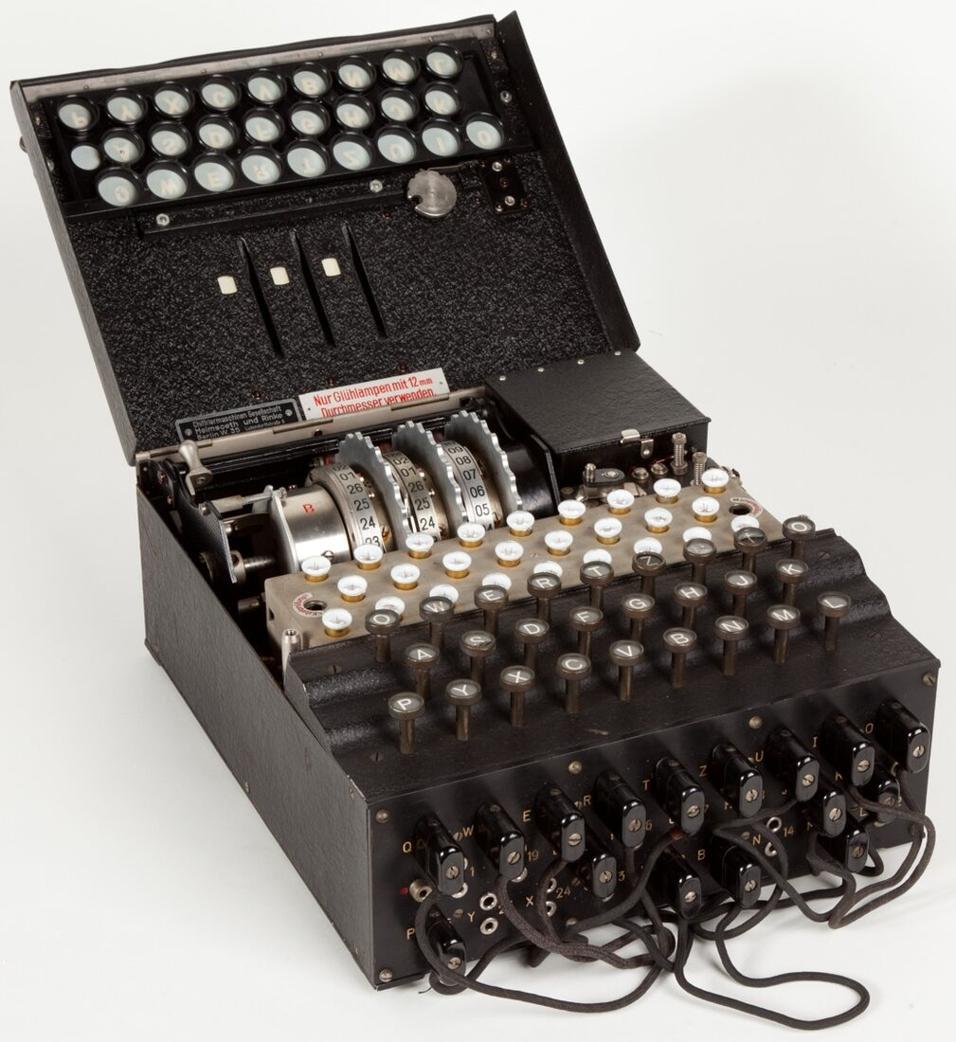
What is this?

Slide 3
It's Called the Enigma Machine
Germany used it in World War 2 to send secret messages.
Rotating wheels inside scrambled every letter you typed.
Only an identical machine, set up the same way, could unscramble it.
Millions of possible settings: too many to guess by hand.
Alan Turing
led the Bletchley Park team that cracked it, and his ideas became the basis of the modern computer.

Slide 4
Intro to Python
PYTHON CRASH COURSE
$ spyder _
Zero experience needed. We're using Spyder, live.
Dr. Hughes

Slide 5

Open Spyder
TASK 1
Open Spyder and find the console. Follow Part 1 of your booklet.
10 minutes

Slide 6
Meet the Terminal
TIP Spyder's console runs Python instantly, one line at a time.
>>> # type here, press Enter
No saving. No running a file. Just type, and press Enter.

Slide 7
Python Is a Calculator
>>> 2 + 2
4

Slide 8
The Four Basics
+
-
>>> 5 + 3
add
subtract
8
>>> 5 - 3
*
/
2
>>> 5 * 3
multiply
divide
15
>>> 5 / 3
1.6666666666666667

Slide 9
Try It Yourself
>>> 8 / 2 # pizza, split between 2 people
4.0
>>> 7 * 6
42
// type these into Spyder's console yourselves before checking the answers

Slide 10
Leftovers: the % Operator
>>> 10 % 3 # 10 slices, 3 people, 1 left over
1
// "modulo" is the remainder after dividing

Slide 11
Order Matters
>>> 2 + 3 * 4
14
>>> (2 + 3) * 4
20
Python follows normal maths rules: multiply before add, unless brackets say otherwise.

Slide 12
Giving Things Names
10 MIN
NOTE A variable is a labelled box that holds a value.
>>> name = value
Name on the left, value on the right.

Slide 13
Your First Variable
>>> age = 16
>>> age
16

Slide 14
Strings: Text in Quotes
str
text, always in quotes
>>> name = "Zendaya"
>>> name
'Zendaya'

Slide 15
Numbers: int vs float
int
float
whole number: 95
has a decimal point: 1.75
1 score = 95
2 height = 1.75
// int = whole number. float = has a decimal point.

Slide 16
True or False: Booleans
bool
True or False, nothing else
1 is_hungry = True
2 is_raining = False
// only ever two values: True or False

Slide 17
Check the Type
>>> type(age)
<class 'int'>
>>> type(name)
<class 'str'>
>>> type(height)
<class 'float'>
>>> type(is_hungry)
<class 'bool'>

Slide 18
Variables Can Change
>>> score = 95
>>> score = score + 5
>>> score
100
In Python, = means store, not equals.

Slide 19
Remember f(x) From Maths?
f(x) = x + 1
NOTE Put a number in, get a number out. A function is a machine for that.

Slide 20
Python Functions Do the Same
1 def add_one(x):
2 return x + 1
// def = "define a function". return = "send this value back"

Slide 21
Calling a Function
>>> add_one(5)
6

Slide 22
Anatomy of a Function
1 def add_one(x):
2 return x + 1
def
add_one
x
x + 1
keyword
name we chose
input (parameter)
output

Slide 23
Multiple Inputs
1 def add(a, b):
2 return a + b
>>> add(3, 4)
7

Slide 24
Why Bother?
Write the maths once. Reuse it forever.
>>> add(10, 20)
30
>>> add(100, 1)
101

Slide 25
The Function Ladder
TASK 4
Open ladder.py. Work down the rungs and test each one with its chip.
20 minutes

Slide 26
Where the Ladder Ends (1/2)
1 def add(a, b):
2 # TODO
4 def subtract(a, b):
5 # TODO
// rung 5: these four are your target

Slide 27
Where the Ladder Ends (2/2)
1 def multiply(a, b):
2 # TODO
4 def divide(a, b):
5 # TODO
// names must be exactly these four

Slide 28
We Do This One Together
7 MIN
1 def add(a, b):
2 # TODO
2 return a + b

Slide 29
Testing add()
>>> add(2, 3)
5

Slide 30
Model Answer: subtract()
ANSWERS
1 def subtract(a, b):
2 # TODO
2 return a - b

Slide 31
Testing subtract()
>>> subtract(10, 4)
6

Slide 32
Model Answer: multiply()
ANSWERS
1 def multiply(a, b):
2 # TODO
2 return a * b

Slide 33
Testing multiply()
>>> multiply(6, 7)
42

Slide 34
Model Answer: divide()
ANSWERS
1 def divide(a, b):
2 # TODO
2 return a / b

Slide 35
Testing divide()
>>> divide(20, 4)
5.0
NOTE Division always gives back a float, even when it divides evenly.

Slide 36
Compare Yours
1 def add(a, b):
2 return a + b
3 def subtract(a, b):
4 return a - b
5 def multiply(a, b):
6 return a * b
7 def divide(a, b):
8 return a / b
Same shape, different maths.

Slide 37
Before the Calculator
TIP The function names must be exactly add, subtract, multiply, divide. All four must run in the console before the calculator works.
// calculator.py calls them by name. One wrong name and it finds nothing

Slide 38
Making Decisions
7 MIN
NOTE If it's raining: bring an umbrella. Otherwise, don't.
Code needs to make decisions too.

Slide 39
The if Statement
1 temperature = 30
2 if temperature > 25:
3 print("It's hot!")
It's hot!

Slide 40
if / else
1 temperature = 10
2 if temperature > 25:
3 print("It's hot!")
4 else:
5 print("It's chilly")
It's chilly
// else only runs when the if didn't

Slide 41
Comparison Operators
==
!=
>
equal to
not equal to
greater than
<
>=
<=
less than
greater or equal
less or equal
// note the double ==. A single = would try to store a value instead

Slide 42
elif: More Than Two Choices
1 score = 72
B
2 if score >= 90:
3 print("A")
4 elif score >= 70:
5 print("B")
6 elif score >= 50:
7 print("C")
8 else:
9 print("Needs work")
// Python checks each condition top to bottom, stops at the first true one

Slide 43
Combining Conditions
1 age = 16
2 if age >= 13 and age <= 19:
3 print("You're a teenager!")
You're a teenager!
// "and" means both sides need to be true

Slide 44
Build the Calculator
TASK 6
Open calculator.py. Follow Steps 1 to 4 and paste in your four functions.
20 minutes

Slide 45
Step 1: The Four Functions
add()
subtract()
multiply()
divide()
NOTE Paste your ladder functions into calculator.py.

Slide 46
Step 2: Ask the User
1 operation = input("Pick: + - * / ")
2 num1 = float(input("First number: "))
3 num2 = float(input("Second number: "))
// input() always gives text back. float() turns it into a number

Slide 47
Step 3: Decide What To Do
1 if operation == "+":
2 result = add(num1, num2)
3 elif operation == "-":
4 result = subtract(num1, num2)
5 elif operation == "*":
6 result = multiply(num1, num2)
7 elif operation == "/":
8 result = divide(num1, num2)

Slide 48
Step 4: Show the Result
1 print(f"Answer: {result}")
// f-strings drop a variable straight into text with { }

Slide 49
calculator.py (1/2)
1 operation = input("Pick: + - * / ")
2 num1 = float(input("First number: "))
3 num2 = float(input("Second number: "))
5 if operation == "+":
6 result = add(num1, num2)
7 elif operation == "-":
8 result = subtract(num1, num2)
// plus YOUR four ladder functions pasted at the top of the file

Slide 50
calculator.py (2/2)
9 elif operation == "*":
10 result = multiply(num1, num2)
11 elif operation == "/":
12 result = divide(num1, num2)
14 print(f"Answer: {result}")

Slide 51
Run It!
Pick: + - * / *
First number: 6
Second number: 7
Answer: 42.0

Slide 52
Doing Things Again and Again
STRETCH
Loops = don't repeat yourself.

Slide 53
The for Loop
STRETCH
1 for i in range(5):
0
2 print(i)
1
2
3
4
// range(5) counts 0, 1, 2, 3, 4: five numbers, starting at 0

Slide 54
for Over a List
STRETCH
1 snacks = ["pizza", "chips", "soda"]
pizza
2 for snack in snacks:
chips
3 print(snack)
soda

Slide 55
The while Loop
STRETCH
1 count = 0
0
2 while count < 3:
1
3 print(count)
2
4 count += 1
// keeps going while the condition is true. Forget count += 1 and it never stops

Slide 56
for vs while
STRETCH
for
while
a known number of times
until something changes
for = a known number of times. while = until something changes.

Slide 57
What You Built Today
6 MIN
✓ terminal maths
✓ variables
✓ functions
✓ a set of functions you wrote yourself
✓ if statements
✓ a working calculator
✓ for & while loops

Slide 58
You're a Programmer Now
Every big program is just this: smaller pieces, put together.
CHALLENGE Add power(a, b) to ladder.py and to the calculator (a new elif for **).

