Slide 1
5-A-DAY: Knowledge Recall
STARTER
Question
Answer
What is a variable?
A named location in which to store values
1
What does input() do?
Asks the user to enter data, which is stored in a variable
2
Which command shows a message on the screen?
print()
3
Is 2nd_score a valid variable name? Why?
No. A variable name cannot start with a number
4
Write "average price" in camel case
averagePrice
5

Slide 2



Inside the
Computer
OCR GCSE Computer Science | Systems Architecture
Today we take a real computer apart.

Slide 3


What do you
already know?
PART A
Rate each part of a computer on the worksheet, 1 to 3. Write one thing you know. No talking.
3 mins

Slide 4




Parts tour
WATCH
Motherboard
CPU
RAM
Storage
Everything plugs into it
The brain: follows instructions
Short-term memory: what is in use now
Long-term memory: keeps files when off
Power supply
Heat sink and fan
Graphics card
Turns mains electricity into power for the parts
Keeps the CPU cool
Makes the pictures for the screen

Slide 5

Work on the worksheet.
PARTS B AND C
10 mins

Slide 6
Rules at the table
Hold by the edges
Never touch the gold
1
2
Boards and cards: edges only, with two hands
Pins and contacts can be damaged by fingers
Put it back
Back to your seat
3
4
Return every part to the tray for the next group
Carry on with your worksheet when you are done

Slide 7
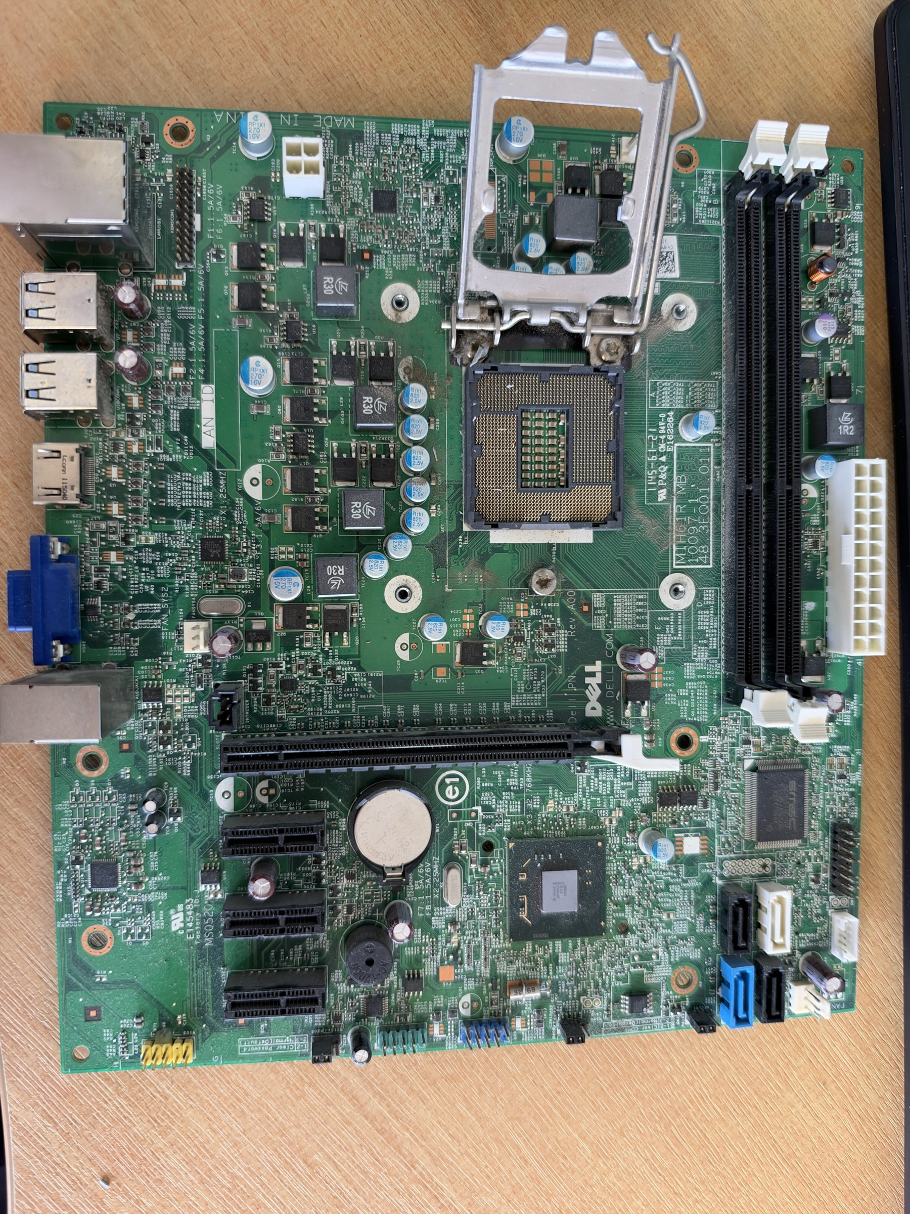
Check Part B: the motherboard
ANSWERS
8. CPU power connector
Extra power for the CPU
2. RAM slots
Memory sticks go here
8
7. Back panel ports
USB, video and network
7
2
1. CPU socket
Where the CPU is fitted
1
5
3. Graphics card slot
For a graphics card (PCIe)
5. Main power connector
Power from the power supply
3
6
6. CMOS battery
Keeps the clock running when off
4
4. SATA ports
Cables to storage drives

Slide 8
Check Part C: match up
ANSWERS
1. Match each part to its job
CPU C, RAM E, Storage A, Motherboard D, Power supply F, Heat sink and fan B
2. Pick up one part
Your own answer: size, weight, metal or plastic, pins, moving parts
3. Which part gets hot? How is it cooled?
The CPU (and graphics card). A heat sink and a fan cool it
4. RAM or storage loses everything with no power?
RAM. Storage keeps your files when the power is off

Slide 9
How the parts work together
TOGETHER
Storage
RAM
CPU
Long-term. Files and folders live here.
Short-term. Copied here when you open them.
Fetches and runs instructions from RAM.
The motherboard connects all of them
The power supply powers everything, and the fan keeps the CPU cool

Slide 10

The fetch-decode-execute cycle
TOGETHER
1. FETCH
2. DECODE
3. EXECUTE
Get the next instruction from RAM
Work out what the instruction means
Carry out the instruction
Then repeat. A 3 GHz CPU does about 3 billion cycles every second.
New word: the CPU has a control unit. It organises these steps, like the conductor of an orchestra.

Slide 11
Example: saving a document
TOGETHER
You press Save. What does the CPU do?
The CPU gets the save instruction from RAM
1. FETCH
RAM
The CPU works out: write this document to storage
2. DECODE
CPU
The document is copied from RAM to the SSD, so it is kept when the power is off
3. EXECUTE
Storage
Then the CPU fetches the next instruction. One real save takes thousands of cycles.

Slide 12
Check Part D: bringing it together
ANSWERS
1. The three steps
FETCH the next instruction from RAM. DECODE: work out what it means. EXECUTE: carry it out
2. Opening a game
Copied from storage into RAM, so the CPU can run it
3. Saving a document
Fetch the save instruction from RAM. Decode: write it to storage. Execute: copy it to storage
4. Why repeat the cycle?
To keep running the program, one instruction after another, billions of times a second

Slide 13

Compare two
laptops
PART E
Use the spec table to answer questions 1 to 4 on the worksheet. Questions 5 to 9 are extension.
7 mins

Slide 14
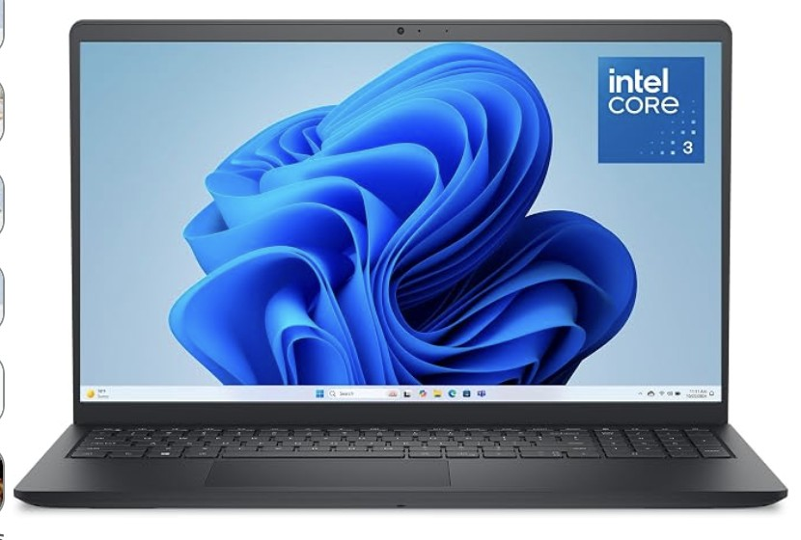
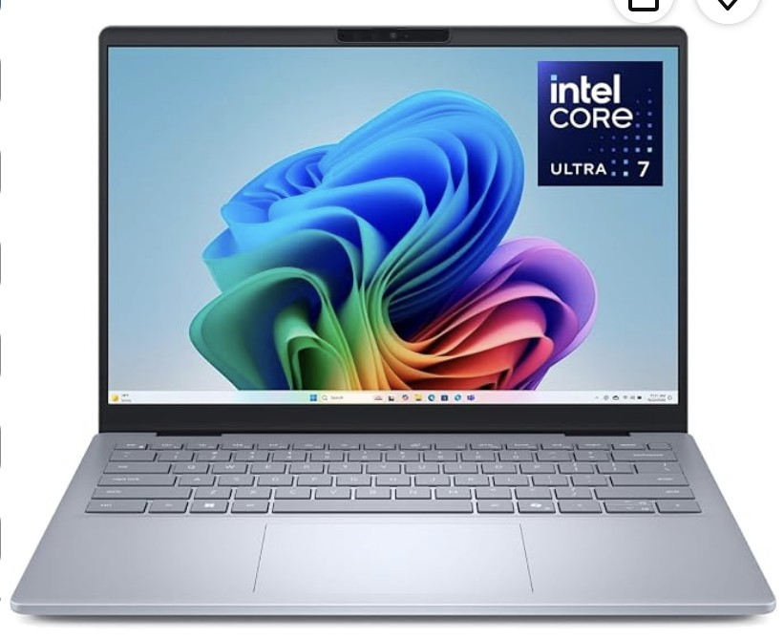
Compare two laptops
Spec | Laptop A | Laptop B
Processor | Intel Core 3 (100U) | Intel Core Ultra 7 (258V)
Processor speed | 1.2 GHz | 2.2 GHz
Number of cores | 6 | 8
Cache (MB) | 10 | 12
RAM | 8 GB | 32 GB
RAM speed | 4400 MHz | 8533 MHz
Storage (SSD) | 512 GB | 1 TB
Price | £484 | £1,320
Laptop A: Dell 15
Laptop B: Dell 14 Plus

Slide 15
Part E: answers
ANSWERS
1. Which laptop has more RAM, and how many GB more?
Laptop B, by 24 GB (32 - 8). That is 4 times as much.
2. How many 50 GB Blu-ray movies?
A: 512 ÷ 50 = 10 (10.24, so 10). B: 1000 ÷ 50 = 20
3. How many 500 MB apps open at once?
A: 8000 ÷ 500 = 16. B: 32000 ÷ 500 = 64
4. GHz: million or billion? Cycles per second for A?
Billion (giga). Laptop A: 1.2 billion cycles every second

Slide 16
Part E extension: answers
ANSWERS
5. 4400 MHz in GHz
4.4 GHz
6. More cores?
2 more (8 and 6). Not always faster: software must use them, and clock speed matters
7. Why fewer apps in real life?
The operating system and other programs use RAM too
8. Essays and browsing
Laptop A: enough RAM and storage, and £836 cheaper (any choice backed by numbers)
9. Video editing
Laptop B: 32 GB RAM, 1 TB storage, faster processor and RAM

