Slide 1

The Fetch-Execute Cycle
OCR J277 1.1.1
Systems architecture part 1 of 6.

Slide 2
Lesson 1 objectives
LESSON 1
State the purpose of the CPU.
1
Explain what a program and an instruction are.
2
Name and describe the three stages of the fetch-execute cycle.
3
Set up your workbook and make your first entry.
4

Slide 3
Think back
RECALL
What are the three stages the CPU repeats?
Fetch, decode, execute
Where are programs held while they are running?
In RAM (copied there from storage)
Why is RAM needed as well as storage?
RAM is much faster to access, so the CPU is not left waiting

Slide 4
Key words
KEY WORDS
CPU
Central Processing Unit. Processes data and runs instructions.
Instruction
One small step the CPU can carry out, such as add two numbers.
Program
A list of instructions, held in memory in order.
Address
The number that says where an item is held in memory.
Fetch-execute cycle
The repeating process the CPU uses to run each instruction.

Slide 5
The purpose of the CPU
1.1.1
Runs programs
It carries out the instructions of a program, one after another.
Processes data
It does the calculations and makes the decisions.
Controls the computer
It coordinates the other parts so they work together.
Works very fast
Billions of instructions every second.
WATCH OUT The CPU is not where files are kept. That is storage.

Slide 6
Programs live in memory
INSTRUCTIONS
Address | Contents | Instruction or data?
0 | Get the number from address 20 | Instruction
1 | Add the number from address 21 | Instruction
2 | Save the answer in address 22 | Instruction
3 | Stop | Instruction
20 | 5 | Data
21 | 3 | Data
NOTE Every item in memory has an address, like a house number.

Slide 7
The fetch-execute cycle
DIAGRAM
RAM
instruction
FETCH
get the next instruction
DECODE
work out what it means
EXECUTE
carry it out
the cycle repeats

Slide 8
What happens at each stage
THE CYCLE
FETCH
DECODE
EXECUTE
The Program Counter holds the address of the next instruction.
That instruction is copied from memory (RAM) into the CPU.
The Program Counter increments (goes up by 1).
The Control Unit works out what the instruction means.
It then knows what to do and which data to use.
The instruction is carried out.
For example the ALU does a calculation, or a result is stored.
NOTE Then the cycle repeats with the next instruction.

Slide 9
Check understanding
CHECK
Give the three stages of the cycle in order.
Fetch, decode, execute
What does the Program Counter hold?
The address of the next instruction
Where is the instruction fetched from?
Memory (RAM)
Why must the cycle repeat?
A program has many instructions. Each pass runs only one.

Slide 10
Crack the Vault: your jobs
3 VOLUNTEERS
FETCHER
DECODER
EXECUTOR
Say FETCH.
Get the card with the same number as the Program Counter (PC).
Add 1 to the PC.
Give the card to the Decoder.
Say DECODE.
Work out what the card says.
Tell the Executor.
Say EXECUTE.
Do the maths on the calculator.
Say the answer. It is the password.
NOTE Two vaults. Each answer is a password.

Slide 11
We do: vault 1
CARD 0 RED
FETCH
The Program Counter (PC) is 0. Get card 0 from the pile. The PC is now 1.
DECODE
What does the card say?
EXECUTE
Use the calculator: 73 × 21.
TIP 73 × 21 = 1533. Type 1533 as the password for vault 1.

Slide 12
We do: vault 2
CARD 1 BLUE
FETCH
The Program Counter (PC) is 1. Get card 1 from the pile. The PC is now 2.
DECODE
What does the card say?
EXECUTE
Use the calculator: 4286 + 3917.
TIP 4286 + 3917 = 8203. Type 8203 as the password for vault 2.

Slide 13
Get your workbook
WORKBOOK
Get a copy of the Y10 Computer Science Workbook.
Save it in your Documents.
Open it and type your name on the cover.

Slide 14
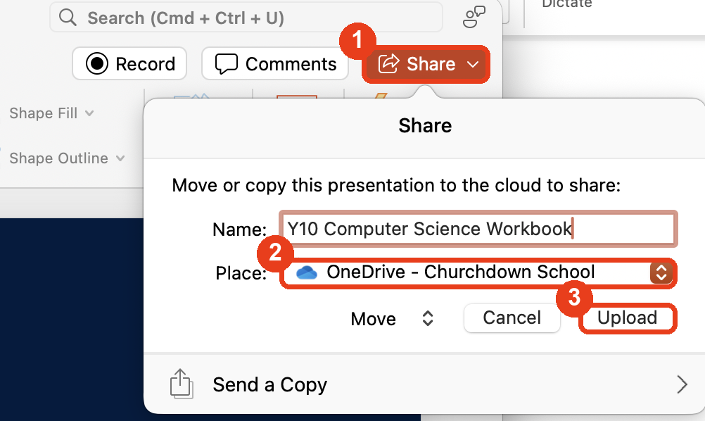
Save it to OneDrive
WORKBOOK
Click Share, at the top right.
1
Choose OneDrive as the place.
2
Click Upload.
3

Slide 15
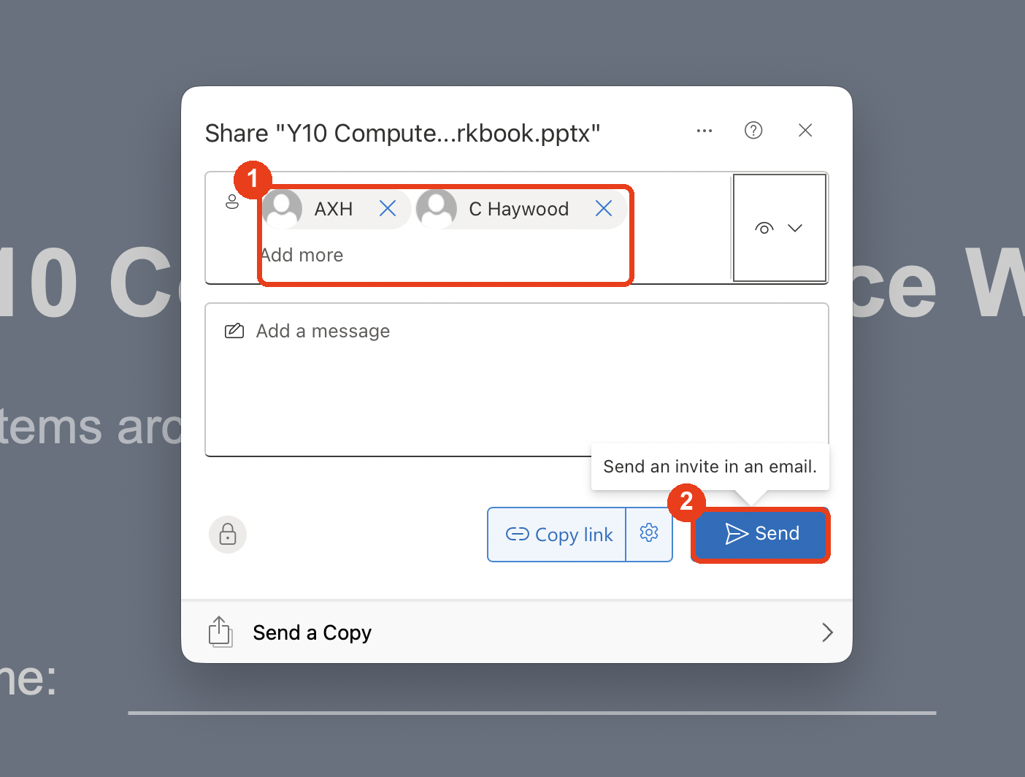
Share it with your teachers
WORKBOOK
Add your teachers.
1
Click Send.
2

Slide 16
Your first entry: draw the cycle
15 MINUTES
FETCH is when ...
DECODE is when ...
EXECUTE is when ...
RAM
instruction
FETCH
get the next instruction
DECODE
work out what it means
EXECUTE
carry it out
the cycle repeats
The Program Counter ...
The cycle repeats because ...

Slide 17
Key Terms Review
KEY TERMS
Term | Cue
CPU | runs programs, processes ...
Instruction | one small ...
Program | a list of ... held in memory
Address | where an item is ...
Fetch-execute cycle | fetch, decode, ... then repeat
Write each meaning in your own words in your workbook.

Slide 18

Following a program
LESSON 2
Trace each pass of the cycle.

Slide 19
Lesson 2 objectives
LESSON 2
Describe what happens at each stage for each instruction of a short program.
1
Explain how the Program Counter changes and why the cycle repeats.
2
Answer real exam questions on the cycle.
3

Slide 20
Think back
RECALL
What is the purpose of the CPU?
To run programs: process data and carry out instructions
What happens in the fetch stage?
The next instruction is copied from memory (RAM) into the CPU
What does the Program Counter hold?
The address of the next instruction

Slide 21
Our program in memory
WALK-THROUGH
0
Get number from 20
Predict
1
Add number from 21
What will be saved at address 22 when the program stops?
2
Save answer in 22
3
Stop
20
5
8 (5 + 3)
21
3
22
?

Slide 22
Cycle 1: get the number
TRACE
Fetch
The Program Counter holds 0, so the instruction at address 0 is copied from memory into the CPU. The Program Counter becomes 1.
Decode
The Control Unit works out what it means: get the number from address 20.
Execute
The number 5 is copied from address 20 into the CPU.

Slide 23
Cycles 2 to 4
TRACE
Cycle 2: add
Fetch the instruction at address 1 (Program Counter becomes 2). Decode: add the number from address 21. Execute: the ALU adds 3 to 5. The answer is 8.
Cycle 3: save
Fetch the instruction at address 2 (Program Counter becomes 3). Decode: save the answer. Execute: 8 is written to address 22.
Cycle 4: stop
Fetch the instruction at address 3. Decode: stop. Execute: the program ends.

Slide 24


Activity
ACTIVITY
Activity to be added here.
10 minutes

Slide 25
Why does the cycle repeat?
THE CYCLE
A program is many instructions. One pass runs only one of them.
The Program Counter always points to the next instruction.
It keeps going until the program ends or the computer is switched off.
NOTE The cycle runs again and again, billions of times a second.

Slide 26
Common mistakes
WATCH OUT
The CPU stores programs.
No. Storage keeps them. RAM holds the ones running.
The Program Counter counts the instructions.
No. It holds the address of the next instruction.
Programs are fetched in the fetch stage.
No. One instruction at a time is fetched from memory.
Execute always means calculate.
No. It might be a store, a load, or stopping.

Slide 27
Exam practice
EXAM
Describe what happens during the fetch-execute cycle. [2]
Any two: instruction fetched from memory; decoded; executed; ALU does the calculations
Identify two events that take place during the fetch-execute cycle. [2]
Any two: fetched; decoded; executed; the process repeats; program counter incremented
Name the register that 'stores the address of the next instruction to be fetched and increments each cycle'. [1]
Program Counter (PC)
From OCR J277/01 past papers: June 2024 Q6(a); OCR sample paper Q1(d); June 2022 Q2

Slide 28
Key Terms Review
KEY TERMS
Term | Cue
Fetch | get the next instruction from ...
Decode | work out what it ...
Execute | carry ... out
Program Counter | holds the address of the ...
Write each meaning in your own words in your workbook.

