Slide 1
5-A-DAY: Knowledge Recall
STARTER
Question
Answer
Where would you find the ribbon?
At the top of an application
1
Where would you find the taskbar?
Usually at the bottom of the screen
2
How do you save a file for the first time, or if you need to save with a different name?
Use Save As
3
Which key on the keyboard allows you to input a special character or an uppercase letter?
Shift key
4
What does the backspace key do?
Deletes characters to the left of the cursor
5

Slide 2




Y7 Digital Literacy
& E-Safety
Term 1 Recap
Detectives Lesson

Slide 3
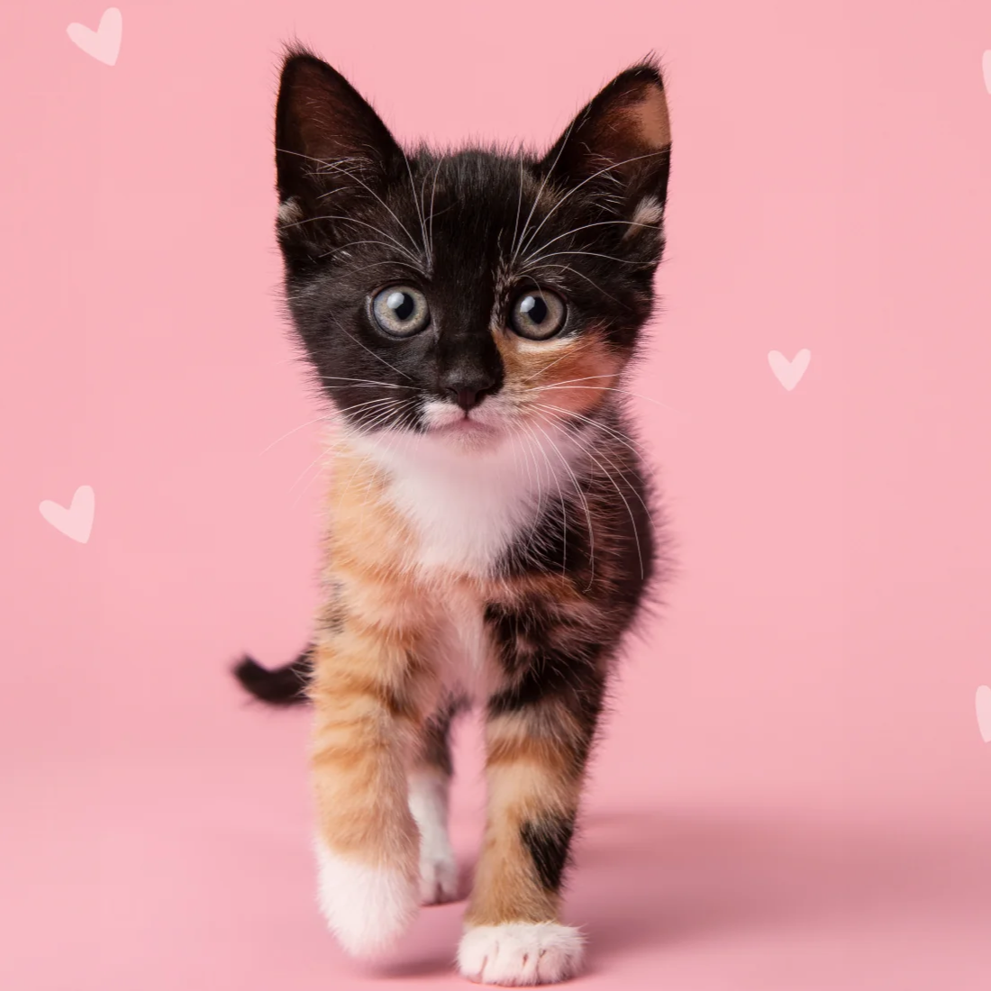
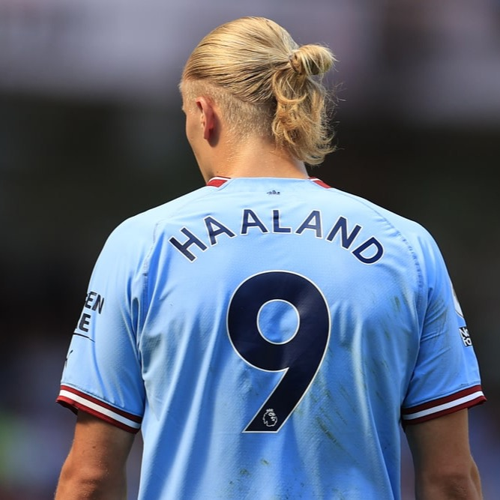

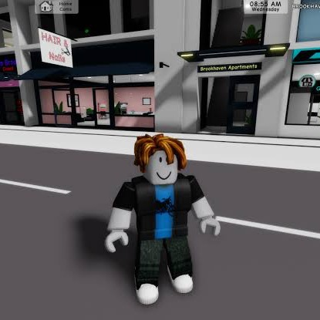

Guess the Password
TASK 1
Read the four stories. Draw a line from each person to their password.
5 minutes

Slide 4
Task 1: Guess the Password
ANSWERS
Jenny
James
Aisha
Owen
PrincessPenny1
Haaland9
Taylor1989
OwenRoblox
Her kitten's name, and she always writes #PrincessPenny
His favourite footballer
Her favourite artist and album
His own name and his favourite game
Passwords made from things people know about you are easy to guess.

Slide 5

Cyberbullying
TASK 2
Complete each sentence with a word from the word bank.
5 minutes

Slide 6
Task 2: Cyberbullying
ANSWERS
1 Example: If you receive mean messages online, you should block, report and tell an adult you trust.
2
Spreading rumours about someone online is a form of bullying.
3
Sending messages to threaten someone is cyberbullying.
4
The victim of cyberbullying often feels alone and scared.
5
Take a screenshot of the mean message as proof.
6
Bullies often hide behind a fake nickname.
7
Never tell anyone your password.
8
Keep the mean messages. Do not delete them.
9
Do not reply. Just ignore the bully.
10
A real friend would not post mean things about you.

Slide 7
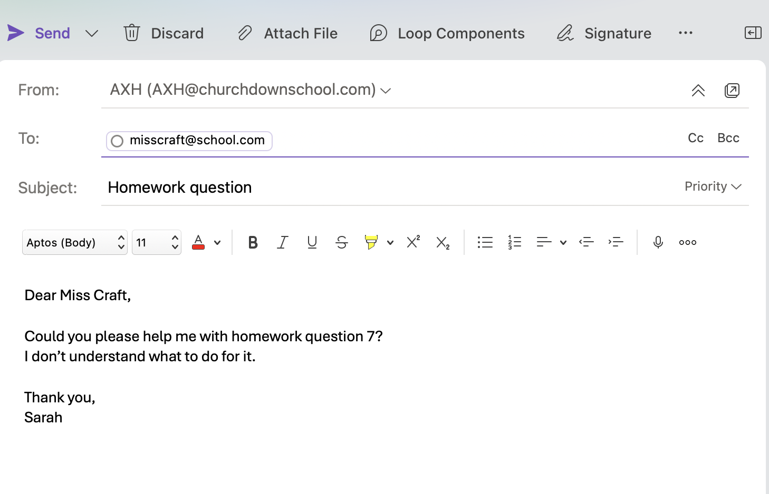
Emails
TASK 3
Label the parts of the email, then complete the do and don't rules.
5 minutes

Slide 8
Task 3: Emails (Part A)
ANSWERS
1
Send
1
2
To
2
3
4
Cc
3
5
4
Bcc
6
5
Subject
6
Greeting
7
Sign-off
7

Slide 9
Task 3: Emails (Part B)
ANSWERS
DO
DON'T
Start all emails with a greeting
Share passwords or personal details
Write a clear subject line
Write in ALL CAPITALS or be rude
Sign off with your name
Open attachments or links from people you do not know
Check your spelling before you send

Slide 10
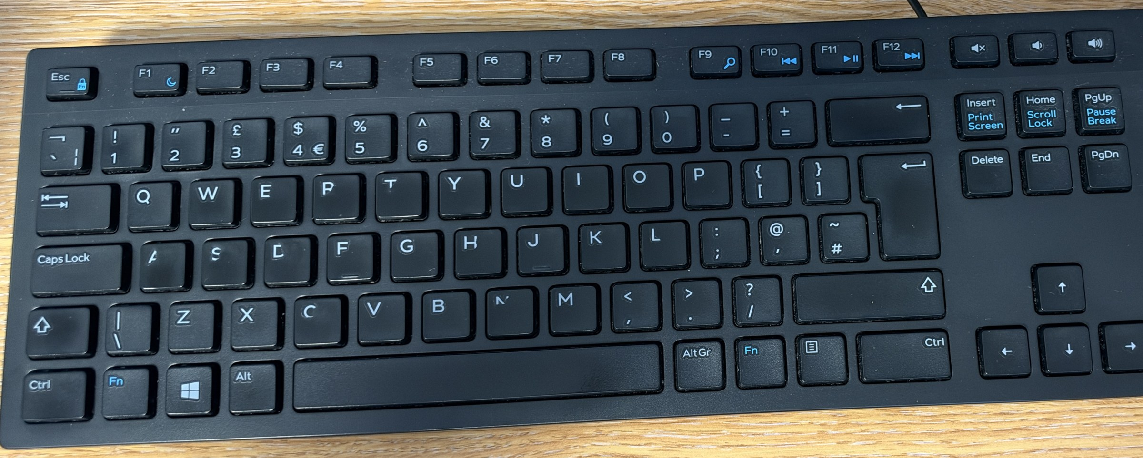
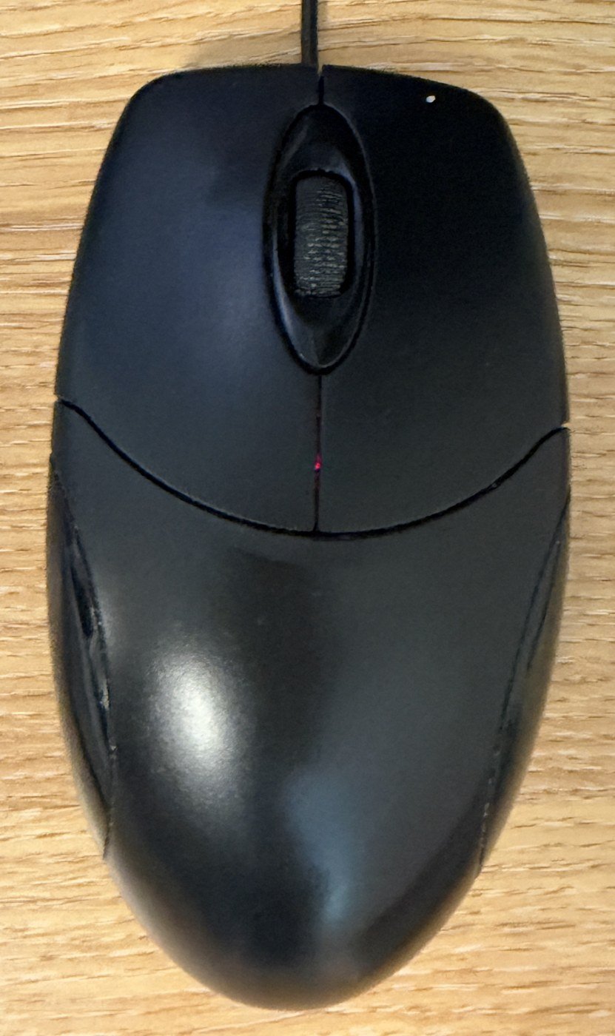
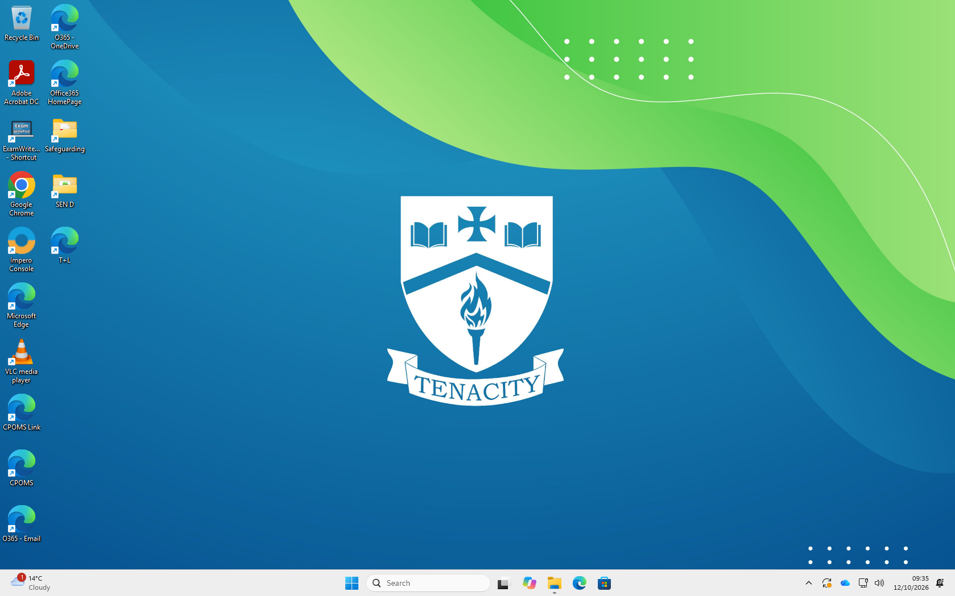
Mouse, Keyboard and Desktop
TASK 4
Label the mouse, the keyboard, the desktop and a File Explorer window, then write what each part does.
10 minutes

Slide 11
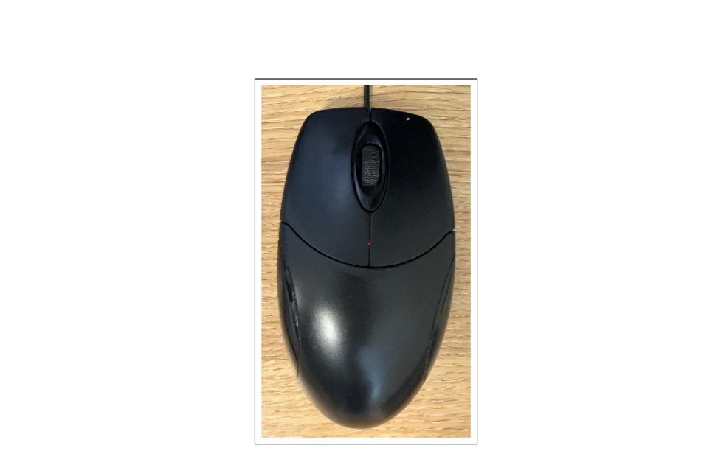
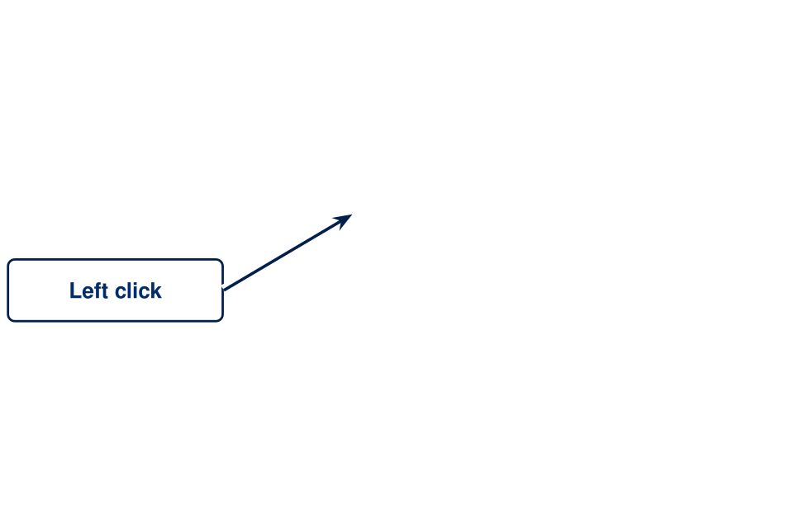
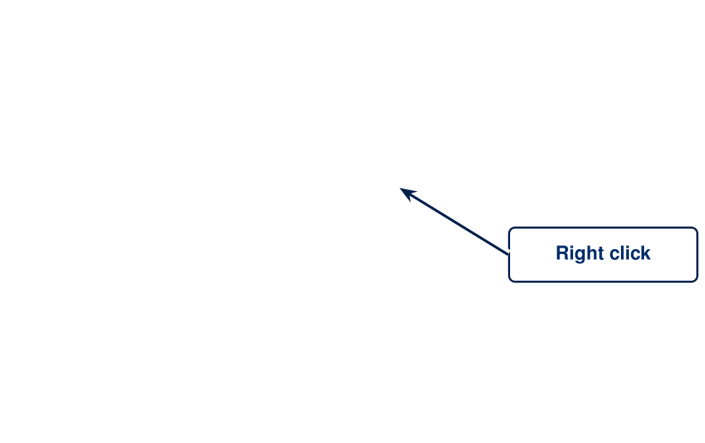
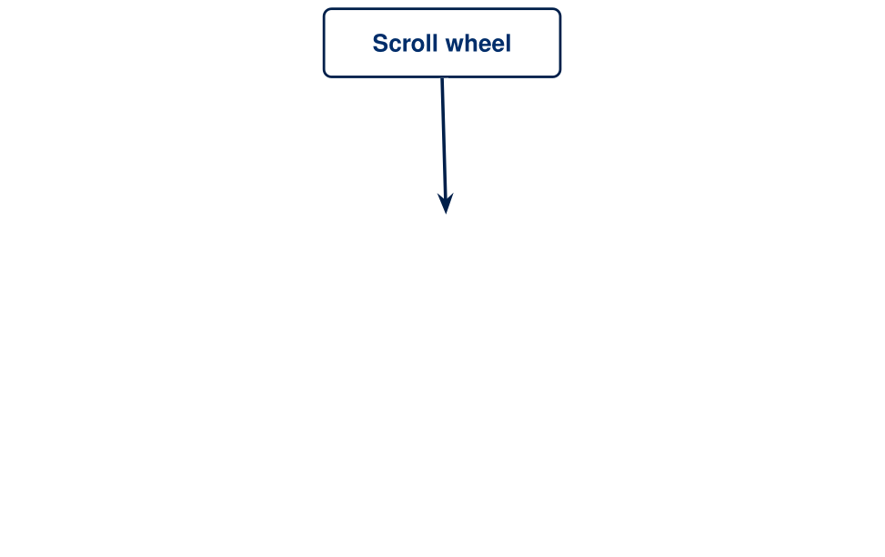
Task 4A: The Mouse
ANSWERS

Slide 12
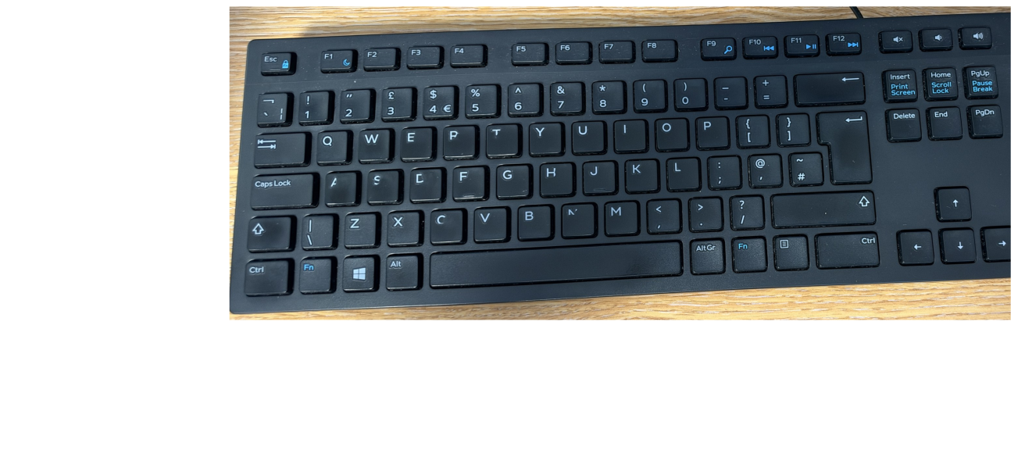
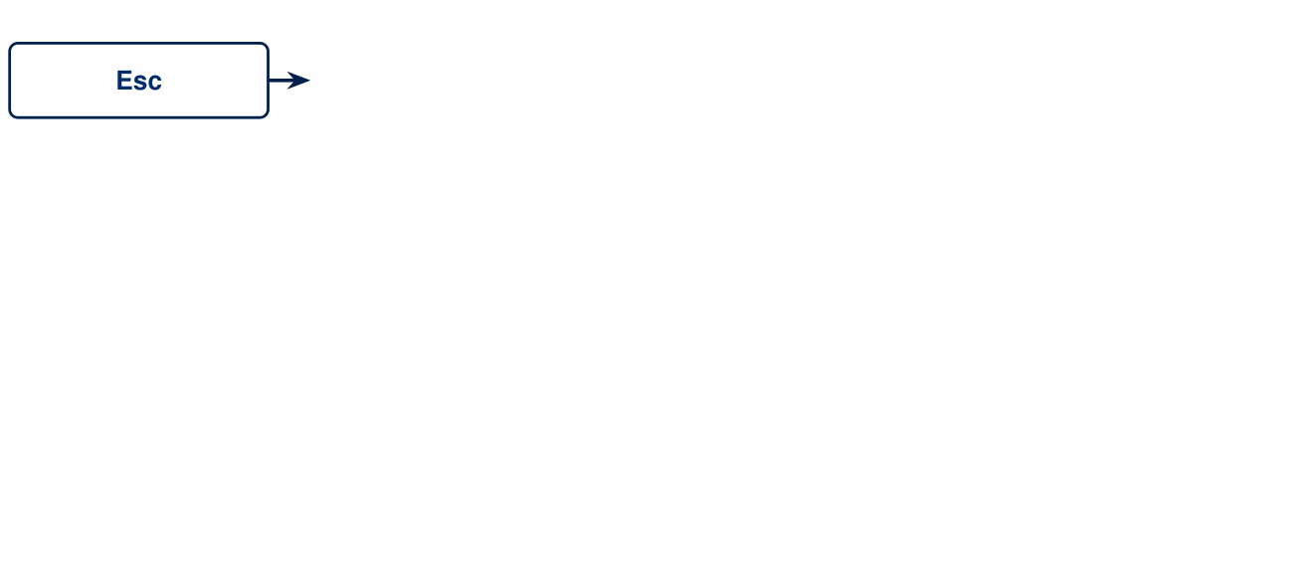
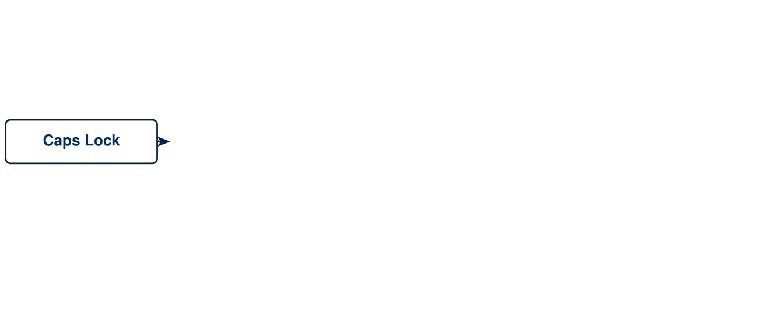
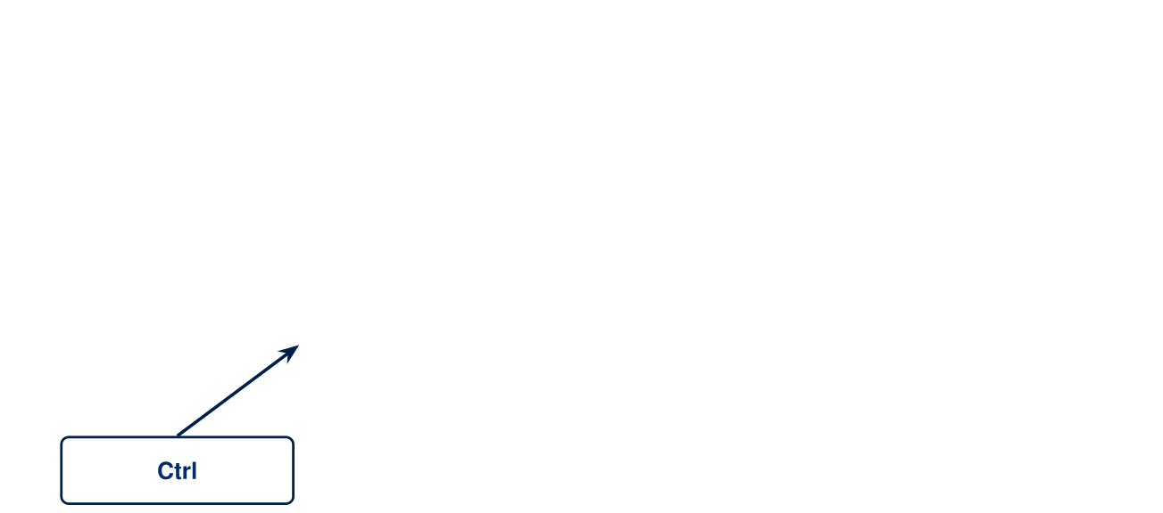
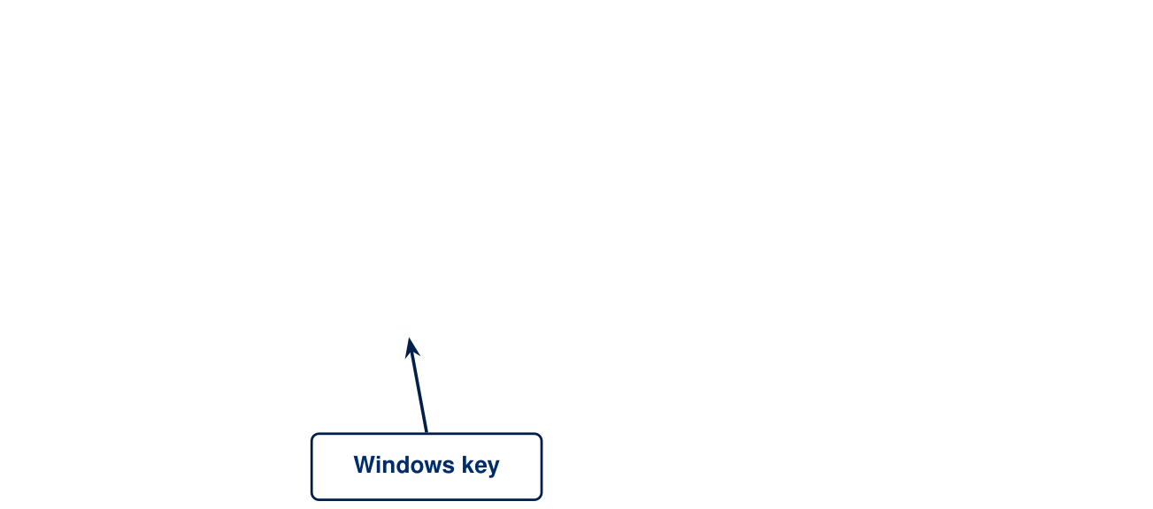
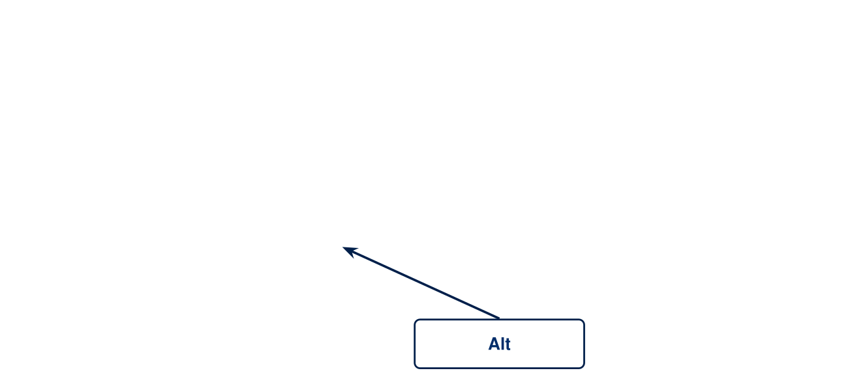
Task 4A: The Keyboard
ANSWERS

Slide 13
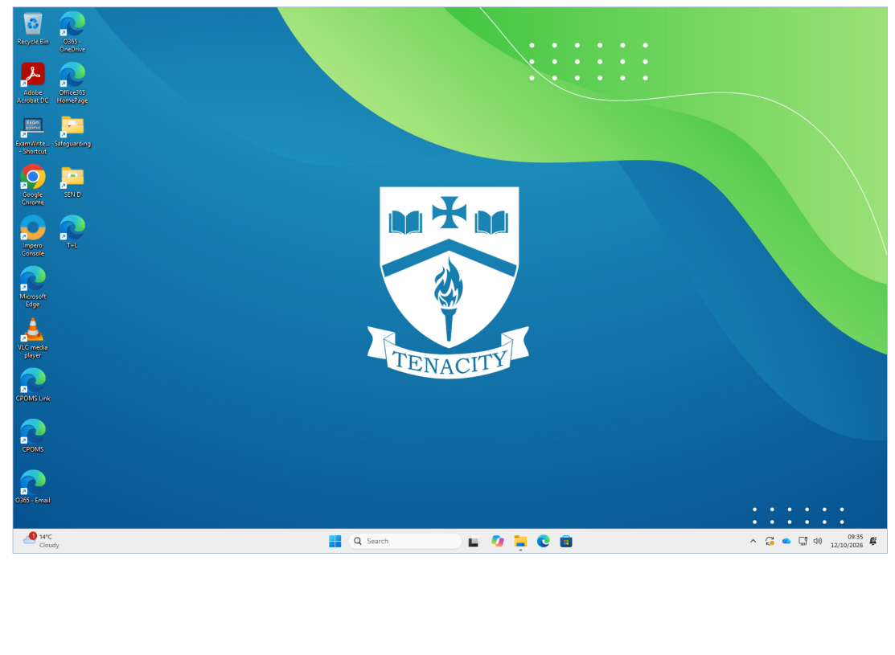
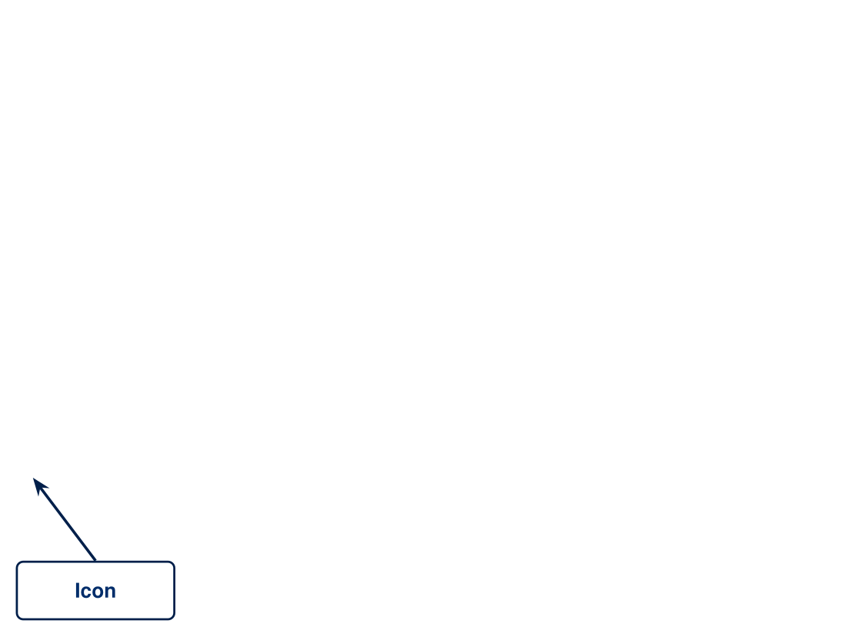
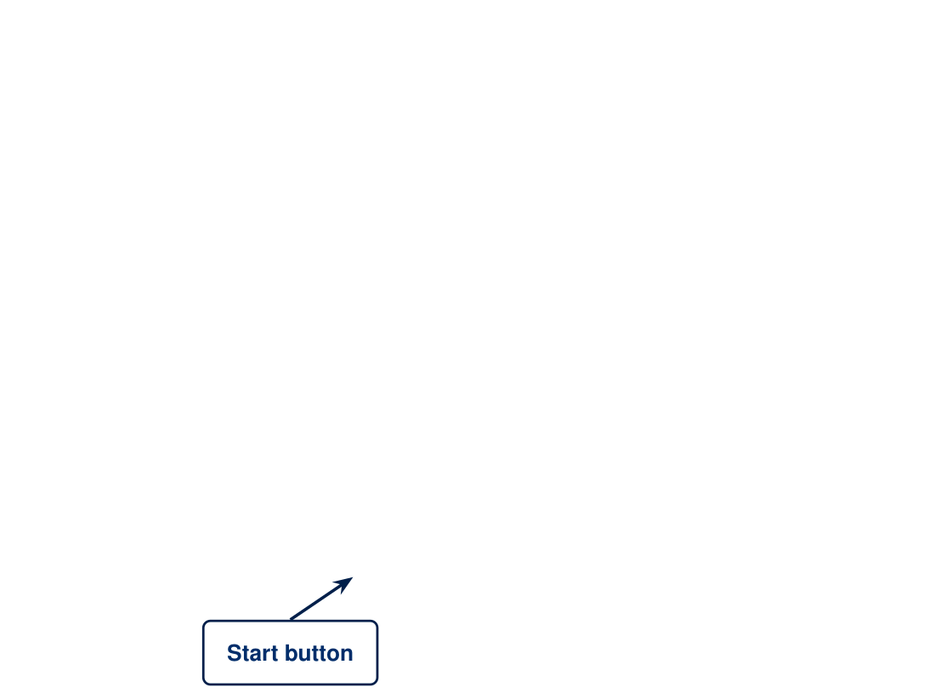
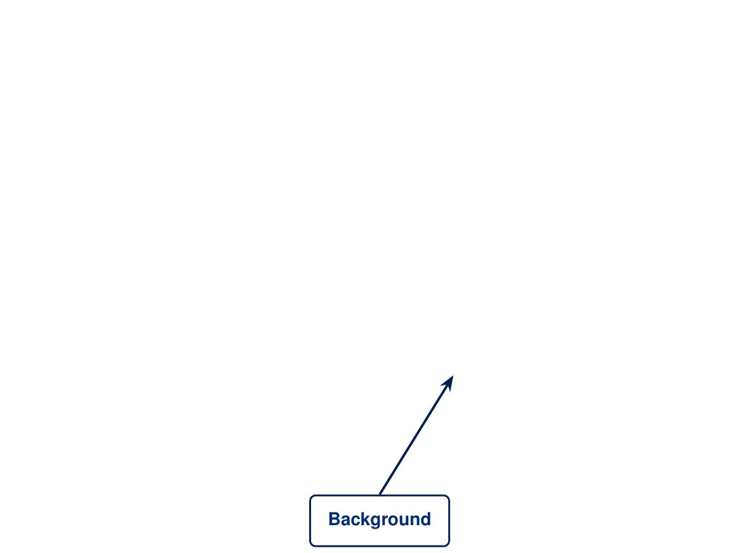
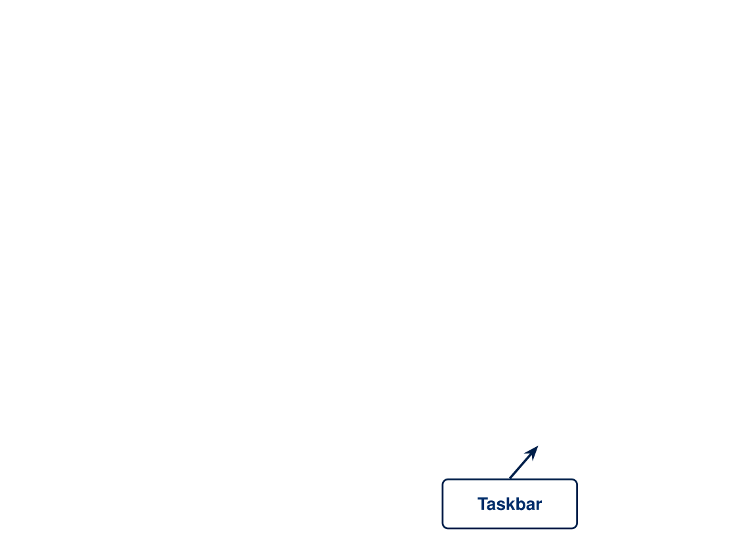
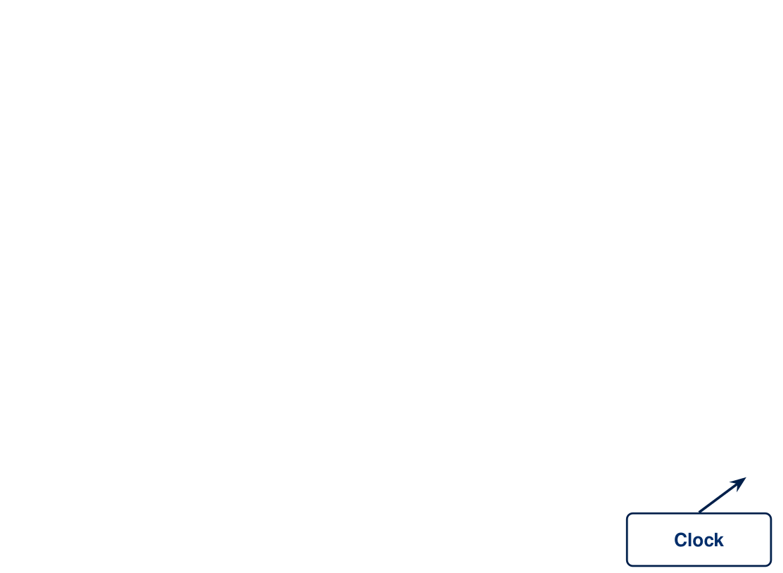
Task 4B: The Desktop
ANSWERS

Slide 14
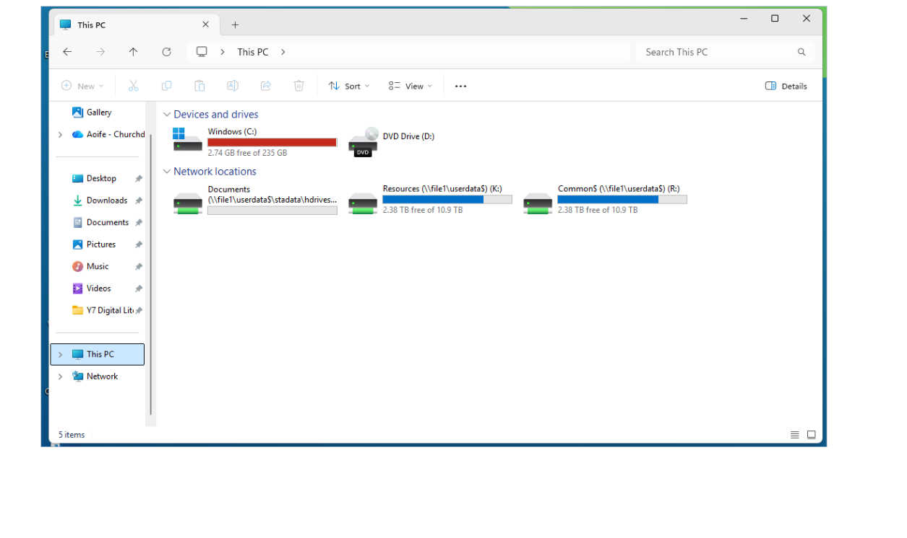


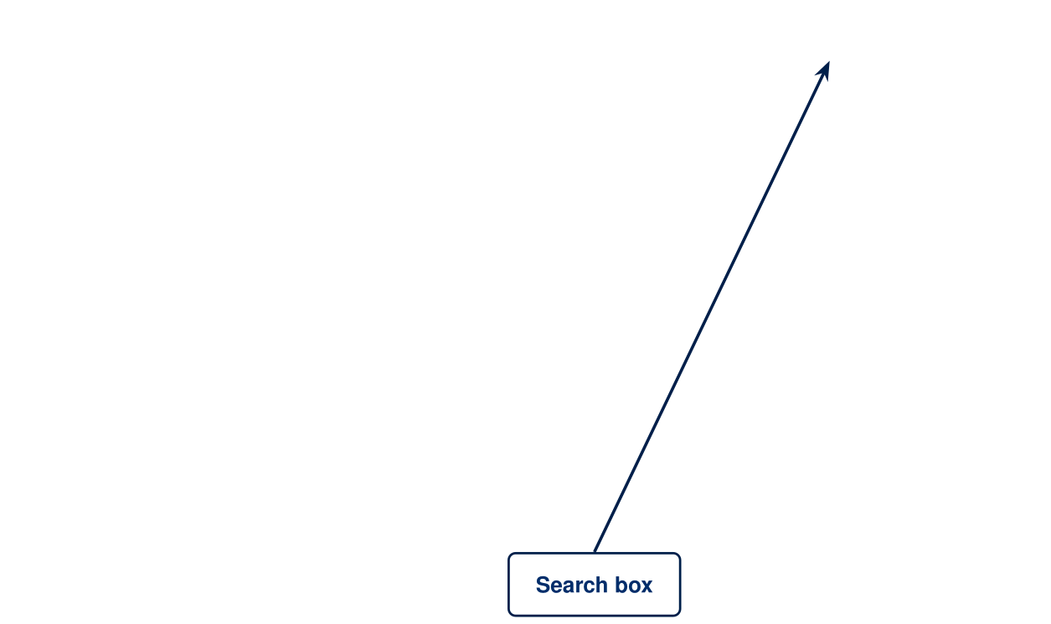
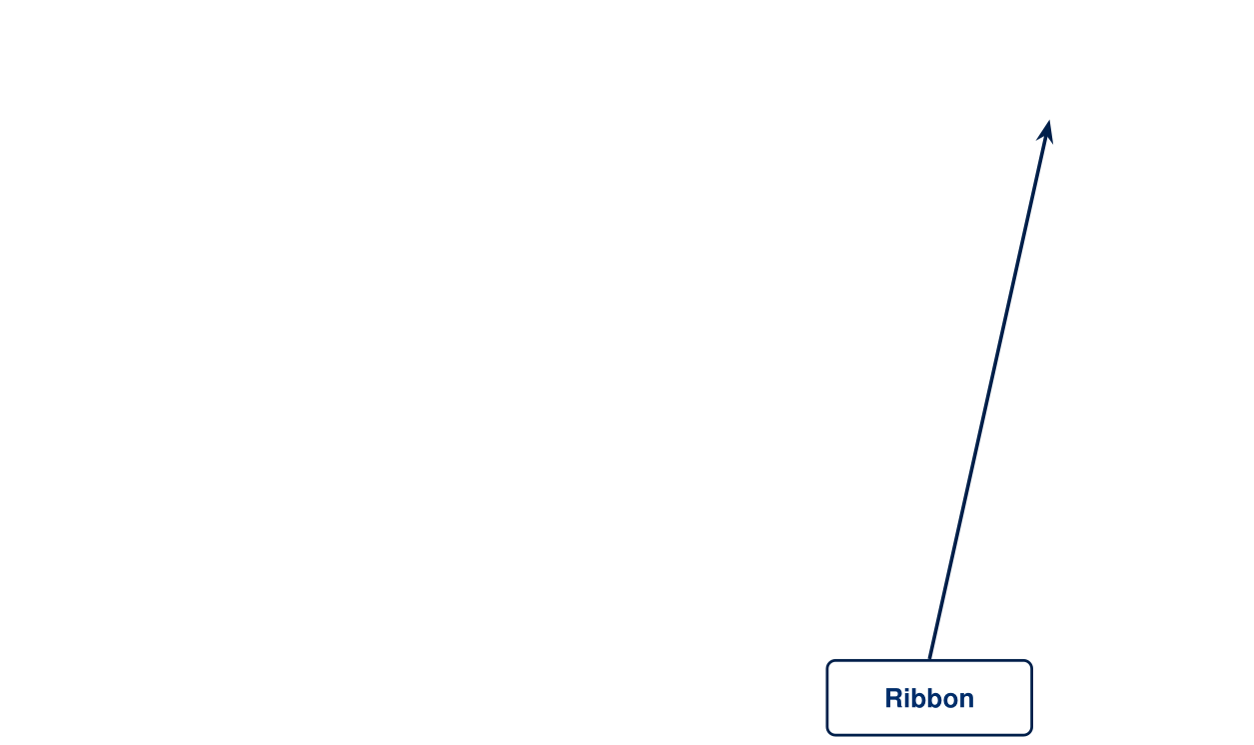
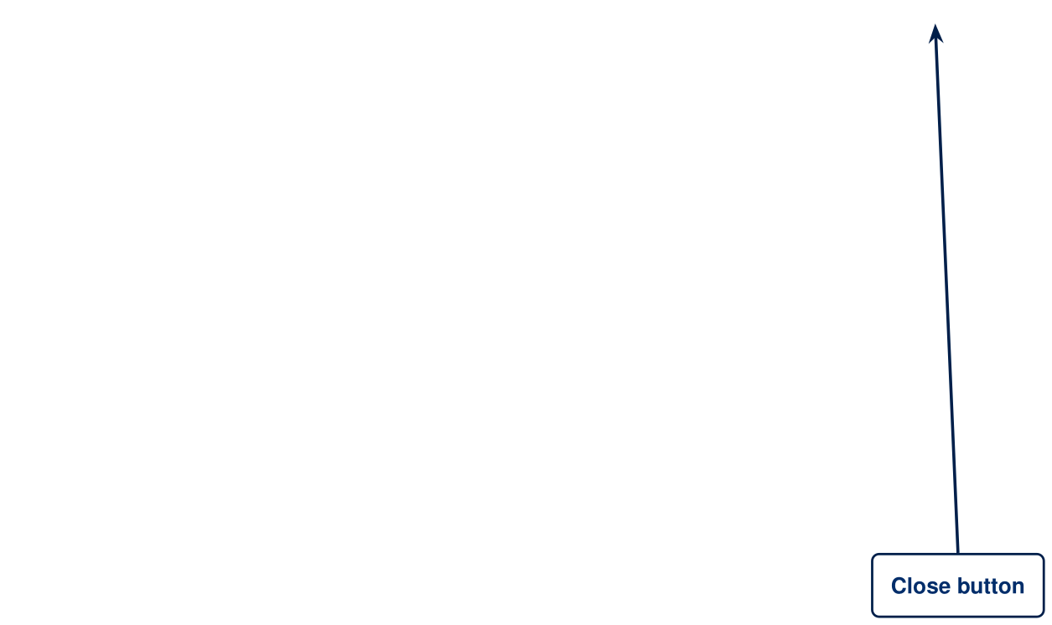
Task 4B: File Explorer
ANSWERS

Slide 15
Task 4C: Keys and mouse
ANSWERS
Windows key
Opens the Start menu, so you can find apps and files
Ctrl key
Used with other keys to give commands, e.g. Ctrl + C to copy
Alt key
Used with other keys for shortcuts, e.g. Alt + Tab to switch windows
Esc key
Cancels commands
Caps Lock key
Types all letters in capitals
Left click
Selects something, or opens it with a double click
Right click
Opens a menu of options
Scroll wheel
Scrolls up and down a page

Slide 16
Task 4D: Desktop and Explorer
ANSWERS
Start button
Opens the Start menu, so you can find apps and files
Taskbar
Shows open apps and shortcuts along the bottom
Desktop icon
A shortcut that opens a program or file
Background
The picture behind your icons
Clock
Shows the time and date
Address bar
Shows which folder you are in
Ribbon
Buttons for actions such as copy, sort and view
Navigation pane
Quick links to folders and drives
Search box
Finds files and folders
Close button
Closes the window

Slide 17

File, Folders and Desktop
TASK 5
Find the ten words in the word search. DESKTOP is done for you.
5 minutes

Slide 18
Task 5: File, Folders and Desktop
ANSWERS
D | E | S | K | T | O | P | N | Q | T | A | J | M
F | R | I | B | B | O | N | W | Z | P | P | L | Z
Z | J | S | U | R | X | Q | V | V | S | W | B | B
F | V | T | O | V | E | R | W | R | I | T | E | U
U | K | F | Q | W | J | S | D | C | R | S | X | J
H | F | U | Y | G | I | J | O | B | N | H | P | P
Z | Q | O | X | S | L | W | C | U | L | U | L | O
B | D | D | L | V | A | R | U | M | R | U | O | K
L | F | O | R | D | W | V | M | O | D | C | R | S
I | Y | J | N | P | E | P | E | B | X | L | E | W
Z | V | V | U | S | E | R | N | A | M | E | R | S
Z | F | L | T | K | R | L | T | H | S | P | Z | D
C | H | A | F | R | T | A | S | K | B | A | R | L
DESKTOP
DOCUMENTS
TASKBAR
RESOURCES
RIBBON
USERNAME
EXPLORER
SAVEAS
FOLDER
OVERWRITE
Words run across, down and diagonally.

