Slide 1

Von Neumann and Registers
OCR J277 1.1.1
Systems architecture 3 of 6. Lesson 3.

Slide 2
Lesson objectives
LESSON 3
Describe the Von Neumann architecture.
1
Explain the difference between storing data and storing an address.
2
State the purpose of the Program Counter, MAR, MDR and Accumulator.
3
Trace a program through the fetch-execute cycle.
4

Slide 3
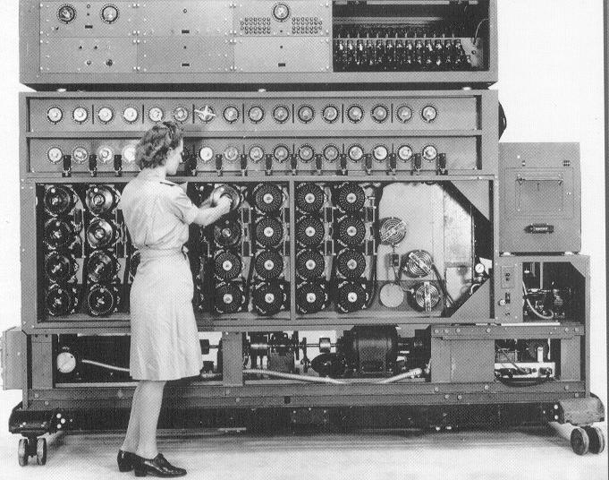
The Bombe
Built to break Enigma codes
Drums set by hand for each new job
Motor and wiring built for ONE job
Fixed-program: to change the job, rewire the machine

Slide 4
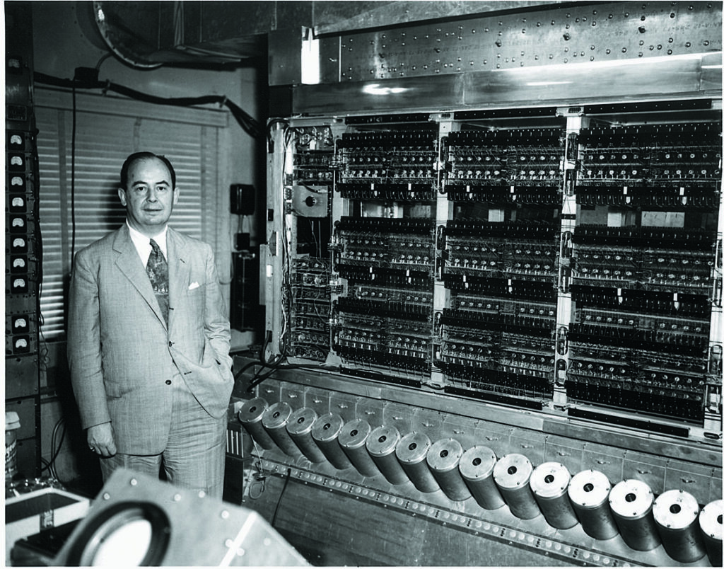
An early stored-program computer
John von Neumann described the stored-program design in 1945
One memory holds instructions AND data
New job? Load a new program into memory. No rewiring.

Slide 5
Knowledge Check!
RECALL
What is the difference between a fixed-program and a stored-program computer?
Fixed: changing the program means rewiring the machine. Stored: the program is in memory and can be changed.
Where are the instructions and the data stored in a Von Neumann computer?
Together, in the same main memory, in binary
Which register holds the address of the next instruction, and what happens to it during a fetch?
The Program Counter. It is incremented (goes up by 1).
What does the accumulator hold?
The result of calculations done by the ALU

Slide 6
Key words
KEY WORDS
Von Neumann
A design where instructions and data share one memory.
Address
The location of an item in memory.
Data
A value being used or stored, such as a number.
Program Counter
PC. Stores the address of the next instruction.
MAR
Memory Address Register. Stores an address.
MDR
Memory Data Register. Stores data.
Accumulator
ACC. Stores the result of calculations.

Slide 7
Von Neumann architecture
ONE SHARED MEMORY
CPU
Main memory (RAM)
instructions and data
Control Unit
ALU
Instructions
Registers
PC
address
MAR
address
MDR
data
ACC
data
Data

Slide 8
Address versus data
KEY IDEA
Address | Contents | Is the contents data?
0 | Get number from 20 | An instruction
1 | Add number from 21 | An instruction
20 | 5 | Data
21 | 3 | Data
TIP Think of lockers. The address is the locker number. The data is what is inside.

Slide 9
The four registers
REGISTERS
Program Counter (PC)
Stores the address of the next instruction to be fetched. Increments each cycle.
MAR
Stores the address in memory that is about to be read from or written to.
MDR
Stores the data or instruction that has just been fetched, or is about to be stored.
Accumulator (ACC)
Stores the result of calculations done by the ALU.
WATCH OUT Say what it STORES, not what it does. 'Stores the address...' earns the mark. 'Fetches' does not.

Slide 10
Address or data?
SORT
Program Counter
Address
MAR
Address
MDR
Data
Accumulator
Data

Slide 11


Trace a Program
ACTIVITY
Open Y10 Trace a Program. Puzzle 1 rows 2 to 5, then Puzzle 2. Stretch: Puzzles 3 to 5.
18 minutes

Slide 12
Exam Marker Training
ACTIVITY
Finish Exam Marker Training 01 in pairs. You are the examiner: find the lost marks.
10 minutes

Slide 13

Model answers
CHECK TOGETHER
Exam Marker Training 01.

Slide 14
Puzzle 1
ANSWERS
Cycle
FETCH
DECODE
EXECUTE
Memory
PC at the start
Instruction fetched
PC becomes
What does the instruction mean?
Number copied, made or saved
Program
Data
0
GET 20
20
2750
1
0
GET 20
1
Get the number from address 20
2750
1
ADD 21
21
1480
2
2
1
ADD 21
2
Add the number from address 21
4230
2
SUBTRACT 22
22
389
3
3
2
SUBTRACT 22
3
Subtract the number from address 22
3841
3
SAVE 23
23
?
3841
4
4
STOP
4
3
SAVE 23
4
Save the answer in address 23
3841
5
5
4
STOP
5
Stop
-

Slide 15
Puzzle 2
ANSWERS
Cycle
FETCH
DECODE
EXECUTE
Memory
PC at the start
Instruction fetched
PC becomes
What does the instruction mean?
Number copied, made or saved
Program
Data
0
GET 20
20
1650
1
1
0
GET 20
1
Get the number from address 20
1650
1
ADD 21
21
2310
2
2
1
ADD 21
2
Add the number from address 21
3960
2
SAVE 25
22
870
3
3
2
SAVE 25
3
Save the answer in address 25
3960
3
GET 22
23
415
4
4
3
GET 22
4
Get the number from address 22
870
4
ADD 23
25
?
3960
5
5
4
ADD 23
5
Add the number from address 23
1285
5
ADD 25
26
?
5245
6
6
5
ADD 25
6
Add the number from address 25
5245
6
SAVE 26
7
7
6
SAVE 26
7
Save the answer in address 26
5245
7
STOP
8
8
7
STOP
8
Stop
-

Slide 16
Puzzle 3 (cycles 1 to 5)
ANSWERS
Cycle
FETCH
DECODE
EXECUTE
Memory
PC at the start
Instruction fetched
PC becomes
What does the instruction mean?
Number copied, made or saved
Program
Data
0
GET 20
20
2600
1
1
0
GET 20
1
Get the number from address 20
2600
1
ADD 21
21
1450
2
2
1
ADD 21
2
Add the number from address 21
4050
2
SAVE 24
22
900
3
3
GET 22
23
275
3
2
SAVE 24
3
Save the answer in address 24
4050
4
SUBTRACT 23
24
?
4050
4
4
3
GET 22
4
Get the number from address 22
900
5
SAVE 25
25
?
5
6
GET 24
26
?
5
4
SUBTRACT 23
5
Subtract the number from address 23
625
7
ADD 25
8
SAVE 26
9
STOP

Slide 17
Puzzle 3 (cycles 6 to 10)
ANSWERS
Cycle
FETCH
DECODE
EXECUTE
Memory
PC at the start
Instruction fetched
PC becomes
What does the instruction mean?
Number copied, made or saved
Program
Data
0
GET 20
20
2600
6
6
5
SAVE 25
6
Save the answer in address 25
625
1
ADD 21
21
1450
7
7
6
GET 24
7
Get the number from address 24
4050
2
SAVE 24
22
900
8
3
GET 22
23
275
8
7
ADD 25
8
Add the number from address 25
4675
4
SUBTRACT 23
24
4050
9
9
8
SAVE 26
9
Save the answer in address 26
4675
5
SAVE 25
25
?
625
6
GET 24
26
?
10
4675
10
9
STOP
10
Stop
-
7
ADD 25
8
SAVE 26
9
STOP

Slide 18
Puzzle 4 (cycles 1 to 6)
ANSWERS
Cycle
FETCH
DECODE
EXECUTE
Memory
PC at the start
Instruction fetched
PC becomes
What does the instruction mean?
Number copied, made or saved
Program
Data
0
GET 20
20
1200
1
1
0
GET 20
1
Get the number from address 20
1200
1
ADD 21
21
600
2
2
SAVE 24
22
750
2
1
ADD 21
2
Add the number from address 21
1800
3
ADD 24
23
330
3
3
2
SAVE 24
3
Save the answer in address 24
1800
4
SAVE 25
24
?
1800
5
SUBTRACT 22
25
?
3600
4
4
3
ADD 24
4
Add the number from address 24
3600
6
ADD 24
26
?
7
SAVE 26
27
?
5
5
4
SAVE 25
5
Save the answer in address 25
3600
8
GET 23
6
9
ADD 25
6
5
SUBTRACT 22
6
Subtract the number from address 22
2850
10
SAVE 27
11
STOP

Slide 19
Puzzle 4 (cycles 7 to 12)
ANSWERS
Cycle
FETCH
DECODE
EXECUTE
Memory
PC at the start
Instruction fetched
PC becomes
What does the instruction mean?
Number copied, made or saved
Program
Data
0
GET 20
20
1200
7
7
6
ADD 24
7
Add the number from address 24
4650
1
ADD 21
21
600
8
2
SAVE 24
22
750
8
7
SAVE 26
8
Save the answer in address 26
4650
3
ADD 24
23
330
9
9
8
GET 23
9
Get the number from address 23
330
4
SAVE 25
24
1800
5
SUBTRACT 22
25
3600
10
10
9
ADD 25
10
Add the number from address 25
3930
6
ADD 24
26
?
4650
7
SAVE 26
27
?
3930
11
11
10
SAVE 27
11
Save the answer in address 27
3930
8
GET 23
12
9
ADD 25
12
11
STOP
12
Stop
-
10
SAVE 27
11
STOP

Slide 20
Puzzle 5 (cycles 1 to 7)
ANSWERS
Cycle
FETCH
DECODE
EXECUTE
Memory
PC at the start
Instruction fetched
PC becomes
What does the instruction mean?
Number copied, made or saved
Program
Data
0
GET 20
20
5000
1
1
0
GET 20
1
Get the number from address 20
5000
1
SUBTRACT 21
21
1200
2
2
SAVE 25
22
640
2
1
SUBTRACT 21
2
Subtract the number from address 21
3800
3
GET 22
23
1010
3
4
ADD 23
24
4400
3
2
SAVE 25
3
Save the answer in address 25
3800
5
SAVE 26
25
?
3800
4
4
3
GET 22
4
Get the number from address 22
640
6
GET 25
26
?
1650
7
SUBTRACT 26
27
?
5
5
4
ADD 23
5
Add the number from address 23
1650
8
SAVE 27
28
?
6
9
GET 24
6
5
SAVE 26
6
Save the answer in address 26
1650
10
ADD 27
7
11
SAVE 28
7
6
GET 25
7
Get the number from address 25
3800
12
STOP

Slide 21
Puzzle 5 (cycles 8 to 13)
ANSWERS
Cycle
FETCH
DECODE
EXECUTE
Memory
PC at the start
Instruction fetched
PC becomes
What does the instruction mean?
Number copied, made or saved
Program
Data
0
GET 20
20
5000
8
8
7
SUBTRACT 26
8
Subtract the number from address 26
2150
1
SUBTRACT 21
21
1200
2
SAVE 25
22
640
9
9
8
SAVE 27
9
Save the answer in address 27
2150
3
GET 22
23
1010
10
4
ADD 23
24
4400
10
9
GET 24
10
Get the number from address 24
4400
5
SAVE 26
25
3800
11
6
GET 25
26
1650
11
10
ADD 27
11
Add the number from address 27
6550
7
SUBTRACT 26
27
?
2150
8
SAVE 27
28
?
12
6550
12
11
SAVE 28
12
Save the answer in address 28
6550
9
GET 24
13
13
12
STOP
13
Stop
-
10
ADD 27
11
SAVE 28
12
STOP

Slide 22
Marker training: Section A (1 mark)
ANSWERS
Q1 Name the component of the CPU that performs arithmetic and logical operations.
Student: RAM (0 / 1)
MARK SCHEME
Arithmetic Logic Unit // ALU.
Why 0: RAM holds programs and data while they run. It does not calculate.
Q2 Name the type of tiny storage location inside the CPU that holds one item at a time.
Student: Cache (0 / 1)
MARK SCHEME
Register(s).
Why 0: Cache is a larger store of frequently used instructions and data. Registers are the tiny, fastest locations.
Q3 Name the stage when the Control Unit works out what an instruction means.
Student: Fetch (0 / 1)
MARK SCHEME
Decode.
Why 0: Fetch is when the instruction is copied from memory into the CPU.
Q4 From where is each instruction fetched while a program is running?
Student: The hard drive (0 / 1)
MARK SCHEME
Memory // RAM // primary storage.
Why 0: The program is copied from storage into RAM to run, and instructions are fetched from there.

Slide 23
Marker training Q5 (2 marks)
ANSWERS
Describe the purpose of cache. [2]
MISSING
frequently used instructions / data
STUDENT ANSWER
Cache is a very small amount of memory and it is faster than RAM.
WHY 1 MARK
'Faster than RAM' earns the mark. 'Very small' is not creditable.
Mark given by the examiner:
1 / 2
MODEL ANSWER (2 / 2)
Cache stores frequently used instructions and data. It is faster to access than RAM, so the CPU spends less time waiting.
What is missing? What would earn the 2nd mark?

Slide 24
Marker training Q6 (2 marks)
ANSWERS
Describe the purpose of the Program Counter. [2]
MISSING
address (of the next instruction)
STUDENT ANSWER
It counts the instructions and goes up by one each time.
WHY 1 MARK
'Goes up by one' earns the mark for incrementing.
Mark given by the examiner:
1 / 2
MODEL ANSWER (2 / 2)
The Program Counter is a register that holds the address of the next instruction. It increments by 1 during each fetch.
What is missing? What would earn the 2nd mark?

Slide 25
Marker training Q7 (2 marks)
ANSWERS
Describe the role of the Control Unit. [2]
MISSING
controls / coordinates the fetch-execute cycle
STUDENT ANSWER
It decodes the instructions. It is the boss of the CPU.
WHY 1 MARK
'Decodes the instructions' earns the mark. 'The boss of the CPU' is too vague.
Mark given by the examiner:
1 / 2
MODEL ANSWER (2 / 2)
The Control Unit decodes each instruction. It controls and coordinates the fetch-execute cycle so everything happens in the right order.
What is missing? What would earn the 2nd mark?

Slide 26
Marker training Q8: the mark scheme
ANSWERS
Describe what happens during the fetch-execute cycle. [5]
Mark scheme
1 the Program Counter holds the address of the next instruction
2 the instruction is copied from memory / RAM into the CPU
STUDENT ANSWER
The CPU fetches an instruction from RAM. Then it decodes it and executes it. This is done really fast.
3 the Program Counter is incremented (goes up by 1)
4 the Control Unit decodes the instruction (works out what it means)
5 the instruction is carried out, e.g. the ALU does a calculation or a number is copied into the CPU
6 the cycle repeats with the next instruction.
Mark given by the examiner:
1 / 5
NOTE Naming fetch, decode and execute with no detail is not enough.

Slide 27
Marker training Q8: why 1 / 5
ANSWERS
Describe what happens during the fetch-execute cycle. [5] student scored 1 / 5
What could the student have added to get more marks?
WHY 1 / 5
'From RAM' earns the mark for the instruction being copied from memory. 'Decodes it and executes it' only repeats the question words. 'Really fast' is not creditable.
MODEL ANSWER (5 / 5)
The Program Counter holds the address of the next instruction. That instruction is copied from RAM into the CPU and the Program Counter goes up by 1. The Control Unit decodes it to work out what it means. The instruction is then executed, for example the ALU adds two numbers. The cycle then repeats with the next instruction.

Slide 28
Marker training Q9: the mark scheme
ANSWERS
Describe the roles of the ALU, the Control Unit and cache in the CPU. [5]
Mark scheme
1 ALU: performs calculations / arithmetic
2 ALU: performs logical operations / comparisons (e.g. AND, OR, NOT, greater than)
STUDENT ANSWER
The ALU is the part of the CPU that does the maths. The Control Unit is the brain of the CPU and it runs the program. Cache is a small amount of memory that is very fast.
3 Control Unit: controls / coordinates the fetch-execute cycle
4 Control Unit: decodes instructions
5 Cache: small, very fast memory on or near the CPU
6 Cache: stores frequently used instructions / data, so the CPU waits less.
Mark given by the examiner:
2 / 5
NOTE The Control Unit running the program or doing the calculations is a misconception.

Slide 29
Marker training Q9: why 2 / 5
ANSWERS
Describe the roles of the ALU, the Control Unit and cache in the CPU. [5] student scored 2 / 5
What could the student have added to get more marks?
WHY 2 / 5
'Does the maths' earns an ALU mark. 'Small amount of memory that is very fast' earns a cache mark. 'Brain of the CPU' and 'runs the program' earn nothing: the Control Unit controls the cycle, it does not run the instructions.
MODEL ANSWER (5 / 5)
The ALU performs arithmetic calculations and logical operations such as comparisons. The Control Unit decodes instructions and controls and coordinates the fetch-execute cycle. Cache is small, very fast memory that stores frequently used instructions and data so the CPU does not wait for RAM.

Slide 30
Key Terms Review
KEY TERMS
Term | Cue
Von Neumann | instructions and data in the ... memory
Address | the ... of an item in memory
Data | a ... being used or stored
Program Counter | stores the address of the next ...
MAR | stores the address to read from or ...
MDR | stores the data fetched or to be ...
Accumulator | stores the result of ...
Write each meaning in your own words in your workbook.

