Slide 1
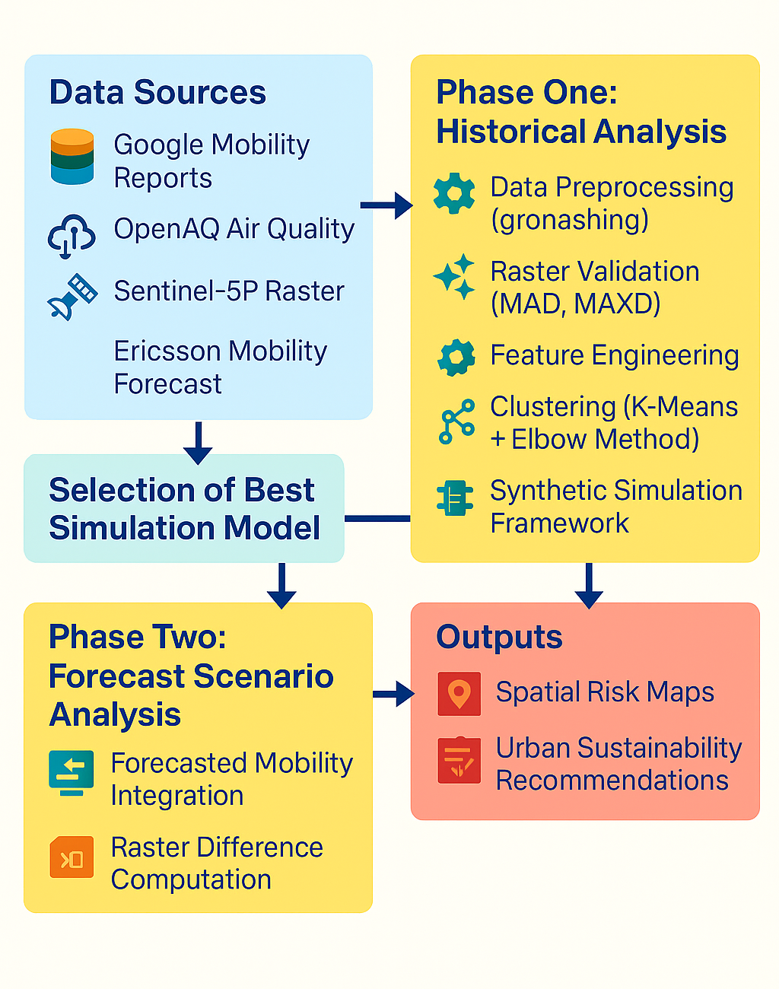
Methodology Overview

Slide 2
Data Processing: Standardized and geohashed datasets (mobility + pollution)
Raster Validation Processing: Standardized and geohashed datasets (m: MAD & MAXD to compare NO₂, SO₂, aerosol layers
Clustering: K-Means clustering with Elbow Method → hotspot zones
Regression: OLS modeling of NO₂ vs workplace mobility
Simulation Scenarios: • Proportional shifts (±10–30%) • Spatial perturbations • Population-weighted variations
Boosting techniques modeled non-linear urban dynamics
Phase 1 – Historical Analysis (2020–2022)

Slide 3
Forecast Data Integration: Ericsson mobility + projected Sentinel-5P rasters
Mapping: Forecast data joined to Phase 1 geohash zones
Change Quantification: • MAD, MAXD, and standard deviation (σ) across forecast years
Visual Analytics: • Time series, raster maps, σ-spread maps, cluster overlays
Risk Evaluation: • Combined mobility growth, pollution increase, and variability • Identified high-risk geohashes for future intervention
Phase 2 – Forecast Scenario (2023–2025)

Slide 4

Phase One Results

Slide 5
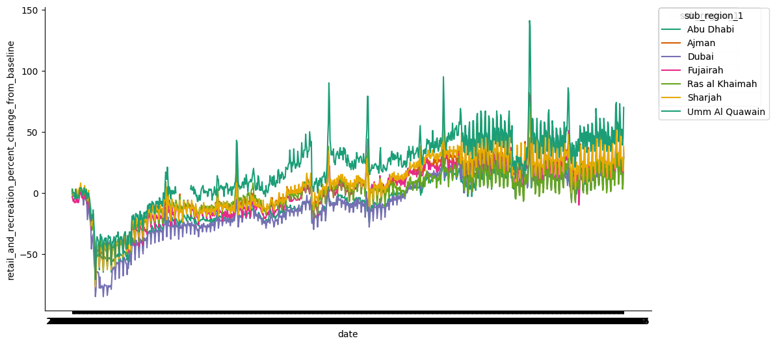
1. Urban Air Quality and Mobility Trends (2020–2022)
Data aggregated by 5-character geohash (~3 km² resolution).
Retail & recreation mobility dropped sharply in 2020 due to lockdowns.
Abu Dhabi and Dubai showed the strongest post-lockdown recovery.
Composite mobility score = average of workplace + transit data from Google.

Slide 6
1. Urban Air Quality and Mobility Trends (2020–2022)
Data aggregated by 5-character geohash (~3 km² resolution).
Retail & recreation mobility dropped sharply in 2020 due to lockdowns.
Abu Dhabi and Dubai showed the strongest post-lockdown recovery.
Composite mobility score = average of workplace + transit data from Google.
Table 1: Preview of the combined dataset showing pollution concentrations and mobility scores for selected UAE geohash zones (2020–2022).
Geohash | NO₂ (µg/m³) | PM₁₀ (µg/m³) | SO₂ (µg/m³) | Mobility Score (%)
thqf4 | 76.8 | 94.6 | 12.5 | 12.10
thqfb | 31.1 | 87.1 | 11.0 | -11.81
thr97 | 19.2 | 67.2 | 10.4 | -13.07

Slide 7
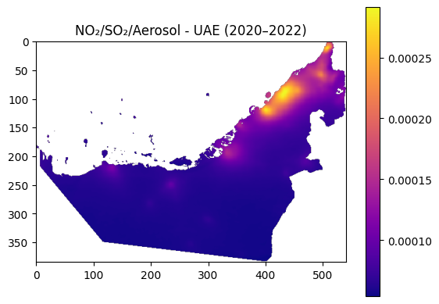
2. Pollution Patterns and Correlations
NO₂ and PM₁₀ highest in Abu Dhabi/Dubai (traffic + industrial).
SO₂ hotspots more scattered — likely from oil/gas and power plants.
WHO NO₂ limit = 40 µg/m³; 3 geohash zones exceeded this.
Correlation matrix highlights:
NO₂–PM₁₀: moderate positive (r = 0.52)
SO₂–Mobility: strong positive (r = 0.84)
PM₁₀–SO₂: weak/negative
Figure A: Geospatial distribution of NO₂, SO₂, and Aerosol concentrations in the UAE (2020–2022). Brighter colors indicate higher pollutant levels.

Slide 8
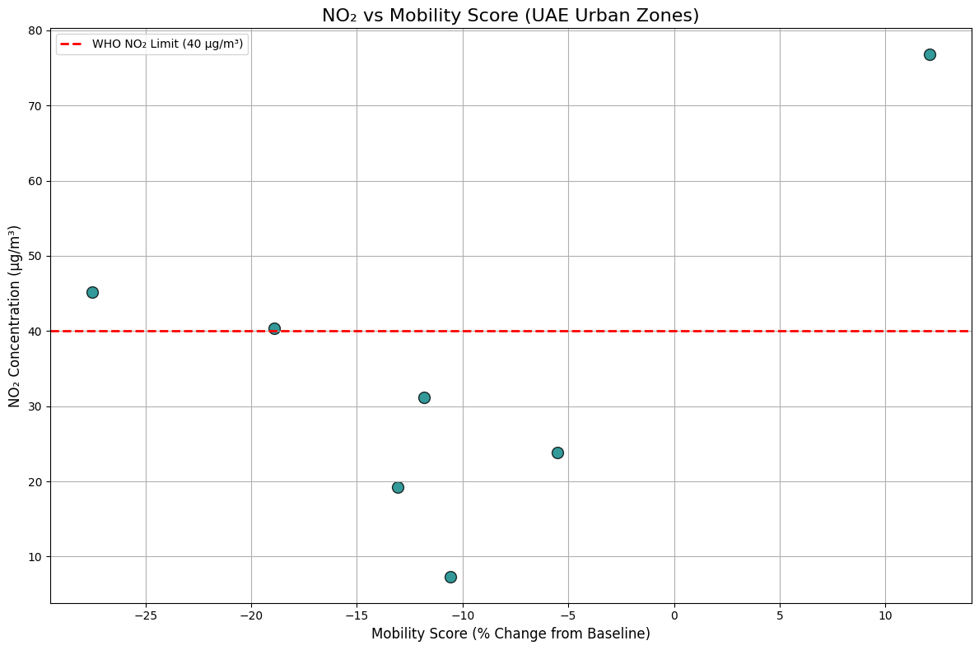
2. Pollution Patterns and Correlations
NO₂ and PM₁₀ highest in Abu Dhabi/Dubai (traffic + industrial).
SO₂ hotspots more scattered — likely from oil/gas and power plants.
WHO NO₂ limit = 40 µg/m³; 3 geohash zones exceeded this.
Correlation matrix highlights:
NO₂–PM₁₀: moderate positive (r = 0.52)
SO₂–Mobility: strong positive (r = 0.84)
PM₁₀–SO₂: weak/negative
Figure X: NO₂ concentrations plotted against mobility score across UAE urban zones. The red dashed line indicates the WHO recommended limit (40 µg/m³). Zone thqf4 appears as a significant outlier with high NO₂ despite positive mobility.

Slide 9
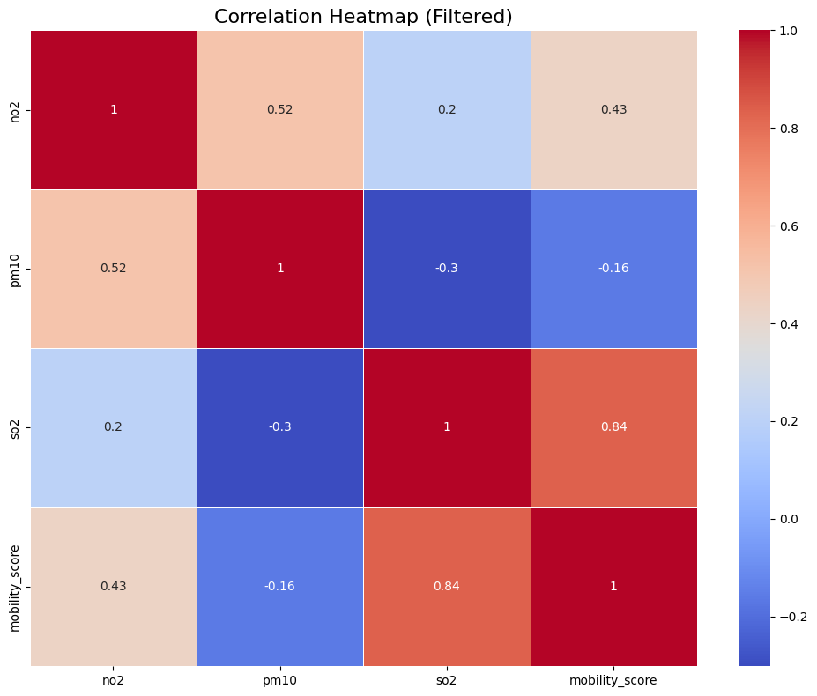
2. Pollution Patterns and Correlations
NO₂ and PM₁₀ highest in Abu Dhabi/Dubai (traffic + industrial).
SO₂ hotspots more scattered — likely from oil/gas and power plants.
WHO NO₂ limit = 40 µg/m³; 3 geohash zones exceeded this .
Correlation matrix highlights:
NO₂–PM₁₀: moderate positive (r = 0.52)
SO₂–Mobility: strong positive (r = 0.84)
PM₁₀–SO₂: weak/negative
Figure G: Correlation heatmap showing relationships among NO₂, PM₁₀, SO₂ concentrations and mobility scores in overlapping geohash zones. Stronger correlations are shown in darker red or blue depending on direction.

Slide 10
3. Beyond Mobility – Fixed Pollution Sources and Industrial Risks
SO₂ pollution doesn't follow mobility trends.
Hotspots in industrial areas: Abu Dhabi (Ruwais), Sharjah industrial belt.
Likely sources: refineries, ports, construction, and cement plants.
Proposals:
Stricter industrial SO₂ regulations
Satellite + ground monitoring (TROPOMI, Sentinel-5P)
Zoning policies to buffer emissions from residential zones
Mandatory audits for high-output industries

Slide 11
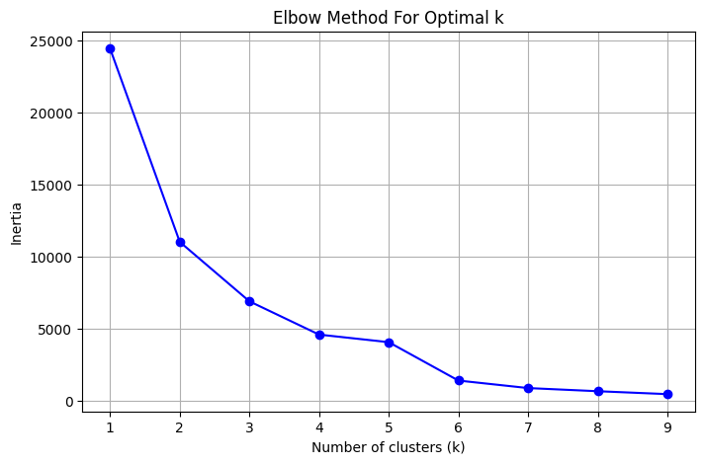
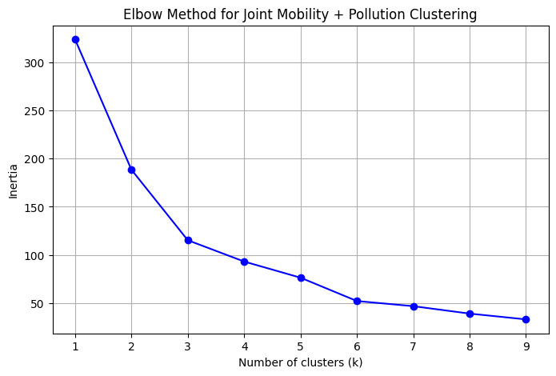
4. Mobility–Pollution Clustering & Zone Typologies
K-Means clustering (optimal k=3) based on mobility & pollution data.
Zones categorized into 4 types:
Type A: High Mobility – Low Pollution
Type B: Low Mobility – High Pollution
Type C: High Mobility – High Pollution
Type D: Low Mobility – Low Pollution
Figure C: Elbow Method for Optimal k using mobility scores.
Figure W: Elbow Method for Joint Mobility + Pollution Clustering.

Slide 12
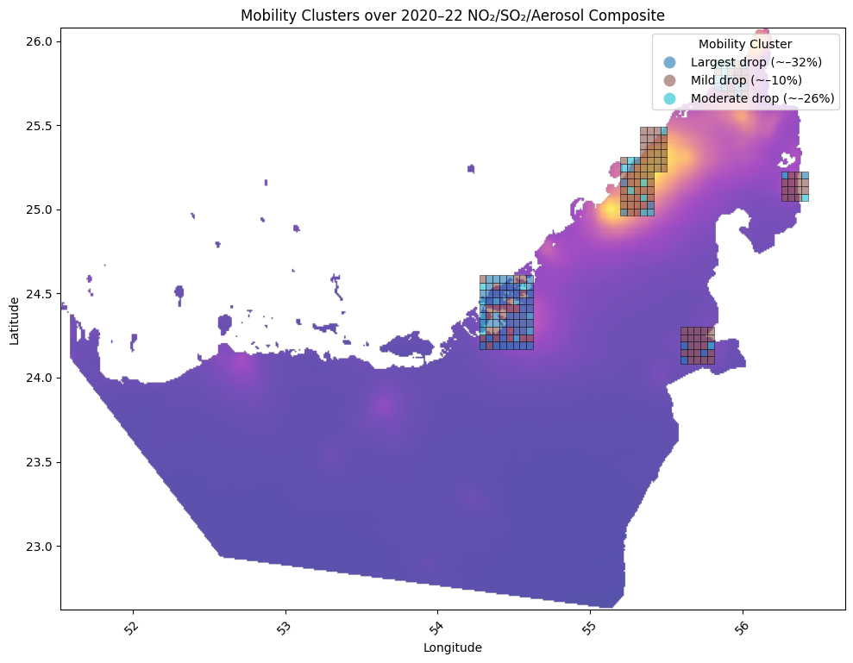
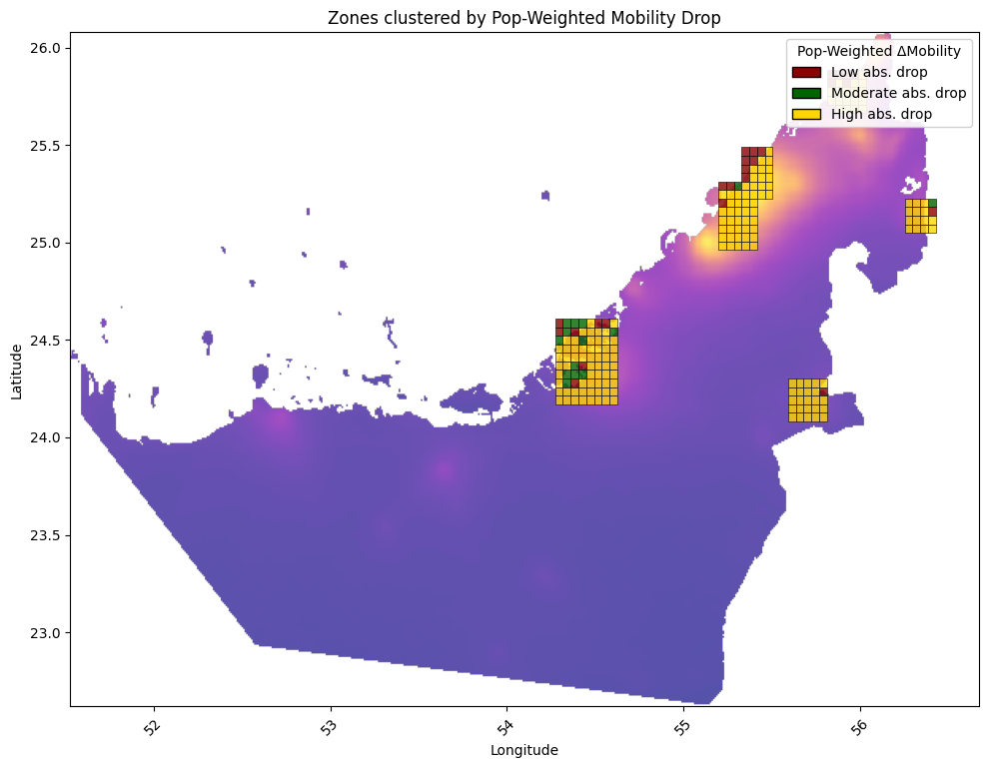
4. Mobility–Pollution Clustering & Zone Typologies
K-Means clustering (optimal k=3) based on mobility & pollution data.
Zones categorized into 4 types:
Type A: High Mobility – Low Pollution
Type B: Low Mobility – High Pollution
Type C: High Mobility – High Pollution
Type D: Low Mobility – Low Pollution
Figure Y: Spatial distribution of mobility clusters (k = 3) overlaid on NO₂/SO₂/Aerosol Composite (2020–2022). Zones are color-coded by mobility cluster label.
Figure R: Spatial clustering of geohash zones by population-weighted absolute mobility drop. Darker zones reflect higher impact reductions.

Slide 13
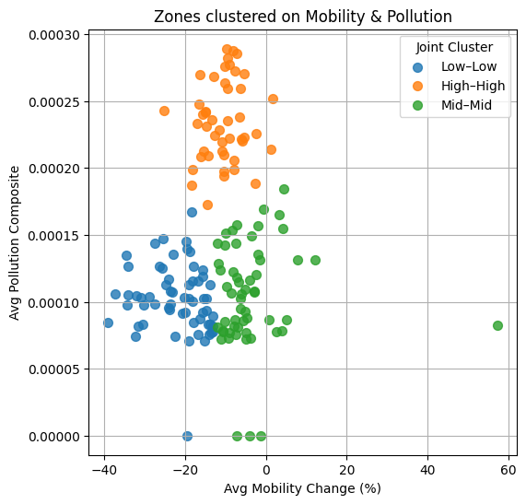
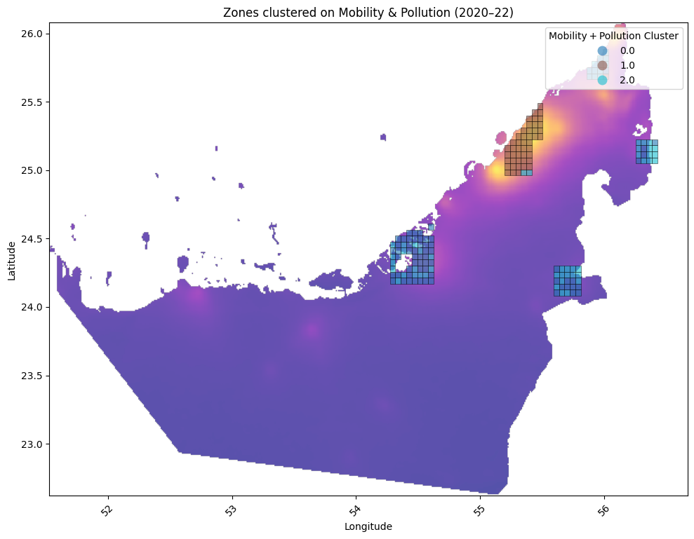
4. Mobility–Pollution Clustering & Zone Typologies
K-Means clustering (optimal k=3) based on mobility & pollution data.
Zones categorized into 4 types:
Type A: High Mobility – Low Pollution
Type B: Low Mobility – High Pollution
Type C: High Mobility – High Pollution
Type D: Low Mobility – Low Pollution
Figure U: Geographic distribution of joint mobility–pollution clusters (2020–2022) overlaid on composite pollution raster.
Figure T: Scatterplot of zones clustered by both mobility change and average pollution composite.

Slide 14
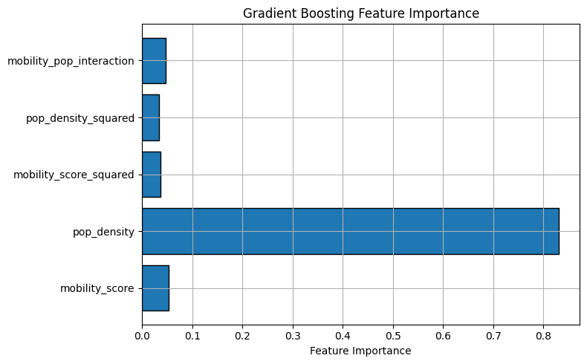
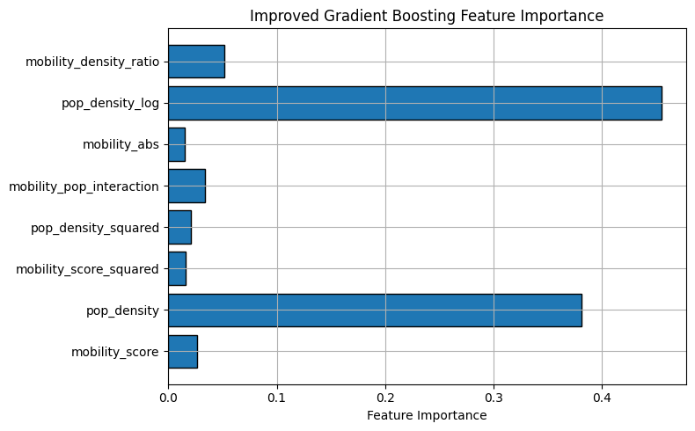
5. Predictive Modeling of NO₂ Concentrations
Linear Regression vs. Random Forest models (2020–2022)
Random Forest R² > 0.7; Linear model underperforms in nonlinear zones.
Population density is the strongest predictor (Figure P).
Improved model adds engineered features (mobility/density ratio) for better balance (Figure O).
Figure P: Feature importance from the initial Gradient Boosting model.
Figure O: Feature importance from the improved Gradient Boosting model.

Slide 15
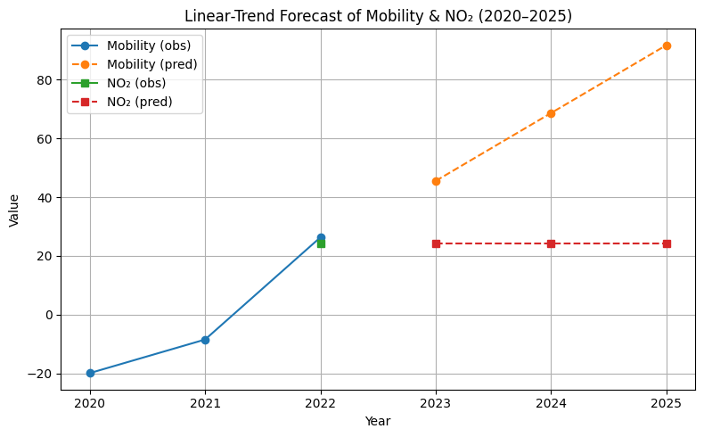

6. Forecasting & Policy Recommendations (2023–2025)
Mobility expected to rise through 2025 (Figure Z), NO₂ levels remain flat without action.
Forecasted pollution hotspots persist in coastal urban centers (Figure B).
Type C zones (high mobility, high pollution): → Need electric public transport, congestion control.
Type B zones (low mobility, high pollution): → Require strict industrial regulation, zoning reform.
Promote green corridors, satellite + ground monitoring, and digital twin simulations.
Shift from reactive to proactive urban air quality management using data-driven tools.
Figure Z: Linear-trend forecast of average UAE mobility and NO₂ levels from 2020 to 2025.
Figure B: Projected NO₂, SO₂, and aerosol index distribution in the UAE (2023–2025).

Slide 16
ADD RESULTS OF PHASE 2

Slide 17
Conclusion:
Combined satellite, sensor, and mobility data using geohashing.
Found clear link between traffic and NO₂, with exceptions in industrial zones.
Population density emerged as the strongest predictor of pollution.
Gradient Boosting models outperformed linear models in detecting patterns.
Framework supports both historical analysis and future scenario planning.

Slide 18
Add weather, topography, and wind data for better accuracy.
Track more pollutants: PM2.5, CO, O₃.
Use time-based models (LSTM, TCNs) for better forecasting
Map emissions with zoning data for policy checks
Build real-time dashboards for monitoring
Simulate green policy impacts: EV adoption, traffic controls.
Expand analysis to GCC countries for regional insights.
Future work:

