Slide 1
title
Michael Friendly
Psych 6135
http://friendly.github.io/6135

Slide 2
Visualizing distributions
The basics:
Histograms
Density plots
Boxplots
Doing better:
rainclouds
…

Slide 3
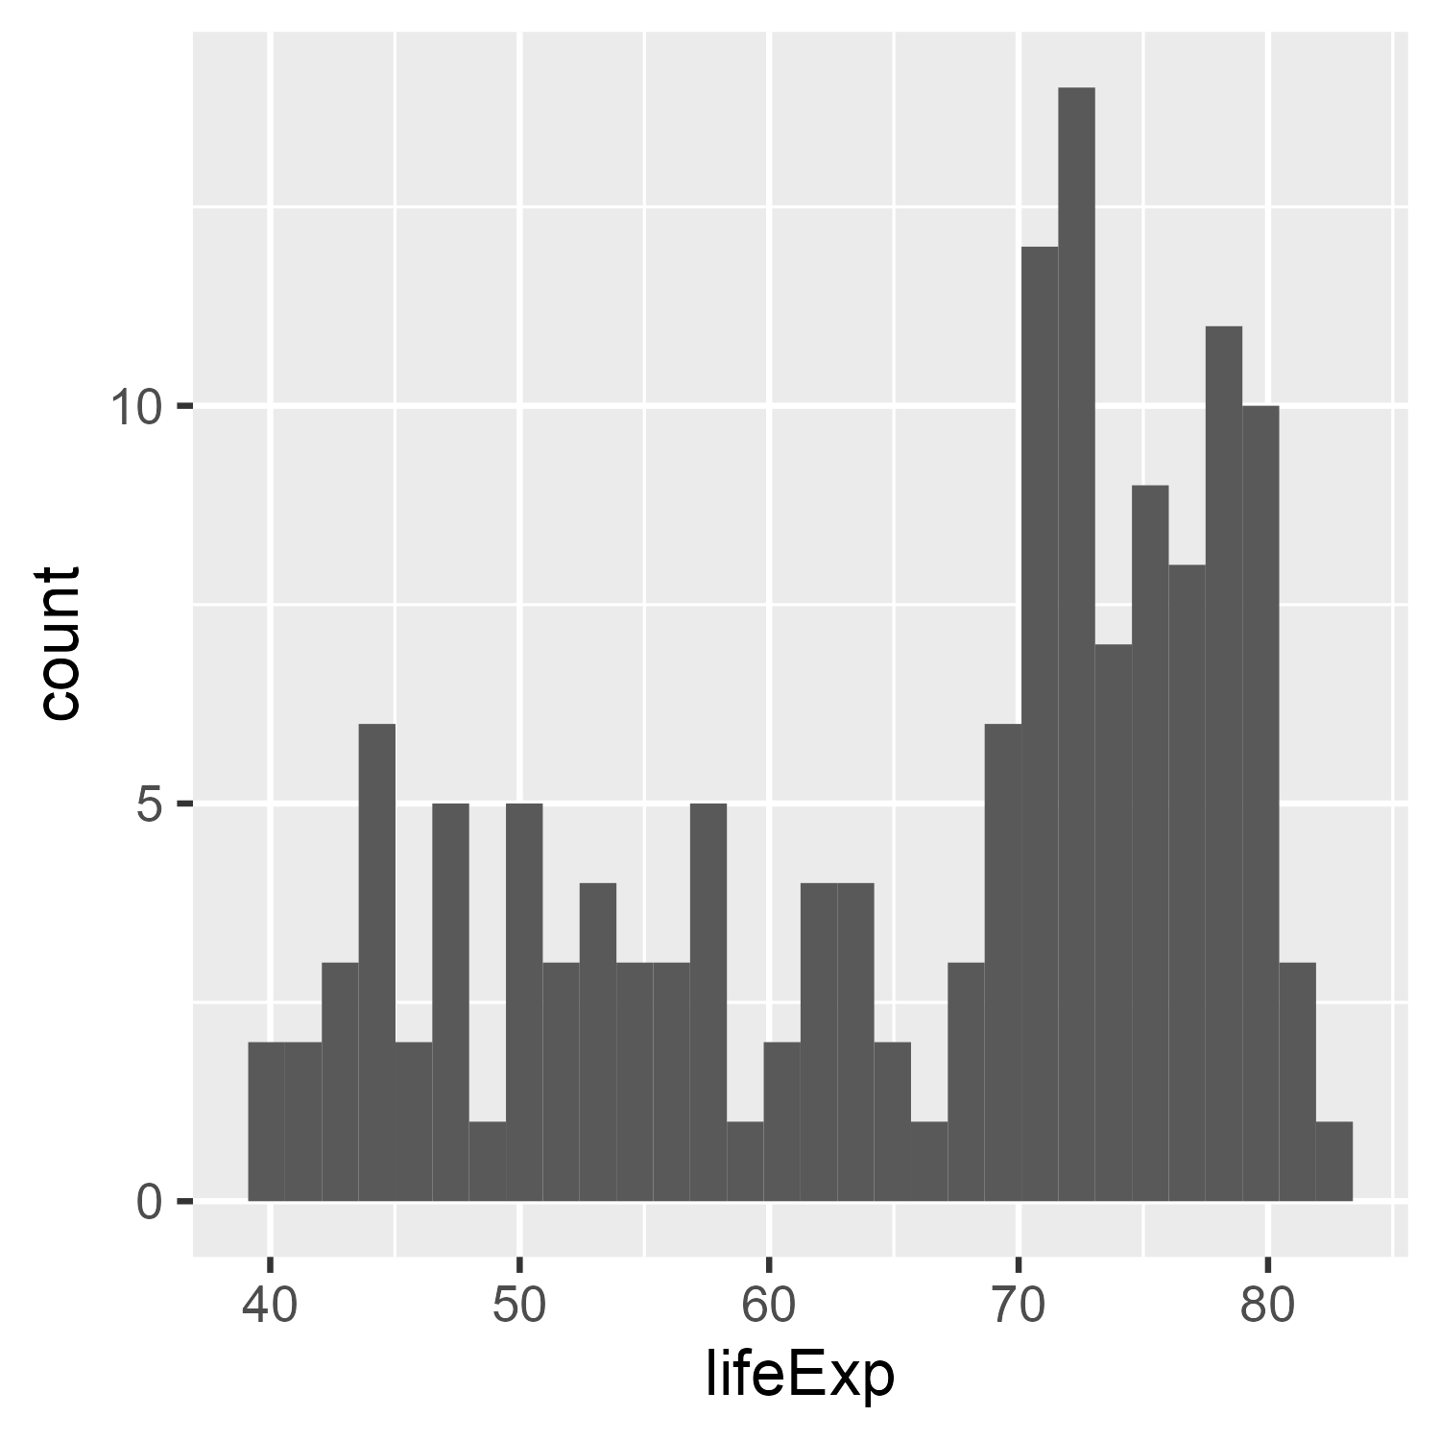
Histograms
Perhaps the simplest display
divide the data into bins
bar plot of the frequencies: length ~ frequency
library(gapminder)
gapminder_2002 <- gapminder %>%
filter(year == 2002)
ggplot(gapminder_2002,
aes(x = lifeExp)) +
geom_histogram()
`stat_bin()` using `bins = 30`. Pick better value with `binwidth`.

Slide 4
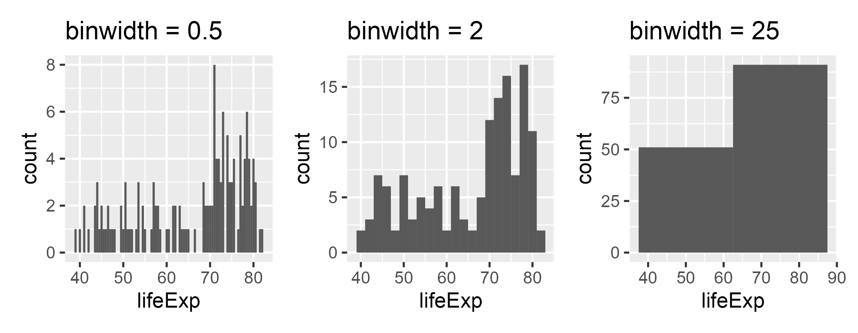
Histograms: bin width
Explicitly selecting the binwidth shows:
the Goldilocks principle
the default is often OK, but optimal “best” is harder to define
ggplot(gapminder_2002, aes(x = lifeExp)) + geom_histogram(binwidth = )
too small
about right
too large

Slide 5
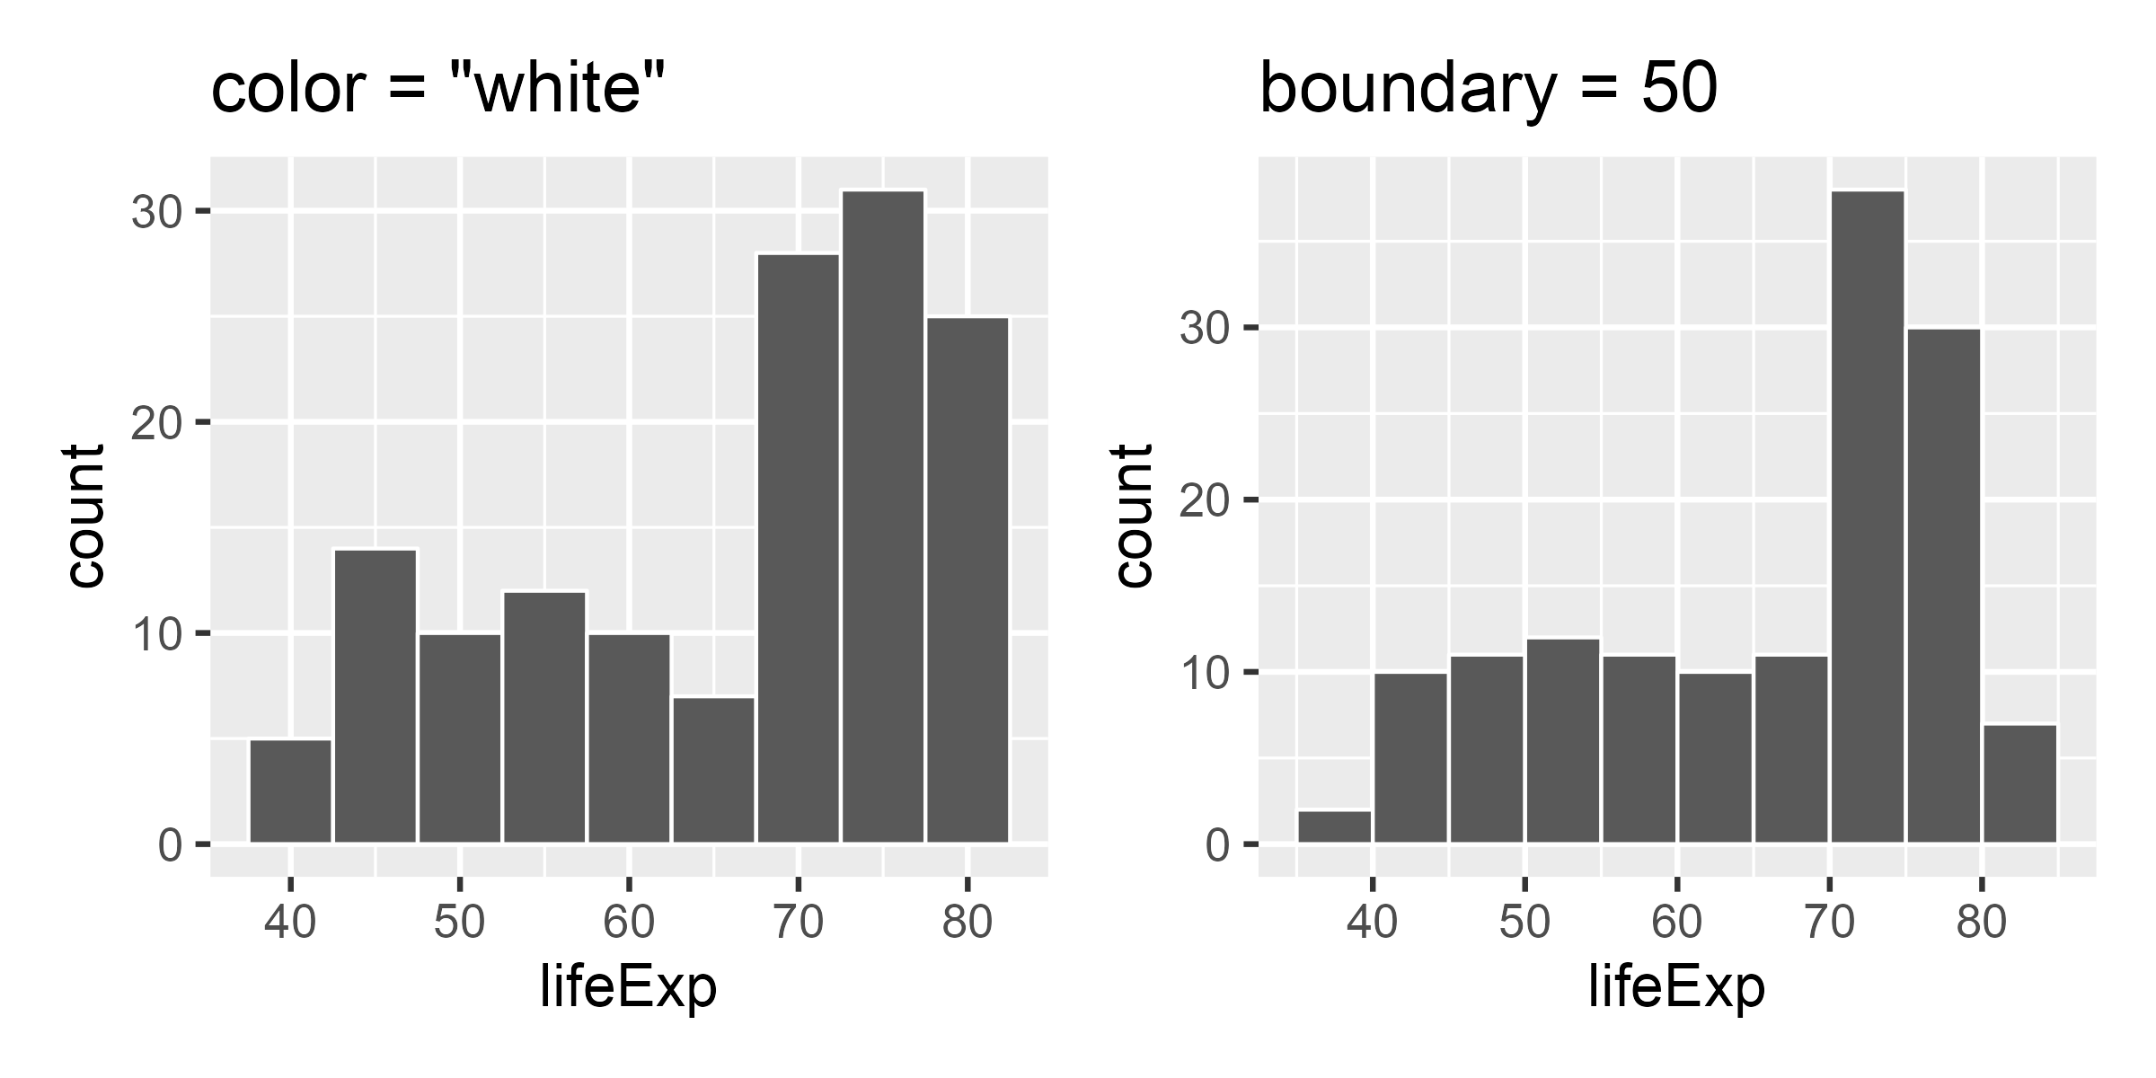
Histograms: other properties
Pay attention to graphic details
border color to make bars distinct
set bar boundaries to edges
geom_histogram(…, color = “white”)
geom_histogram(…, boundary=50)

Slide 6
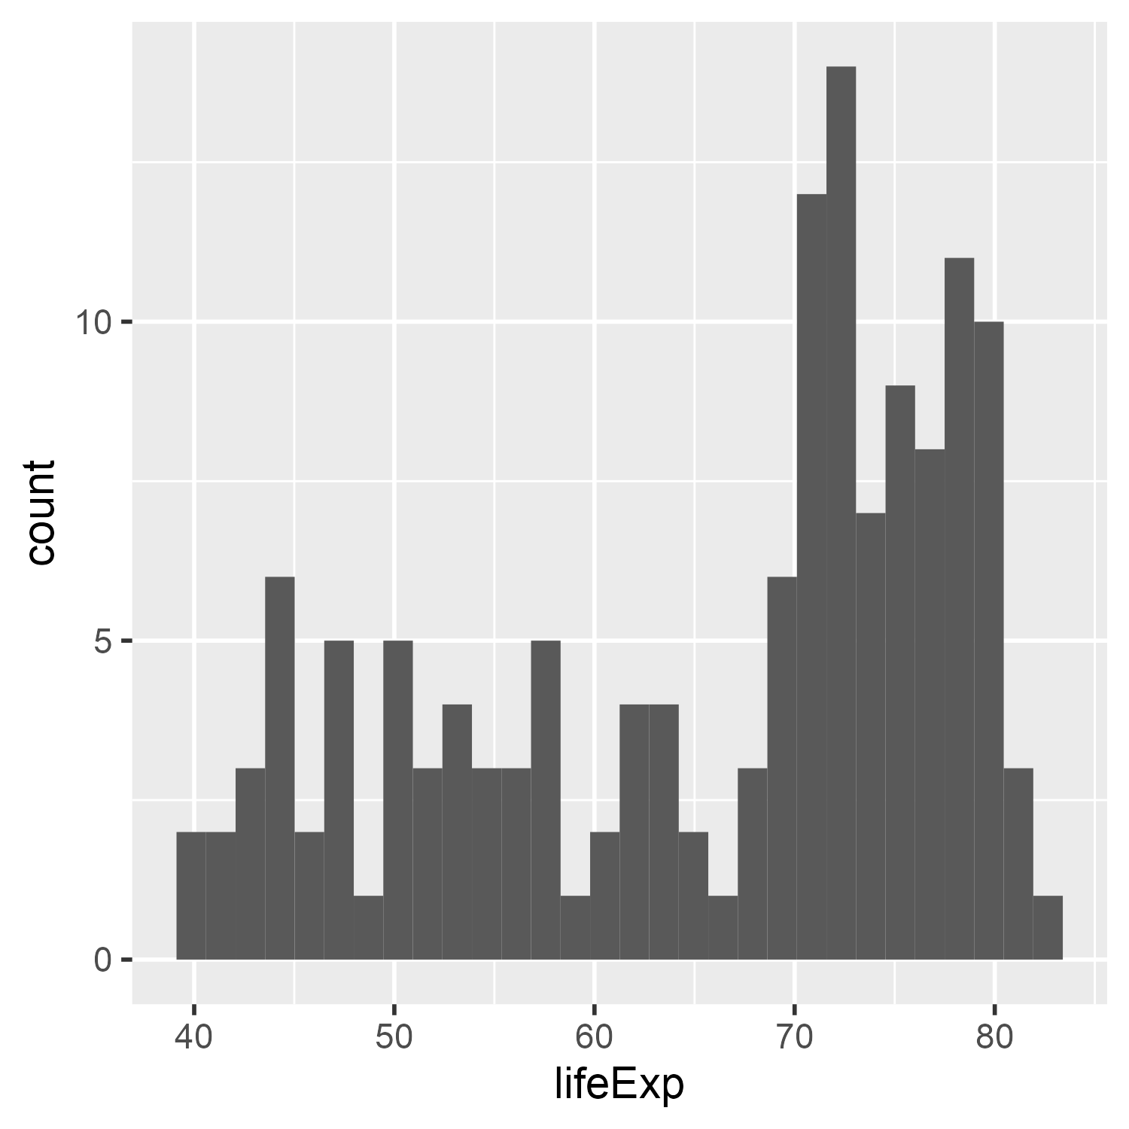
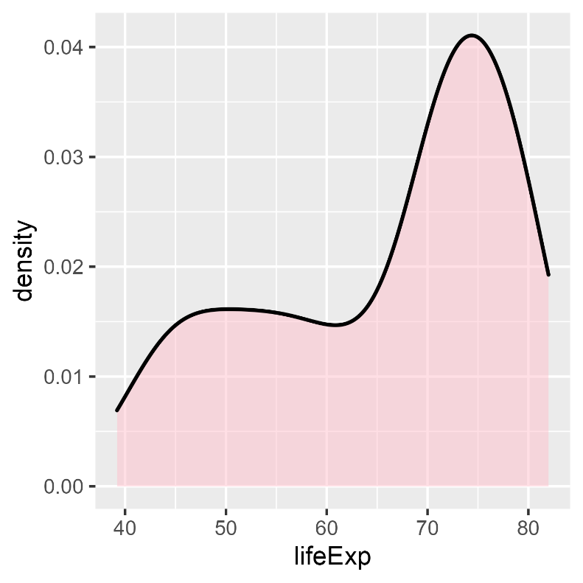
Density plots
Basic idea: Smooth the distribution to avoid artifacts of discrete bins and bin centers
Uses a “kernel”, e.g, gaussian, averaged over a moving window

Slide 7
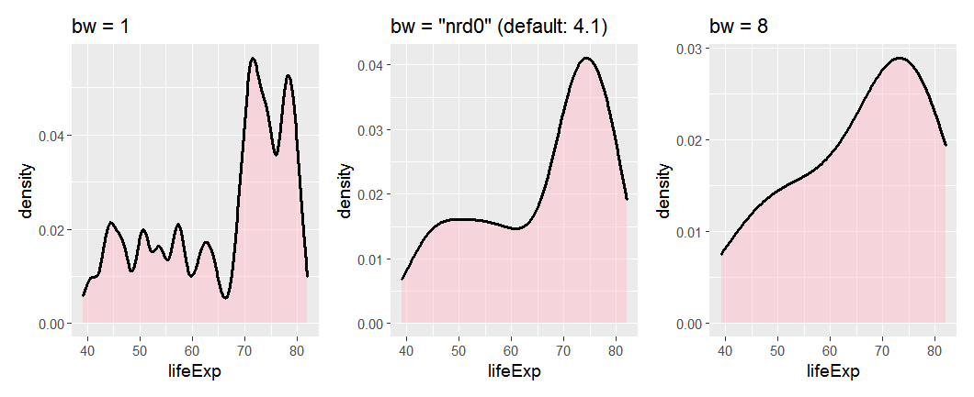
Density plots: bandwidth
The result depends on the width of the moving window – bandwidth
The default calculation is usually reasonable, but beware of weird data

Slide 8
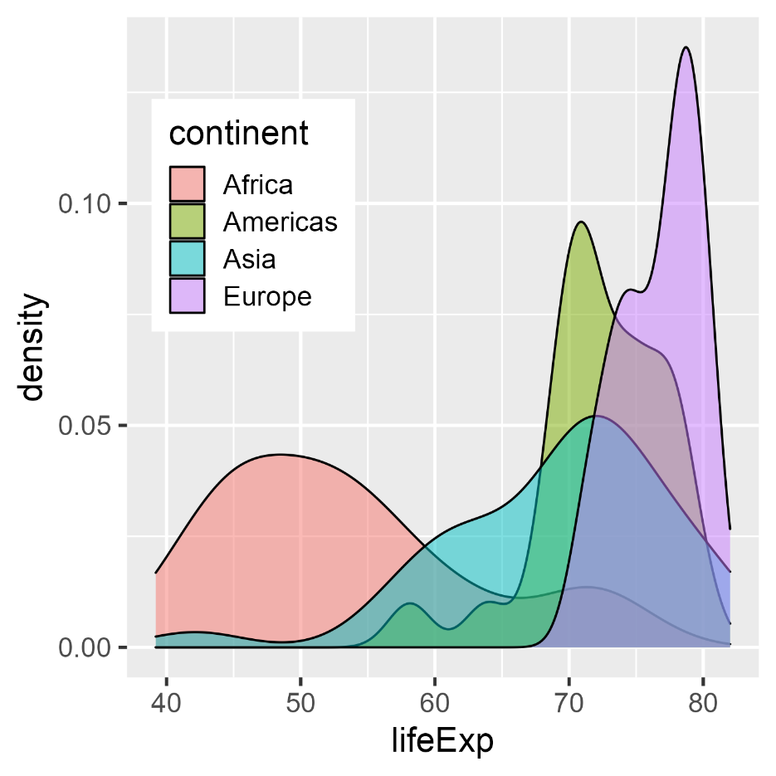
Comparing groups
For multiple groups, using the fill aesthetic is a decent start
gap_2002c <-
gapminder_2002 %>%
filter(continent != "Oceania")
ggplot(gap_2002c,
aes(x = lifeExp,
fill = continent)) +
geom_density(alpha = 0.5) +
theme(legend.position = c(.2, .7))
NB: ggplot picks a joint bandwidth, here: 2.52

Slide 9
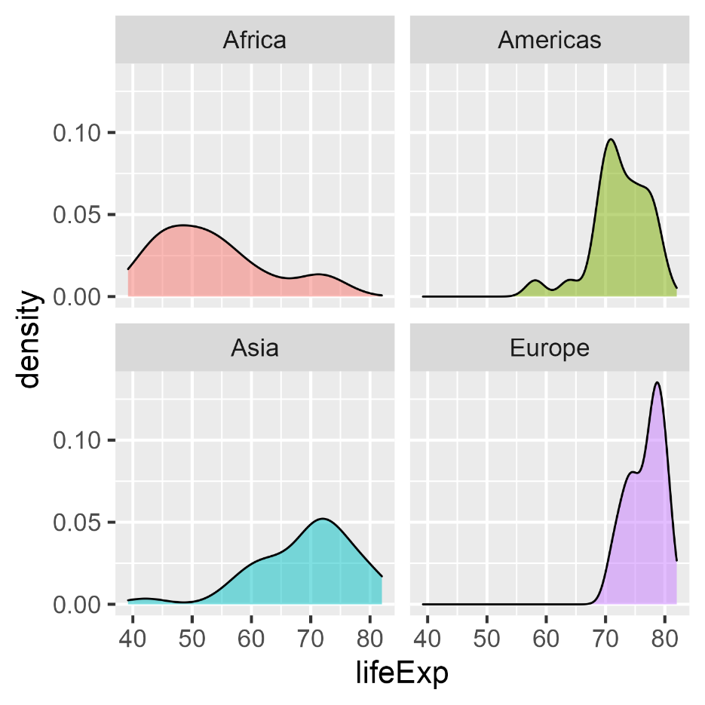
Comparing groups: Facets
ggplot(gap_2002c,
aes(x = lifeExp,
fill = continent)) +
geom_density(alpha = 0.5) +
facet_wrap(~ continent) +
theme(legend.position = "none")

Slide 10
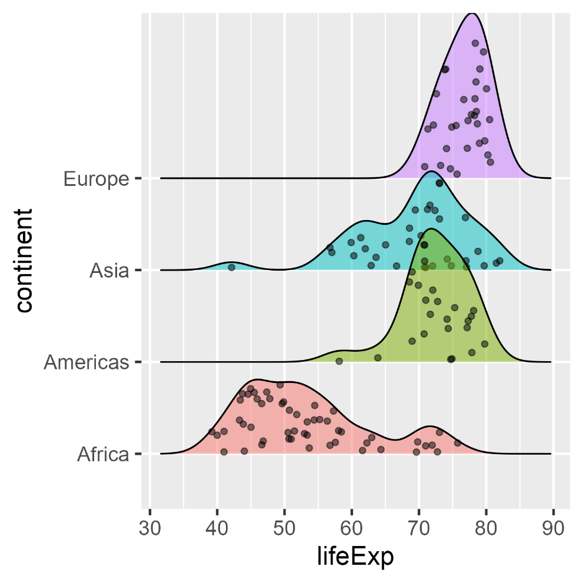
{ggridges}: Ridgeline plots
Ridgeline plots are partially overlapping density plots, suggesting a mountain range.
Useful for comparing distributions over time or circumstances
Adding jittered points helps to show where the data are
library(ggridges)
ggplot(gap_2002c,
aes(x=lifeExp,
y=continent,
fill=continent)) +
geom_density_ridges(
alpha = 0.5,
jittered_points=TRUE) +
theme(legend.position = "none")

Slide 11
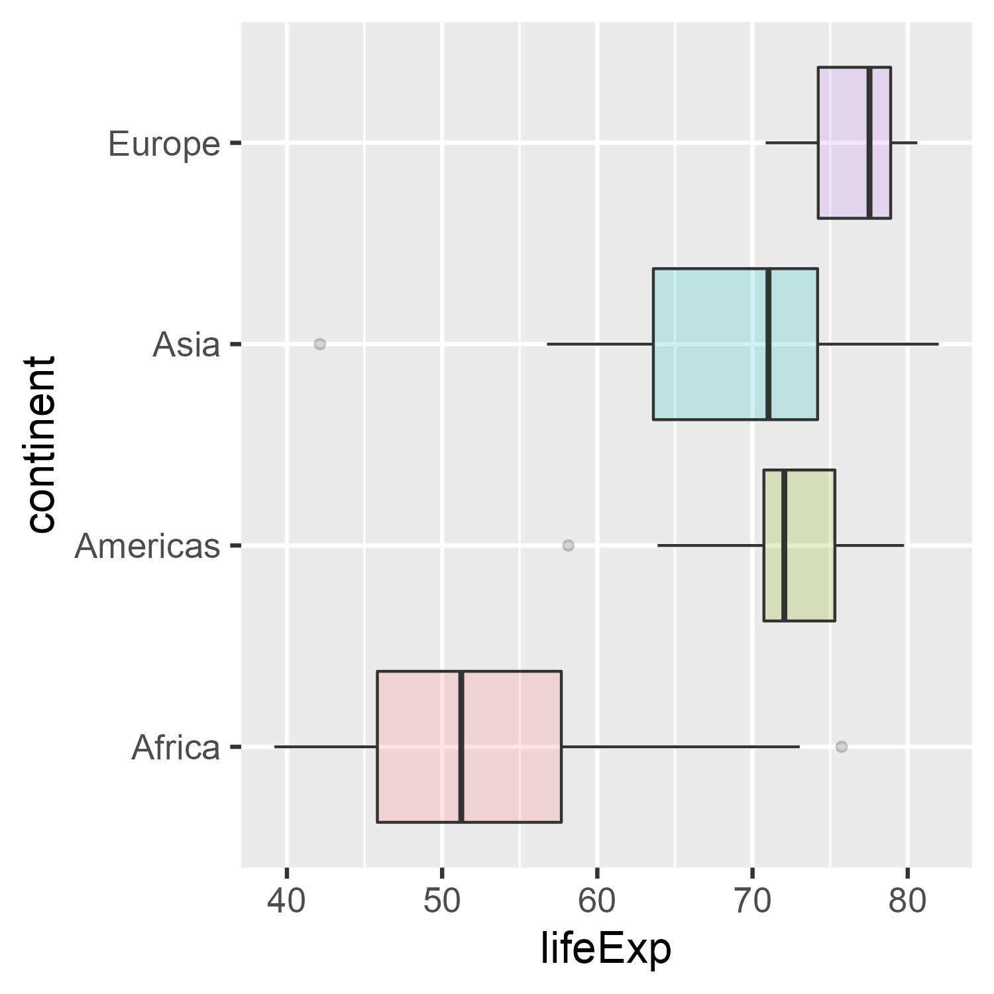
Boxplots
Boxplots a more schematic summary of a dataset– median, quartiles, whiskers & outliers
ggplot(gap_2002c,
aes(x=lifeExp,
y=continent,
fill=continent)) +
geom_boxplot(alpha = 0.2) +
theme(legend.position = "none")

Slide 12
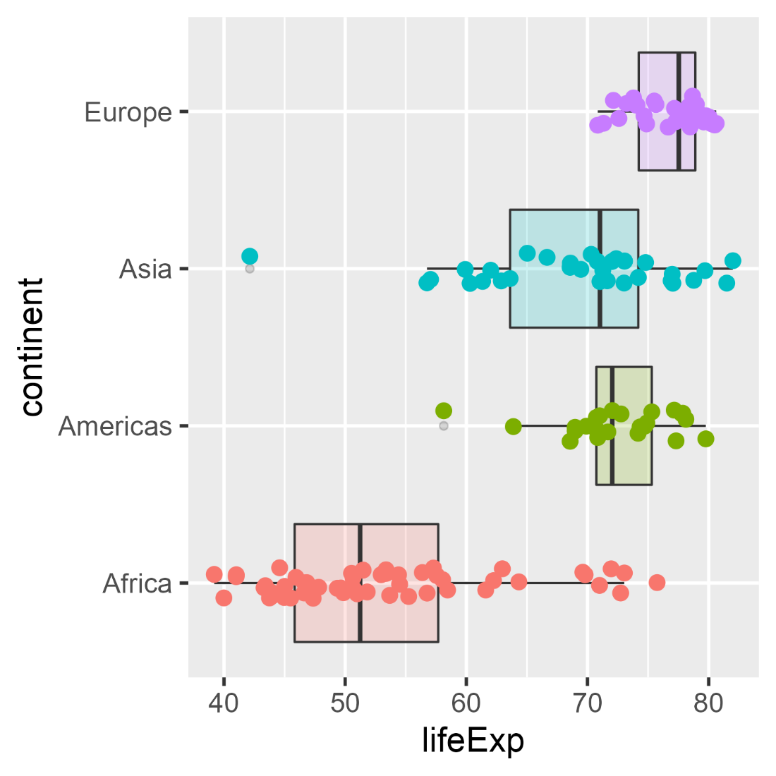
Boxplots
But perhaps too schematic– it sometimes helps to see the data as jittered points
ggplot(gap_2002c,
aes(x=lifeExp,
y=continent,
fill=continent)) +
geom_boxplot(alpha = 0.2) +
geom_point(aes(color = continent),
position =
position_jitter(height=0.1)) +
theme(legend.position = "none")

Slide 13
Boxplots

