Slide 1

Illusions
Jala Rizeq
Data Visualization
January 31st, 2019

Slide 2
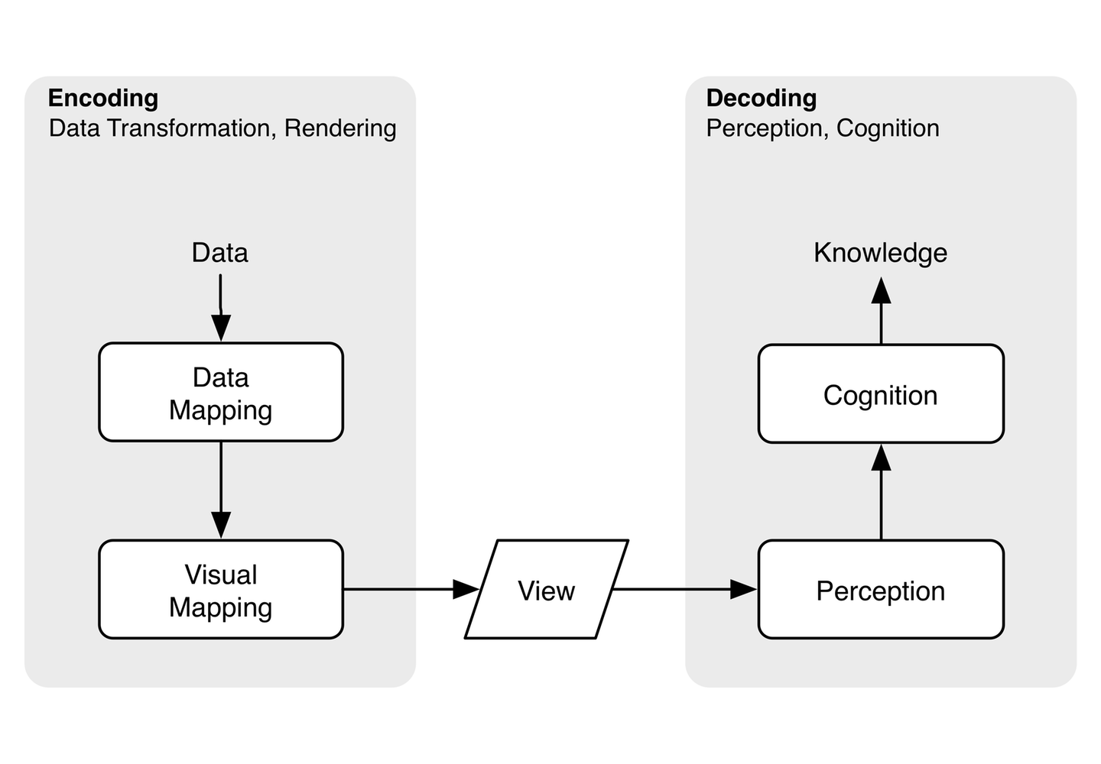
Graphical perception – extracting information from graphs
Graphical cognition – visual processing requiring that we consciously inspect things and be able to make statements such as the smallest person is the second from the top
Notes:
Best to have decoding happen at a perceptual level

Slide 3
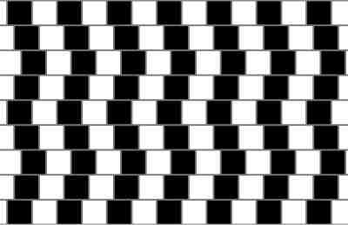
The famous Café Wall Illusion named by psychologist Richard Gregory in 1970s
The parallel horizontal lines appear to be bent.
Notice that each brick is surrounded by the grey line, so a colour in between the dark and light colour of the bricks.
The distortion is highly dependent on the luminance contrast of the tiles: it increases with increased luminance contrast.
Notes:
It's a classic optical illusion that dates back to the late 1800s.

Slide 4
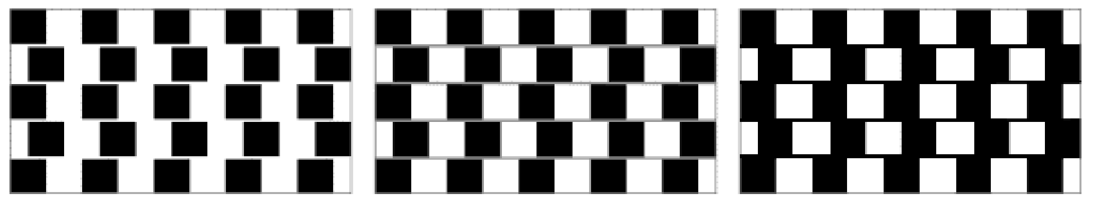
The Café Wall display, showing the basic effect of change of luminance of the mortar lines. The illusion is only present when the mortar luminance lies between, or at least is not far outside, the luminances of the dark and light tiles. The mortar width was controlled with spacers (Figure 3 taken from Gregory and Heard 1979).

Slide 5
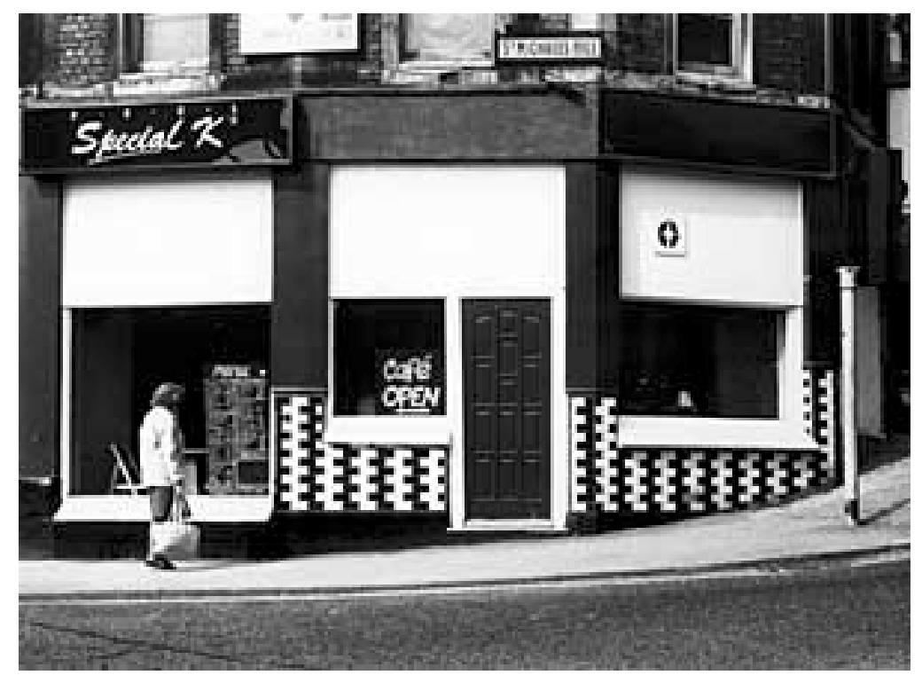
The original of the Café Wall, St Michael’s Hill, Bristol.

Slide 6
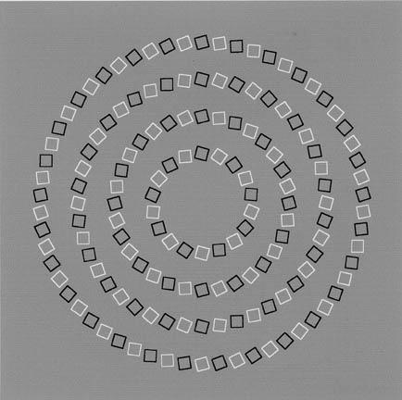
There is no spiral in the photo - squares that our eyes incorrectly understand as spiral.
Notes:
There is no spiral on the following picture. It's just nicely put squares that our eyes incorrectly understand as spiral. Look closer.

Slide 7
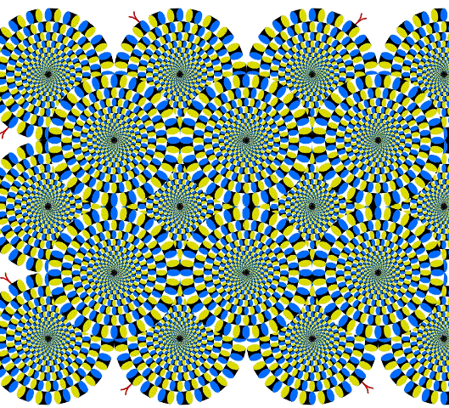
An example of a peripheral drift illusion – perceive still images as moving ones.
The image was inspired by the famous illusion "Rotating Snakes," created by Japanese psychologist and professor Akiyoshi Kitaoka in 2003.
Notes:
Interestingly enough, when you stare at one part of the photo without moving or blinking your eyes, that part stops "swirling" (while the circles in your peripheral vision continue to "move").

Slide 8
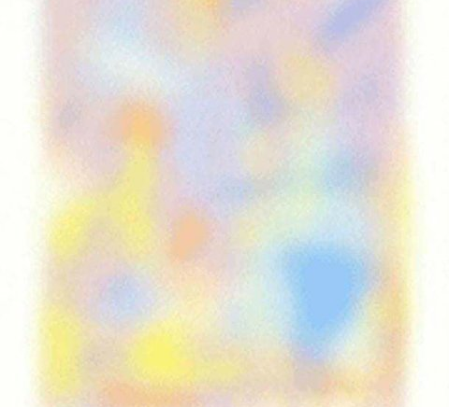
An example of the Troxler’s fading circle illusion.
Discovered in 1804 by Ignaz Troxler, a Swiss physician and philosopher.
If you focus on this image for about 30 seconds, it'll disappear completely.
Notes:
variation of a famous optical illusion called Troxler's fading circle. Discovered in 1804 by Ignaz Troxler, a Swiss physician and philosopher,
your sensory neurons tend to filter out information that is constant — stimuli that your brain has deemed non-essential and non-threatening. As Live Science's Brandon Specktor explained, this ability to adapt quickly to stimuli allows your brain to focus on things that are actually important.
When you force your eyes to focus on one point, the way you do with Troxler-style illusions, your brain receives no new information to process. At this point, stimuli in your peripheral vision take on the nature of their surrounding environment — in this case, a white background — as your brain "fills in" information it has deemed unimportant to process.

Slide 9
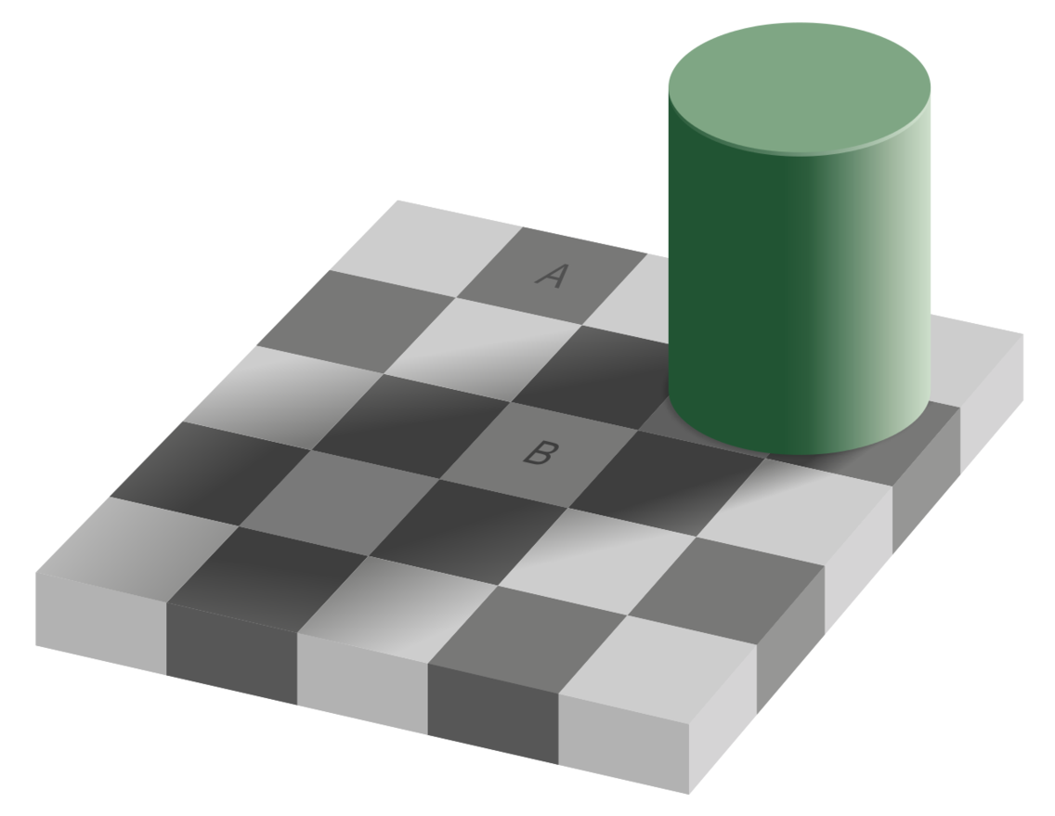
Checker shadow illusion- the effect has to do with the way our brains interpret color and shadow.

Slide 10
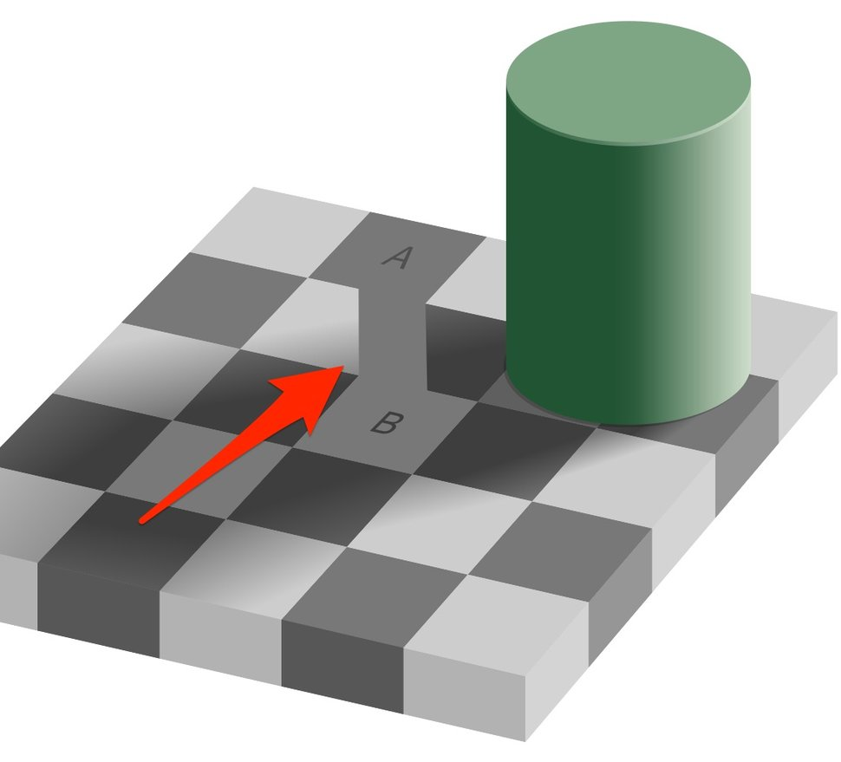
Your brain is always comparing things - Square A is surrounded by lighter squares, making it appear darker, while Square B is surrounded by darker squares, making it look lighter.
The shadow also messes with your perception and amplifies the effect.

Slide 11

Popular example in advertising
Notes:
arrow between the “E” and “X” in FedEx’s logo.

Slide 12
Sources
http://brainden.com/line-illusions.htm#prettyPhoto[pp_gal]/0/
https://visme.co/blog/best-optical-illusions/
https://www.scientificpsychic.com/graphics/index.html
https://www.thisisinsider.com/best-optical-illusions-photos-2017-10#this-photo-of-kendall-jenner-kylie-jenner-and-hailey-baldwin-went-viral-earlier-this-year-but-not-for-the-reason-you-might-think-36
http://www.richardgregory.org/papers/cafe_wall/cafe-wall.pdf
https://journals.sagepub.com/doi/pdf/10.1068/p250503

