Slide 1
title
Michael Friendly
Psych 6135
http://euclid.psych.yorku.ca/www/psy6135/

Slide 2
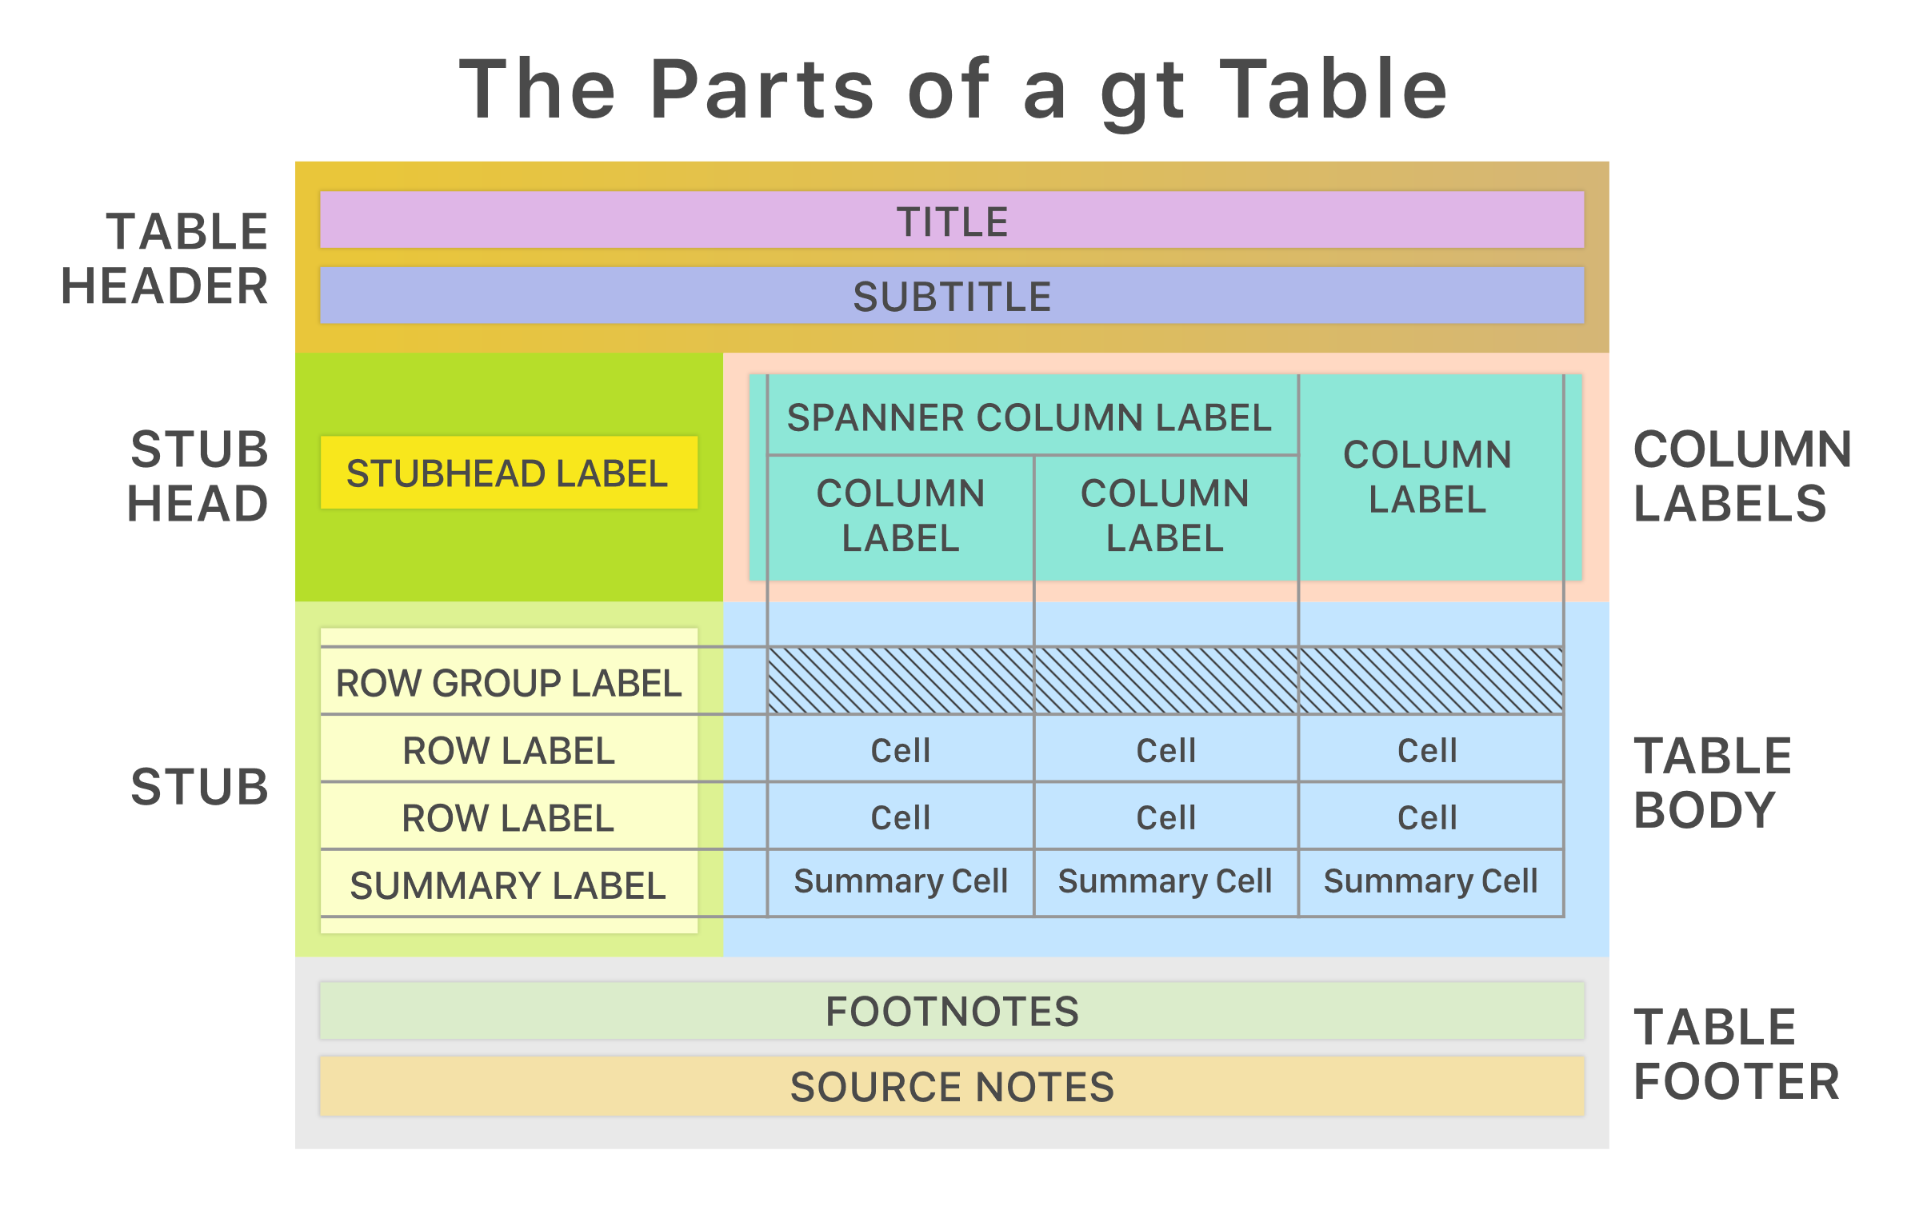
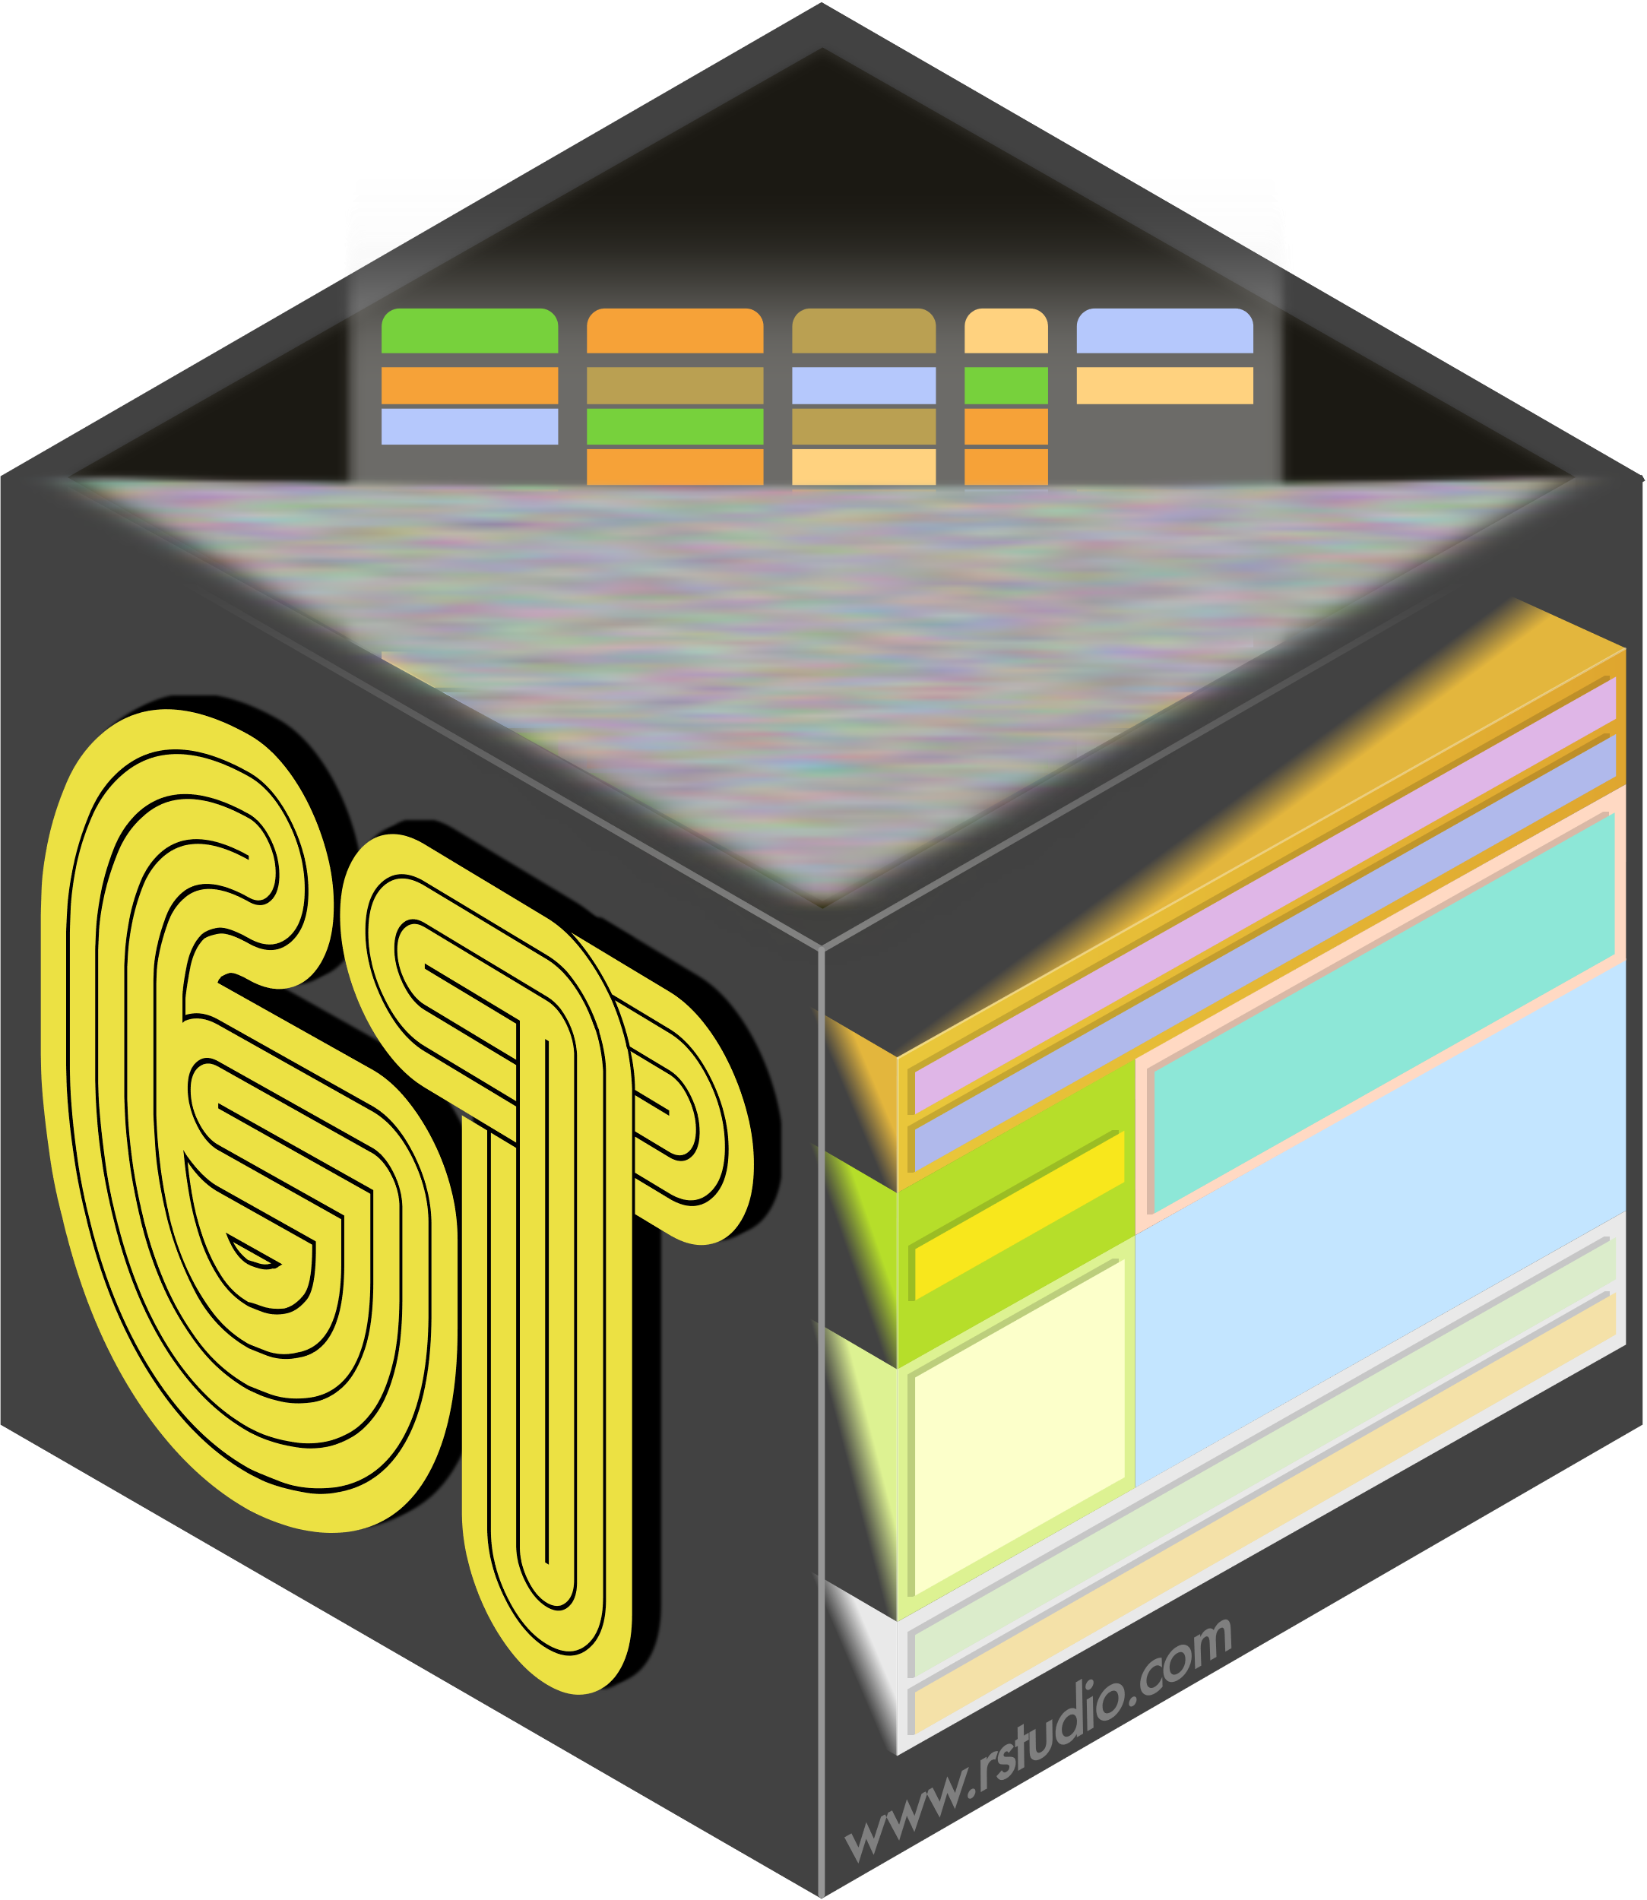
Tables with {gt}
The {gt} package aims to provide a grammar of tables just as ggplot2 does for graphs
Designed to be simple to use, yet powerful
iris %>% gt()

Slide 3
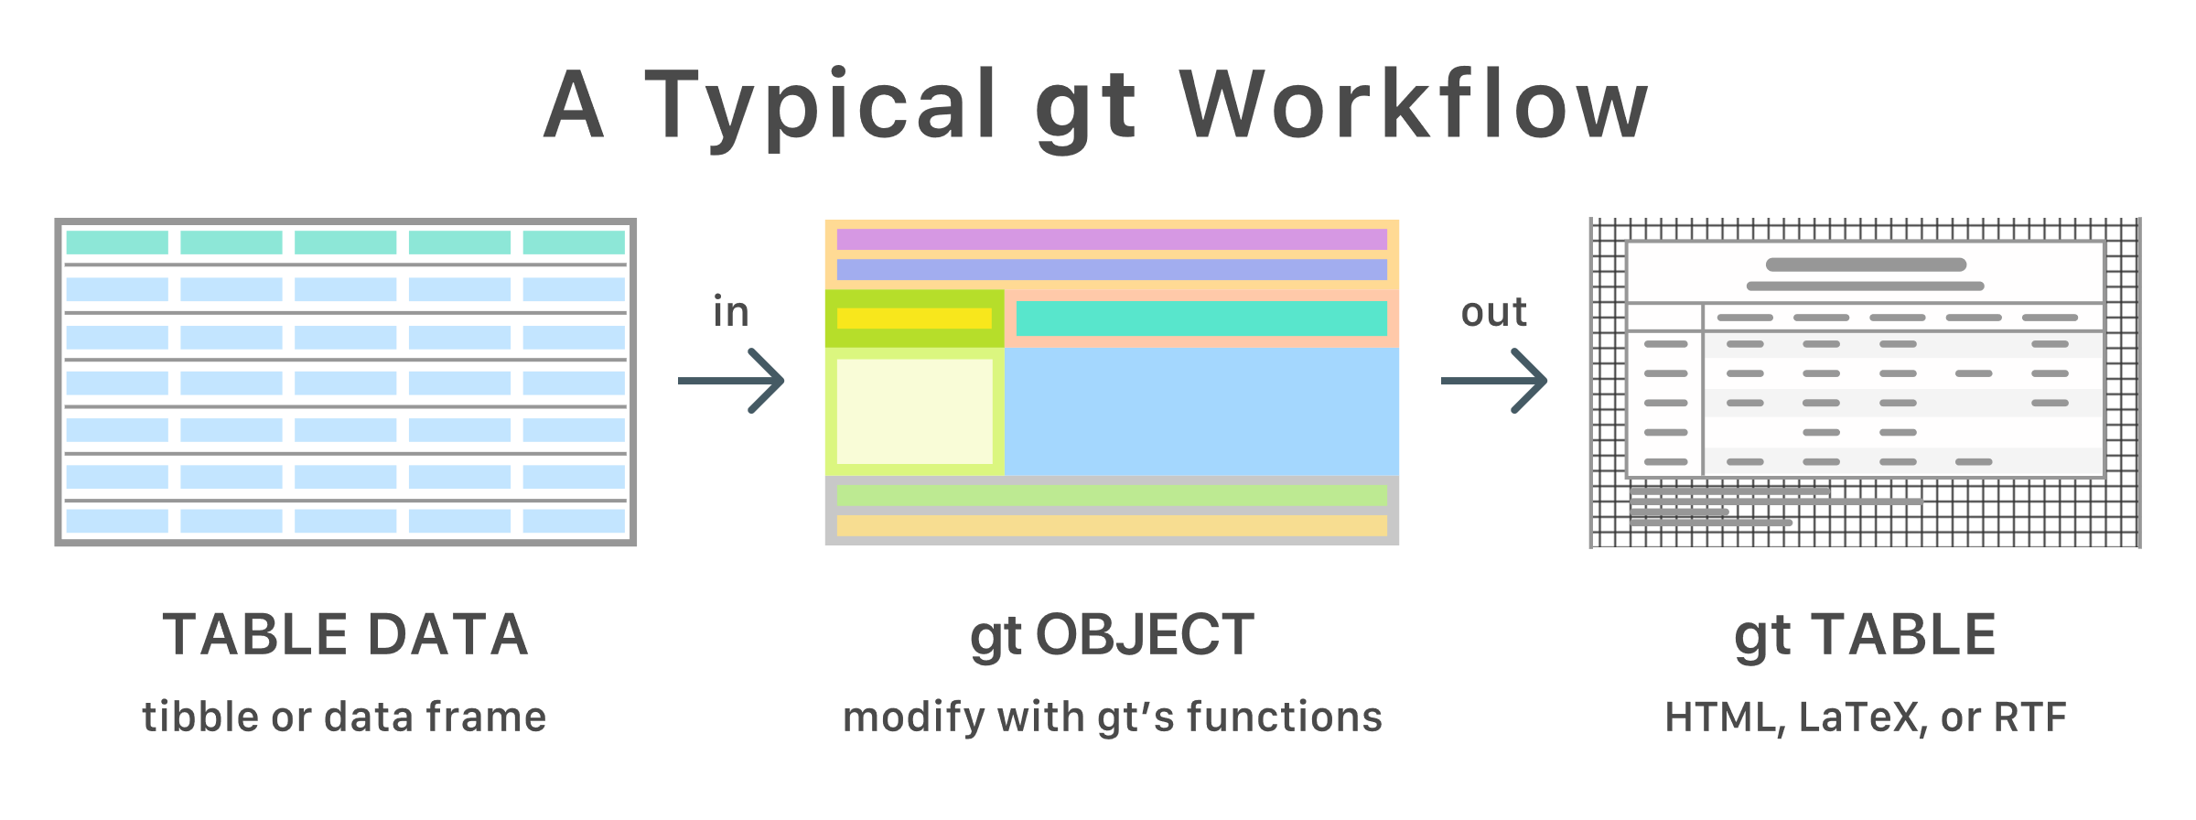
{gt} workflow
Data table -> gt_tbl object
iris %>% gt() %>%
tab_header(…) %>%
tab_options(…) %>% gtsave()

Slide 4
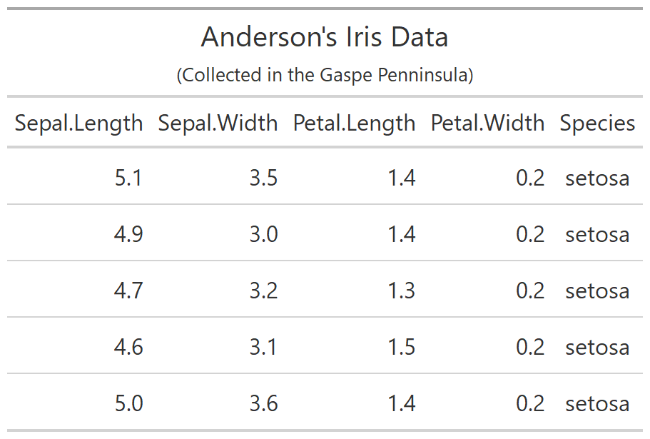
iris_tab <-
iris %>%
slice(1:5) %>%
gt() %>%
tab_header(
title = "Anderson's Iris Data",
subtitle = "(Collected in …)")

Slide 5
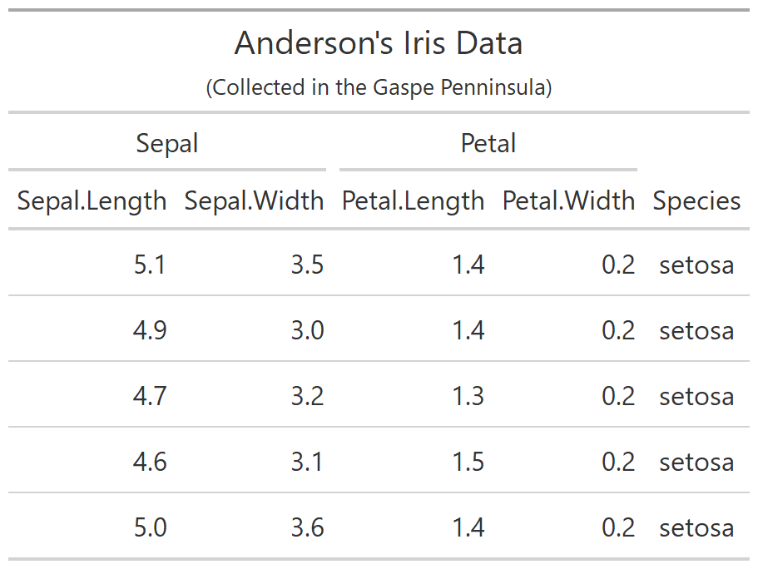
iris_tab <-
iris %>%
slice(1:5) %>%
gt() %>%
tab_header(
title = "Anderson's Iris Data",
subtitle = "(Collected in …)")
iris_tab <-
iris_tab %>%
tab_spanner(
label = "Sepal",
columns = c(Sepal.Length,
Sepal.Width)) %>%
tab_spanner(
label = "Petal",
columns = c(Petal.Length,
Petal.Width)) %>%

Slide 6
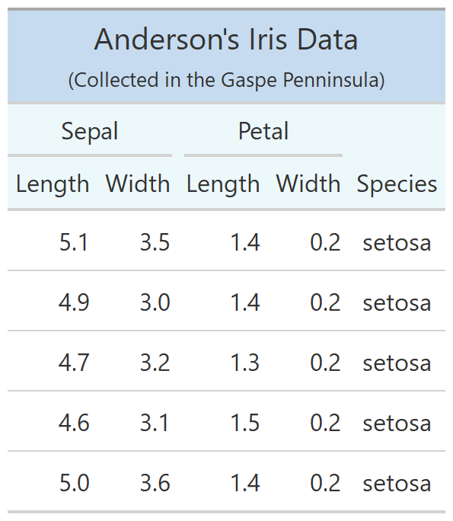
iris_tab <-
iris %>%
slice(1:5) %>%
gt() %>%
tab_header(
title = "Anderson's Iris Data",
subtitle = "(Collected in …)")
iris_tab <- iris_tab %>%
cols_label(
Sepal.Length = "Length",
Sepal.Width = "Width",
Petal.Length = "Length",
Petal.Width = "Width") %>%
tab_options(
heading.background.color = "#c6dbef",
column_labels.background.color = "#edf8fb")
iris_tab <-
iris_tab %>%
tab_spanner(
label = "Sepal",
columns = c(Sepal.Length,
Sepal.Width)) %>%
tab_spanner(
label = "Petal",
columns = c(Petal.Length,
Petal.Width)) %>%

