Slide 1
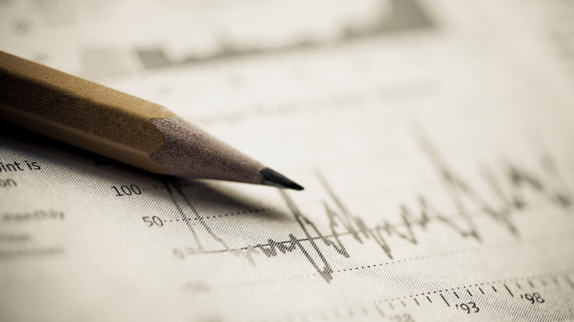
Evaluating Graphical Literacy
Stephanie bell

Slide 2

Graphical Literacy
Graphical literacy (sometimes referred to as the broader term ‘graphicacy’) is the ability to understand graphically presented information.
Related but distinct from numeracy.

Slide 3
Graphical Literacy Components
1
Read the data.
2
Read between the data
3
Read beyond the data

Slide 4
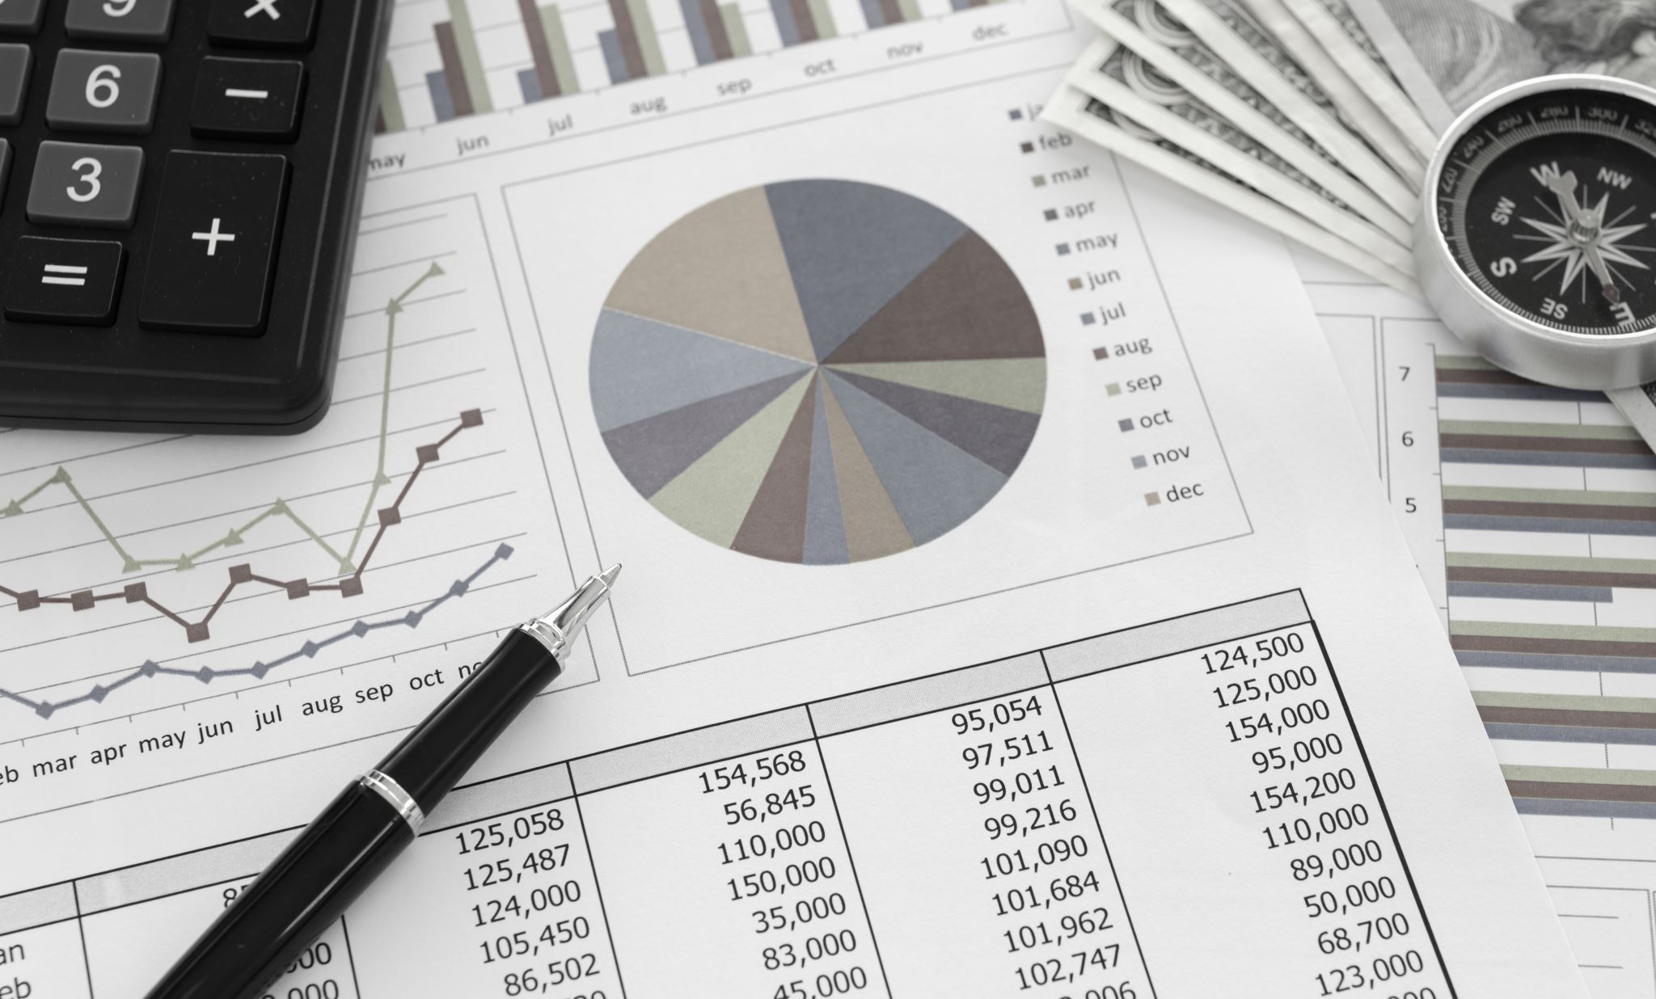
Who Cares?
Graphs are useful in conveying all types of information, including risks and benefits of lifestyle, treatment, and help reduce the biases of anecdotal evidence.
Graphical literacy moderates the benefits of graphical inclusion in both scientific and news articles.
Understanding user literacy can also help us in evaluating our tools and present data more effectively.

Slide 5

Assessing Graph Literacy
Created by study authors for research purposes.
Subsets of existing measures.
Objective Graph Literacy Scales.
Subjective Graph Literacy Scale.

Slide 6
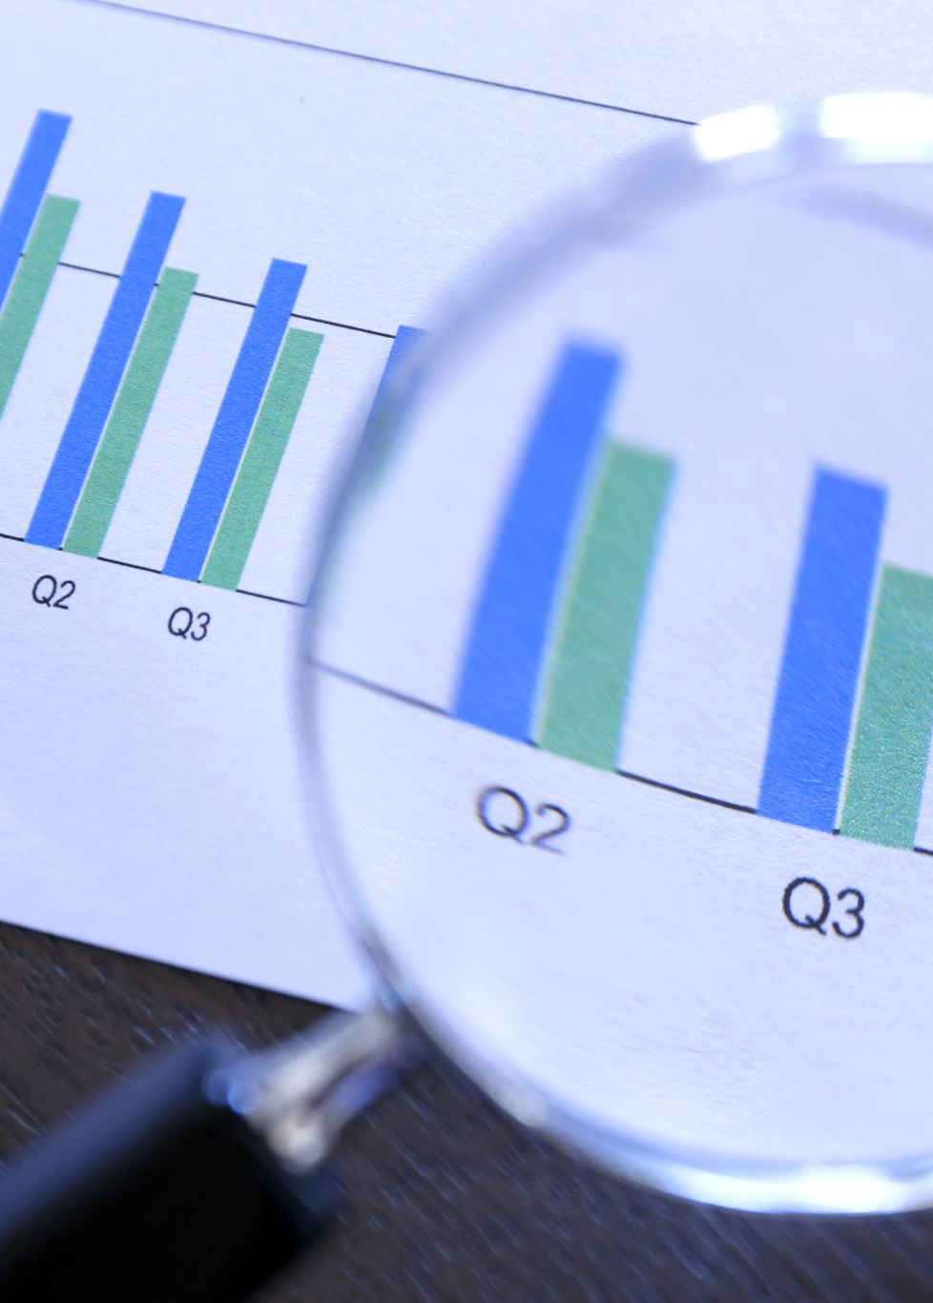
Objective Graph Literacy Scale
The OGS (Galesic & Garcia-Retamero, 2011) is one of the most widely used measures of graph literacy intended for use in the general public.
Scale consists of 13 items measuring the 3 domains of graph literacy for 4 different types of graph (bar, line, pie, and icon).
Developed using items pulled from broader scales.

Slide 7
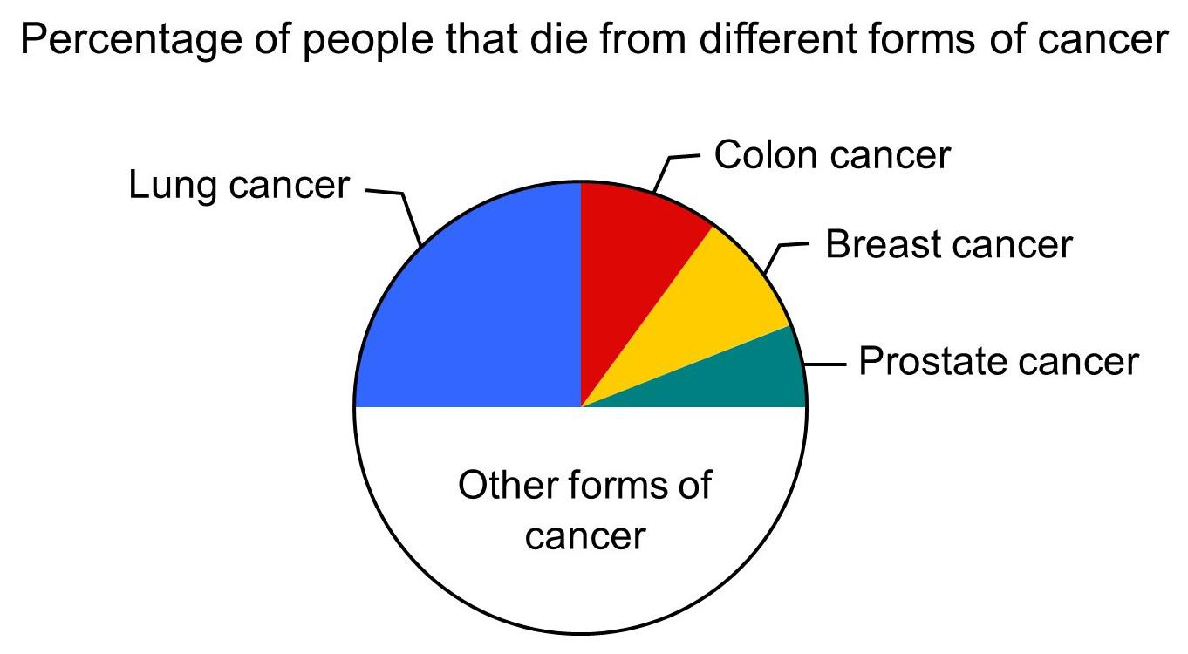
GLS Sample Items
Here is some information about different forms of cancer. Approximately what percentage of people who die from cancer die from colon cancer, breast cancer, and prostate cancer taken together? ____%

Slide 8
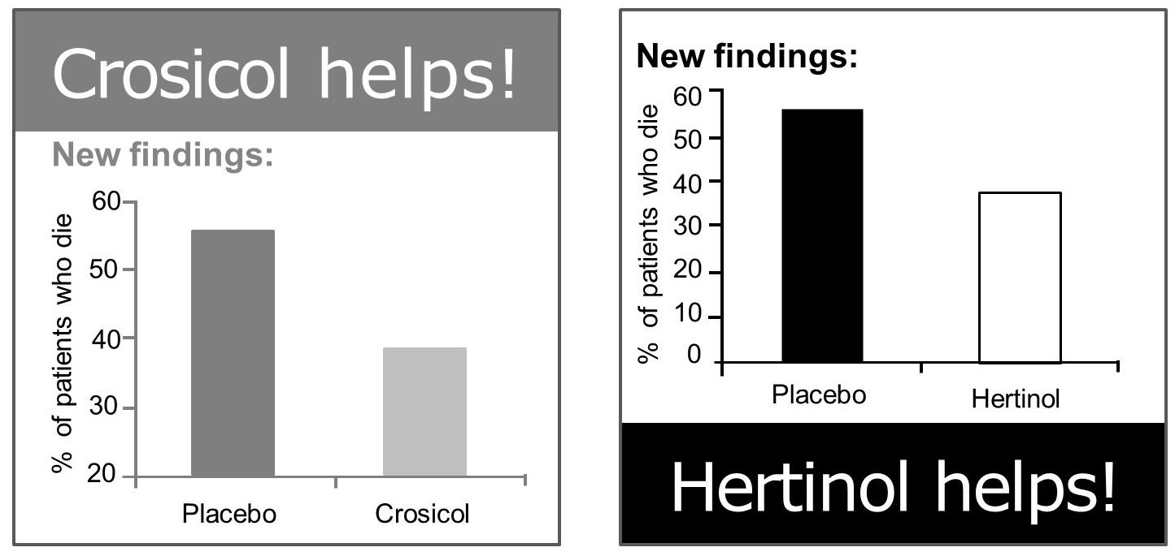
GLS Sample Items
In a magazine, you see two advertisements, one on page 5 and another on page 12. Each is for a different drug for treating heart disease, and each includes a graph showing the effectiveness of the drug compared to placebo (sugar pills).
Compared to the placebo, which treatment leads to a larger decrease in the percentage of patients who die?
Crosicol – Hertinol – They are equal – Can’t say

Slide 9
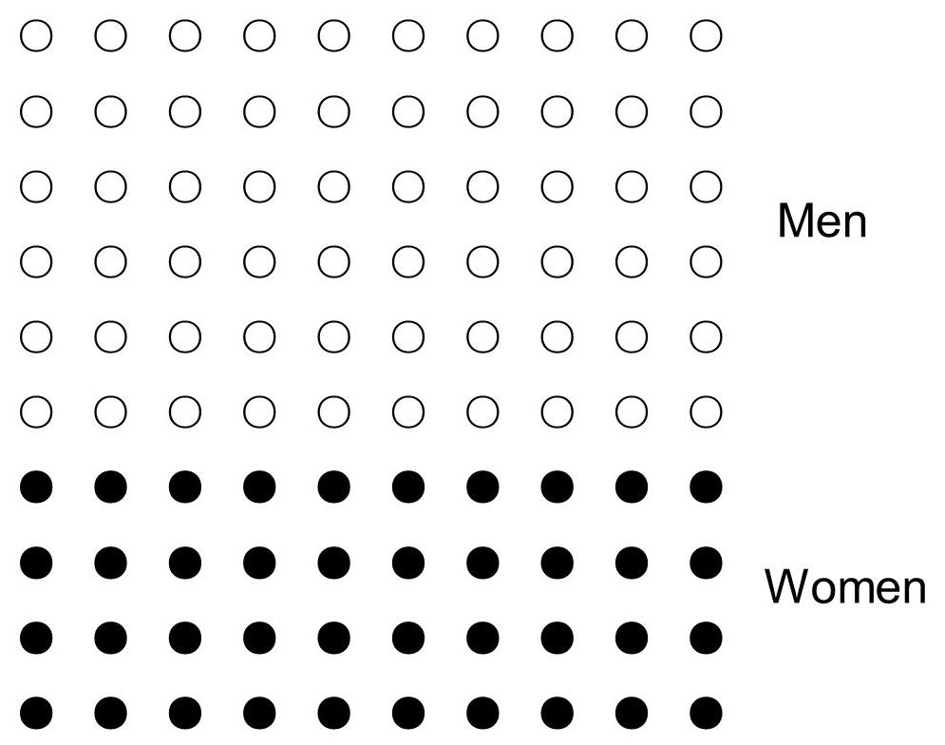
GLS Sample Items
The following figure shows the number of men and women among patients with disease X. The total number of circles is 100.
How many more men than women are there among the 100 patients with disease X? ___ Men.

Slide 10
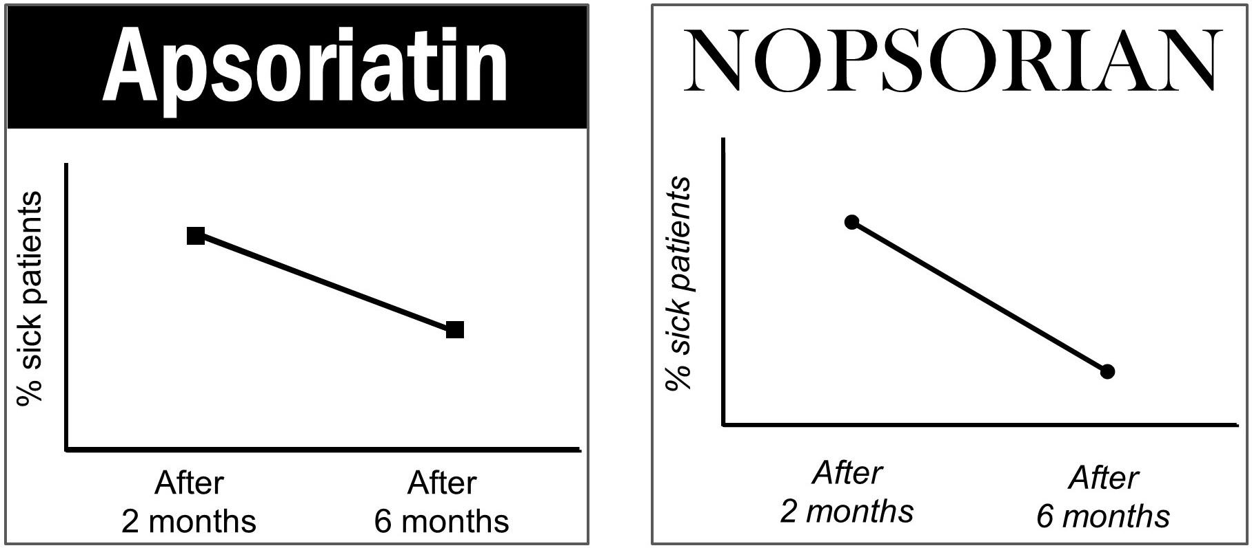
GLS Sample Items
In the newspaper, you see two advertisements, one on page 15 and another on page 17. Each is for a different treatment of psoriasis and each includes a graph showing the effectiveness of the treatment over time.
Which of the treatments contributes to a larger decrease in the percentage of sick patients?
Apsoriatin – Nopsorian – They are equal – Can’t say

Slide 11
Objective Graph Literacy Scale
Average scores from 9-10/13 (SD = ~2) across multiple samples
Coefficient alpha: .74, .79
.65, .49, .45 for domains 1, 2, and 3, respectively
Mean item-total correlations: .19, .21
Moderately correlated with numeracy, mildly correlated with education, and mild-moderately correlated with graphical literacy items from more difficult measures
Convergent validity shown in other studies

Slide 12
Short Graph Literacy Scale
4-item short version of the GLS using items previously presented.
Items selected based on (1) item-total correlations, (2) relationship to complex visual displays, (3) relationship to numeracy [low to medium], (4) percentage correct [< 90%].
Correlates .90 with long-form scale.
Correlates 44 with comprehension of complex displays.
Weak relationship with numeracy.
Coefficient alpha = .54.

Slide 13
Subjective Graph Literacy Scale
A subjective measure of how well respondents feel they understand graphically-presented material.
E.g. “To what extent do you believe the saying ‘a picture is worth a thousand words?’”
5 and 10 item scales developed in tandem
Coefficient alpha ~.87-.91; test-retest: .86
Evidence of reasonable convergent, predictive, and discriminant validity

Slide 14
Conclusions
Most research has been done in the education area with school-age children
Few options for the general adult population
4- and 13-item GLS and 5-item SGL demonstrate reasonable psychometric properties
But the GLS has somewhat low reliability and should be further investigated
Area under construction!
Research, anyone?

Slide 15
References
Fry, E. (1981.) Graphical literacy. Journal of Reading, 24(5), 383-389.
Galesic, M. & Garcia-Retamero, R. (2011.) Graph literacy: A cross-cultural comparison. Medical Decision Making, 444-457. doi: 10.1177/0272989X10373805
Garcia-Retamero, R., Cokely, E.T., Ghazal, S., & Joeris, A. (2016.) Measuring graph literacy without a test: A brief subjective assessment. Medical Decision Making, 854-867. doi: 10.1177/0272989X16655334
Kramarski, B. & Mevarech, Z.R. (2003). Enhancing mathematical reasoning in the classroom: The effects of cooperative learning and metacognitive training. American Educational Research Journal, 40(1).
Okan, Y. & Garcia-Retamero, R. (2016.) How people with low and high graph literacy process health graphs: Evidence from eye-tracking. Journal of Behavior Decision Making, 29(2-3), 271-294. doi: 10.1002/bdm.1891
Okan, Y., Garcia-Retamero, R., Cokely, E., & Maldonado, A. (2018.) Biasing and debiasing health decisions with bar graphs: Costs and benefits of graph literacy. Quarterly Journal of Experimental Psychology, 71(12). doi: 10.1177/1747021817744546
Okan, Y., Janssen, E., Galesic, M., & Waters, E.A. (2019.) Using the short graph literacy scale to predict precursors of health behavior change. Medical Decision Making, 39(3), 183-195. doi: 10.1177/0272989X19829728
Ring, M., Brahm, T., & Randler, C. (2019.) Do difficulty levels matter for graphical literacy? A performance assessment study with authentic graphs. International Journal of Science Education, 41(13), 1787-1804. doi: 10.1080/09500693.2019.1640915
Roberts, K.L. & Brugar, K.A. (2017.) The view from here: Emergence of graphical literacy. Reading Psychology, 38, 733-777. doi: 10.1080/02702711.2017.1336661

