Slide 1
Applying functions to lists and Parallelism in R
A quick tour of purrr, expand.grid(), and furrr
PSYC6135
Michael Truong
June 8/2021

Slide 2
Today’s Plan
Quick overview in PowerPoint
Quick R markdown tutorial

Slide 3
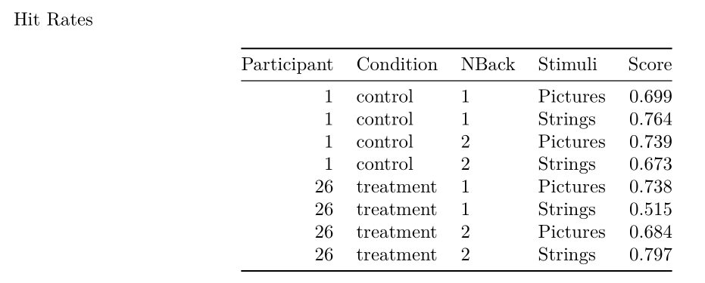
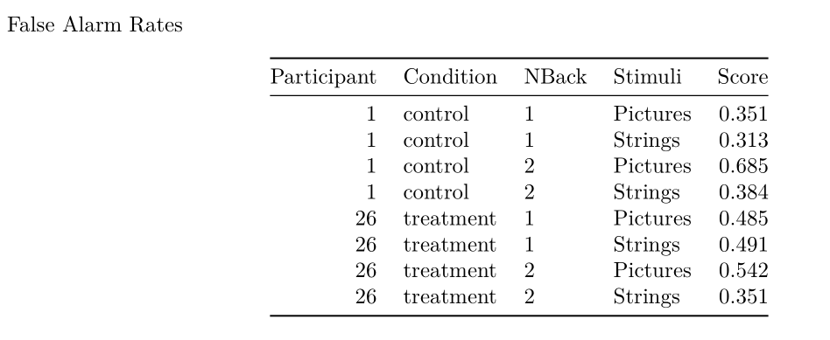
The data

Slide 4
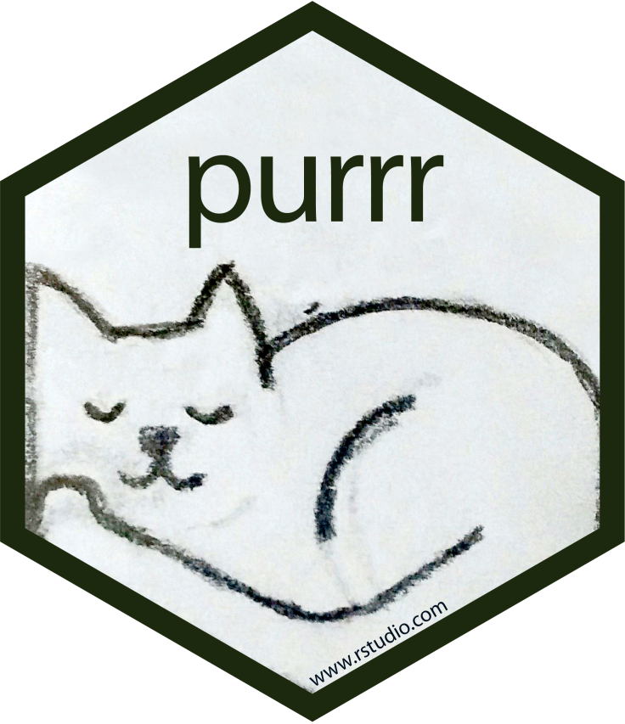


I need to apply the same function many times. How?
purrr::map()
Compare
Note: The apply family of functions can do the same, but I think purrr’s syntax is more elegant.

Slide 5
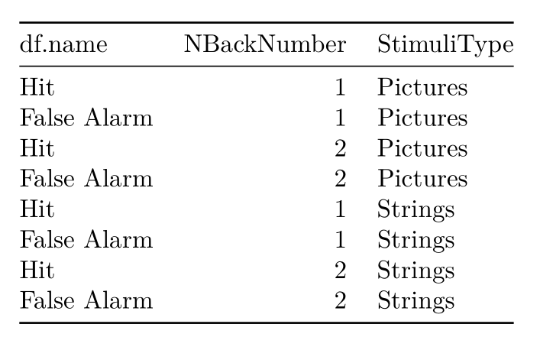
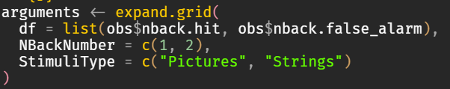
I need to apply the same function many times, but slightly different each time. How?
expand.grid() and purrr::pmap

Slide 6
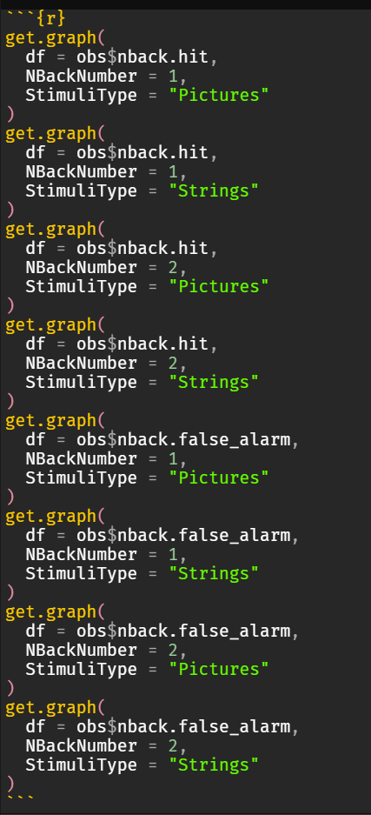

Purrr & expand.grid() Applied

Slide 7

I want to do that in parallel.
Future & furrr: a drop-in replacement
However: Not everything runs faster in parallel

Slide 8
References & Further Reading
Henry, L., & Wickham, H. (2020). purrr: Functional Programming Tools. https://CRAN.R-project.org/package=purrr
Vaughan, D., & Dancho, M. (2021). furrr: Apply Mapping Functions in Parallel using Futures. https://CRAN.R-project.org/package=furrr

