Slide 1
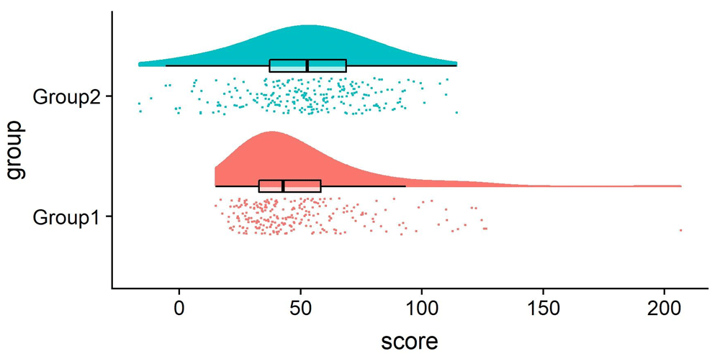

Figure 3. Example Raincloud plot.
Allen M, Poggiali D, Whitaker K et al. Raincloud plots: a multi-platform tool for robust data visualization [version 2]. Wellcome Open Res 2021, 4:63 (doi: 10.12688/wellcomeopenres.15191.2)
Notes:
Figure 3. Example Raincloud plot. The raincloud plot combines an illustration of data distribution (the ‘cloud’), with jittered raw data (the ‘rain’). This can further be supplemented by adding boxplots or other standard measures of central tendency and error. See figure3.Rmd for code to generate this figure.
Allen M, Poggiali D, Whitaker K et al.. Raincloud plots: a multi-platform tool for robust data visualization [version 2]. Wellcome Open Res 2021, 4:63 (doi: 10.12688/wellcomeopenres.15191.2)

