Slide 1
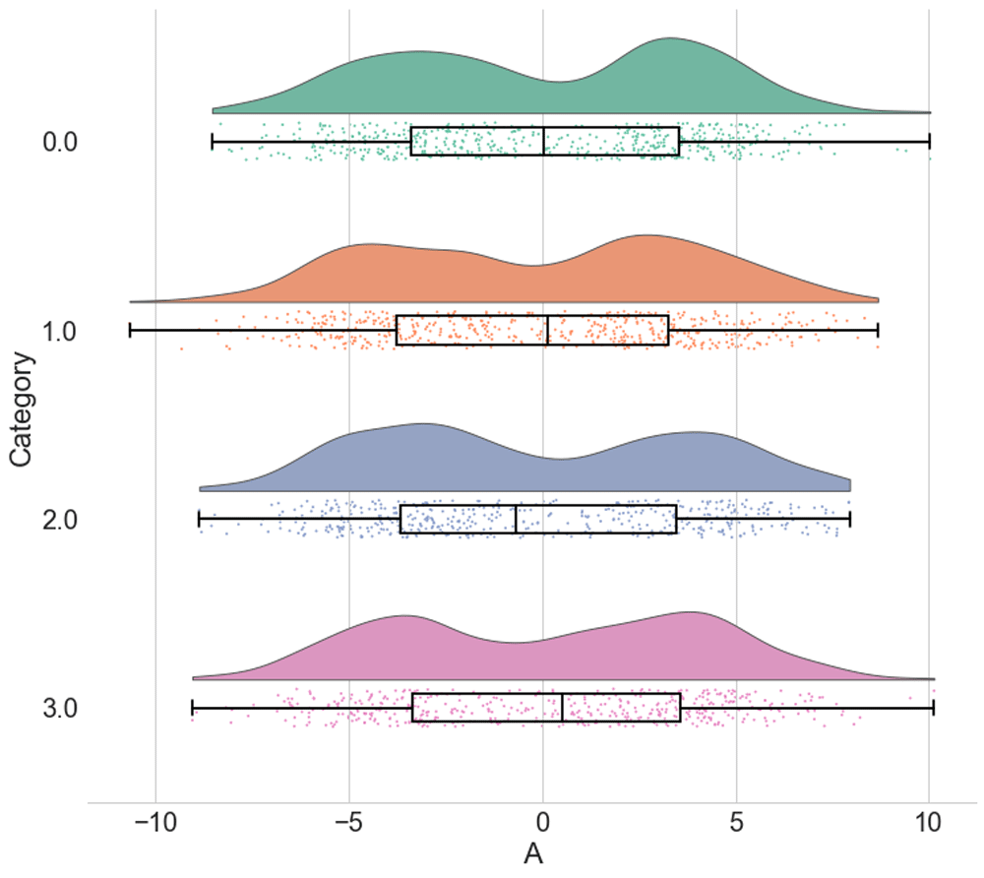

Figure 4. Raincloud plots leave little to the imagination.
Allen M, Poggiali D, Whitaker K et al. Raincloud plots: a multi-platform tool for robust data visualization [version 2]. Wellcome Open Res 2021, 4:63 (doi: 10.12688/wellcomeopenres.15191.2)
Notes:
Figure 4. Raincloud plots leave little to the imagination. By replacing the redundantly mirrored probability distribution with a boxplot and raw data-points, the raincloud plot provides the user with information both about individual observations and patterns among them (such as striation or clustering), and overall tendencies in the distribution. As illustrated here, even a boxplot plus raw data may hide bimodality or other crucial facets of the data. See figure4.ipynb for code to generate these figures.
Allen M, Poggiali D, Whitaker K et al.. Raincloud plots: a multi-platform tool for robust data visualization [version 2]. Wellcome Open Res 2021, 4:63 (doi: 10.12688/wellcomeopenres.15191.2)

