Slide 1
Data Visualization: Psychology?
Michael Friendly
Psych 6135

Slide 2
Where’s the psychology?
Perceptual
Limitations
Strengths

Slide 3

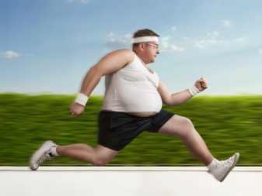
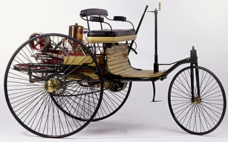
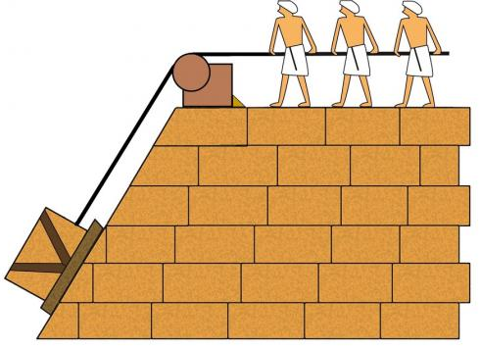
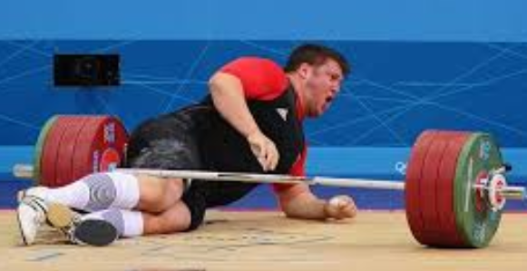
Physical limitations
Speed of locomotion
Strength
Overcome these with:
Wheel & axle
Horse & buggy
Steam engine
Automobile
Rocket
Inclined plane
Pulley
Lever

Slide 4


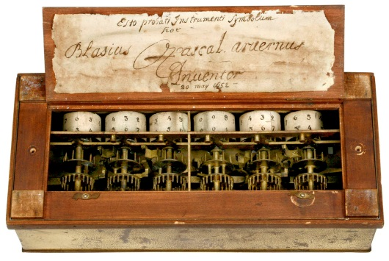
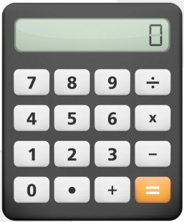
Perceptual & cognitive limitations
Attention
~ 1-4 items
some hard-wired processes
Working memory
~ 4-7 items
Uses attention, encoding
Long-term memory
Unlimited, but often reconstructed
Computation
Rote for simple tasks (5x7=?)
Rudimentary otherwise
Overcome some of these with:
Writing systems
Books, histories
Computational aids

Slide 5
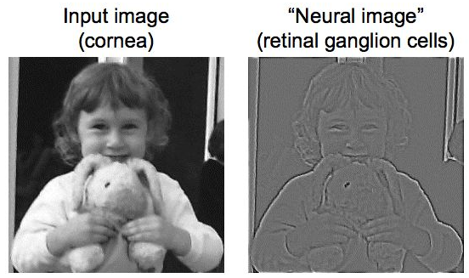
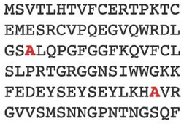
Perceptual strengths
Edge detection – neural hardware to detect edges in visual scenes
Detecting anomalies in visual scenes: color, size, shape, -- preattentive
orientation

