Slide 1

Dissecting a ggplot2-based function
Naomi MG

Slide 2
“It [the layered grammar] is also useful for discovering new types of graphics, as the grammar defines the parameter space of statistical graphics.” (Wickham, 2010, p.9)

Slide 3
1 ggplot(data = dat, mapping = aes(x=X1,y=X2)) +

Slide 4
1 ggplot(data = dat, mapping = aes(x=X1,y=X2)) +
Table 1
Dataframe ‘dat’
Variable | X1 | X2
EI | 1 | 0
PD | -0.20 | 1
effect | -0.20 | 0
start1 | 0 | 1
start2 | 1 | 0

Slide 5
1 ggplot(data = dat, mapping = aes(x=X1,y=X2)) +
Table 1
Dataframe ‘dat’
Variable | X1 | X2
EI | 1 | 0
PD | -0.20 | 1
effect | -0.20 | 0
start1 | 0 | 1
start2 | 1 | 0

Slide 6
1 ggplot(data = dat, mapping = aes(x=X1,y=X2)) +
Table 1
Dataframe ‘dat’
Variable | X1 | X2
EI | 1 | 0
PD | -0.20 | 1
effect | -0.20 | 0
start1 | 0 | 1
start2 | 1 | 0

Slide 7
1 ggplot(data = dat, mapping = aes(x=X1,y=X2)) +

Slide 8
1 ggplot(data = dat, mapping = aes(x=X1,y=X2)) +

Slide 9
1 ggplot(data = dat, mapping = aes(x=X1,y=X2)) +
2 geom_point(shape=c(3,3,3,3,23,3,3,3,3,3,3,3,3,3,21,8,16,16,3,3,3), fill=c("black”…"purple","blue”…"black"), color=c("black”…"purple”…"black"), size=c(3,3,3,3,2,3,3,3,3,3,3,3,3,3,2,2,0.1,0.1,3,3,3), stroke = 0.7) +

Slide 10
1 ggplot(data = dat, mapping = aes(x=X1,y=X2)) +
2 geom_point(shape=c(3,3,3,3,23,3,3,3,3,3,3,3,3,3,21,8,16,16,3,3,3), fill=c("black”…"purple","blue”…"black"), color=c("black”…"purple”…"black"), size=c(3,3,3,3,2,3,3,3,3,3,3,3,3,3,2,2,0.1,0.1,3,3,3), stroke = 0.7) +

Slide 11
1 ggplot(data = dat, mapping = aes(x=X1,y=X2)) +
2 geom_point(shape=c(3,3,3,3,23,3,3,3,3,3,3,3,3,3,21,8,16,16,3,3,3), fill=c("black”…"purple","blue”…"black"), color=c("black”…"purple”…"black"), size=c(3,3,3,3,2,3,3,3,3,3,3,3,3,3,2,2,0.1,0.1,3,3,3), stroke = 0.7) +

Slide 12
1 ggplot(data = dat, mapping = aes(x=X1,y=X2)) +
2 geom_point(shape=c(3,3,3,3,23,3,3,3,3,3,3,3,3,3,21,8,16,16,3,3,3), fill=c("black”…"purple","blue”…"black"), color=c("black”…"purple”…"black"), size=c(3,3,3,3,2,3,3,3,3,3,3,3,3,3,2,2,0.1,0.1,3,3,3), stroke = 0.7) +

Slide 13
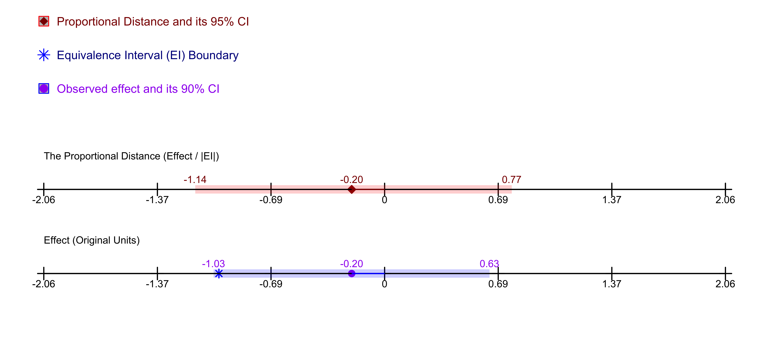
geom_point(shape=21,fill="darkred”,color="darkred”, size=3)

Slide 14
1 ggplot(data = dat, mapping = aes(x=X1,y=X2)) +
2 geom_point(shape=c(3,3,3,3,23,3,3,3,3,3,3,3,3,3,21,8,16,16,3,3,3), fill=c("black”…"purple","blue”…"black"), color=c("black”…"purple”…"black"), size=c(3,3,3,3,2,3,3,3,3,3,3,3,3,3,2,2,0.1,0.1,3,3,3), stroke = 0.7) +
3 ylim(-0.5, 3) +

Slide 15
1 ggplot(data = dat, mapping = aes(x=X1,y=X2)) +
2 geom_point(shape=c(3,3,3,3,23,3,3,3,3,3,3,3,3,3,21,8,16,16,3,3,3), fill=c("black”…"purple","blue”…"black"), color=c("black”…"purple”…"black"), size=c(3,3,3,3,2,3,3,3,3,3,3,3,3,3,2,2,0.1,0.1,3,3,3), stroke = 0.7) +
3 ylim(-0.5, 3) +
4 annotate("rect", xmin = cil, xmax = ciu, ymin = -0.05, ymax = 0.05, alpha = .2, fill = "blue") +

Slide 17
3 ylim(-0.5, 3) +
4 annotate("rect", xmin = cil, xmax = ciu, ymin = -0.05, ymax = 0.05, alpha = .2, fill = "blue") +
5 geom_step(data=dat[6:7,], color = "black") +
10 annotate("text",x=effect, y=1.12, label=format(round(PD, 2), nsmall = 2), size=3, colour = "darkred") +
.
.
.

Slide 18
3 ylim(-0.5, 3) +
4 annotate("rect", xmin = cil, xmax = ciu, ymin = -0.05, ymax = 0.05, alpha = .2, fill = "blue") +
5 geom_step(data=dat[6:7,], color = "black") +
10 annotate("text",x=effect, y=1.12, label=format(round(PD, 2), nsmall = 2), size=3, colour = "darkred") +
.
.
.

Slide 19
10 annotate("text",x=effect, y=1.12, label=format(round(PD, 2), nsmall = 2), size=3, colour = "darkred") +
22 annotate("text",x=-3*onefourth, y=0.4, label="Effect (Original Units)", size=3, hjust = 0) +
.
.
.

Slide 21
35 theme(panel.grid.major = element_blank(), panel.grid.minor = element_blank(), axis.title = element_blank(), panel.background = element_blank(), axis.line = element_blank(), axis.ticks= element_blank(), axis.text = ggplot2::element_blank()
67 ggsave(filename = "Proportional_Distance_Plot.png" ,width = 9, height = 4, device='png', dpi=700)
.
.
.

Slide 22
THANK YOU!!

