Slide 1
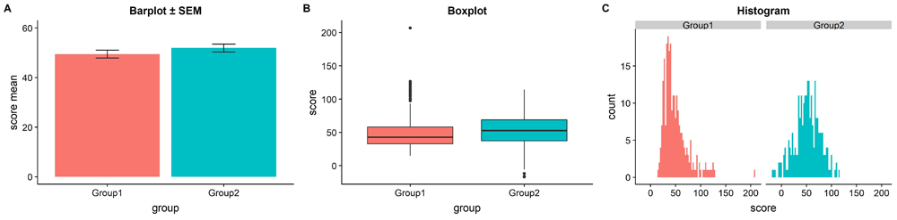

Figure 1. The trouble with barplots.
Allen M, Poggiali D, Whitaker K et al. Raincloud plots: a multi-platform tool for robust data visualization [version 2]. Wellcome Open Res 2021, 4:63 (doi: 10.12688/wellcomeopenres.15191.2)
Notes:
Figure 1. The trouble with barplots. Example reproduced from “Boxplots vs. Barplots” (2016) two simulated datasets with mean = 50, sd = 25, and 1000 observations. A) a barplot and errorbars representing +/- standard error of the mean gives the impression that the measure is equivalent between the two groups. In fact, group 1 is drawn from an exponential distribution as seen in B) boxplots, and C) histograms. The barplot not only obscures the underlying nature of the observations, but also hides the fact that these data are not appropriate for standard parametric inference. See figure1.Rmd for code to generate these figures.
Allen M, Poggiali D, Whitaker K et al.. Raincloud plots: a multi-platform tool for robust data visualization [version 2]. Wellcome Open Res 2021, 4:63 (doi: 10.12688/wellcomeopenres.15191.2)

Slide 2
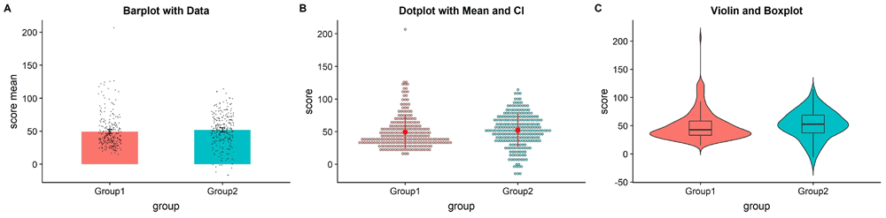
Figure 2. Extant approaches to improved data plotting.
Allen M, Poggiali D, Whitaker K et al. Raincloud plots: a multi-platform tool for robust data visualization [version 2]. Wellcome Open Res 2021, 4:63 (doi: 10.12688/wellcomeopenres.15191.2)
Notes:
Figure 2. Extant approaches to improved data plotting. A) The simplest improvement is to add jittered raw data points to the standard boxplot and +/- standard error scheme. B) Alternatively, dotplots can be used to supplement visualizations of central tendency and error, at the risk of added complexity due to the dependence of such plots on choices such as bin-width and dot size. C) A popular recent alternative is the violin plot coupled with boxplots or similar. However, this needlessly mirrors information about the redundant data axis (here, the x-axis). See figure2.Rmd for code to generate these figures.
Allen M, Poggiali D, Whitaker K et al.. Raincloud plots: a multi-platform tool for robust data visualization [version 2]. Wellcome Open Res 2021, 4:63 (doi: 10.12688/wellcomeopenres.15191.2)

Slide 3
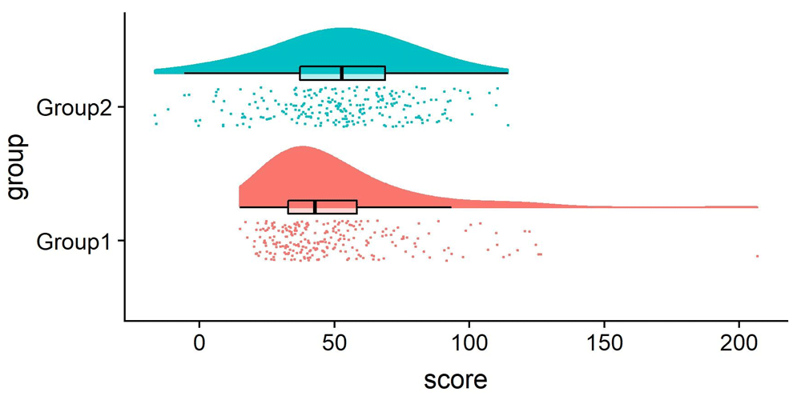
Figure 3. Example Raincloud plot.
Allen M, Poggiali D, Whitaker K et al. Raincloud plots: a multi-platform tool for robust data visualization [version 2]. Wellcome Open Res 2021, 4:63 (doi: 10.12688/wellcomeopenres.15191.2)
Notes:
Figure 3. Example Raincloud plot. The raincloud plot combines an illustration of data distribution (the ‘cloud’), with jittered raw data (the ‘rain’). This can further be supplemented by adding boxplots or other standard measures of central tendency and error. See figure3.Rmd for code to generate this figure.
Allen M, Poggiali D, Whitaker K et al.. Raincloud plots: a multi-platform tool for robust data visualization [version 2]. Wellcome Open Res 2021, 4:63 (doi: 10.12688/wellcomeopenres.15191.2)

Slide 4
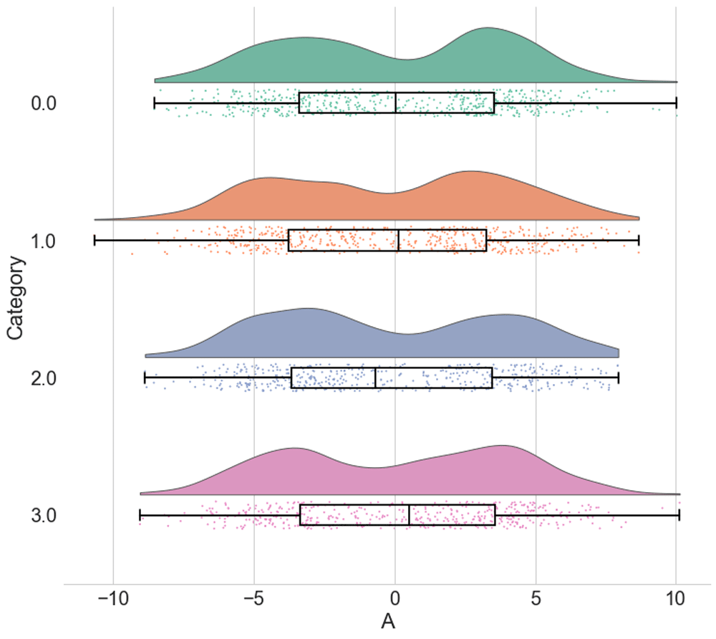
Figure 4. Raincloud plots leave little to the imagination.
Allen M, Poggiali D, Whitaker K et al. Raincloud plots: a multi-platform tool for robust data visualization [version 2]. Wellcome Open Res 2021, 4:63 (doi: 10.12688/wellcomeopenres.15191.2)
Notes:
Figure 4. Raincloud plots leave little to the imagination. By replacing the redundantly mirrored probability distribution with a boxplot and raw data-points, the raincloud plot provides the user with information both about individual observations and patterns among them (such as striation or clustering), and overall tendencies in the distribution. As illustrated here, even a boxplot plus raw data may hide bimodality or other crucial facets of the data. See figure4.ipynb for code to generate these figures.
Allen M, Poggiali D, Whitaker K et al.. Raincloud plots: a multi-platform tool for robust data visualization [version 2]. Wellcome Open Res 2021, 4:63 (doi: 10.12688/wellcomeopenres.15191.2)

