Slide 1
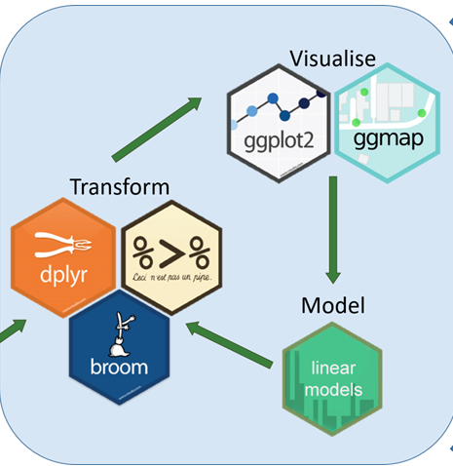
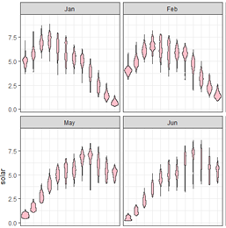
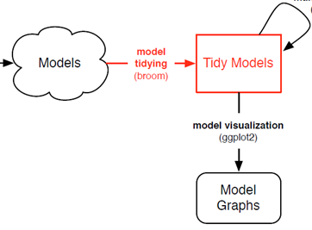
ggplot2: Going further in the tidyverse
Michael Friendly
Psych 6135
http://euclid.psych.yorku.ca/www/psy6135/

Slide 2
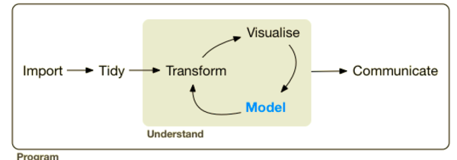
A larger view: Data science
Data science treats statistics & data visualization as parts of a larger process
Data import: text files, data bases, web scraping, …
Data cleaning → “tidy data”
Model building & visualization
Reproducible report writing

Slide 3

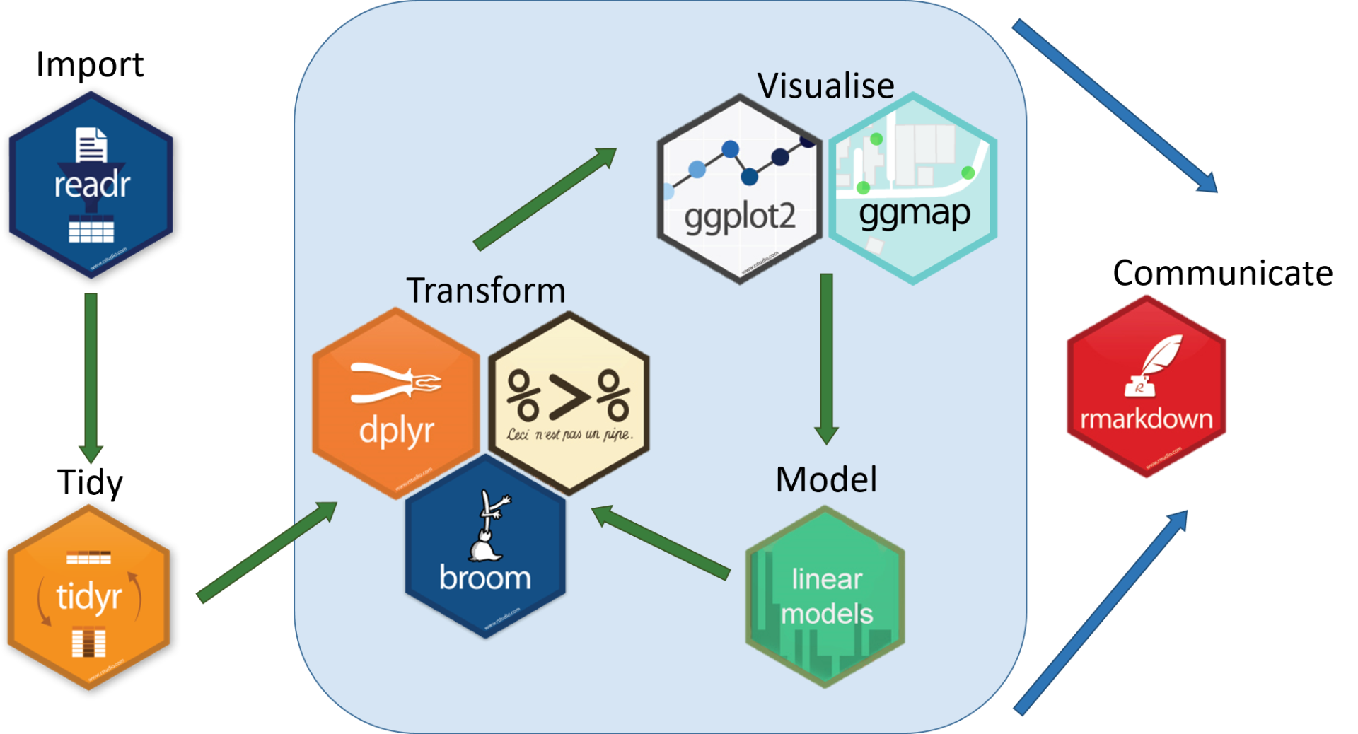
The tidyverse of R packages

Slide 4
Topics
Data import / export
Data wrangling: getting your data into shape
dplyr & tidyr
pipes: %>%
grouping & summarizing
Example: NASA data on solar radiation
Visualizing models: broom
Example: gapminder data
ggplot2 extensions
tables in R

Slide 5
Data Import / Export
The readr package is the modern, tidy way to import and export data
Tabular data:
comma delimited (read.csv)
any other delimiters (“;” = read.csv2; <tab> = read_tsv)
Data types:
specify column types or let functions guess
Other data formats
package | Data types
haven | SAS, SPSS, Stata
readxl | Excel files (.xls and xlsx)
DBI | Databases (SQL, …)
rvest | HTML (web scraping)

Slide 6
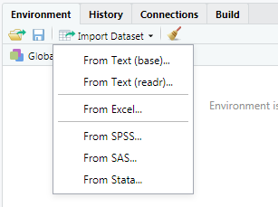
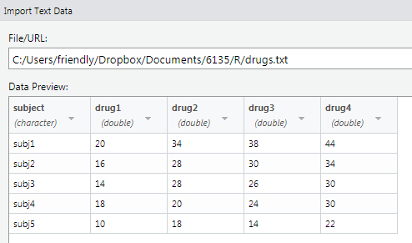
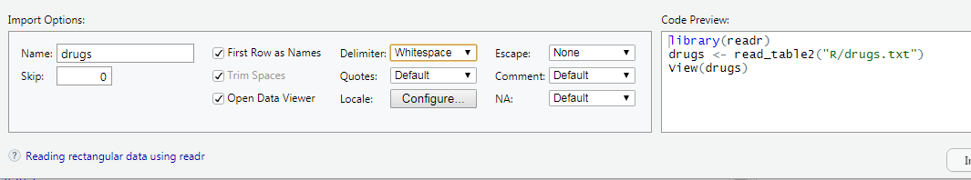
Data Import: RStudio
file:
options:
code:

Slide 7



Data transformation tools
Some common data types can be messy when imported. Tidy tools are there to help
dates/times | lubridate | read dates/times in various formats; extract components
factors | forcats | Change order of levels, drop levels, combine levels
strings | stringr | detect matches, subset, replace

Slide 8
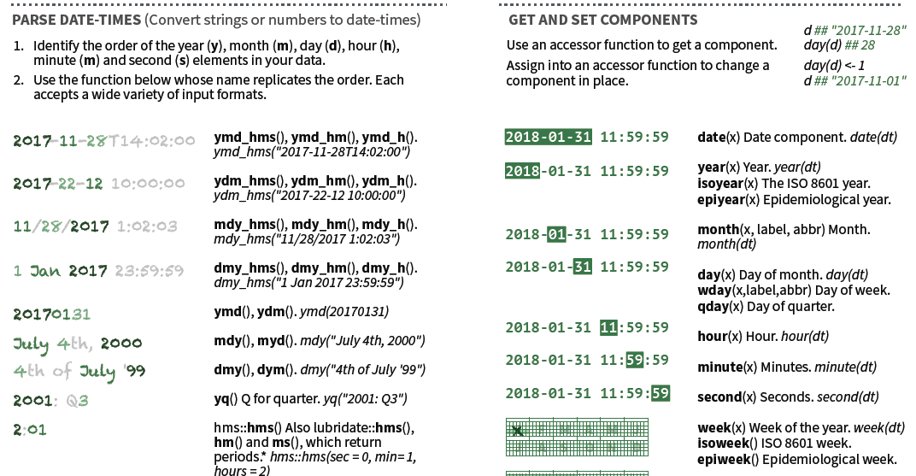
lubridate: Dates & times
Learn more at: http://lubridate.tidyverse.org

Slide 9
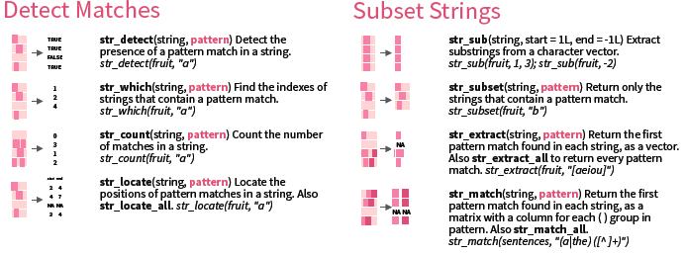
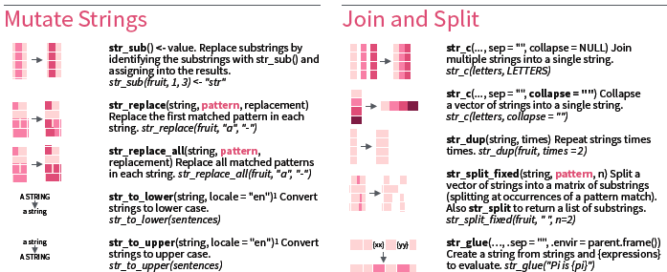
stringr: Manipulating strings
Learn more at: http://stringr.tidyverse.org

Slide 10
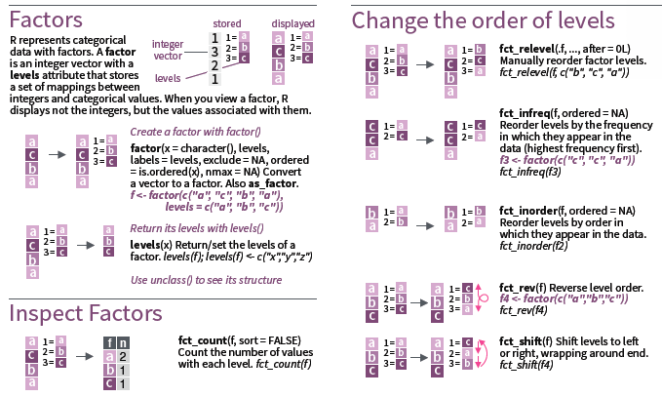
forcats: Working with factors
R represents categorical variables as factors, useful for analysis (e.g., ANOVA)
In graphics, we often want to recode levels or reorder them
Learn more at: http://forcats.tidyverse.org

Slide 11

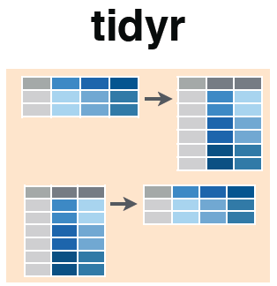
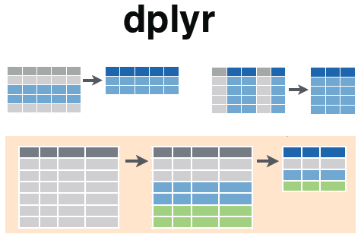


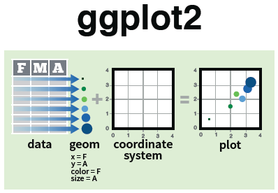

Tidy tools: overview
gather()
%>%
filter()
select()
spread()
Reshape data to be tidy
Manipulate & summarize tidy data
Visualize me!

Slide 12
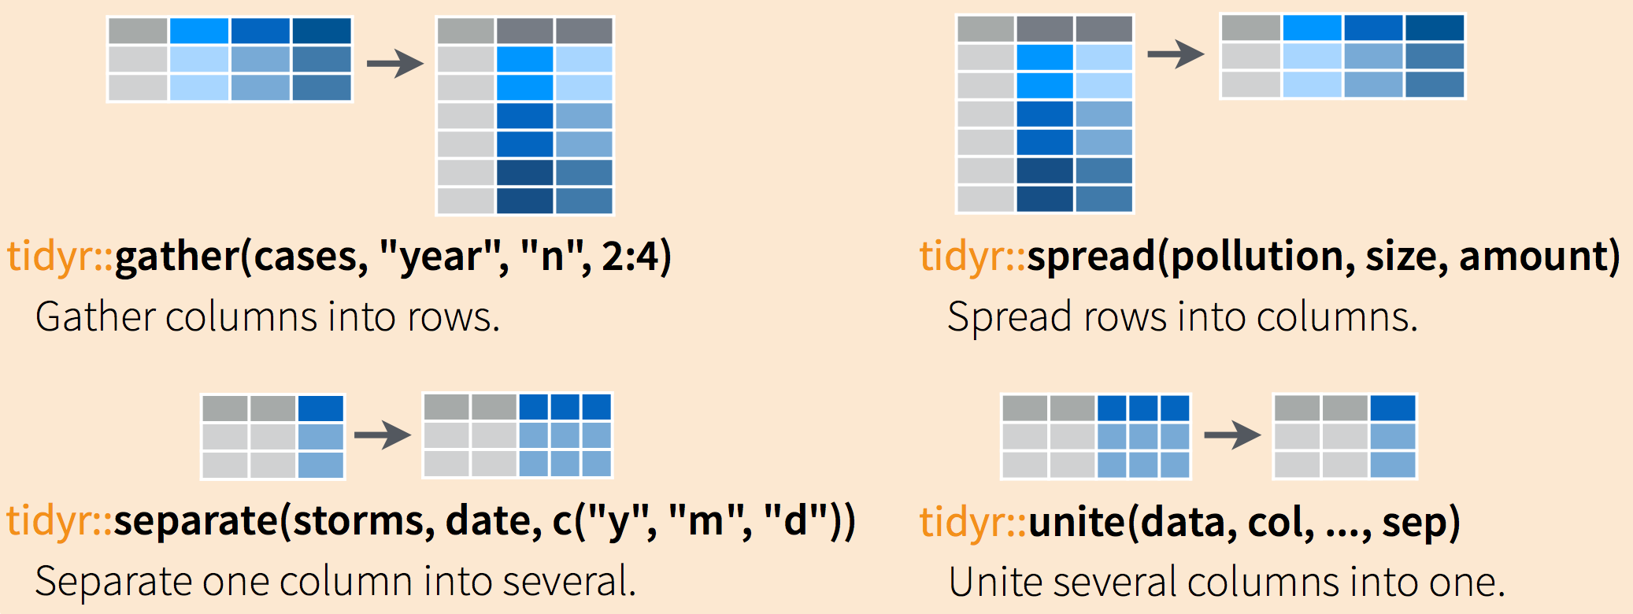
Tidy operations
Reshape long to wide
synonym: tidyr::pivot_longer()
Reshape long to wide
synonym: tidyr::pivot_longer()
Separate parts of a value into several variables
Join related variables into one

Slide 13
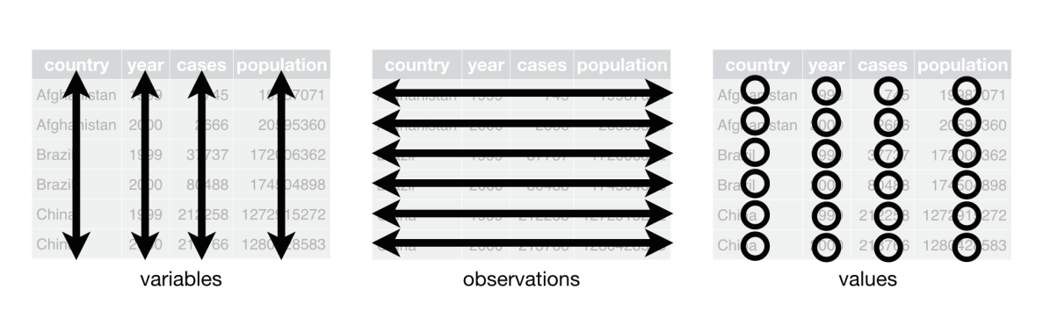
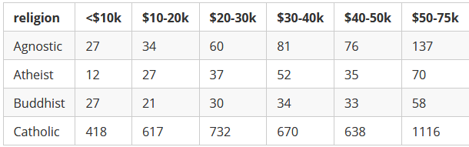
Data wrangling with dplyr & tidyr
What is Tidy Data?
A dataset is said to be tidy if:
observations are in rows
variables are in columns
each value is in its own cell.
A “messy” dataset: Survey of income by religion from Pew Research
Values of income are in separate columns, not one variable
Column headers are values, not variable names
Cell values are frequencies--- implicit, not explicit
This organization is easy in Excel
But, this makes data analysis and graphing hard

Slide 14
Tidying: reshaping wide to long
We can tidy the data by reshaping from wide to long format using tidyr::gather()
> pew <- read.delim(
file = "http://stat405.had.co.nz/data/pew.txt",
header = TRUE,
stringsAsFactors = FALSE, check.names = FALSE)
> (pew1 <- pew[1:4, 1:6]) # small subset
religion <$10k $10-20k $20-30k $30-40k $40-50k
1 Agnostic 27 34 60 81 76
2 Atheist 12 27 37 52 35
3 Buddhist 27 21 30 34 33
4 Catholic 418 617 732 670 638
key
value
columns
>library(tidyr)
> gather(pew1, "income", "frequency", 2:6)
religion income frequency
1 Agnostic <$10k 27
2 Atheist <$10k 12
3 Buddhist <$10k 27
4 Catholic <$10k 418
5 Agnostic $10-20k 34
6 Atheist $10-20k 27
7 Buddhist $10-20k 21
8 Catholic $10-20k 617
9 Agnostic $20-30k 60
10 Atheist $20-30k 37
11 Buddhist $20-30k 30
12 Catholic $20-30k 732
13 Agnostic $30-40k 81
14 Atheist $30-40k 52
15 Buddhist $30-40k 34
16 Catholic $30-40k 670
… … … …
Another solution, using reshape2::melt()
> library(reshape2)
> pew_tidy <- melt(
data = pew1,
id = "religion",
variable.name = "income",
value.name = "frequency"
)
NB: income is a character variable; we might want to create an ordered factor or numeric version

Slide 15

Using pipes: %>%
R is a functional language
This means that f(x) returns a value, as in y <- f(x)
That value can be passed to another function: g(f(x))
And so on: h(g(f(x)))
This gets messy and hard to read, unless you break it down step by step
> x <- c(0.109, 0.359, 0.63, 0.996, 0.515, 0.142)
> exp(diff(log(x)))
[1] 3.29 1.75 1.58 0.52 0.28
> # Compute the logarithm of `x`, calculate lagged differences,
> # return the exponential function of the result
> log(x)
[1] -2.216 -1.024 -0.462 -0.004 -0.664 -1.952
> diff(log(x)) #calculate lagged diffs
[1] 1.19 0.56 0.46 -0.66 -1.29
> exp(diff(log(x))) # convert back to original scale
[1] 3.29 1.75 1.58 0.52 0.28

Slide 16
Using pipes: %>%
Pipes (%>%) change the syntax to make this easier
Basic rules
x %>% f() passes object on left hand side as first argument (or . argument) of function on right hand side
x %>% f() is the same as f(x)
x %>% f(y) is the same as f(x, y)
y %>% f(x, ., z) is the same as f(x, y, z)
x %<>% f()does the same, but assigns the result to x
Shortcut for x <- x %>% f()
> # use pipes
> x %>% log() %>% diff() %>% exp()
[1] 3.29 1.75 1.58 0.52 0.28

Slide 17
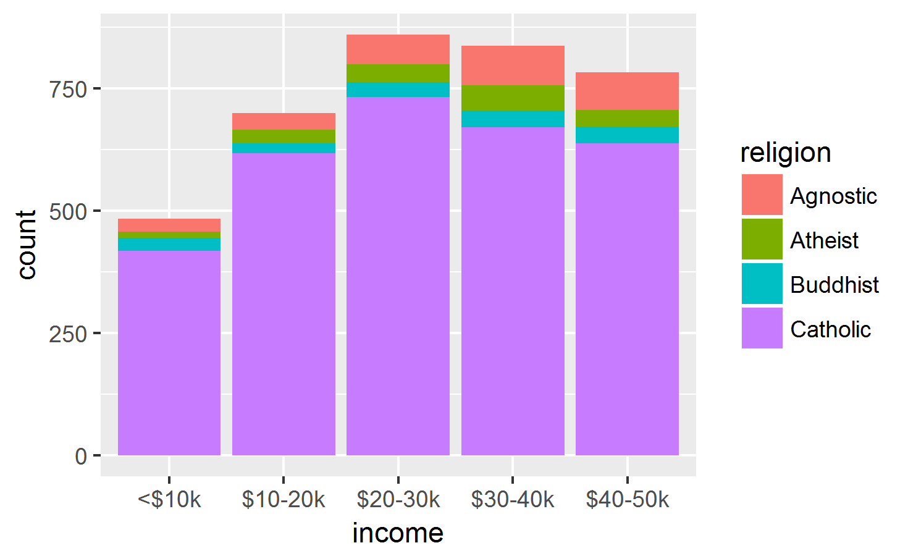
Using pipes: %>% ggplot()
For the Pew data, mutate income into an ordered factor and make a ggplot
pew1 %>%
gather("income", "frequency", 2:6) %>% # reshape
mutate(income = ordered(income, levels=unique(income))) %>% # make ordered
ggplot(aes(x=income, fill=religion)) + # plot
geom_bar(aes(weight=frequency)) # as freq bars
mutate() calculates or transforms column variables
ordered(income) levels are now ordered appropriately.
The result is piped to ggplot()

Slide 18
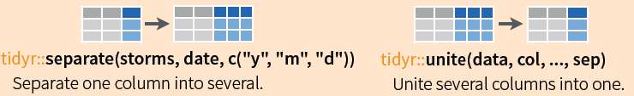
Tidying: separate() and unite()
It sometimes happens that several variables are crammed into one column, or parts of one variable are split across multiple columns
For example, for the pew data, we might want separate income into low & high
pew_long %>%
mutate(inc = gsub("[\\$k]", "", income)) %>%
mutate(inc = gsub("<", "0-", inc)) %>%
separate(inc, c("low", "high"), "-") %>%
head()
religion income frequency low high
1 Agnostic <$10k 27 0 10
2 Atheist <$10k 12 0 10
3 Buddhist <$10k 27 0 10
4 Catholic <$10k 418 0 10
5 Agnostic $10-20k 34 10 20
6 Atheist $10-20k 27 10 20

Slide 19
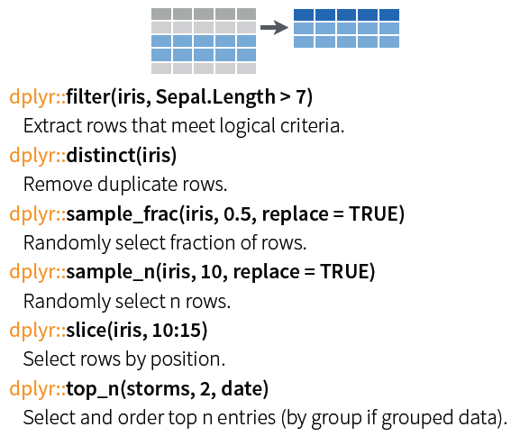
dplyr: Subset observations (rows)
dplyr implements a variety of verbs to select a subset of observations from a dataset
In a pipe expression, omit the dataset name
iris %>% filter(Sepal.Length >7)
iris %>% filter(Species==“setosa”)
iris %>% sample_n(10)
iris %>% slice(1:50) # setosa

Slide 20

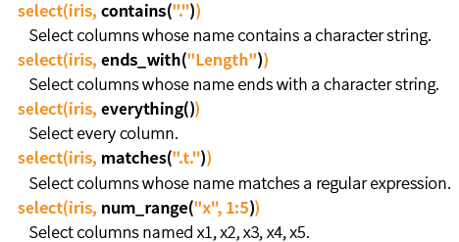
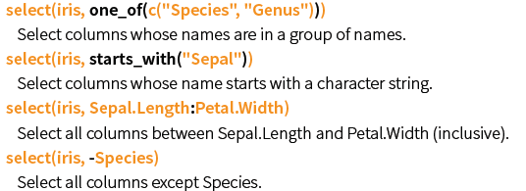
dplyr: Subset variables (columns)
Many helper functions in dplyr allow selection by a function of variable names:

Slide 21
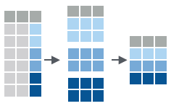

dplyr: group_by() and summarise()
Fundamental operations in data munging are:
grouping a dataset by one or more variables
calculating one or more summary measures
ungrouping: expand to an ungrouped copy, if needed
data
group
summarise
mtcars %>%
group_by(cyl) %>%
summarise(avg=mean(mpg))
data
avg
mtcars %>%
group_by(cyl) %>%
summarise(avg=mean(mpg)) %>%
ungroup()

Slide 22

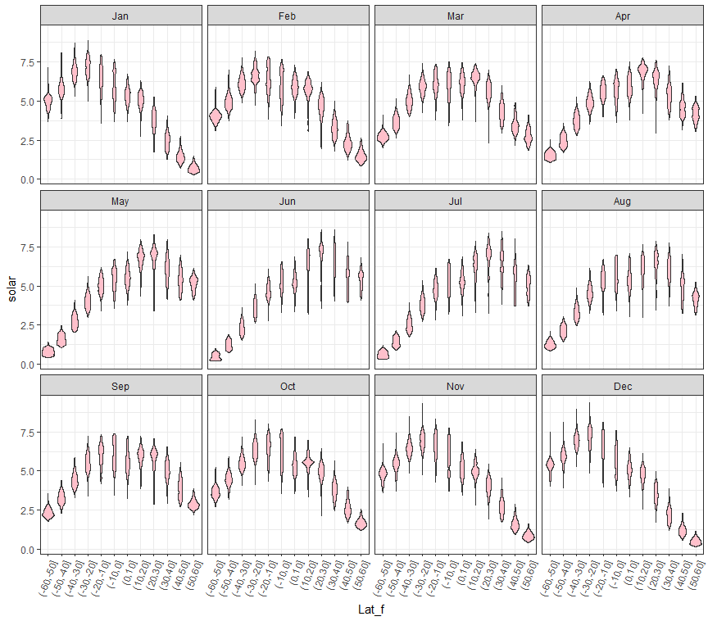
Example: NASA data on solar radiation
Months
How does solar radiation vary with latitude, over months of the year?
How to make this plot?
Q:
what are the basic plot elements?
Solar radiation
Latitude

Slide 23
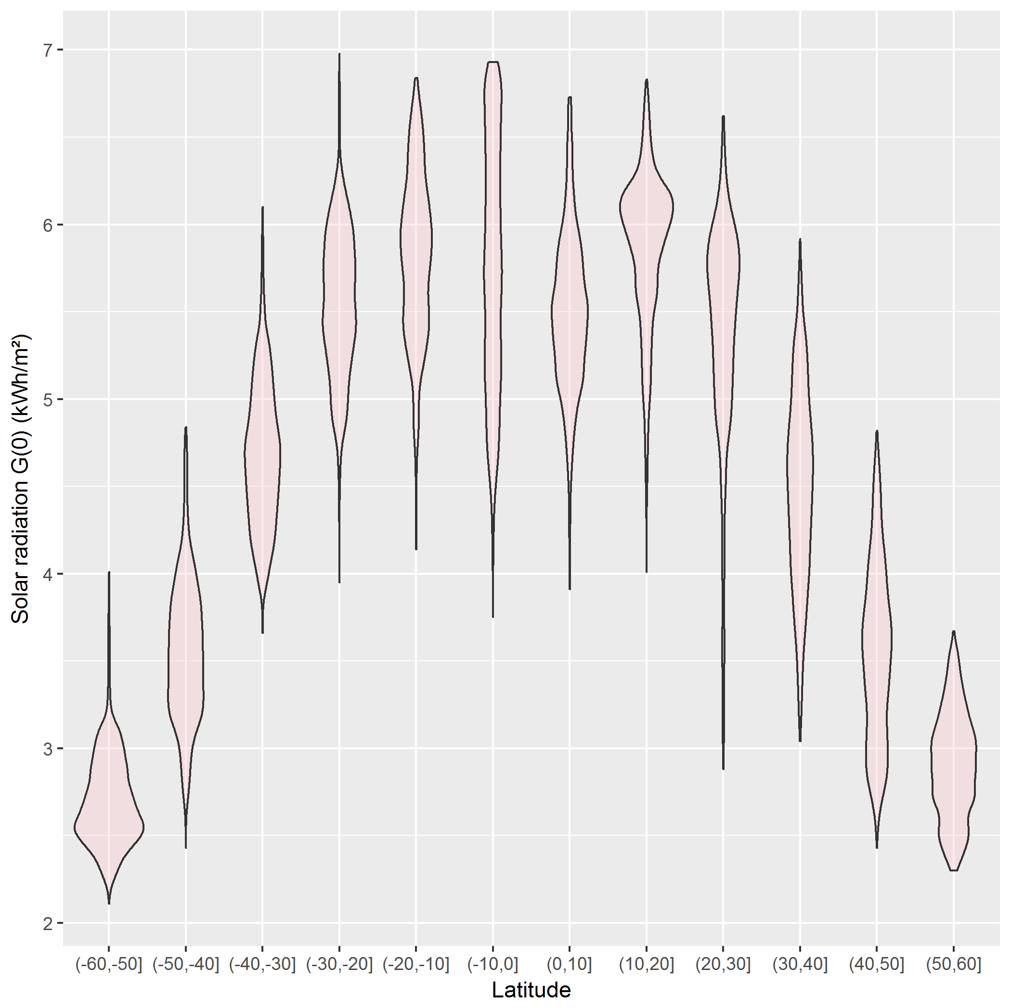
NASA data: solar radiation
This is easy to do for the total Annual solar radiation, a column in the data
> str(nasa)
'data.frame': 64800 obs. of 15 variables:
$ Lat: int -90 -90 -90 -90 -90 -90 -90 -90 -90 -90 ...
$ Lon: int -180 -179 -178 -177 -176 -175 -174 -173 -172 -171 ...
$ Jan: num 9.63 9.63 9.63 9.63 9.63 9.63 9.63 9.63 9.63 9.63 ...
$ Feb: num 5.28 5.28 5.28 5.28 5.28 5.28 5.28 5.28 5.28 5.28 ...
$ Mar: num 0.75 0.75 0.75 0.75 0.75 0.75 0.75 0.75 0.75 0.75 ...
$ Apr: num 0 0 0 0 0 0 0 0 0 0 ...
$ May: num 0 0 0 0 0 0 0 0 0 0 ...
$ Jun: num 0 0 0 0 0 0 0 0 0 0 ...
$ Jul: num 0 0 0 0 0 0 0 0 0 0 ...
$ Aug: num 0 0 0 0 0 0 0 0 0 0 ...
$ Sep: num 0.1 0.1 0.1 0.1 0.1 0.1 0.1 0.1 0.1 0.1 ...
$ Oct: num 3.24 3.24 3.24 3.24 3.24 3.24 3.24 3.24 3.24 3.24 ...
$ Nov: num 8.28 8.28 8.28 8.28 8.28 8.28 8.28 8.28 8.28 8.28 ...
$ Dec: num 11 11 11 11 11 ...
$ Ann: num 3.19 3.19 3.19 3.19 3.19 3.19 3.19 3.19 3.19 3.19 ...
nasa %>%
filter(abs(Lat) < 60) %>%
mutate(Latf = cut(Lat, pretty(Lat, n=10))) %>%
ggplot(aes(x=Latf, y=Ann)) +
geom_violin(fill="pink", alpha=0.3) +
labs(x="Latitude", y="Solar radiation G(0) (kWh/m²)")

Slide 24
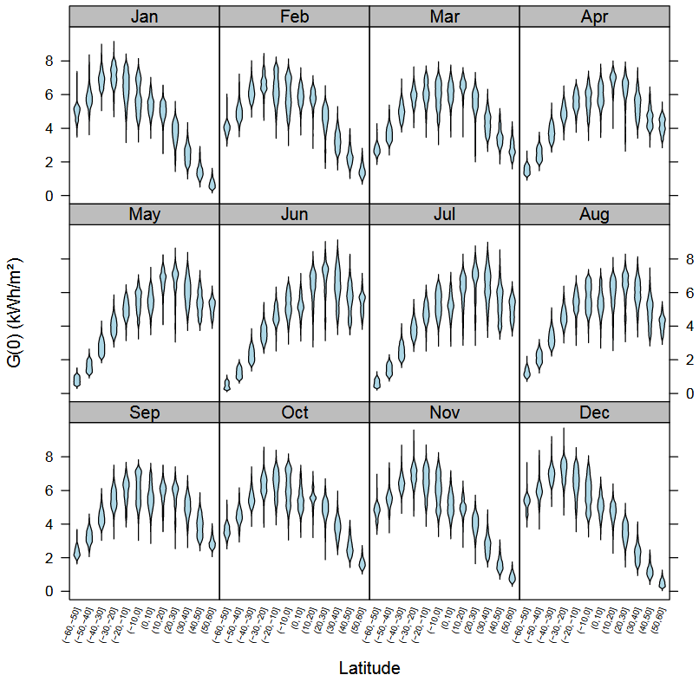
Faceting & tidy data
This is complicated to do for the separate months, because the data structure is untidy--- months were in separate variables (wide format)
> str(nasa)
'data.frame': 64800 obs. of 15 variables:
$ Lat: int -90 -90 -90 -90 -90 -90 -90 -90 -90 -90 ...
$ Lon: int -180 -179 -178 -177 -176 -175 -174 -173 -172 -171 ...
$ Jan: num 9.63 9.63 9.63 9.63 9.63 9.63 9.63 9.63 9.63 9.63 ...
$ Feb: num 5.28 5.28 5.28 5.28 5.28 5.28 5.28 5.28 5.28 5.28 ...
$ Mar: num 0.75 0.75 0.75 0.75 0.75 0.75 0.75 0.75 0.75 0.75 ...
$ Apr: num 0 0 0 0 0 0 0 0 0 0 ...
$ May: num 0 0 0 0 0 0 0 0 0 0 ...
$ Jun: num 0 0 0 0 0 0 0 0 0 0 ...
$ Jul: num 0 0 0 0 0 0 0 0 0 0 ...
$ Aug: num 0 0 0 0 0 0 0 0 0 0 ...
$ Sep: num 0.1 0.1 0.1 0.1 0.1 0.1 0.1 0.1 0.1 0.1 ...
$ Oct: num 3.24 3.24 3.24 3.24 3.24 3.24 3.24 3.24 3.24 3.24 ...
$ Nov: num 8.28 8.28 8.28 8.28 8.28 8.28 8.28 8.28 8.28 8.28 ...
$ Dec: num 11 11 11 11 11 ...
$ Ann: num 3.19 3.19 3.19 3.19 3.19 3.19 3.19 3.19 3.19 3.19 ...

Slide 25
tidying the data
To plot solar radiation against latitude by month (separate panels), we need to:
remove the Ann column
reshape the data to long format, so solar is all in one column
library(tidyr)
library(dplyr)
library(ggplot2)
nasa_long <- nasa %>%
select(-Ann) %>%
gather(month, solar, Jan:Dec, factor_key=TRUE) %>%
filter( abs(Lat) < 60 ) %>%
mutate( Lat_f = cut(Lat, pretty(Lat, 12)))
%>% “pipes” data to the next stage
select() extracts or drops columns
gather() collapses columns into key-value pairs
filter() subsets observations
mutate() creates new variables

Slide 26
tidying the data
> str(nasa_long)
'data.frame': 514080 obs. of 5 variables:
$ Lat : int -59 -59 -59 -59 -59 -59 -59 -59 -59 -59 ...
$ Lon : int -180 -179 -178 -177 -176 -175 -174 -173 -172 -171 ...
$ month: Factor w/ 12 levels "Jan","Feb","Mar",..: 1 1 1 1 1 1 1 1 1 1 ...
$ solar: num 5.19 5.19 5.25 5.25 5.17 5.17 5.15 5.15 5.15 5.15 ...
$ Lat_f: Factor w/ 12 levels "(-60,-50]","(-50,-40]",..: 1 1 1 1 1 1 1 1 1 1 ...
> head(nasa_long)
Lat Lon month solar Lat_f
1 -59 -180 Jan 5.19 (-60,-50]
2 -59 -179 Jan 5.19 (-60,-50]
3 -59 -178 Jan 5.25 (-60,-50]
4 -59 -177 Jan 5.25 (-60,-50]
5 -59 -176 Jan 5.17 (-60,-50]
6 -59 -175 Jan 5.17 (-60,-50]
For ease of plotting, I created a factor version of Lat with 12 levels
The data are now in a form where I can plot solar against Lat or Lat_f and facet by month

Slide 27
plotting the tidy data
Using geom_violin() shows the shapes of the distributions for levels of Lat_f
ggplot(nasa_long, aes(x=Lat_f, y=solar)) +
geom_violin(fill="pink") +
facet_wrap(~ month) +
theme_bw() +
theme(axis.text.x =
element_text(angle = 70,
hjust = 1))
facet_wrap(~month) does the right thing
I had to adjust the x-axis labels for Lat_f to avoid overplotting

Slide 28
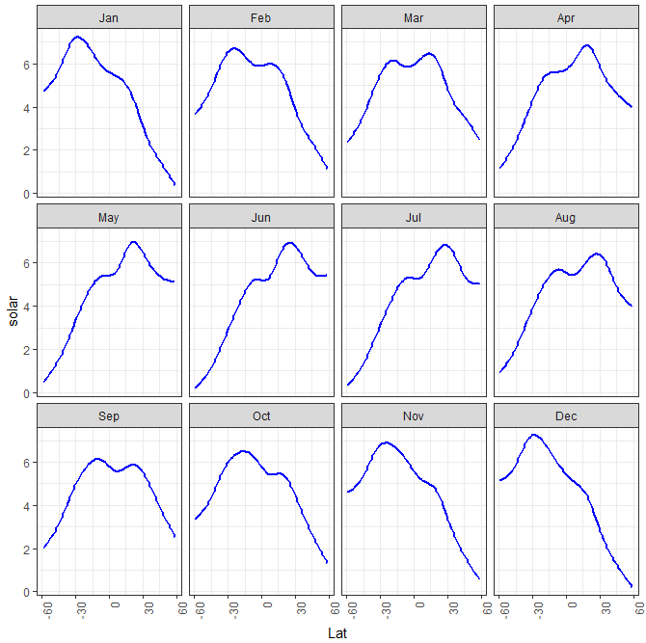
plotting the tidy data: smoothing
ggplot(nasa_long, aes(x=Lat, y=solar)) +
geom_smooth(color="blue" ) +
facet_wrap(~ month) +
theme_bw()
Here we treat Lat as quantitative.
geom_smooth() uses method = “gam” here because of large n
The variation in the smoothed trends over the year suggest quite lawful behavior
Can we express this as a statistical model ?

Slide 29
build a model
What we saw in the plot suggests a generalized additive model, with a smooth, s(Lat)
library(mgcv)
nasa.gam <- gam(solar ~ Lon + month + s(Lat), data=nasa_long)
summary(nasa.gam)
Family: gaussian
Link function: identity
Formula:
solar ~ Lon + month + s(Lat)
Parametric coefficients:
Estimate Std. Error t value Pr(>|t|)
(Intercept) 4.691e+00 6.833e-03 686.409 < 2e-16 ***
Lon -1.713e-04 1.898e-05 -9.022 < 2e-16 ***
monthFeb 1.195e-01 9.664e-03 12.364 < 2e-16 ***
… …
monthDec -8.046e-02 9.664e-03 -8.326 < 2e-16 ***
---
Signif. codes: 0 ‘***’ 0.001 ‘**’ 0.01 ‘*’ 0.05 ‘.’ 0.1 ‘ ’ 1
Approximate significance of smooth terms:
edf Ref.df F p-value
s(Lat) 8.997 9 37285 <2e-16 ***
---
Signif. codes: 0 ‘***’ 0.001 ‘**’ 0.01 ‘*’ 0.05 ‘.’ 0.1 ‘ ’ 1
R-sq.(adj) = 0.398 Deviance explained = 39.8%
GCV = 2.0006 Scale est. = 2.0005 n = 514080
The violin plots suggest that variance is not constant. I’m ignoring this here by using the default gaussian model.
Model terms:
Lon wasn’t included before
month is a factor, for the plots
s(Lat) fits a smoothed term in latitude, averaged over other factors
There are other model choices, but it is useful to visualize what we have done so far

Slide 30
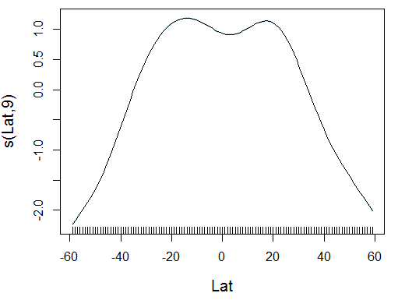
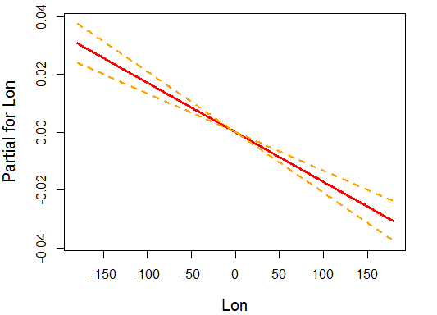
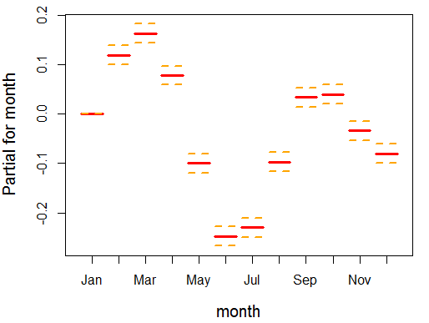
visualize the model
Effect plots show the fitted relationship between the response and model terms, averaged over other predictors.
The mgcv package has its own versions of these.
plot(nasa.gam, cex.lab=1.25)
termplot(nasa.gam, terms="month", se=TRUE, lwd.term=3, lwd.se=2, cex.lab=1.25)
termplot(nasa.gam, terms="Lon", se=TRUE, lwd.term=3, lwd.se=2, cex.lab=1.25)
why the dip at the equator?
effect of longitude is very small, but maybe interpretable
month should be modeled as a time variable

Slide 31
Visualizing models
R modeling functions [lm(), glm(), …] return model objects, but these are “messy”
extracting coefficients takes several steps: data.frame(coef(mymod))
some info (R², F, p.value) is computed in print() method, not stored
can’t easily combine models
Some have associated plotting functions
plot(model): diagnostic plots
car package: many model plot methods
effects package: plot effects for model terms
But what if you want to:
make a table of model summary statistics
fit a collection of models, compare, summarize or visualize them?

Slide 32

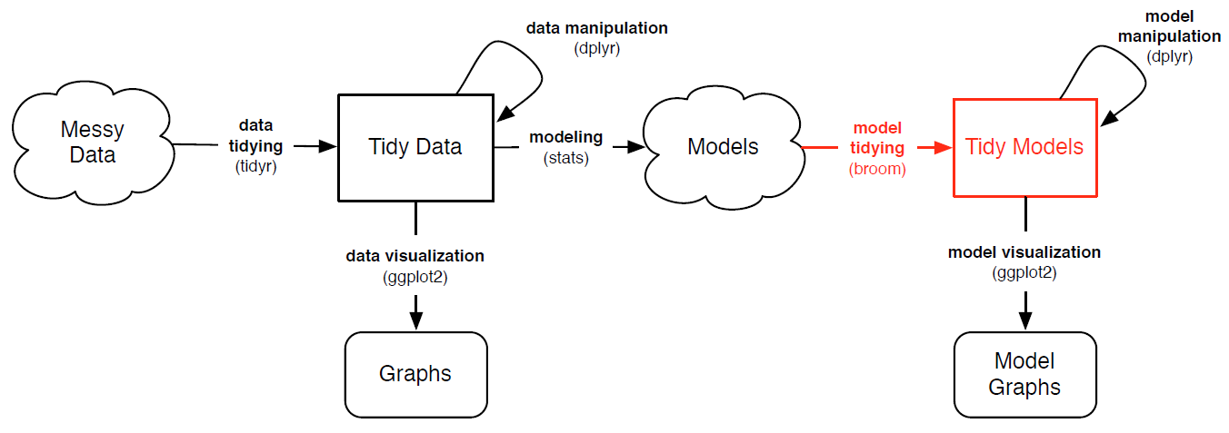
broom: visualizing models
The broom package turns model objects into tidy data frames
glance(models) extracts model-level summary statistics (R², df, AIC, BIC)
tidy(models) extracts coefficients, SE, p-values
augment(models) extracts observation-level info (residuals, …)
Image from: https://opr.princeton.edu/workshops/Downloads/2016Jan_BroomRobinson.pdf

Slide 33
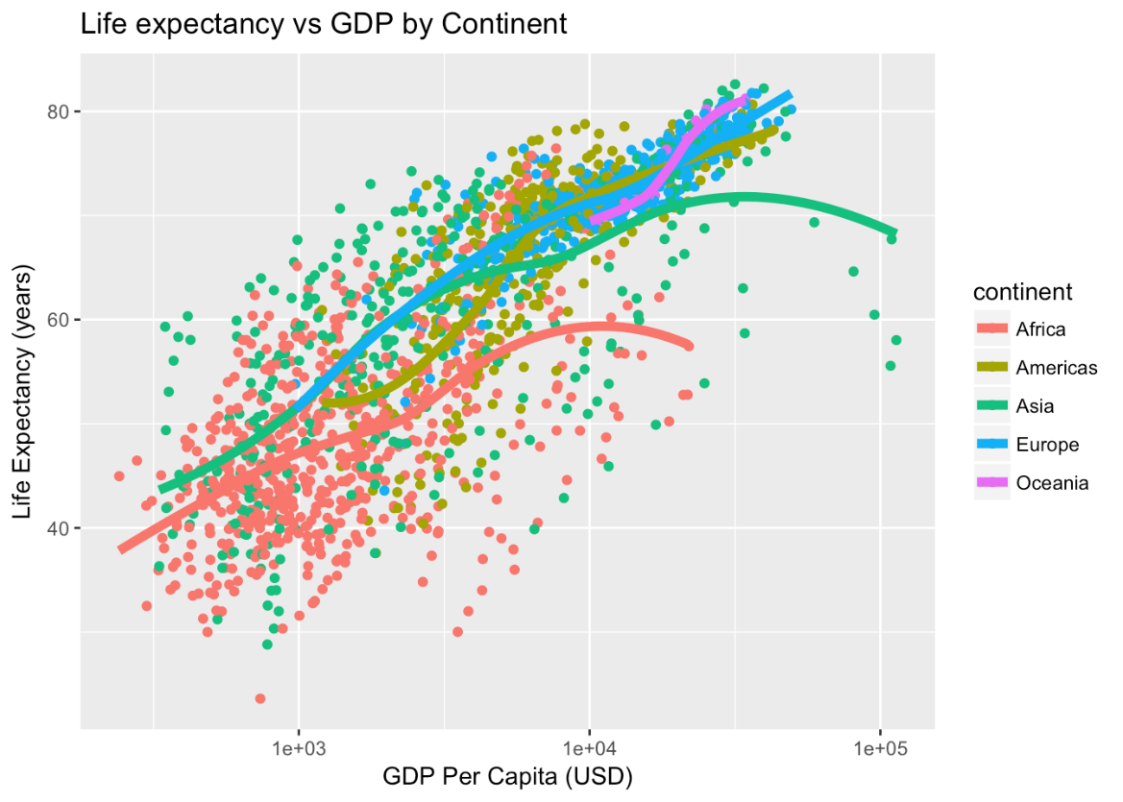
Example: gapminder data
ggplot(aes(x = log(gdpPercap), y=lifeExp, color=continent), data=gapminder) +
geom_point() +
geom_smooth(method = "loess")
How to model this?
How to extract & plot model statistics?
How to fit & display multiple models for subsets?

Slide 34
Example: gapminder data
Predict life expectancy from year, population, GDP and continent:
gapmod <- lm(lifeExp ~ year + pop + log(gdpPercap) + continent, data=gapminder)
summary(gapmod)
Call:
lm(formula = lifeExp ~ year + pop + log(gdpPercap) + continent, data = gapminder)
Residuals:
Min 1Q Median 3Q Max
-24.928 -3.285 0.314 3.699 15.221
Coefficients:
Estimate Std. Error t value Pr(>|t|)
(Intercept) -4.58e+02 1.67e+01 -27.43 < 2e-16 ***
year 2.38e-01 8.61e-03 27.58 < 2e-16 ***
pop 5.40e-09 1.38e-09 3.91 9.5e-05 ***
log(gdpPercap) 5.10e+00 1.60e-01 31.88 < 2e-16 ***
continentAmericas 8.74e+00 4.63e-01 18.86 < 2e-16 ***
continentAsia 6.64e+00 4.09e-01 16.22 < 2e-16 ***
continentEurope 1.23e+01 5.10e-01 24.11 < 2e-16 ***
continentOceania 1.26e+01 1.27e+00 9.88 < 2e-16 ***
---
Signif. codes: 0 ‘***’ 0.001 ‘**’ 0.01 ‘*’ 0.05 ‘.’ 0.1 ‘ ’ 1
Residual standard error: 5.79 on 1696 degrees of freedom
Multiple R-squared: 0.8, Adjusted R-squared: 0.799
F-statistic: 969 on 7 and 1696 DF, p-value: <2e-16
observation level
component level (coefficients)
model level

Slide 35
glance() gives the model level summary statistics
> glance(gapmod)
r.squared adj.r.squared sigma statistic p.value df logLik AIC BIC deviance df.residual
1 0.8 0.7992 5.789 969 0 8 -5406 10830 10879 56835 1696
tidy() gives the model component (term) statistics
> tidy(gapmod)
term estimate std.error statistic p.value
1 (Intercept) -4.585e+02 1.671e+01 -27.433 1.982e-137
2 year 2.376e-01 8.613e-03 27.584 1.122e-138
3 pop 5.403e-09 1.381e-09 3.912 9.496e-05
4 log(gdpPercap) 5.103e+00 1.601e-01 31.876 4.096e-175
5 continentAmericas 8.739e+00 4.635e-01 18.856 3.758e-72
6 continentAsia 6.635e+00 4.091e-01 16.219 4.167e-55
7 continentEurope 1.230e+01 5.102e-01 24.113 1.044e-110
8 continentOceania 1.256e+01 1.270e+00 9.884 1.943e-22
augment() gives the observation level statistics
> augment(gapmod) %>% slice(1:5)
# A tibble: 5 x 12
lifeExp year pop log.gdpPercap. continent .fitted .se.fit .resid .hat .sigma
<dbl> <int> <int> <dbl> <fct> <dbl> <dbl> <dbl> <dbl> <dbl>
1 28.8 1952 8425333 6.66 Asia 46.0 0.408 -17.1 0.00496 5.78
2 30.3 1957 9240934 6.71 Asia 47.4 0.390 -17.1 0.00454 5.78
3 32.0 1962 10267083 6.75 Asia 48.8 0.376 -16.8 0.00423 5.78
4 34.0 1967 11537966 6.73 Asia 49.9 0.372 -15.9 0.00413 5.78
5 36.1 1972 13079460 6.61 Asia 50.5 0.382 -14.4 0.00435 5.78
# ... with 2 more variables: .cooksd <dbl>, .std.resid <dbl>

Slide 36
Going further: fitting multiple models
There may be different relations by continent (interactions)
What if want to fit (and visualize) a separate model for each continent?
dplyr::do() allows us to store the result of an arbitrary computation in a tidy column
# separate models for continents
models <- gapminder %>%
filter(continent != "Oceania") %>% # only two countries
group_by(continent) %>%
do(mod = lm(lifeExp ~ year + pop + log(gdpPercap), data=.))
# view model summaries
models %>% glance(mod)
# A tibble: 4 x 12
# Groups: continent [4]
continent r.squared adj.r.squared sigma statistic p.value df logLik
<fct> <dbl> <dbl> <dbl> <dbl> <dbl> <int> <dbl>
1 Africa 0.500 0.498 6.48 207. 5.90e- 93 4 -2050.
2 Americas 0.720 0.718 4.97 254. 1.39e- 81 4 -904.
3 Asia 0.696 0.694 6.56 299. 5.27e-101 4 -1305.
4 Europe 0.797 0.795 2.46 466. 7.42e-123 4 -833.
# ... with 4 more variables: AIC <dbl>, BIC <dbl>, deviance <dbl>,
# df.residual <int>

Slide 37
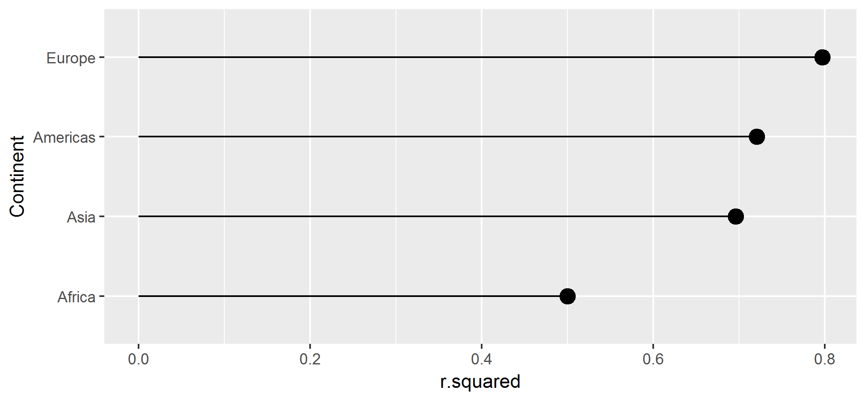
Going further: plotting multiple models
One visual summary might be a plot of R² values, ordered by continent
models %>%
glance(mod) %>%
ggplot(aes(r.squared, reorder(continent, r.squared))) +
geom_point(size=4) +
geom_segment(aes(xend = 0, yend = ..y..)) +
ylab("Continent")

Slide 38
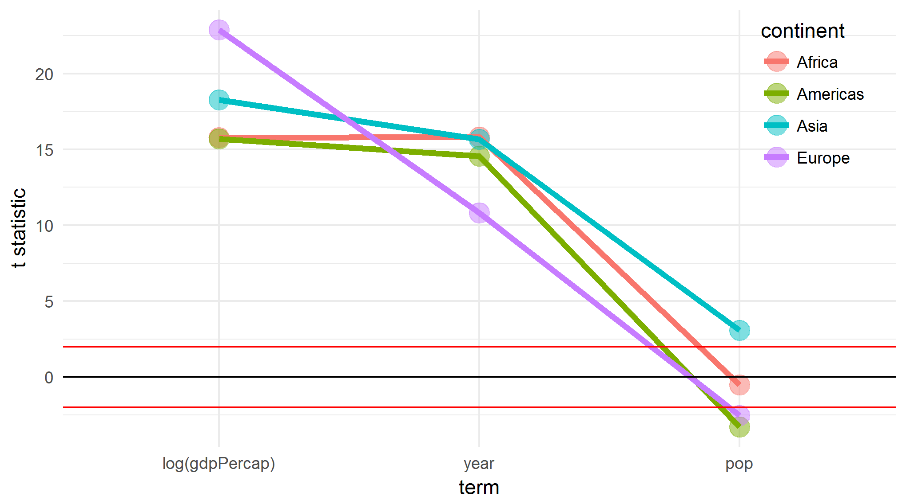
Visualizing coefficients
Coefficient plots are often useful, but these are on different scales.
models %>% tidy(mod) %>% # get model stats
filter(term != "(Intercept)") %>% # ignore the intercept
mutate(term=factor(term, levels=c("log(gdpPercap)", "year", "pop"))) %>% # reorder terms sensibly
ggplot(aes(x=term, y=statistic, color=continent, group=continent)) +
geom_point(size=5, alpha=0.5) +
geom_line(size=1.5) +
geom_hline(yintercept=c(-2, 0, 2), color = c("red", "black", "red")) + # hlines for non-significance
ylab("t statistic") +
theme_minimal() + theme(legend.position=c(0.9, 0.8))
Here, I plot the t-statistics, t=b_{ij}/se(b_{ij}) for all terms in all models.
Any values outside ~ ±2 are significant, p < 0.5!

Slide 39
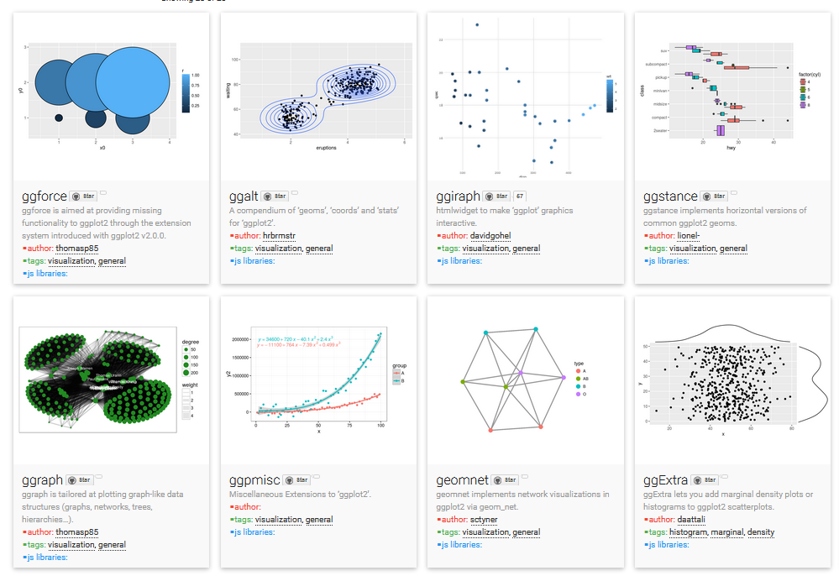
ggplot extensions
There are a large number of ggplot extensions. See: http://www.ggplot2-exts.org/

Slide 40
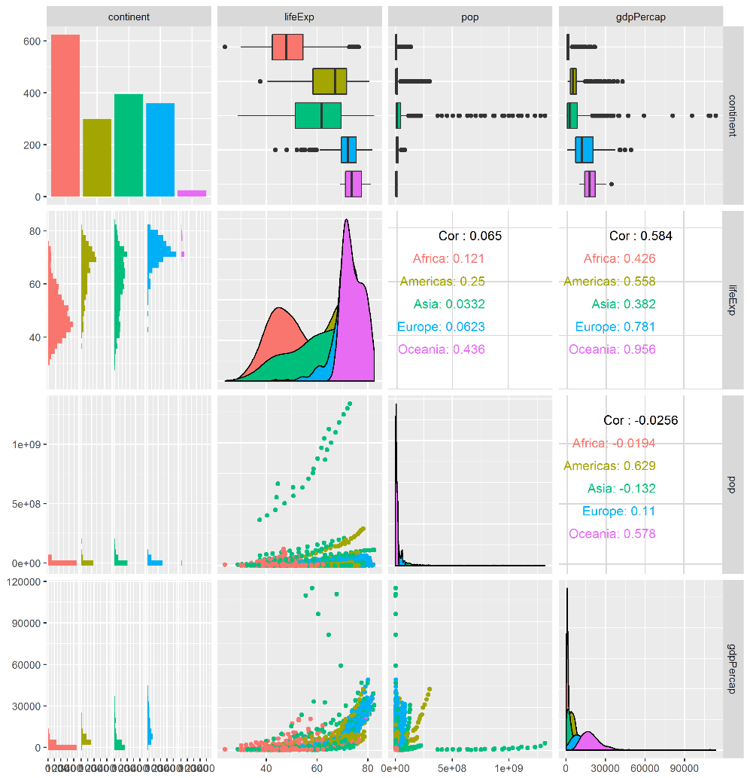
ggplot extensions: GGally
GGally contains a large number of functions that extend ggplot2 to multivariate data
ggpairs() produces generalized scatterplot matrices, with lots of options
library(GGally)
library(dplyr)
library(ggplot2)
library(gapminder)
gapminder %>%
select(-country, -year) %>%
ggpairs(aes(color=continent))

Slide 41
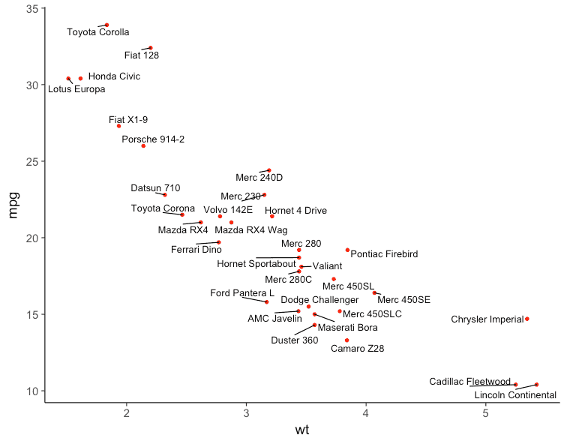
ggplot extensions: ggrepel
devtools::install_github("slowkow/ggrepel")
library(ggplot2)
library(ggrepel)
ggplot(mtcars, aes(wt, mpg)) +
geom_point(color = 'red') +
geom_text_repel(aes(label = rownames(mtcars))) +
theme_classic(base_size = 16)
Plotting text labels is often difficult
ggrepel provides geoms for ggplot2 to repel overlapping text labels.

Slide 42
ggplot extensions: gganimate
gganimate is a wrapper for the animation package with ggplot2.
It adds a frame= aesthetic, and animates the image as the frame variable changes
p5 <- ggplot(gapminder, aes(gdpPercap, lifeExp, size = pop, frame = year)) +
geom_point() +
geom_smooth(aes(group = year), method = "lm", show.legend = FALSE) +
facet_wrap(~continent, scales = "free") +
scale_x_log10()
gganimate(p5)

Slide 43
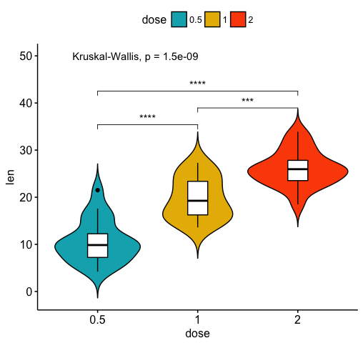
ggpubr
The ggpubr package provides some easy-to-use functions for creating and customizing publication ready plots.
ggviolin(df, x = "dose", y = "len", fill = "dose",
palette = c("#00AFBB", "#E7B800", "#FC4E07"),
add = "boxplot", add.params = list(fill = "white")) +
stat_compare_means(comparisons = my_comparisons, label = "p.signif") +
stat_compare_means(label.y = 50)
see the examples at http://www.sthda.com/english/rpkgs/ggpubr/

Slide 44
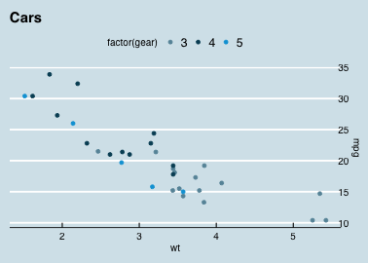
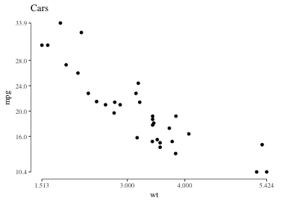
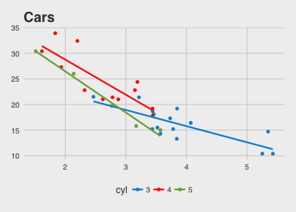
ggthemes
+ theme_economist()
ggthemes provides a large number of extra geoms, scales, and themes for ggplot
install.packages('ggthemes', dependencies = TRUE)
+ theme_tufte()
+ theme_fivethirtyeight()

Slide 45
Tables in R
Not a ggplot topic, but it is useful to know that you can also produce beautiful tables in R
There are many packages for this: See the CRAN Task View on Reproducible Research, https://cran.r-project.org/web/views/ReproducibleResearch.html
xtable: Exports tables to LaTeX or HTML, with lots of control
stargazer: Well-formatted model summary tables, side-by-side
apaStyle: Generate APA Tables for MS Word

Slide 46
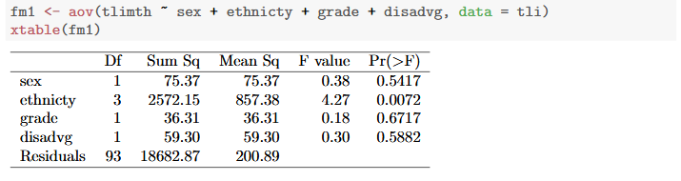
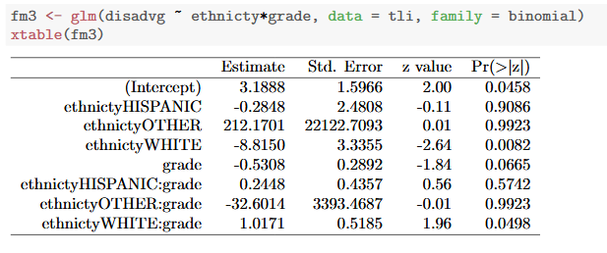
Tables in R: xtable
Just a few examples, stolen from xtable: vignette(“xtableGallery.pdf”)
Too many decimals are used here, but you can control all that

