Slide 1
Miscellaneous slides

Slide 2
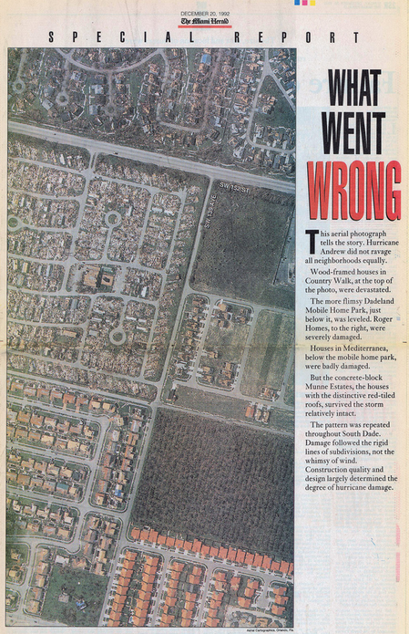
Data journalism: Hurricane Andrew
In Aug. 1992, a category 5 hurricane hit Miami-Dade county
Huge numbers of houses were destroyed, but this varied by neighborhood
Investigative reporters at the Miami Herald discovered why:
Building codes and inspection became lax after 1980. Older homes survived.
This report won the Pulitzer Prize in 1993.
destroyed
undamaged
Source: https://www.flickr.com/photos/juggernautco/sets/72157607210036175/

Slide 3
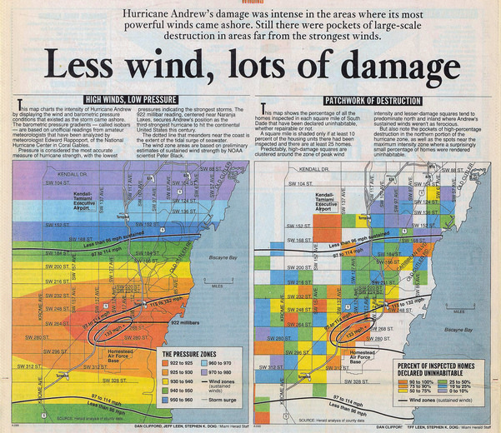
Data journalism: Hurricane Andrew
The report in the Miami Herald contained many detailed analysis maps
There was compelling evidence for the cause of destruction.

