Slide 1
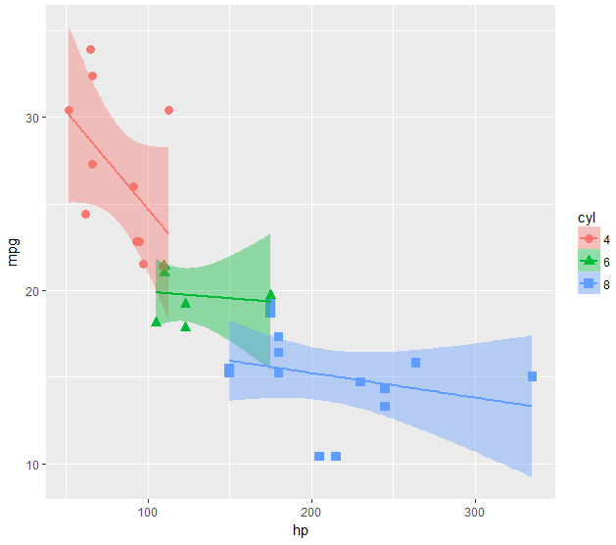
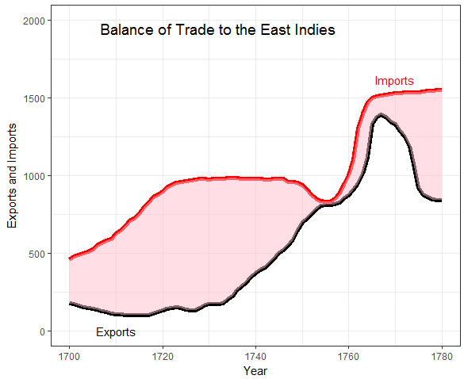
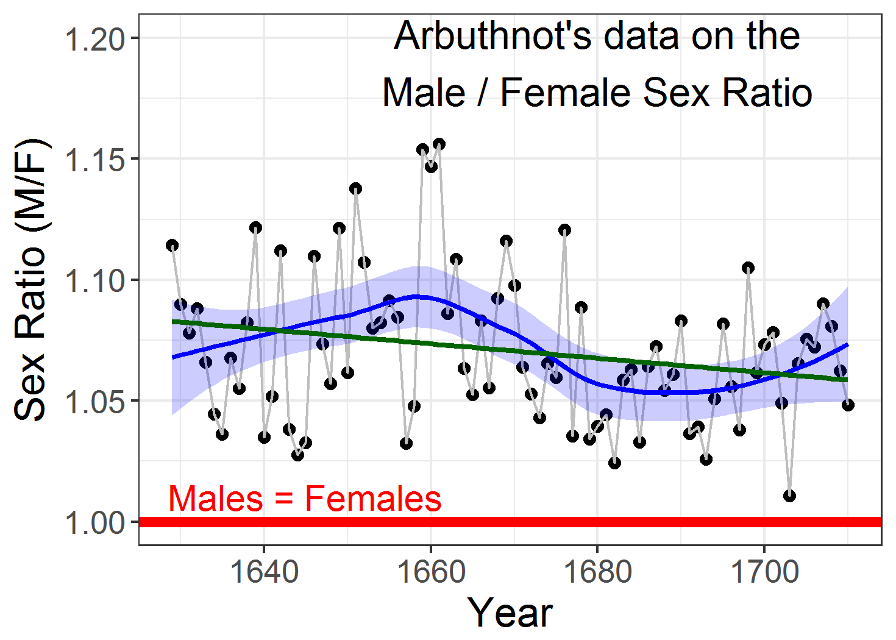
Introduction to ggplot2
Michael Friendly
Psych 6135
https://friendly.github.io/6135

Slide 2
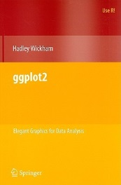
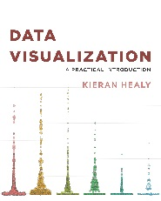
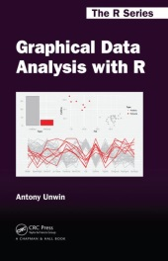

Resources: Books
Hadley Wickham, ggplot2: Elegant graphics for data analysis, 2nd Ed.
1st Ed: Online, http://ggplot2.org/book/
ggplot2 Quick Reference: http://sape.inf.usi.ch/quick-reference/ggplot2/
Complete ggplot2 documentation: http://docs.ggplot2.org/current/
Kieran Healy, Data Visualization, a Practical Introduction
A hands-on introduction to data visualization using ggplot2, with a wide range of topics.
The online version: https://socviz.co/ is a great example of R bookdown publishing.
Antony Unwin, Graphical Data Analysis with R
A gentile introduction to doing visual data analysis, mainly with ggplot2.
R code: http://www.gradaanwr.net/
Winston Chang, R Graphics Cookbook: Practical Recipes for Visualizing Data
Cookbook format, covering common graphing tasks; the main focus is on ggplot2
R code from book: http://www.cookbook-r.com/Graphs/
Download from: http://ase.tufts.edu/bugs/guide/assets/R%20Graphics%20Cookbook.pdf

Slide 3
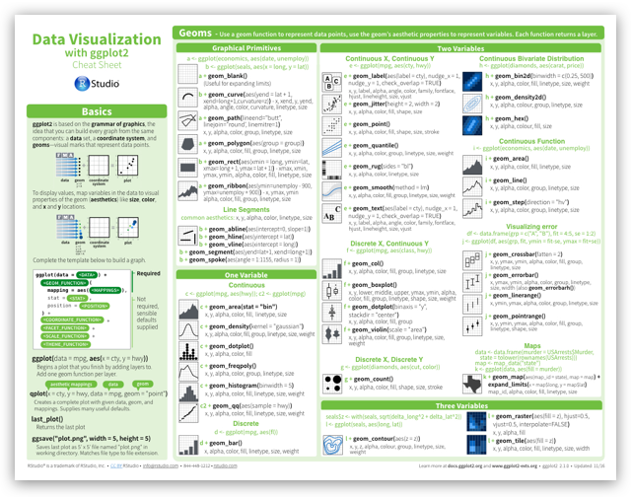
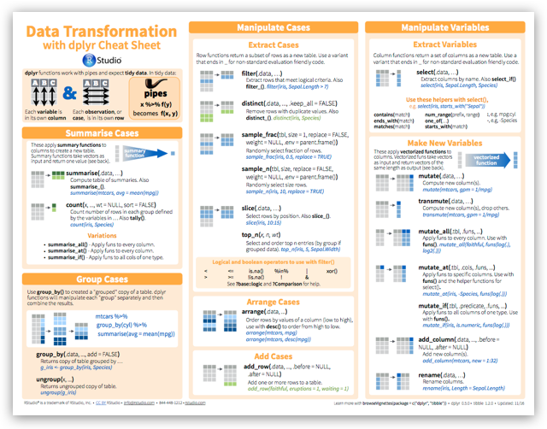
Resources: Cheat sheets
R Studio maintains a large number of cheat sheets, https://www.rstudio.com/resources/cheatsheets/
Topics:
R Studio IDE, Data import, Data transformation (dplyr), Data visualization (ggplot2), R Markdown, …
My collection: R Studio Cheat Sheets

Slide 4
What is ggplot2?
ggplot2 is Hadley Wickham’s R package for producing “elegant graphics for data analysis”
An implementation of the ideas for graphics introduced in Lee Wilkinson’s Grammar of Graphics
These ideas and the syntax of ggplot2 help to think of graphs in a new and more general way
Produces pleasing plots, taking care of many of the fiddly details (legends, axes, colors, …)
It is built upon the “grid” graphics system
It is open software, with a large number of gg_ extensions. See: https://exts.ggplot2.tidyverse.org/gallery/

Slide 5
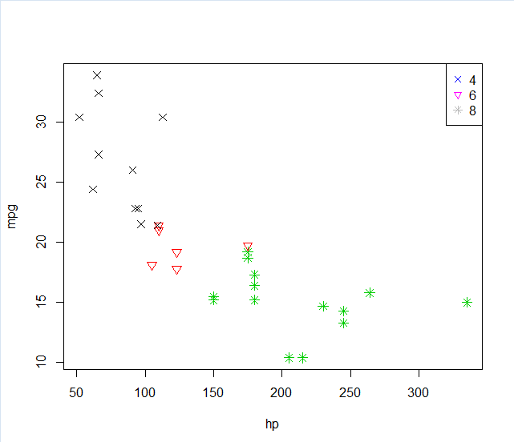
ggplot2 vs base graphics
Some things that should be simple are harder than you’d like in base graphics
Here, I’m plotting gas mileage (mpg) vs. horsepower and want to use color and shape for different # of cylinders.
But I don’t quite get it right!
mtcars$cyl <- as.factor(mtcars$cyl)
plot(mpg ~ hp , data=mtcars,
col=cyl, pch=c(4,6,8)[mtcars$cyl], cex=1.2)
legend("topright", legend=levels(mtcars$cyl),
pch = c(4,6,8),
col=levels(mtcars$cyl))
colors and point symbols work differently in plot() and legend()
goal of ggplot2: this should “just work”

Slide 6
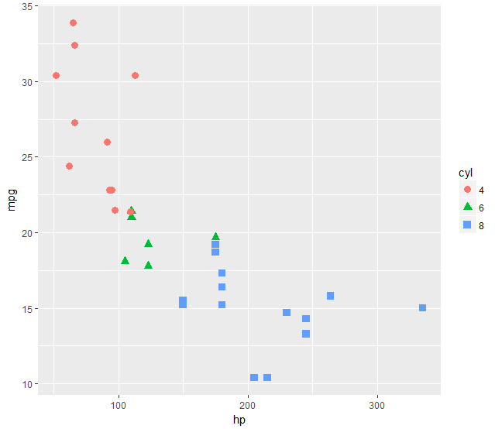
ggplot2 vs base graphics
In ggplot2, just map the data variables to aesthetic attributes
aes(x, y, shape, color, size, …)
ggplot() takes care of the rest
aes() mappings set in the call to ggplot() are passed to geom_point() here
library(ggplot2)
ggplot(mtcars, aes(x=hp, y=mpg, color=cyl, shape=cyl)) +
geom_point(size=3)
Follow along: the R script for this example is at: http://euclid.psych.yorku.ca/www/psy6135/R/gg-cars.R

Slide 7
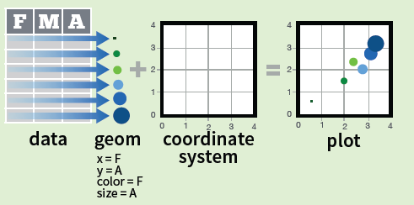
Grammar of Graphics
Every graph can be described as a combination of independent building blocks:
data: a data frame: quantitative, categorical; local or data base query
aesthetic mapping of variables into visual properties: size, color, x, y
geometric objects (“geom”): points, lines, areas, arrows, …
coordinate system (“coord”): Cartesian, log, polar, map,

Slide 8
ggplot2: data + geom -> graph
ggplot(data=mtcars,
aes(x=hp, y=mpg,
color=cyl, shape=cyl)) +
geom_point(size=3)
❶
❷
❸
❹
In this call,
data=mtcars: data frame
aes(x=hp, y=mpg): plot variables
aes(color, shape): attributes
geom_point(): what to plot
the coordinate system is taken to be the standard Cartesian (x,y)

Slide 9
ggplot2: geoms
Wow! I can really see something there.
How can I enhance this visualization?
Easy: add a geom_smooth() to fit linear regressions for each level of cyl
It is clear that horsepower and # of cylinders are highly related (Duh!)
ggplot(mtcars, aes(x=hp, y=mpg, color=cyl, shape=cyl)) +
geom_point(size=3) +
geom_smooth(method="lm", aes(fill=cyl))

Slide 10
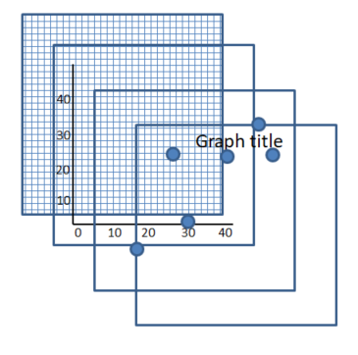
ggplot2: + = layers
In ggplot, a graph is built from layers, connected by the + operation
ggplot( data ) +
aes( x=, y=) +
geom_points() +
ggtitle(“Graph title”)

Slide 11
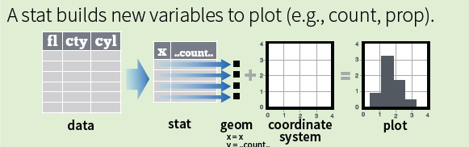
Grammar of Graphics
Other GoG building blocks:
statistical transformations (“stat”) -- data summaries: mean, sd, binning & counting, …
scales: legends, axes to allow reading data from a plot

Slide 12
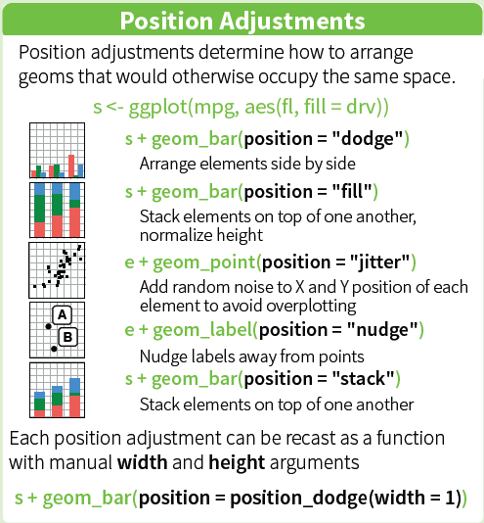
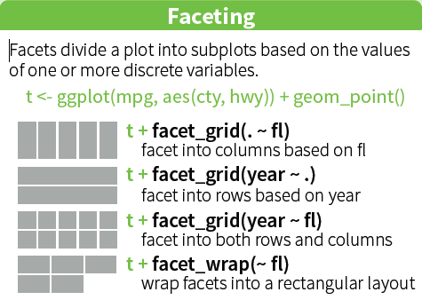
Grammar of Graphics
Other GoG building blocks:
position adjustments: jitter, dodge, stack, …
faceting: small multiples or conditioning to break a plot into subsets.

Slide 13
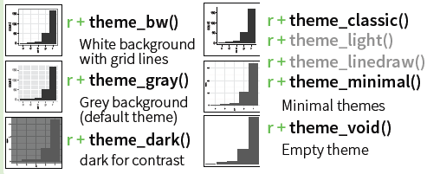
ggplot2: GoG -> graphic language
The implementation of GoG ideas in ggplot2 for R created a more expressive language for data graphs
layers: graph elements combined with “+” (read: “and”)
themes: change graphic elements consistently
ggplot(mtcars, aes(x=hp, y=mpg)) +
geom_point(aes(color = cyl)) +
geom_smooth(method ="lm") +

Slide 14
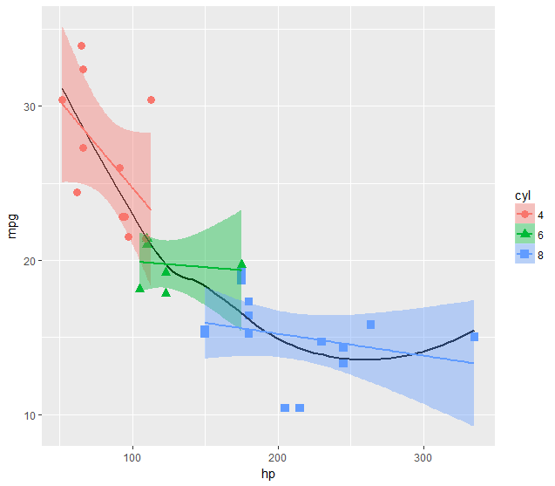
ggplot2: layers & aes()
Aesthetic attributes in the ggplot() call are passed to geom_() layers
Other attributes can be passed as constants (size=3, color=“black”) or
with aes(color=, …) in different layers
This plot adds an overall loess smooth to the previous plot.
color=“black” overrides the aes(color=cyl)
ggplot(mtcars, aes(x=hp, y=mpg)) +
geom_point(size=3, aes(color=cyl, shape=cyl)) +
geom_smooth(method="lm", aes(color=cyl, fill=cyl)) +
geom_smooth(method="loess", color="black", se=FALSE)

Slide 15
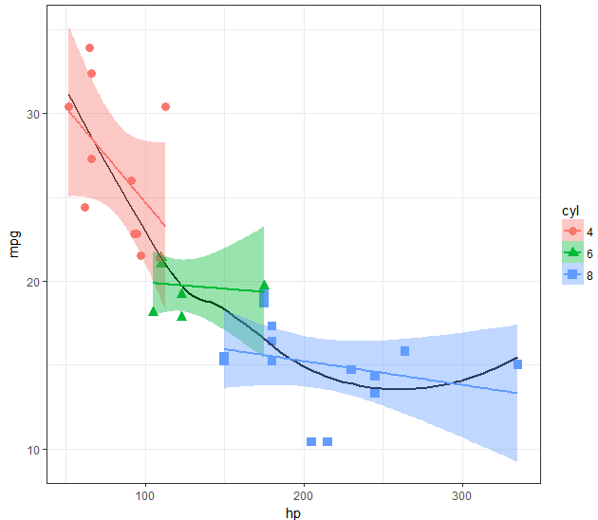
ggplot2: themes
All the graphical attributes of ggplot2 are governed by themes – settings for all aspects of a plot
A given plot can be rendered quite differently just by changing the theme
If you haven’t saved the ggplot object, last_plot() gives you something to work with further
last_plot() + theme_bw()

Slide 16
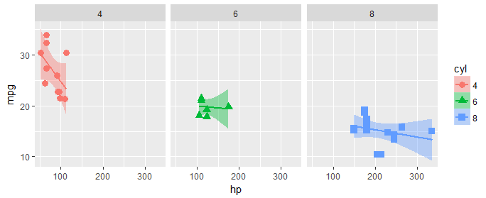
ggplot2: facets
Facets divide a plot into separate subplots based on one or more discrete variables
plt <-
ggplot(mtcars, aes(x=hp, y=mpg, color=cyl, shape=cyl)) +
geom_point(size=3) +
geom_smooth(method="lm", aes(fill=cyl))
plt + facet_wrap(~cyl)

Slide 17
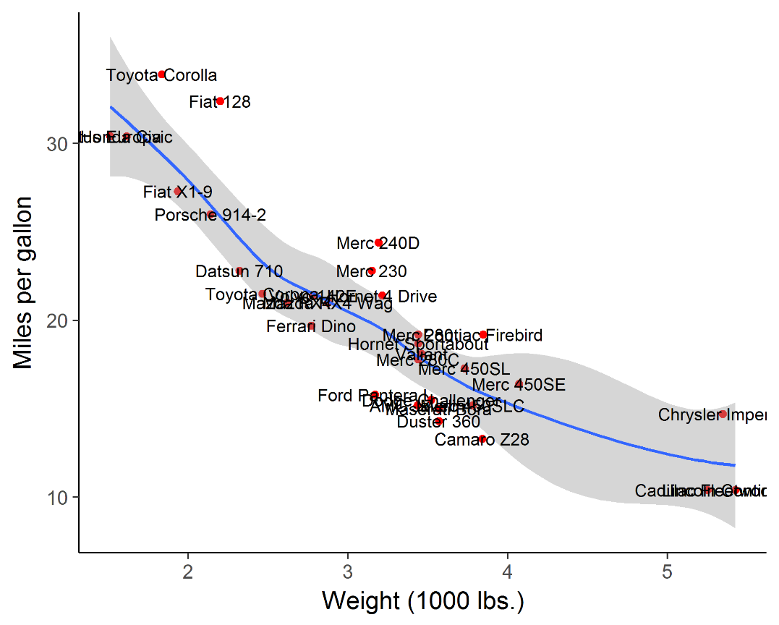
labeling points: geom_text()
plt2 <- ggplot(mtcars, aes(x=wt, y=mpg)) +
geom_point(color = 'red', size=2) +
geom_smooth(method="loess") +
labs(y="Miles per gallon", x="Weight (1000 lbs.)") +
theme_classic(base_size = 16)
plt2 + geom_text(aes(label = rownames(mtcars)))
Sometimes it is useful to label points to show their identities.
geom_text() usually gives messy, overlapping text
Note the use of theme_classic() and better axis labels
But this is still messy: wouldn’t want to publish this.

Slide 18
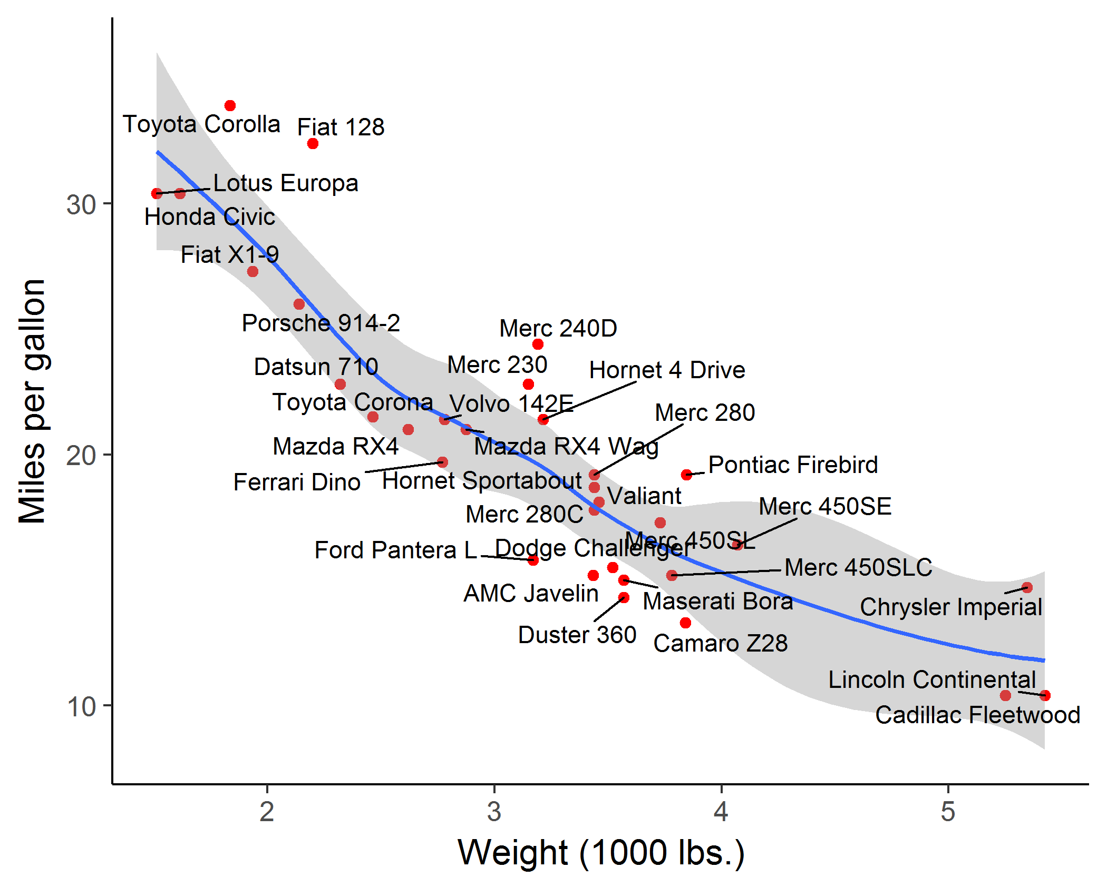
labeling points: geom_text_repel()
library(ggrepel)
plt2 +
geom_text_repel(aes(label = rownames(mtcars)))
geom_text_repel() in the ggrepel package assigns repulsive forces among points and labels to assure no overlap
Some lines are drawn to make the assignment clearer

Slide 19
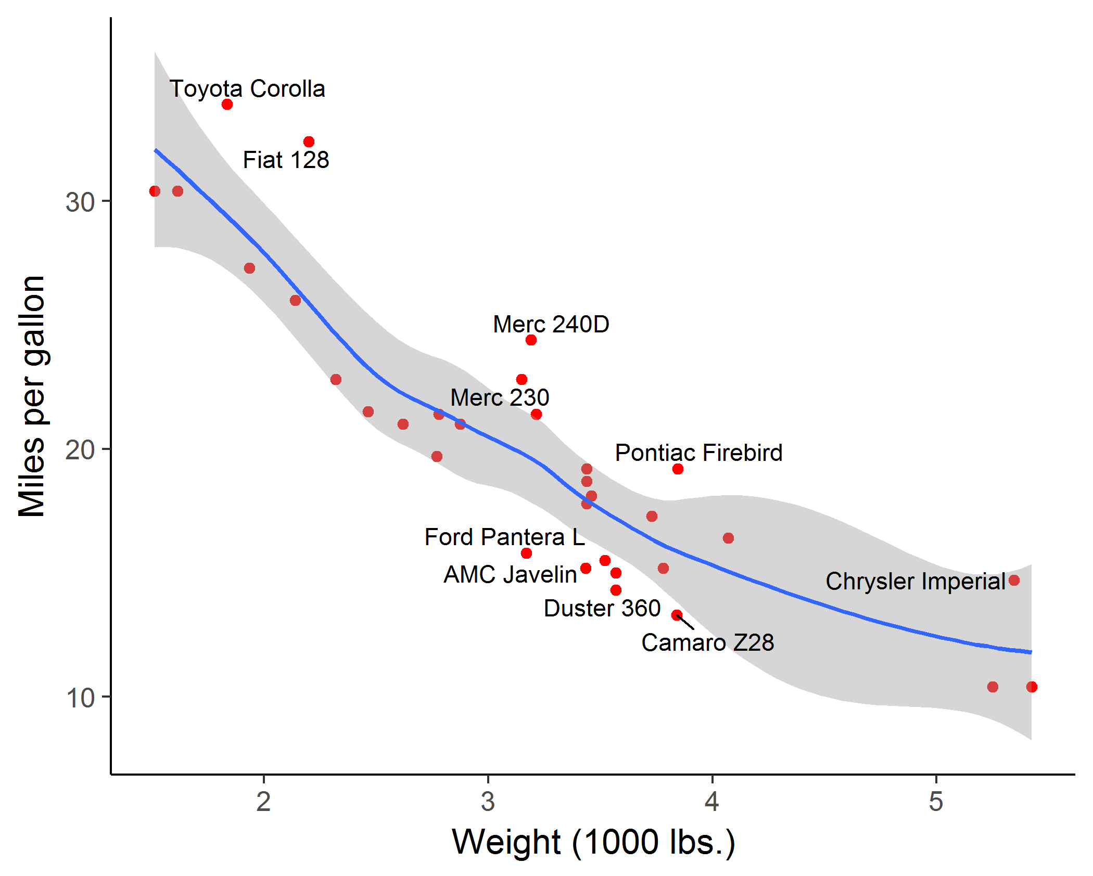
labeling points: selection
It is easy to label points selectively, using some criterion to assign labels to points
mod <- loess( mpg ~ wt, data=mtcars)
resids <- residuals(mod)
mtcars$label <- ifelse(abs(resids) > 2.5,
rownames(mtcars), "")
plt2 + geom_text_repel(aes(label = mtcars$label))
❶
❷
❸
❹
Here, I:
fit the smoothed loess curve,
extract residuals, r_{i}
assign labels where |r_{i}| > 2.5
add the text layer

Slide 20
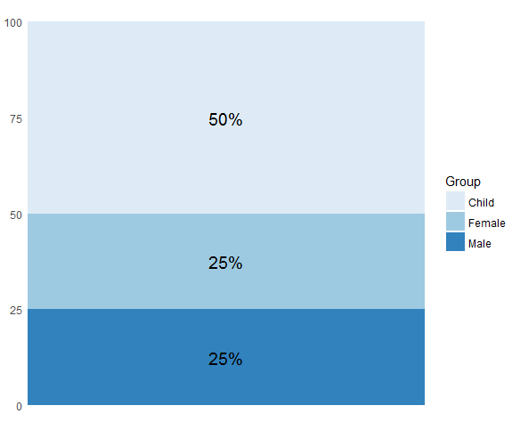
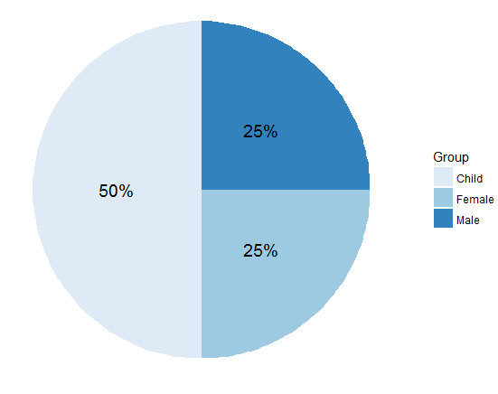
ggplot2: coords
Coordinate systems, coord_*() functions, handle conversion from geometric objects to what you see on a 2D plot.
A simple bar chart, standard coordinates
A pie chart is just a bar chart in polar coordinates!
p <- ggplot(df, aes(x = "", y = value, fill = group)) +
geom_bar( stat = "identity")
p + coord_polar("y", start = 0)

Slide 21
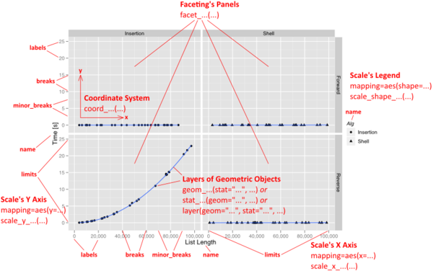
Anatomy of a ggplot
Other details of ggplot concern scales
You can control everything

Slide 22
ggplot objects
Traditional R graphics just produce graphical output on a device
However, ggplot() produces a “ggplot” object, a list of elements
> names(plt)
[1] "data" "layers" "scales" "mapping" "theme" "coordinates"
[7] "facet" "plot_env" "labels"
> class(plt)
[1] "gg" "ggplot"
What methods are available?
> methods(class="gg")
[1] +
> methods(class="ggplot")
[1] grid.draw plot print summary
The “gg” class provides the “+” method
The “ggplot” class provides other, standard methods

Slide 23
Playfair: Balance of trade charts
In the Commercial and Political Atlas, William Playfair used charts of imports and exports from England to its trading partners to ask “How are we doing”?
Here is a re-creation of one example, using ggplot2. How was it done?
> data(EastIndiesTrade,package="GDAdata")
> head(EastIndiesTrade)
Year Exports Imports
1 1700 180 460
2 1701 170 480
3 1702 160 490
4 1703 150 500
5 1704 145 510
6 1705 140 525
… … …

Slide 24
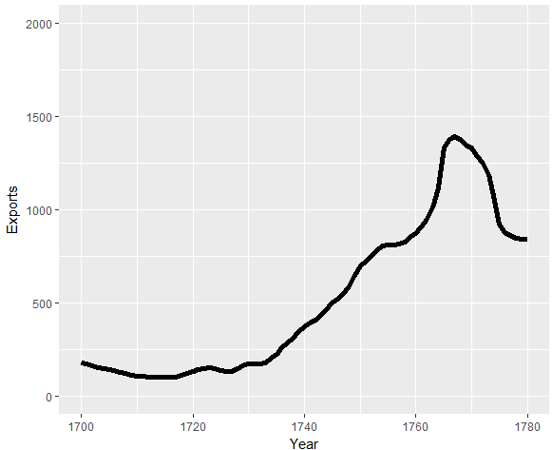
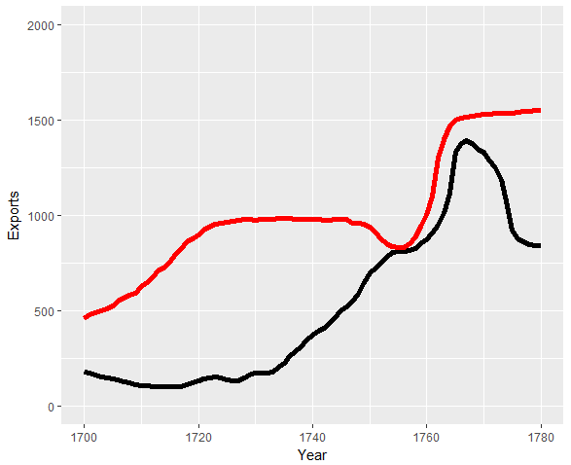
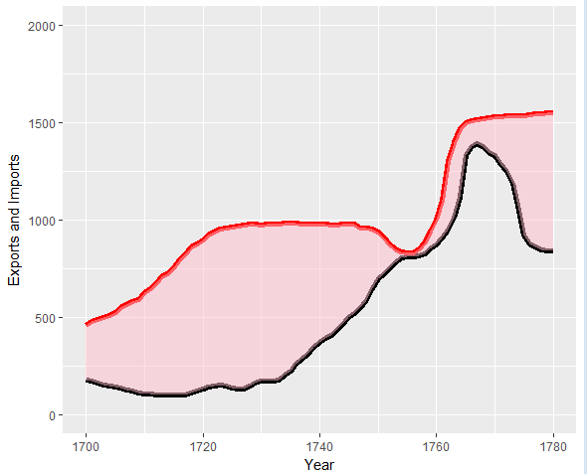
ggplot thinking
I want to plot two time series, & fill the area between them
Start with a line plot of Exports vs. Year: geom_line()
Add a layer for the line plot of Imports vs. Year
c1 <-
ggplot(EastIndiesTrade, aes(x=Year, y=Exports)) +
ylim(0,2000) +
geom_line(colour="black", size=2) +
geom_line(aes(x=Year, y=Imports), colour="red", size=2)
Fill the area between the curves: geom_ribbon()
change the Y label
c1 <- c1 +
geom_ribbon(aes(ymin=Exports, ymax=Imports), fill="pink") +
ylab("Exports and Imports")

Slide 25
That looks pretty good. Add some text labels using annotate()
c1 <- c1 +
annotate("text", x = 1710, y = 0, label = "Exports", size=4) +
annotate("text", x = 1770, y = 1620, label = "Imports", color="red", size=4) +
annotate("text", x = 1732, y = 1950, label = "Balance of Trade to the East Indies", color="black", size=5)
Finally, change the theme to b/w
c1 <- c1 + theme_bw()

Slide 26
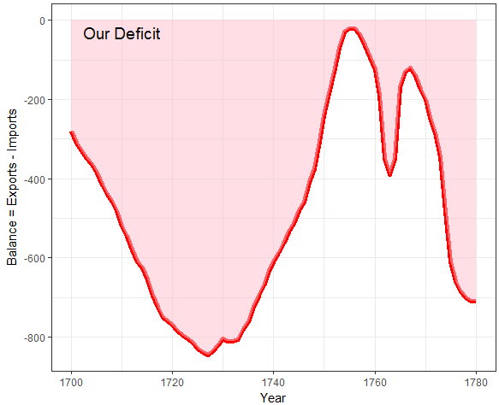
Plot what you want to show
Playfair’s goal was to show the balance of trade with different countries.
Why not plot Exports – Imports directly?
c2 <-
ggplot(EastIndiesTrade, aes(x = Year, y = Exports - Imports)) +
geom_line(colour="red", size=2) +
ylab("Balance = Exports - Imports") +
geom_ribbon(aes(ymin=Exports-Imports, ymax=0), fill="pink",alpha=0.5) +
annotate("text", x = 1710, y = -30, label = "Our Deficit", color="black", size=5) +
theme_bw()
aes(x=, y=) can use expressions calculated from data variables

Slide 27
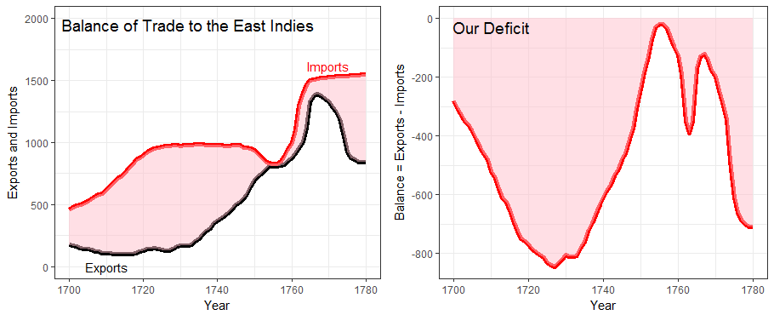
Composing several plots
ggplot objects use grid graphics for rendering
The gridExtra package has functions for combining or manipulating grid-based graphs
library(gridExtra)
grid.arrange(c1, c2, nrow=1)

Slide 28
Saving plots: ggsave()
If the plot is on the screen
ggsave(“path/filename.png”) # height=, width=
If you have a plot object
ggsave(myplot, file=“path/filename.png”)
Specify size:
ggsave(myplot, “path/filename.png”, width=6, height=4)
any plot format (pdf, png, eps, svg, jpg, …)
ggsave(myplot, file=“path/filename.jpg”)
ggsave(myplot, file=“path/filename.pdf”)

Slide 29
Building a custom graph
Custom graphs can be constructed by adding graphical elements (points, lines, text, arrows, etc.) to a basic ggplot()
John Arbuthnot: data on male/female sex ratios:
figure caption
> data(Arbuthnot, package=“HistData”)
> head(Arbuthnot[,c(1:3,6,7)])
Year Males Females Ratio Total
1 1629 5218 4683 1.114 9.901
2 1630 4858 4457 1.090 9.315
3 1631 4422 4102 1.078 8.524
4 1632 4994 4590 1.088 9.584
5 1633 5158 4839 1.066 9.997
6 1634 5035 4820 1.045 9.855
… … … … … …
Arbuthnot didn’t make a graph. He simply calculated the probability that in 81 years from 1629—1710, the sex ratio would always be > 1
The first significance test!
regression line & loess smooth
reference line

Slide 30
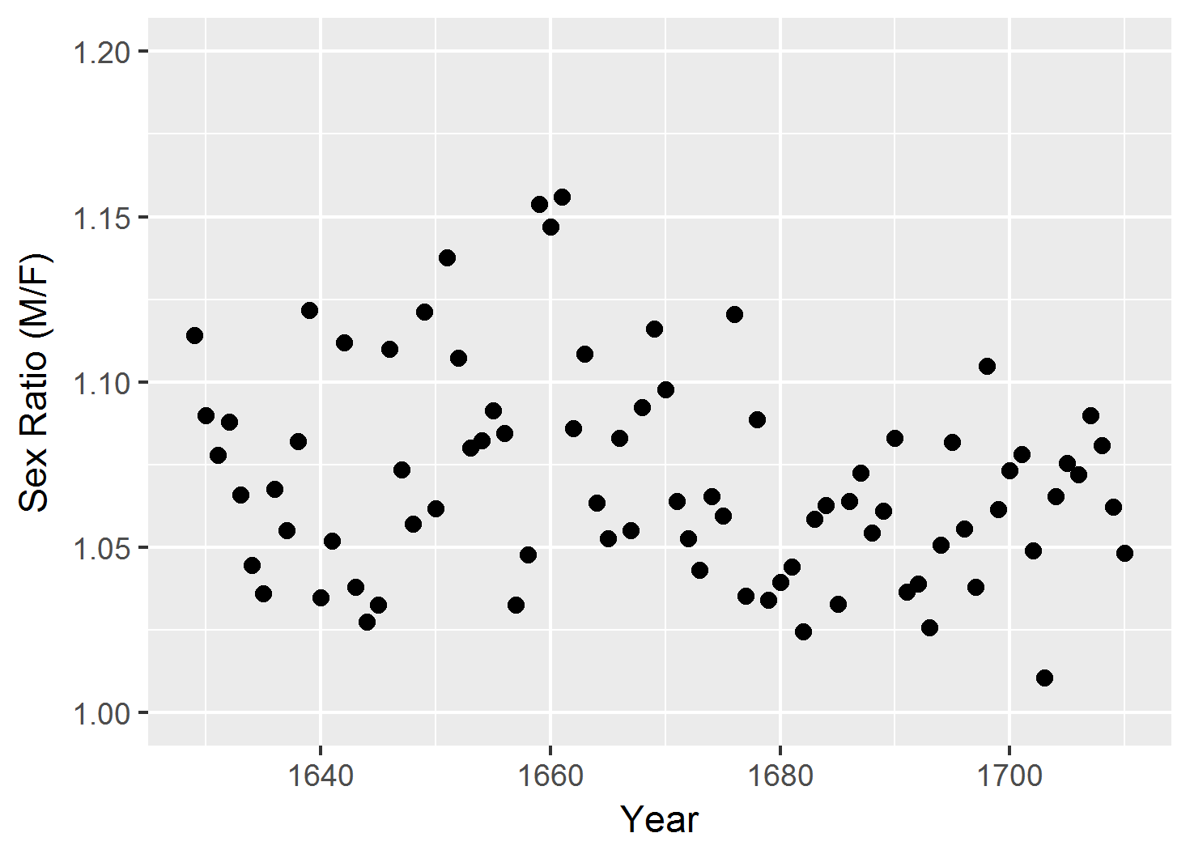
Building a custom graph
ggplot(Arbuthnot, aes(x=Year, y=Ratio)) +
ylim(1, 1.20) +
ylab("Sex Ratio (M/F)") +
geom_point(pch=16, size=2)
Start with a basic scatterplot, Ratio vs. Year
An R script for this example is available at: https://friendly.github.io/6135/R/arbuthnot-gg.R

Slide 31

Building a custom graph
ggplot(Arbuthnot, aes(x=Year, y=Ratio)) +
ylim(1, 1.20) +
ylab("Sex Ratio (M/F)") +
geom_point(pch=16, size=2) +
geom_line(color="gray")
Connect points with a line

Slide 32
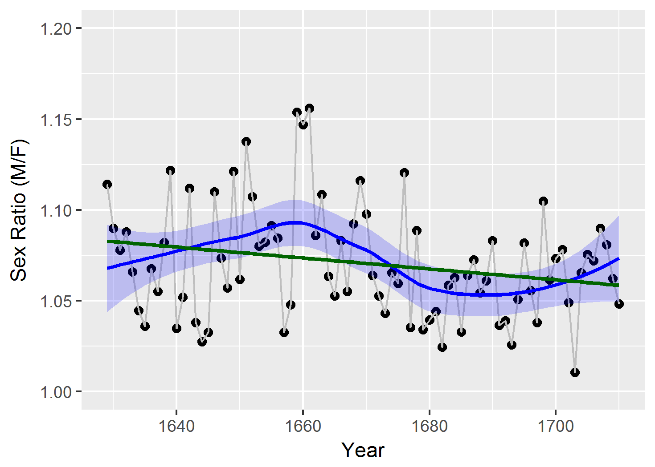
Building a custom graph
ggplot(Arbuthnot, aes(x=Year, y=Ratio)) +
ylim(1, 1.20) +
ylab("Sex Ratio (M/F)") +
geom_point(pch=16, size=2) +
geom_line(color="gray") +
geom_smooth(method="loess", color="blue",
fill="blue", alpha=0.2) +
geom_smooth(method="lm", color="darkgreen",
se=FALSE)
# save what we have so far
arbuth <- last_plot()
Add smooths:
loess curve
linear regression line

Slide 33
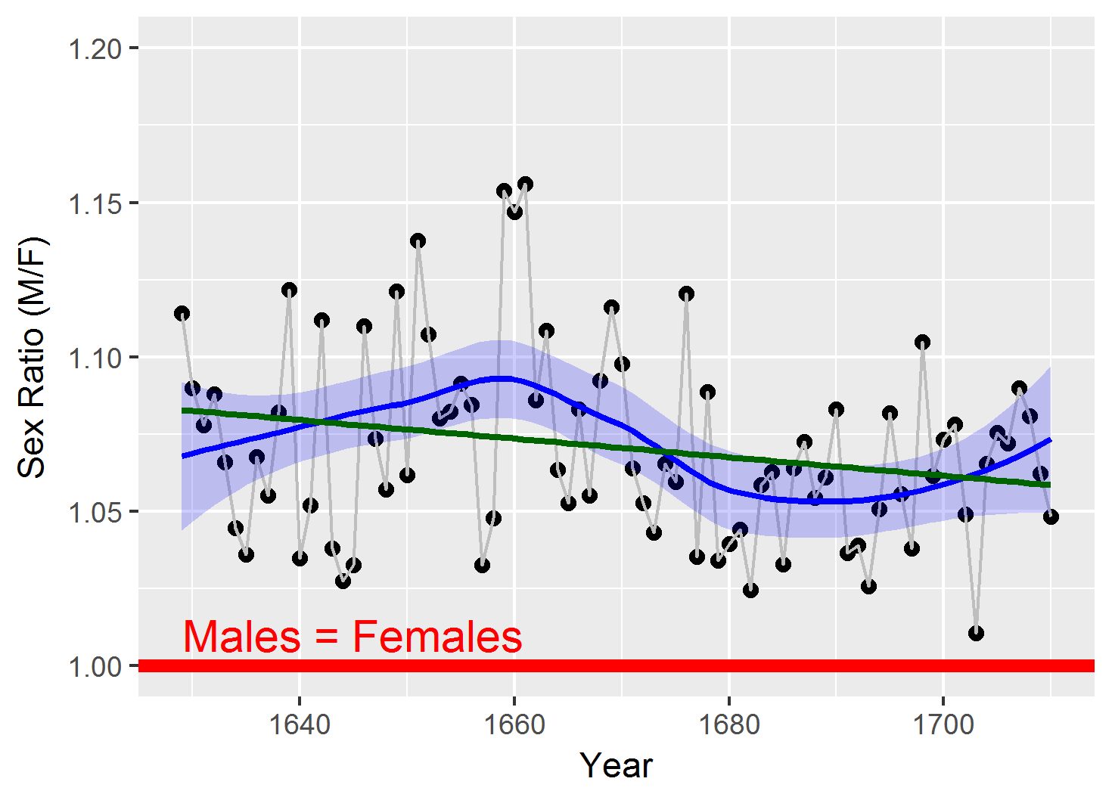
Building a custom graph
arbuth +
geom_hline(yintercept=1, color="red", size=2) +
annotate("text", x=1645, y=1.01, label="Males = Females", color="red", size=5)
Add horizontal reference line
& text label

Slide 34
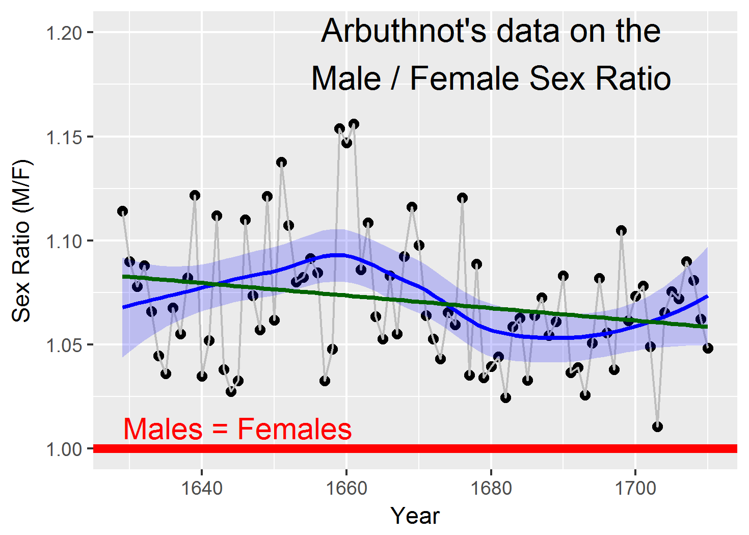
Building a custom graph
arbuth +
geom_hline(yintercept=1, color="red", size=2) +
annotate("text", x=1645, y=1.01, label="Males = Females", color="red", size=5) +
annotate("text", x=1680, y=1.19,
label="Arbuthnot's data on the\nMale / Female Sex Ratio", size=5.5)
Add figure title

Slide 35
Building a custom graph
arbuth +
geom_hline(yintercept=1, color="red", size=2) +
annotate("text", x=1645, y=1.01, label="Males = Females", color="red", size=5) +
annotate("text", x=1680, y=1.19,
label="Arbuthnot's data on the\nMale / Female Sex Ratio", size=5.5) +
theme_bw() + theme(text = element_text(size = 16))
Change the theme and font size

Slide 36
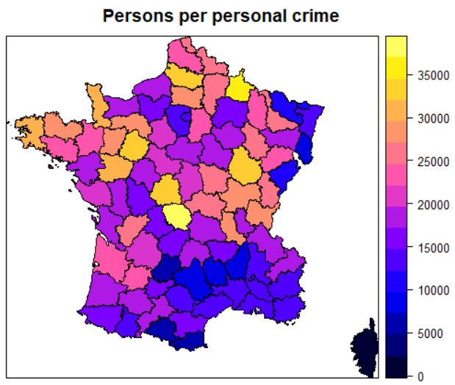
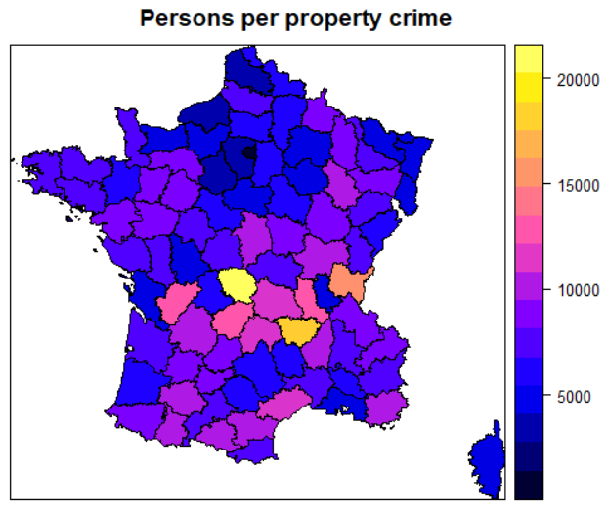
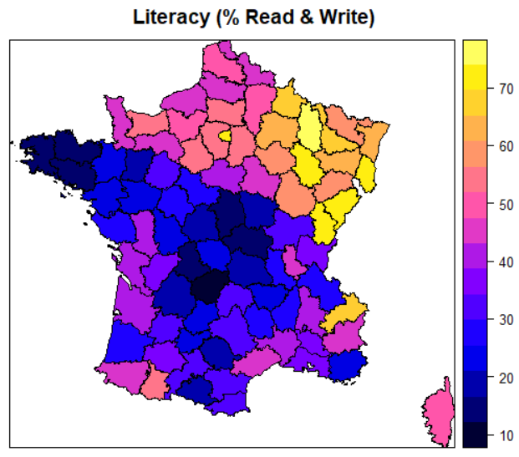
Guerry: Moral statistics of France
Guerry (1833) made shaded maps of France to determine if crime was related to literacy & other factors
library(Guerry)
library(sp)
spplot(gfrance, "Crime_pers")
spplot(gfrance, "Crime_prop")
spplot(gfrance, "Literacy")

Slide 37
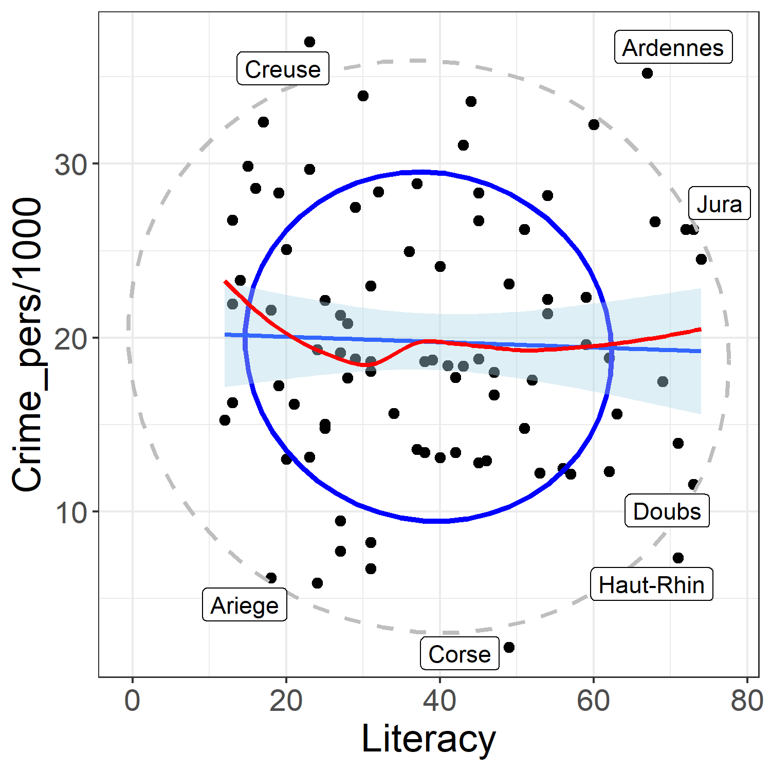
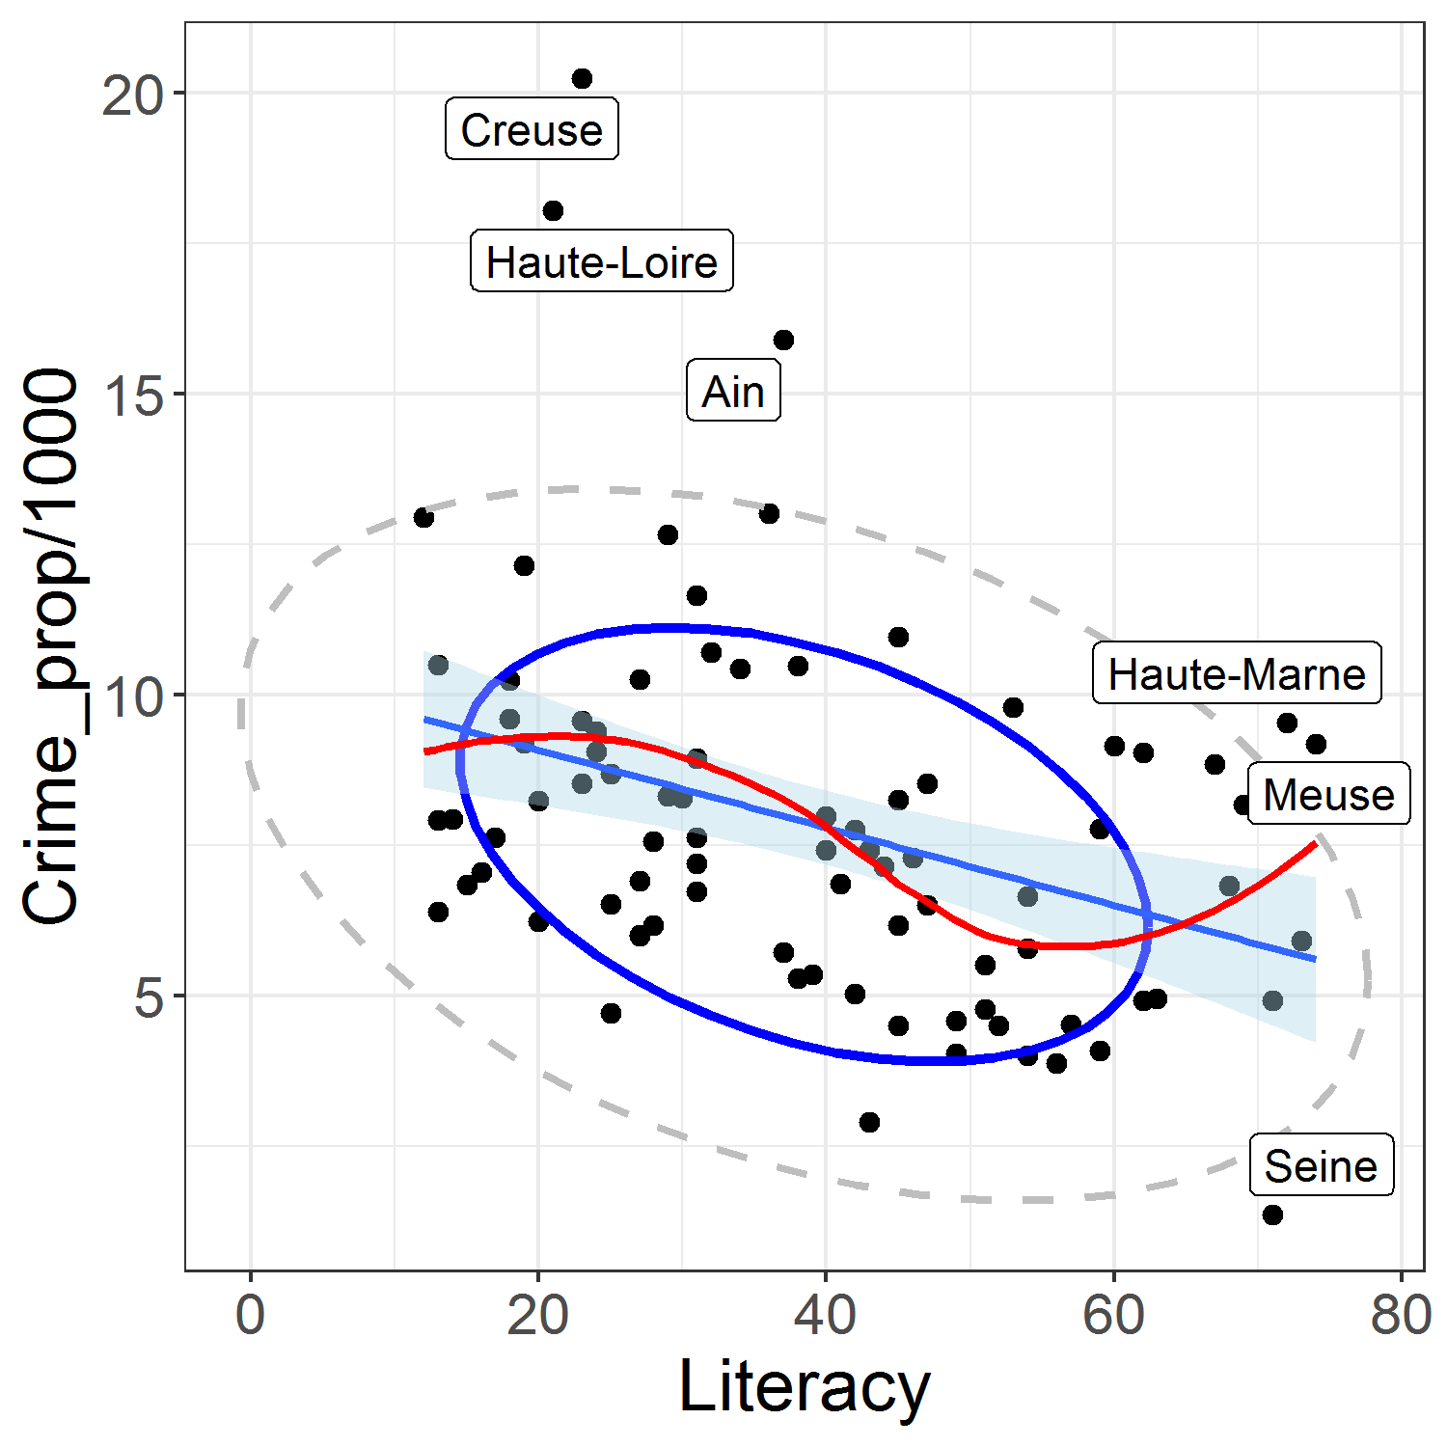
Consulting for Guerry
Guerry: Mes cartes sont très jolies, non? But how can I go further?
MF: Make scatterplots! Add smooths & data ellipses. See you next week at Café Lillas
Guerry: Les boissons sont sur moi!

Slide 38
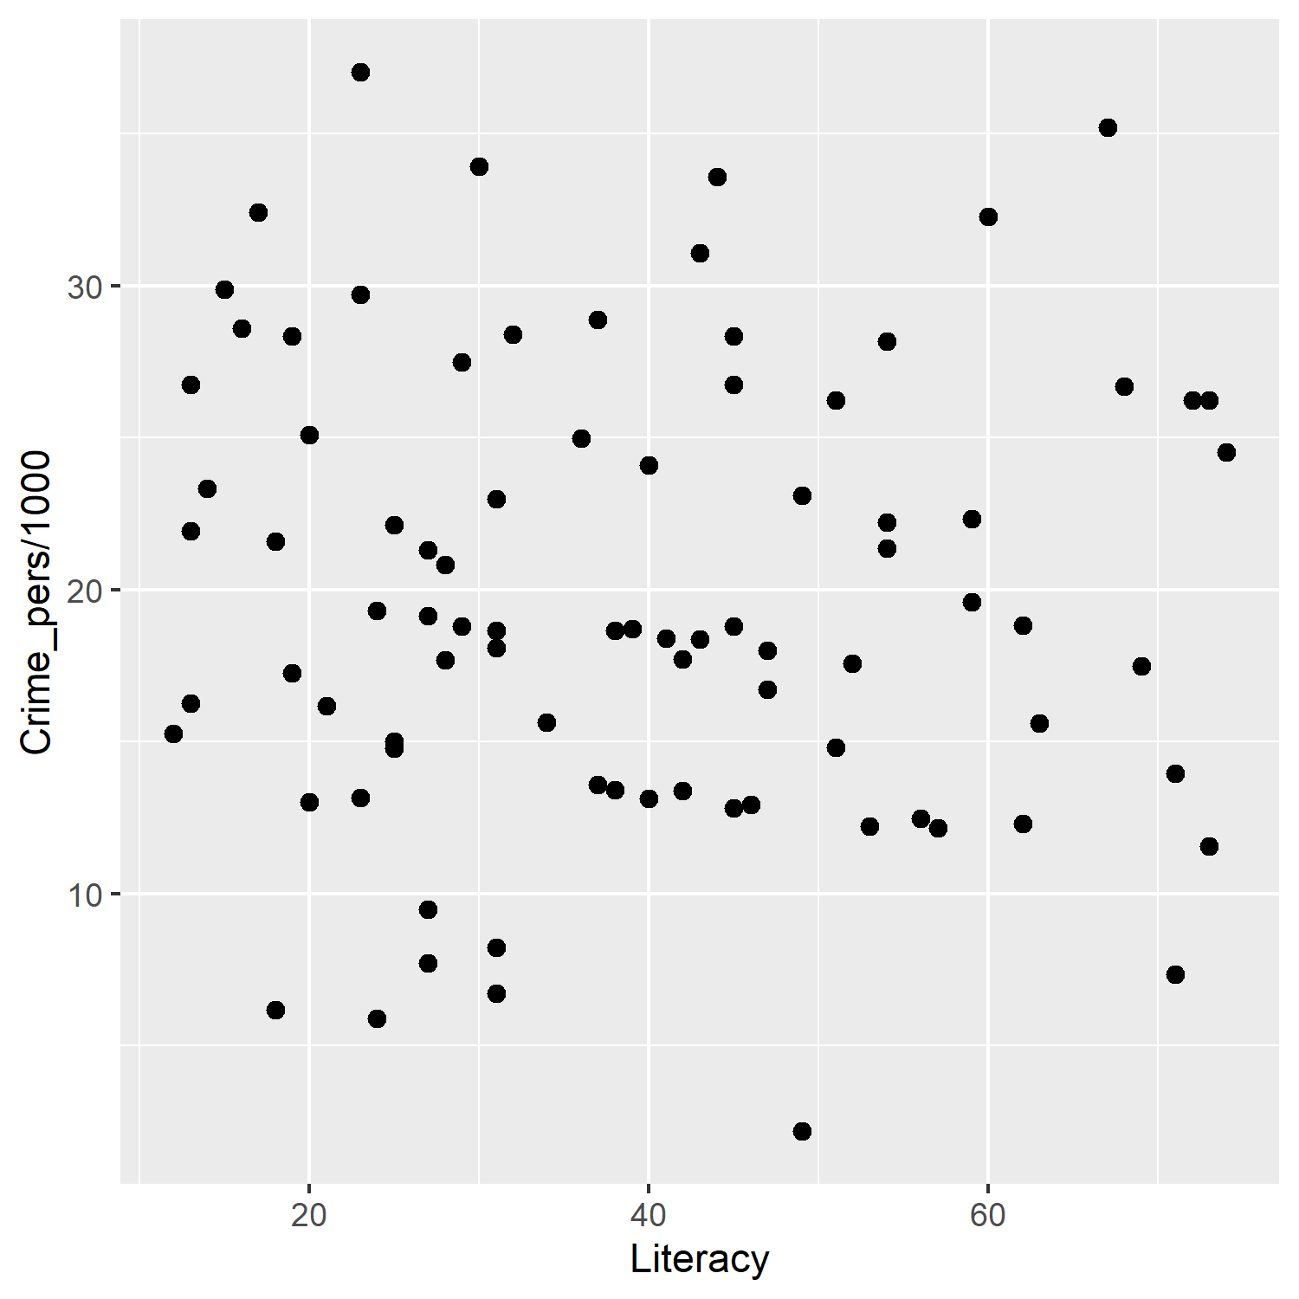
Building Guerry’s plots
ggplot(aes(x=Literacy, y=Crime_pers/1000), data=Guerry) +
geom_point(size=2)
Start with a basic scatterplot

Slide 39
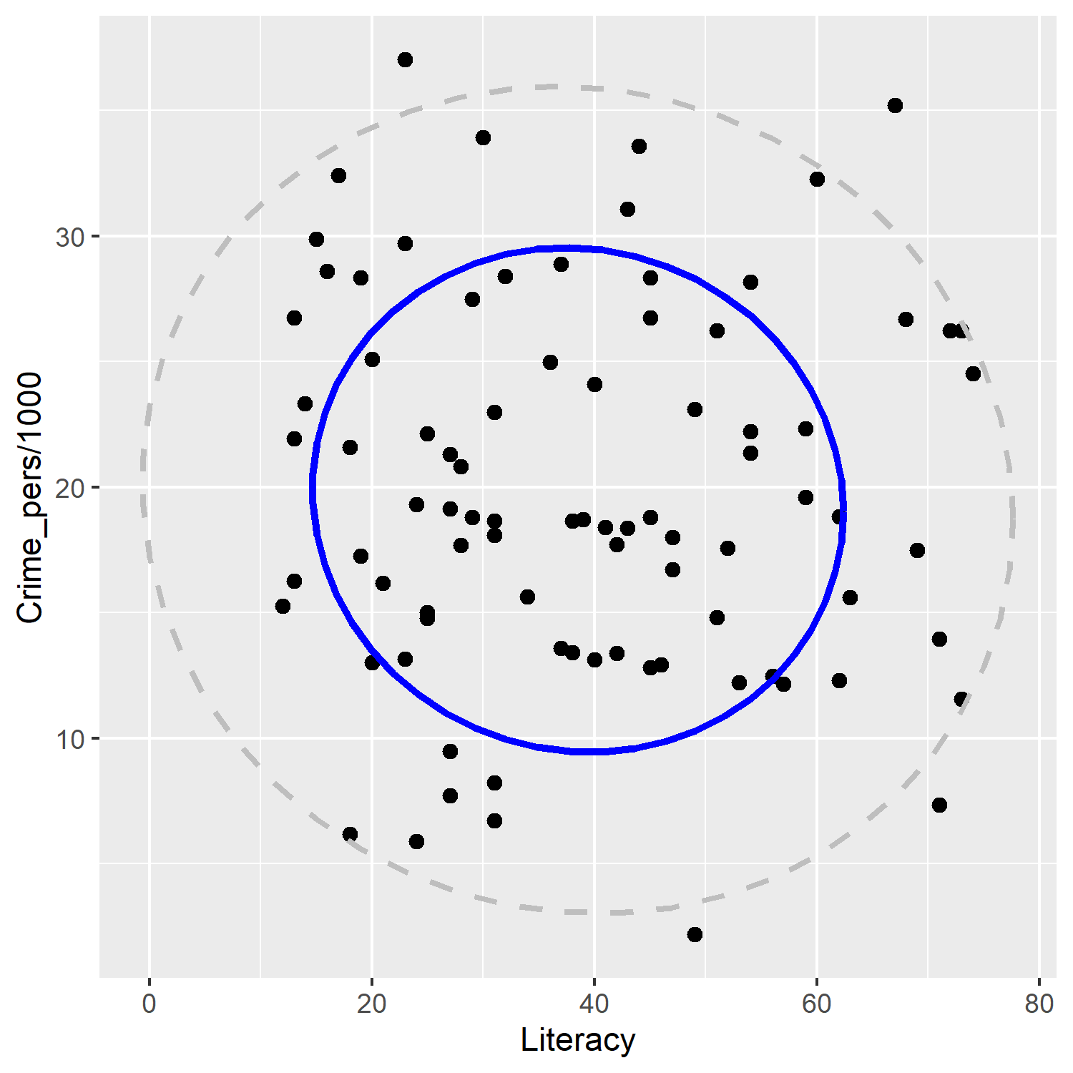
Building Guerry’s plots
ggplot(aes(x=Literacy, y=Crime_pers/1000), data=Guerry) +
geom_point(size=2) +
stat_ellipse(level=0.68, color="blue", size=1.2) +
stat_ellipse(level=0.95, color="gray", size=1, linetype=2)
Add data ellipses to show correlation
68% ~ mean ± 1 sd
95% ~ mean ± 2 sd

Slide 40
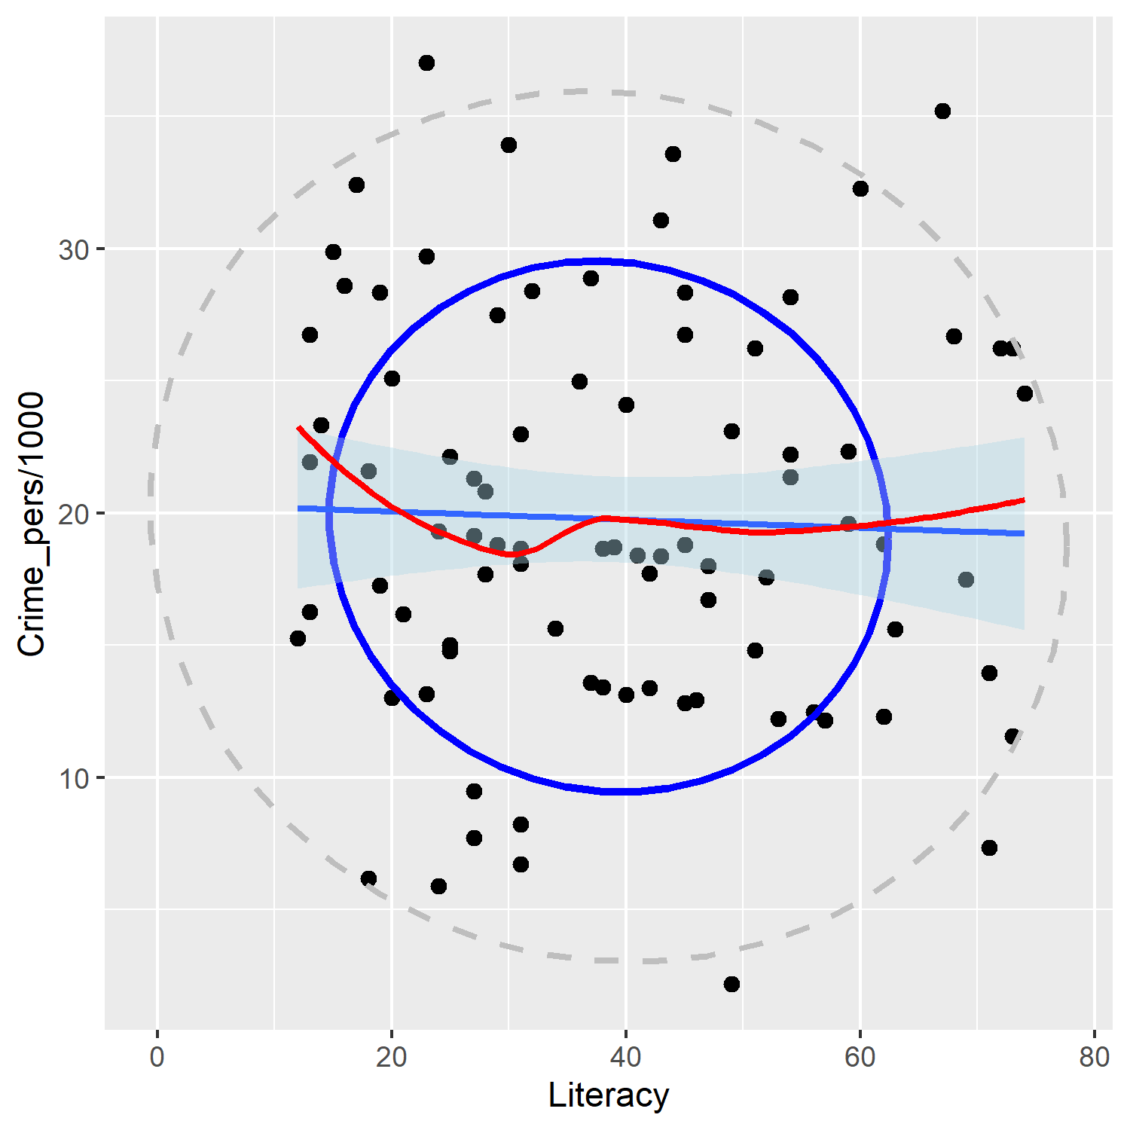
Guerry’s plots: Add smooths
ggplot(aes(x=Literacy, y=Crime_pers/1000), data=Guerry) +
geom_point(size=2) +
stat_ellipse(level=0.68, color="blue", size=1.2) +
stat_ellipse(level=0.95, color="gray", size=1, linetype=2) +
geom_smooth(method="lm", formula=y~x, fill="lightblue") +
geom_smooth(method="loess", formula=y~x, color="red", se=FALSE)
Add lm() and loess() smooths
lm shows regression slope
loess diagnoses possible non-linearity
Coffee break: save the current plot object
gplot <- last.plot()

Slide 41
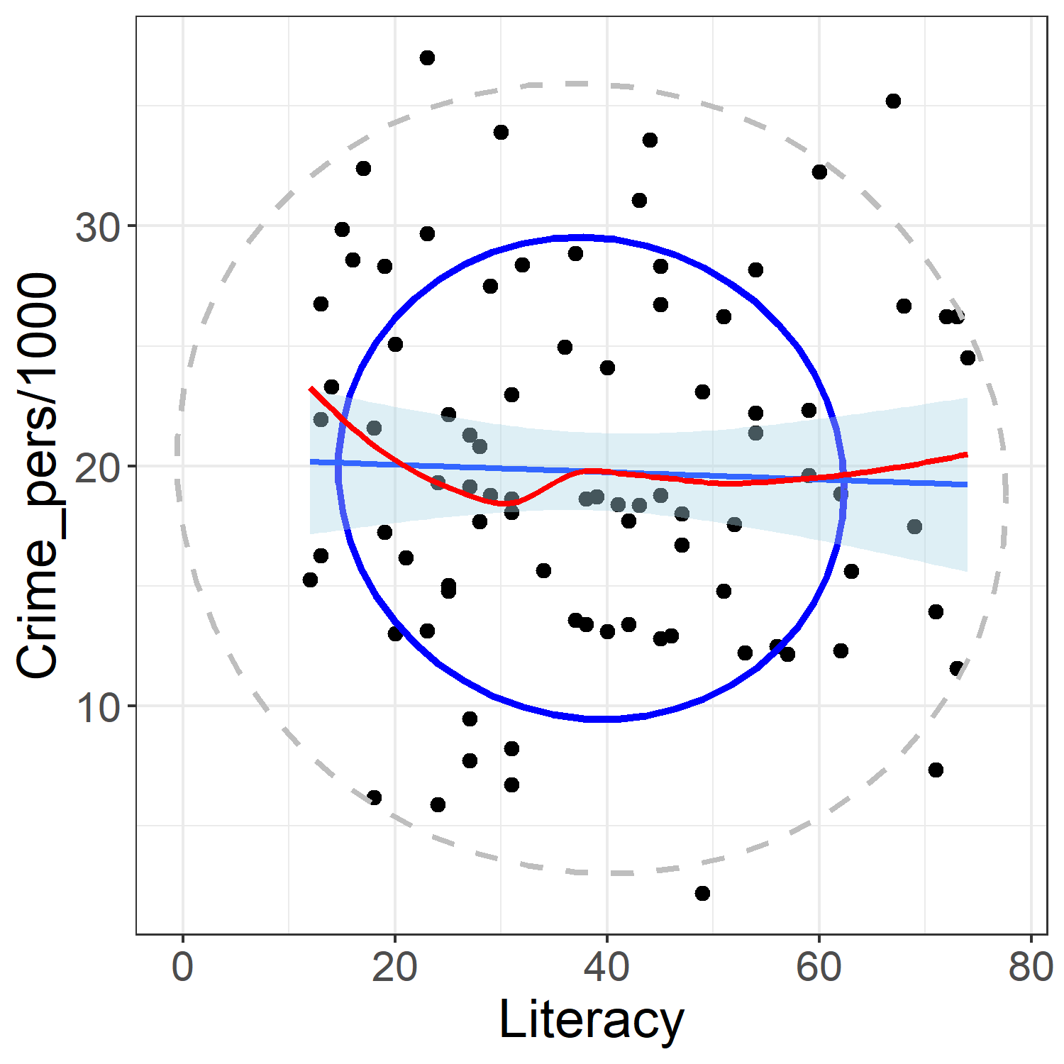
Guerry’s plots: Styling
Guerry: I want to publish this! But need to make axis labels larger
gplot <- last_plot()
gplot + theme_bw() +
theme(text = element_text(size=18))
MF:
Change the basic theme to theme_bw()
Increase the font size for all text
You can change the style of anything you want

Slide 42

Guerry’s plots: Labeling
Guerry: OK, but I see some unusual points. What are they?
MF: Need to calculate “unusualness” – Mahalanobis D² squared distance from centroid
gdf <- Guerry[, c("Literacy", "Crime_pers", "Department")]
gdf$dsq <- mahalanobis(gdf[,1:2], colMeans(gdf[,1:2]), cov(gdf[,1:2]))
$D^{2}$= $(x−\overline{x})′$S⁻¹ $(x−\overline{x})′$
library(ggrepel)
gplot +
theme_bw() +
theme(text = element_text(size=18)) +
geom_label_repel(aes(label=Department),
data = gdf[gdf$dsq > 4.6,])

Slide 43
Summary

