Slide 1
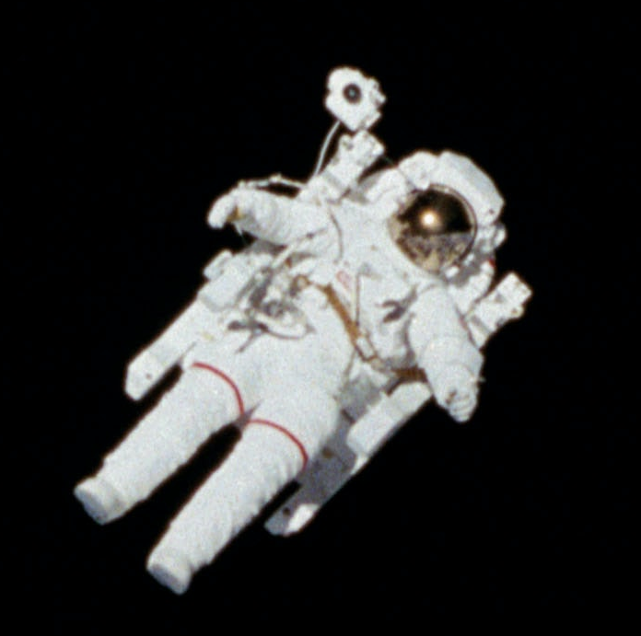
Astronaut database (week 29 2020)
Compiled by NASA and contains basic information on the 1227 people who have been launched into space prior to 2020-01-15
Full name, sex, date of birth, nationality, military status, mission title and year of selection
Which countries are astronauts from?
How old are astronauts when they go into space?

Slide 2
