Slide 1

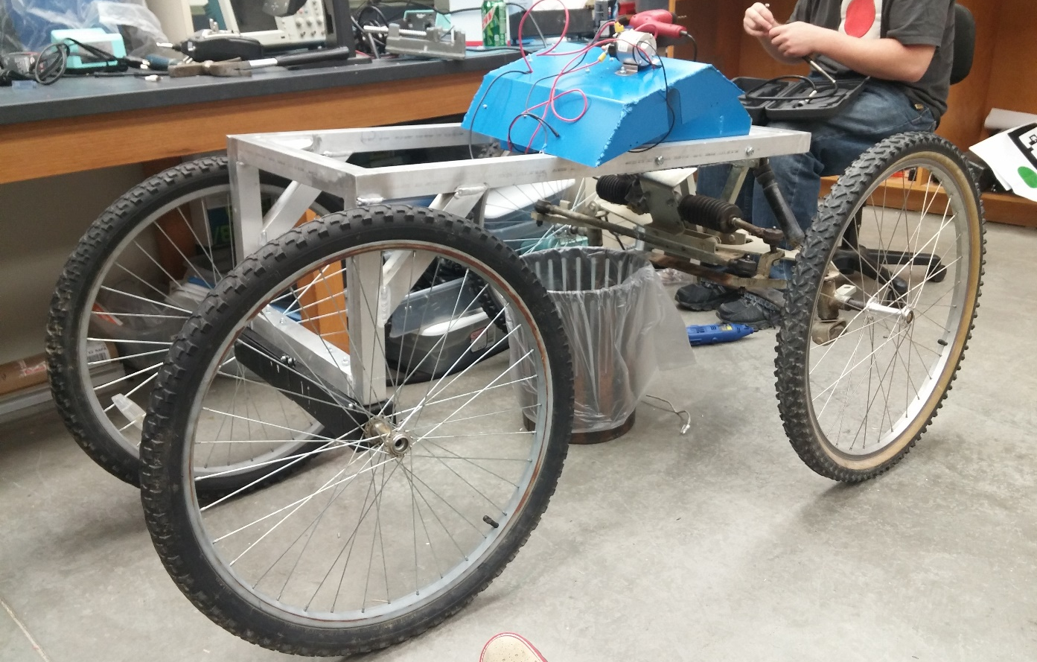
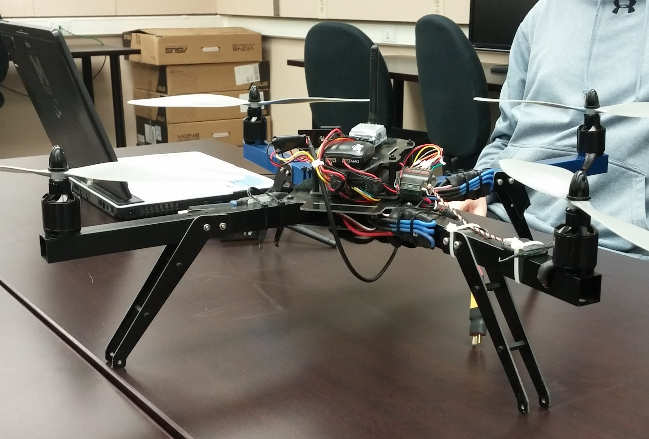
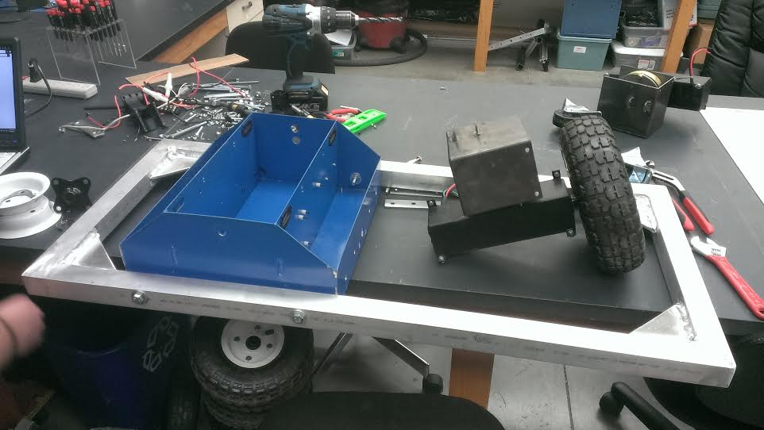
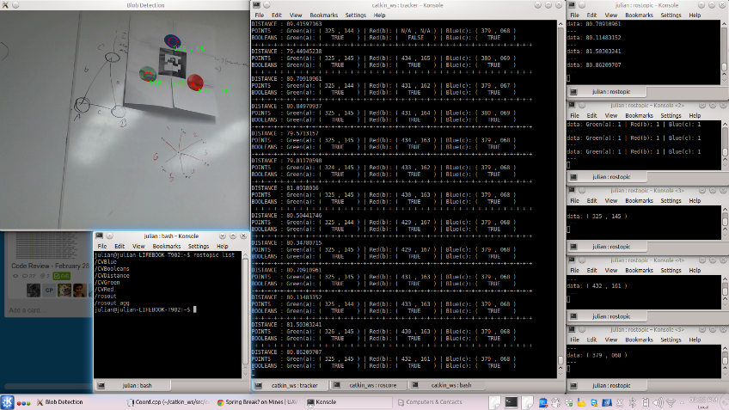
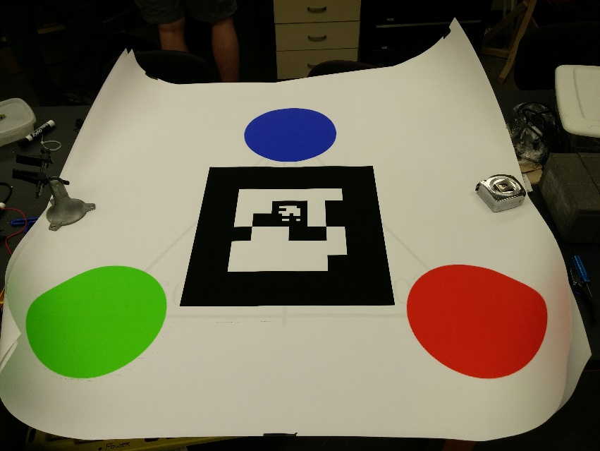
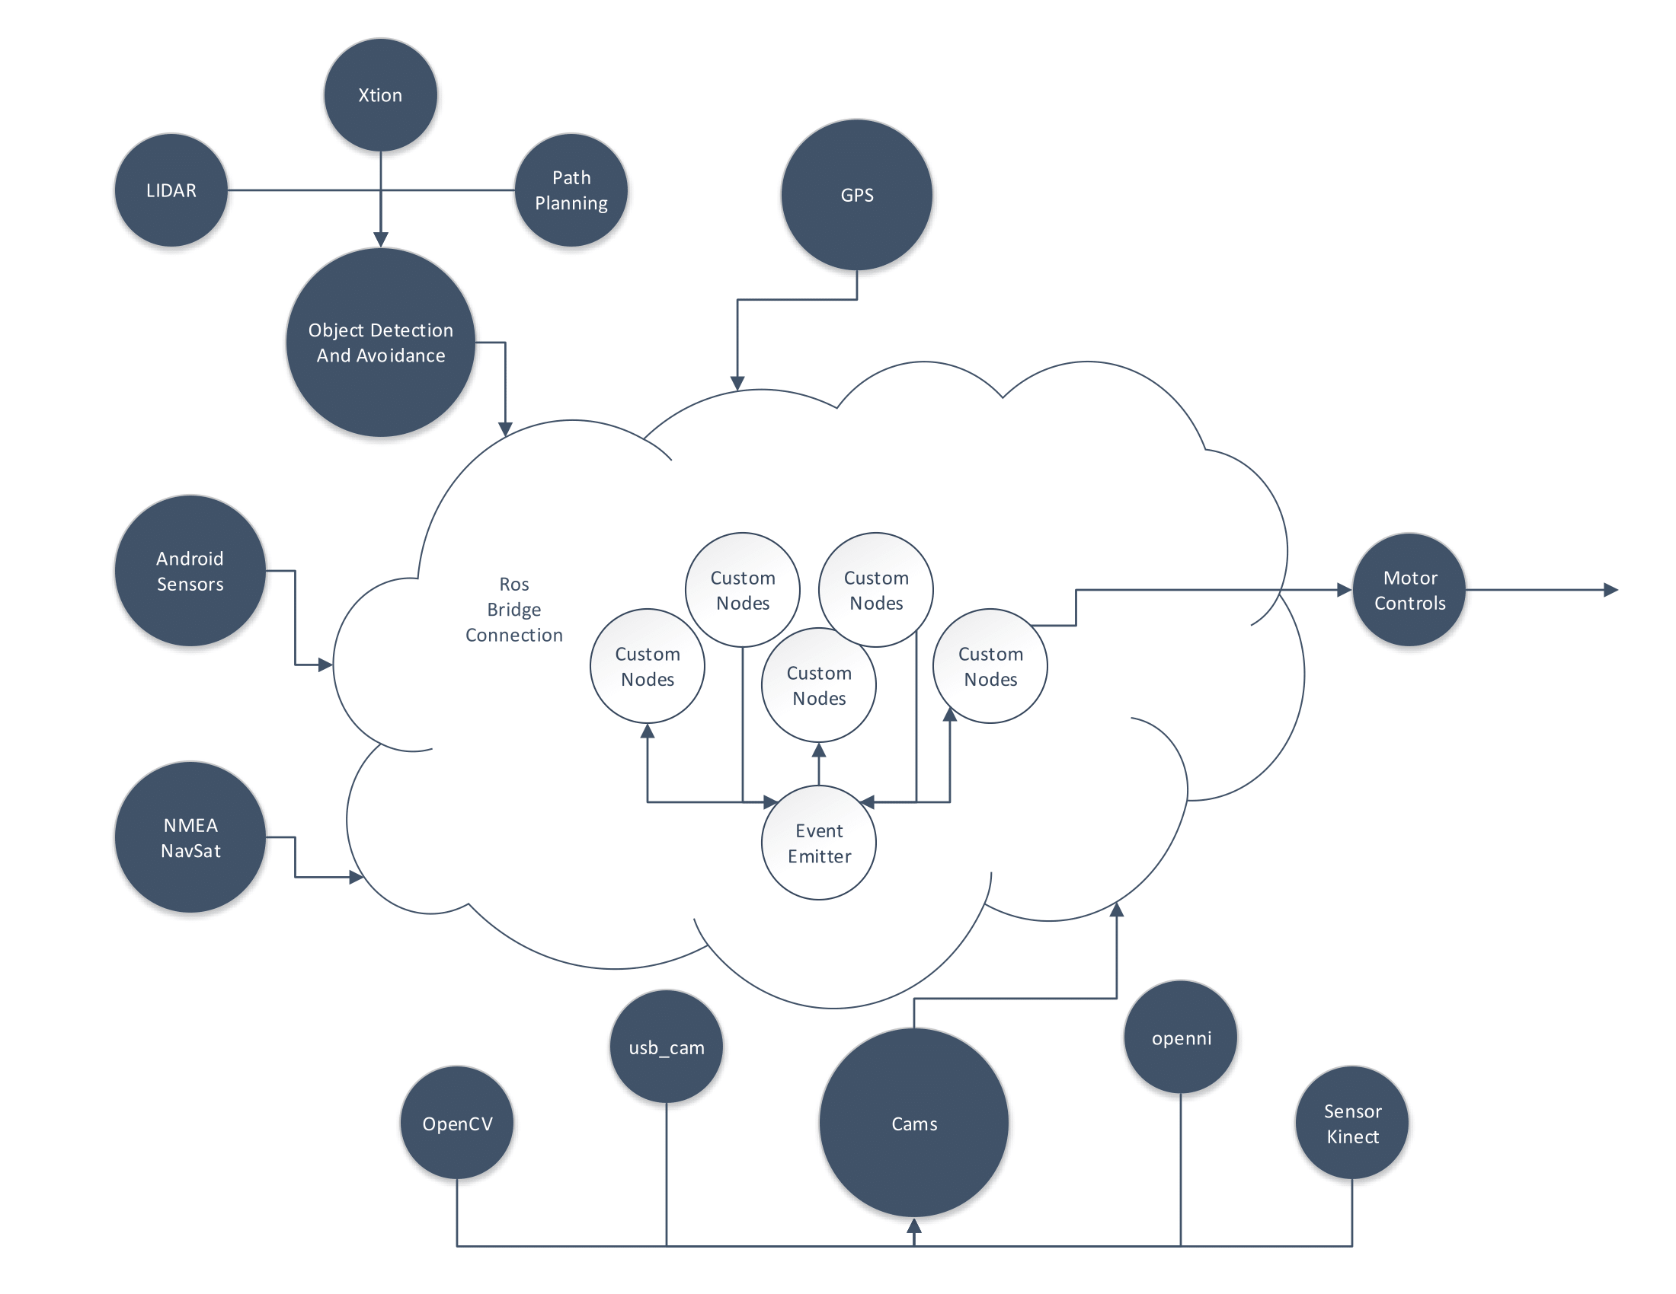
Mobile UAV Landing Pad
Colter Assman, Julian Brackins, Samuel Carroll, Hafiza Farzami, Charles Parsons, Alex Wulff
Sponsor:
Rockwell Collins
Faculty Advisor: Dr. Jeff McGough
Mission
Develop a system for autonomously landing a UAV on a ground vehicle.
Potential usages include assisting search and rescue teams with collecting data in areas unsafe for human interactions, such as forest fires and radioactive zones.
UGV
Frame
Rectangle design to house the power supply and computational container.
Built from 6061-T Aluminium, 22”x44”
Weight of frame: 65 lb
Rated to hold 200 lb.
Steering System
Golf-cart's Ackerman steering system and front suspension
UAV
Mavros:
Communication node for ROS.
Wirelessly communicates with quad copter to send waypoints for navigation.
Craft Landing
OpenCV
Custom ROS Package named cv_tracker. Compares observed size of the landing pad with the known size to determine distance.
Tracks 3 colored circles on landing pad to determine distance and orientation.
ar_track_alvar
Can create tags of any size and resolution.
Tracks the pose of individual AR tags.
Sensing and Computing
Cameras
GPS
Landing Pad
Odroid XU-3 Lite
Odroid XU
Roboteq 2130 Motor Controller
Custom API
API Designed for ease of subscription for topics on custom made nodes.
Assists design complexity for UGV and UAV.
Same API handles both environments for a uniform code design.
Libraries
ROS
OpenCV
ar_track_alvar
Freenect
PCL
Sensor Kinect
Sophus
Openni
Stereo_slam
Eventemitter2
Path Planning
Wavefront Algorithm for UGV navigation.
Point cloud data for detecting nearby obstacles.

