Slide 1
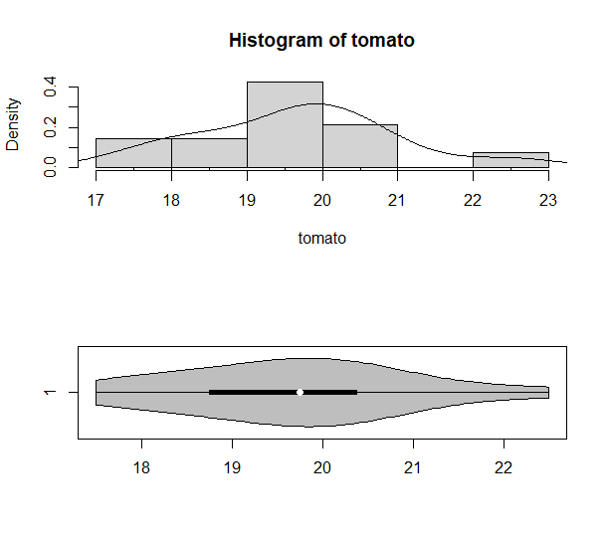
Chapter 2.7

Slide 2
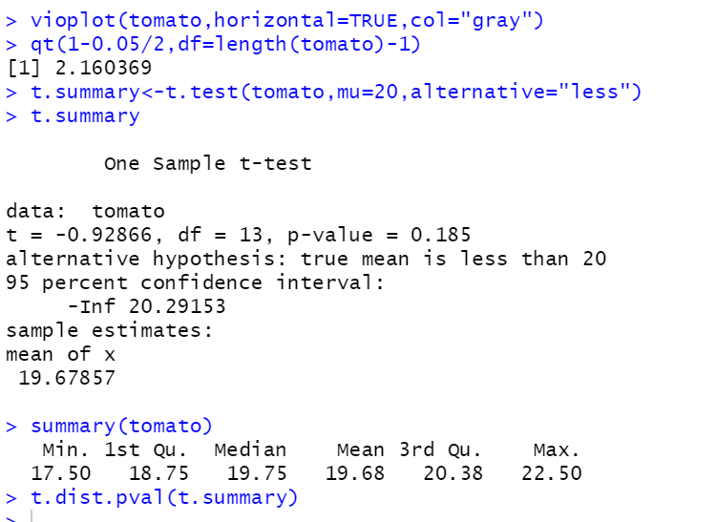
Chapter 2.7

Slide 3
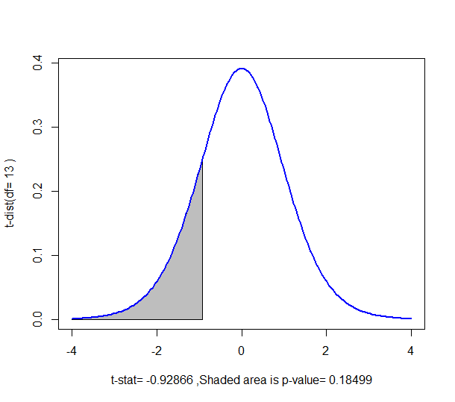
Chapter 2.7

Slide 4
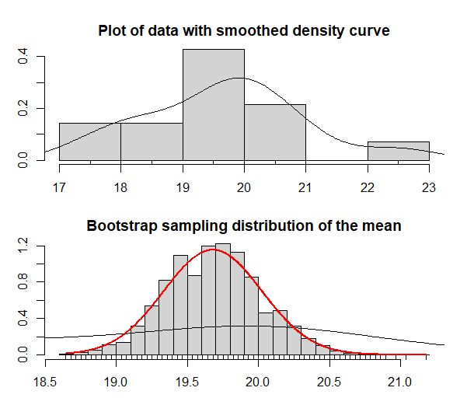
Chapter 2.7

