Slide 1
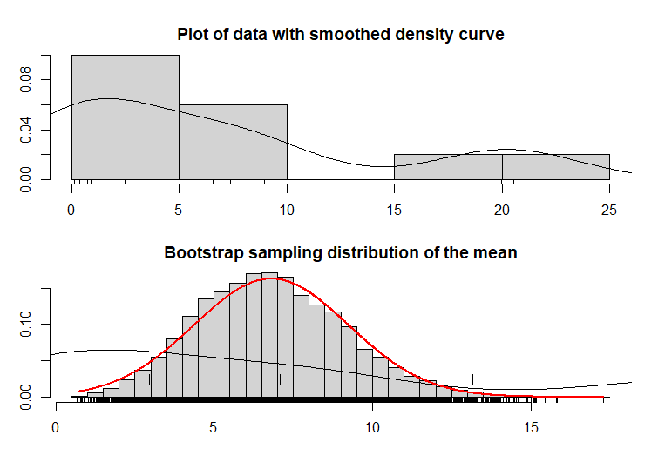
P70-71 Assessing assumptions using the bootstrap
Plot of data does not conform to normal distribution, Bootstrap sampling distribution of the mean tends to normal distribution.

Slide 2
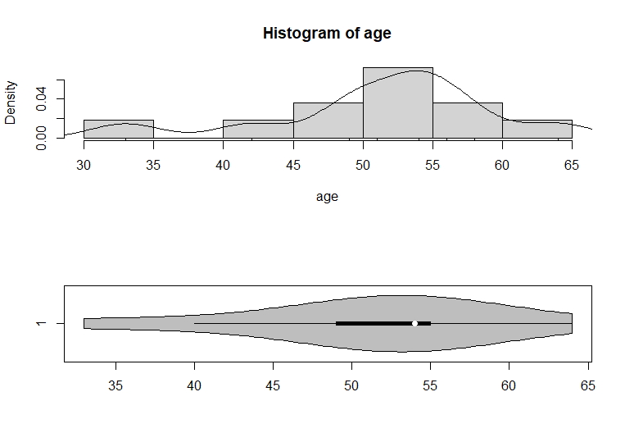
P78-81 Age at First Transplant

Slide 3
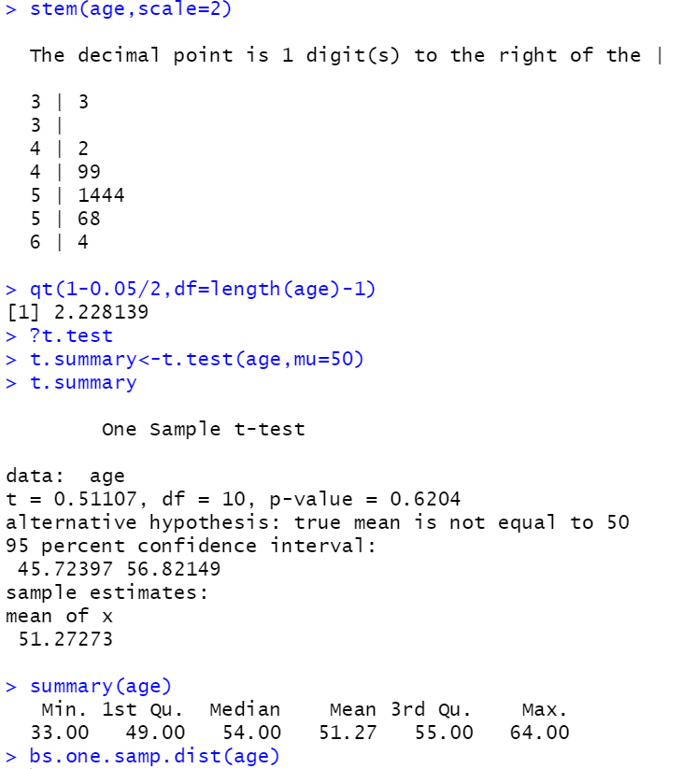
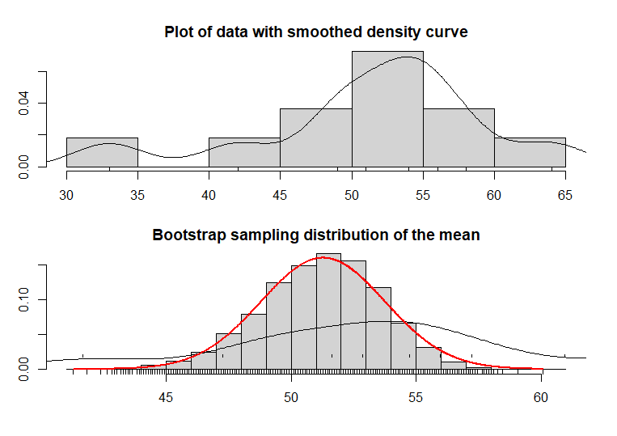
P78-81 Age at First Transplant
The results for the t-test above can be trusted.

Slide 4
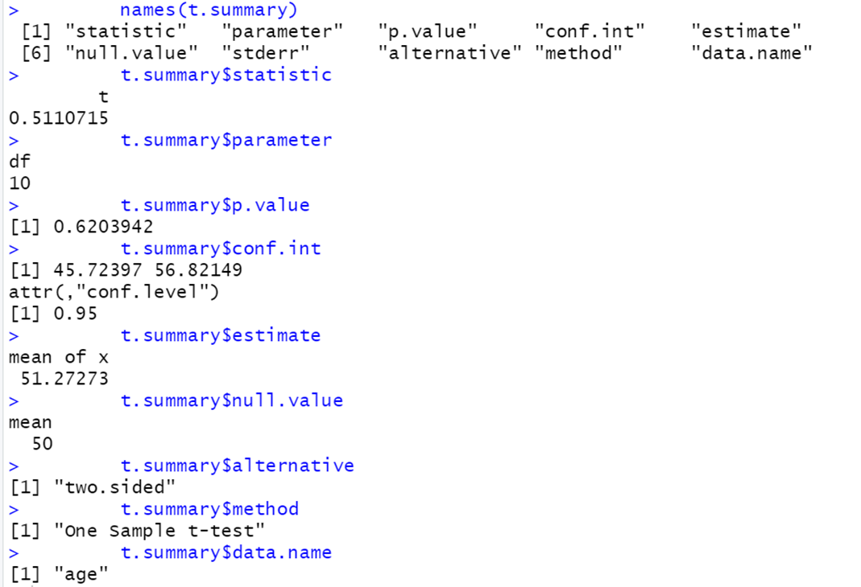
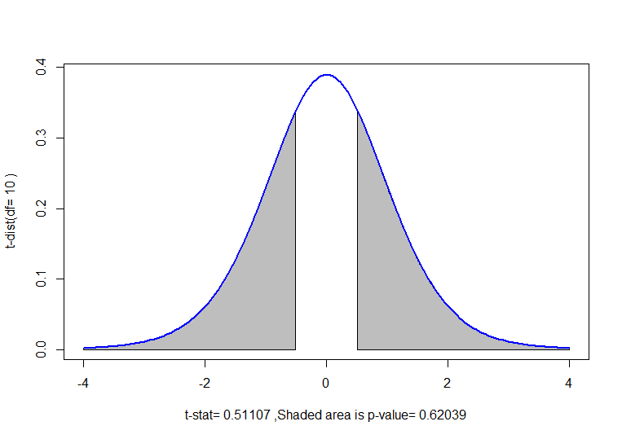
P78-81 Age at First Transplant

Slide 5
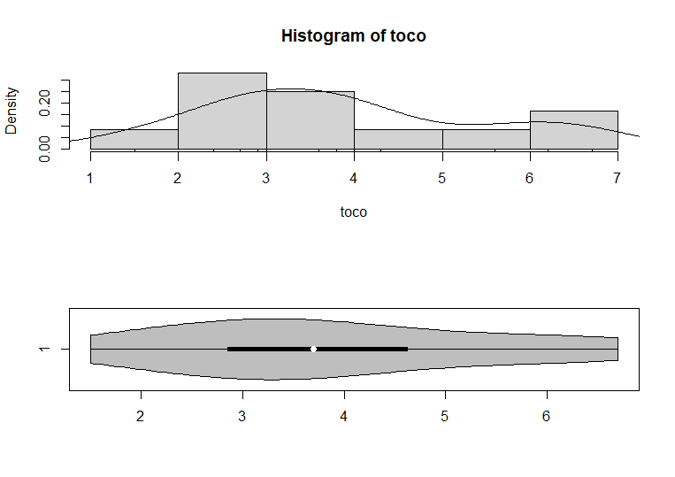
P82 Meteorites

Slide 6
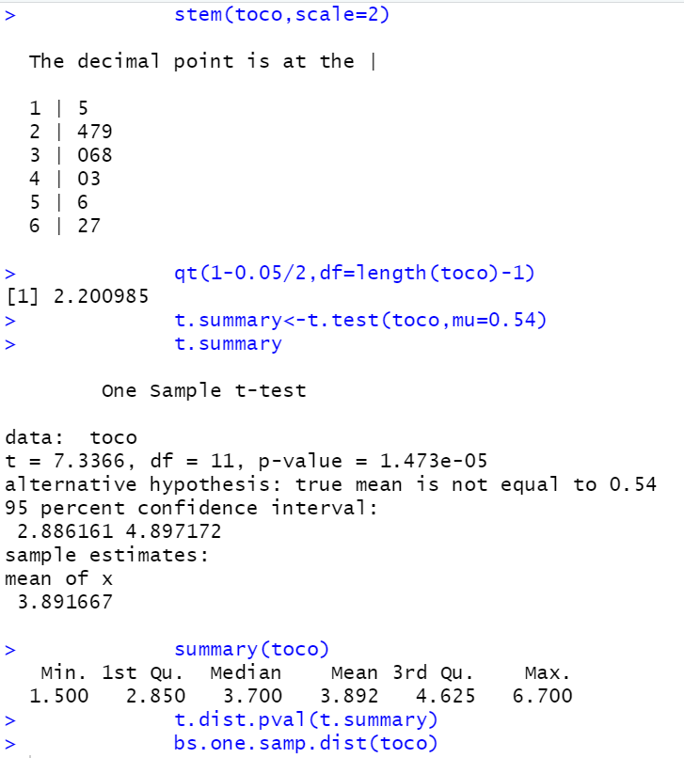
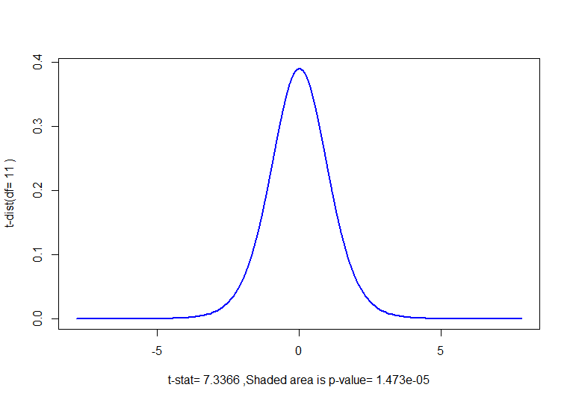
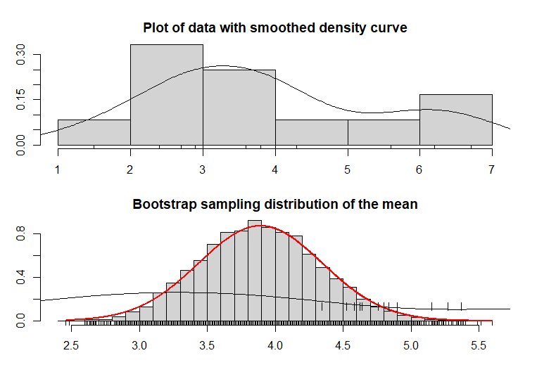
P82 Meteorites

