Slide 1
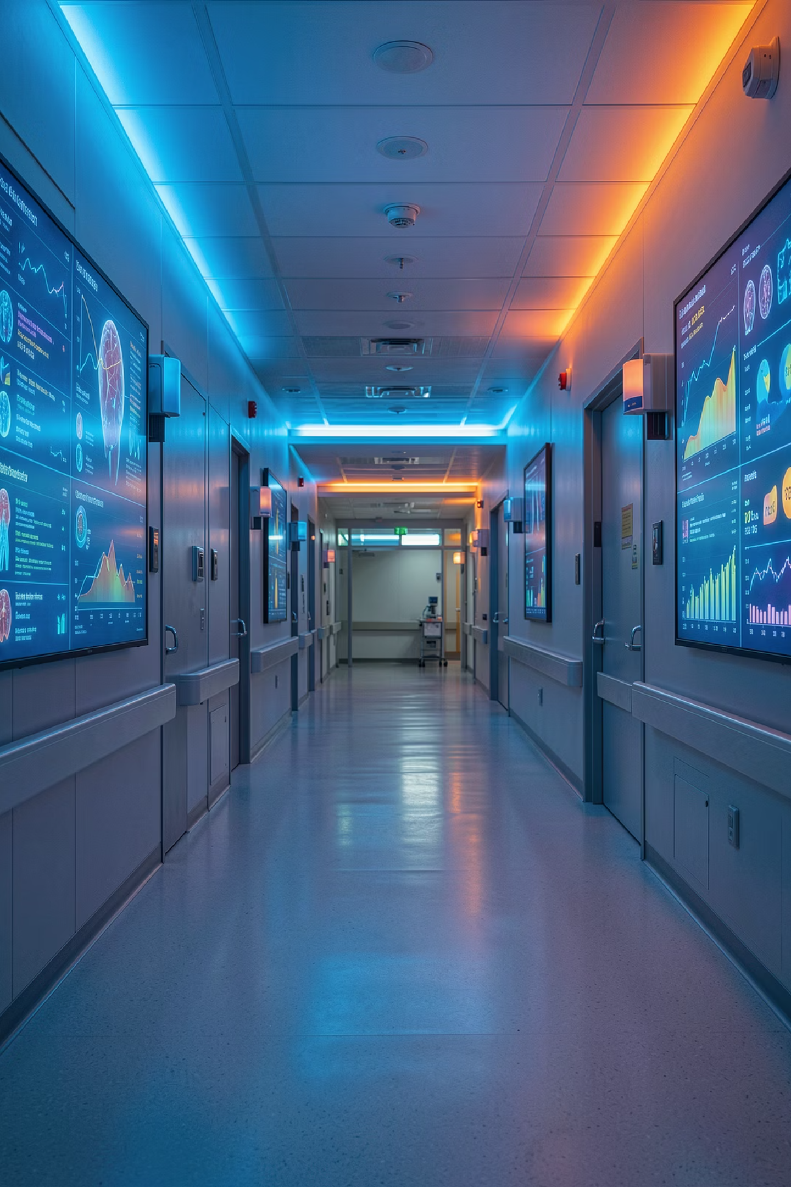
Healthcare Data Analysis Project
Python · MySQL · Power BI — transforming 55,500 patient records into actionable insights

Slide 2

Dataset at a Glance
55,500
Patient Records
16
Data Columns
$21,835
Avg Billing
17.8
Avg Stay (days)

Slide 3


Data Pipeline: Python → MySQL
Load & Explore
Transform
Pandas, NumPy, Matplotlib
Create age groups and risk categories
Clean & Validate
Load to MySQL
Handle nulls, duplicates, datetimes
Insert 55,500 rows via SQLAlchemy
Libraries: Pandas, NumPy, Matplotlib, Seaborn, SQLAlchemy — connected to MySQL via Jupyter Notebook

Slide 4
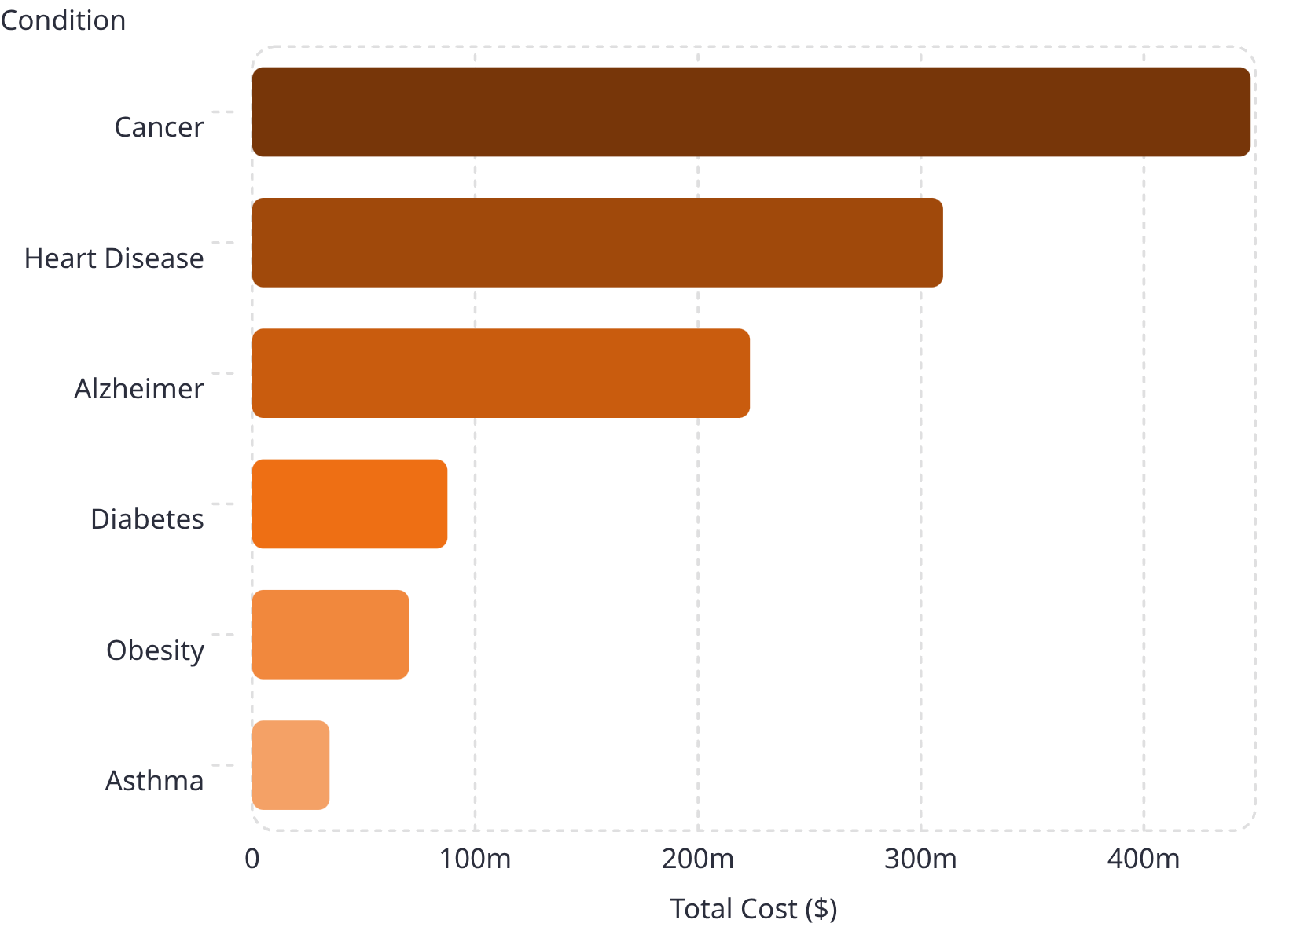
Costliest Medical Conditions
Top 3 by Patient Volume
Flu — 7,046 patients
Diabetes — 7,005 patients
Obesity — 6,994 patients
Cancer alone accounts for $447M in total billing

Slide 5

Critical Cases by Age Group
Elderly
Senior Adult
12,148 critical cases
8,118 critical cases
Adult
435 critical cases
Critical conditions: Cancer, Heart Disease, Alzheimer — concentrated in older age groups

Slide 6
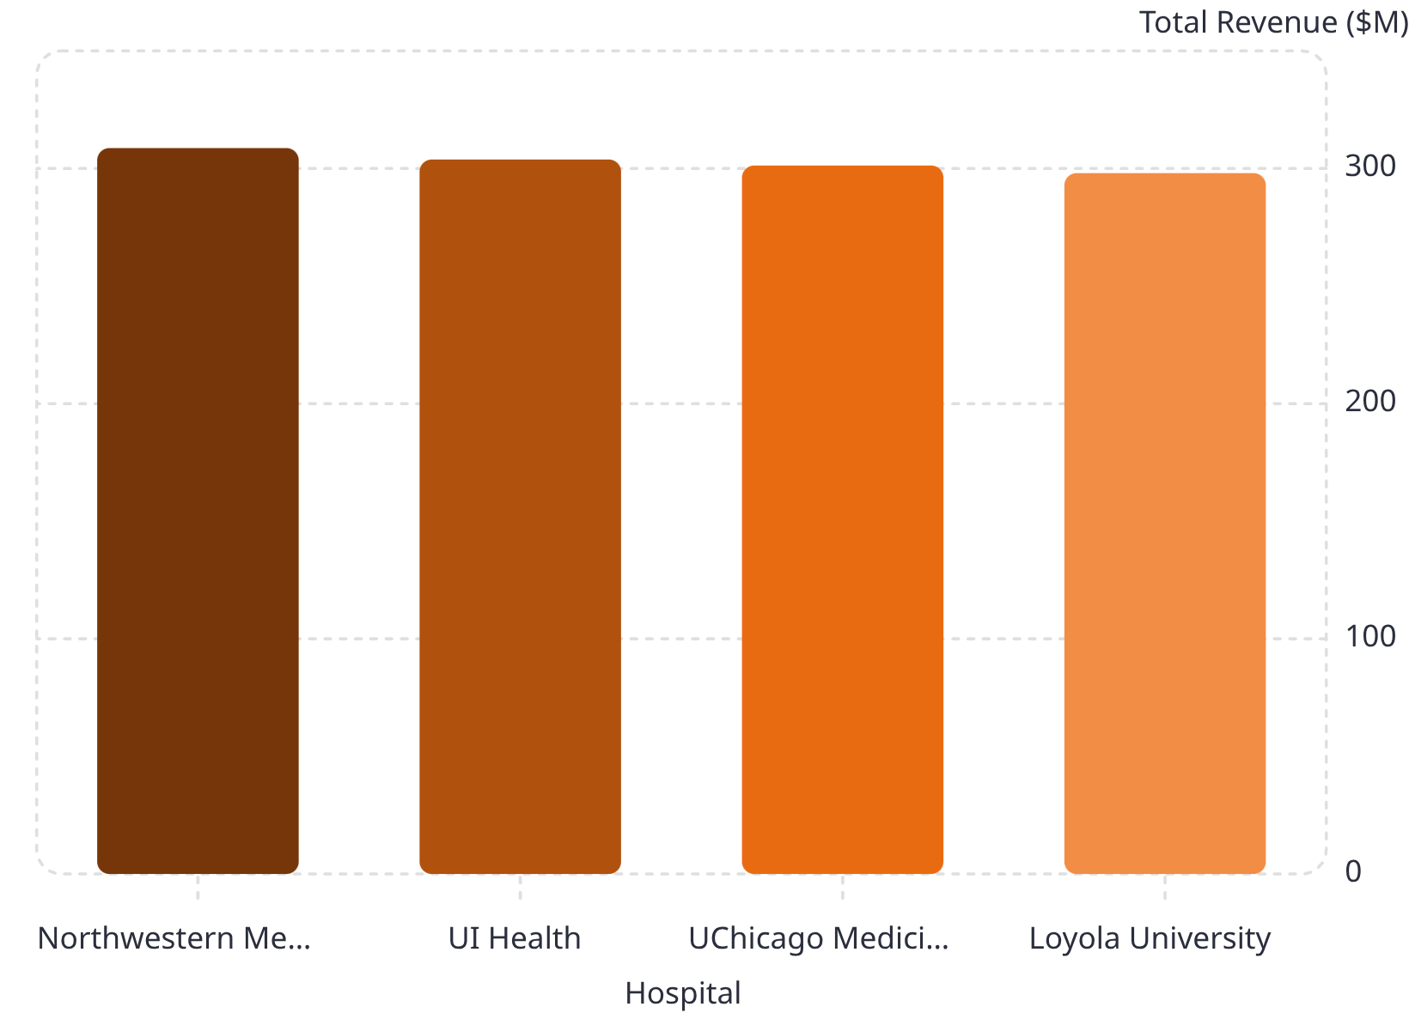
Hospital & Insurance Insights
Key Findings
Northwestern Memorial leads in total revenue and emergency cases (5,122)
Cigna bears the highest cancer treatment cost: $90.9M
All 4 hospitals generate near-equal average billing (~$21.8K)

Slide 7
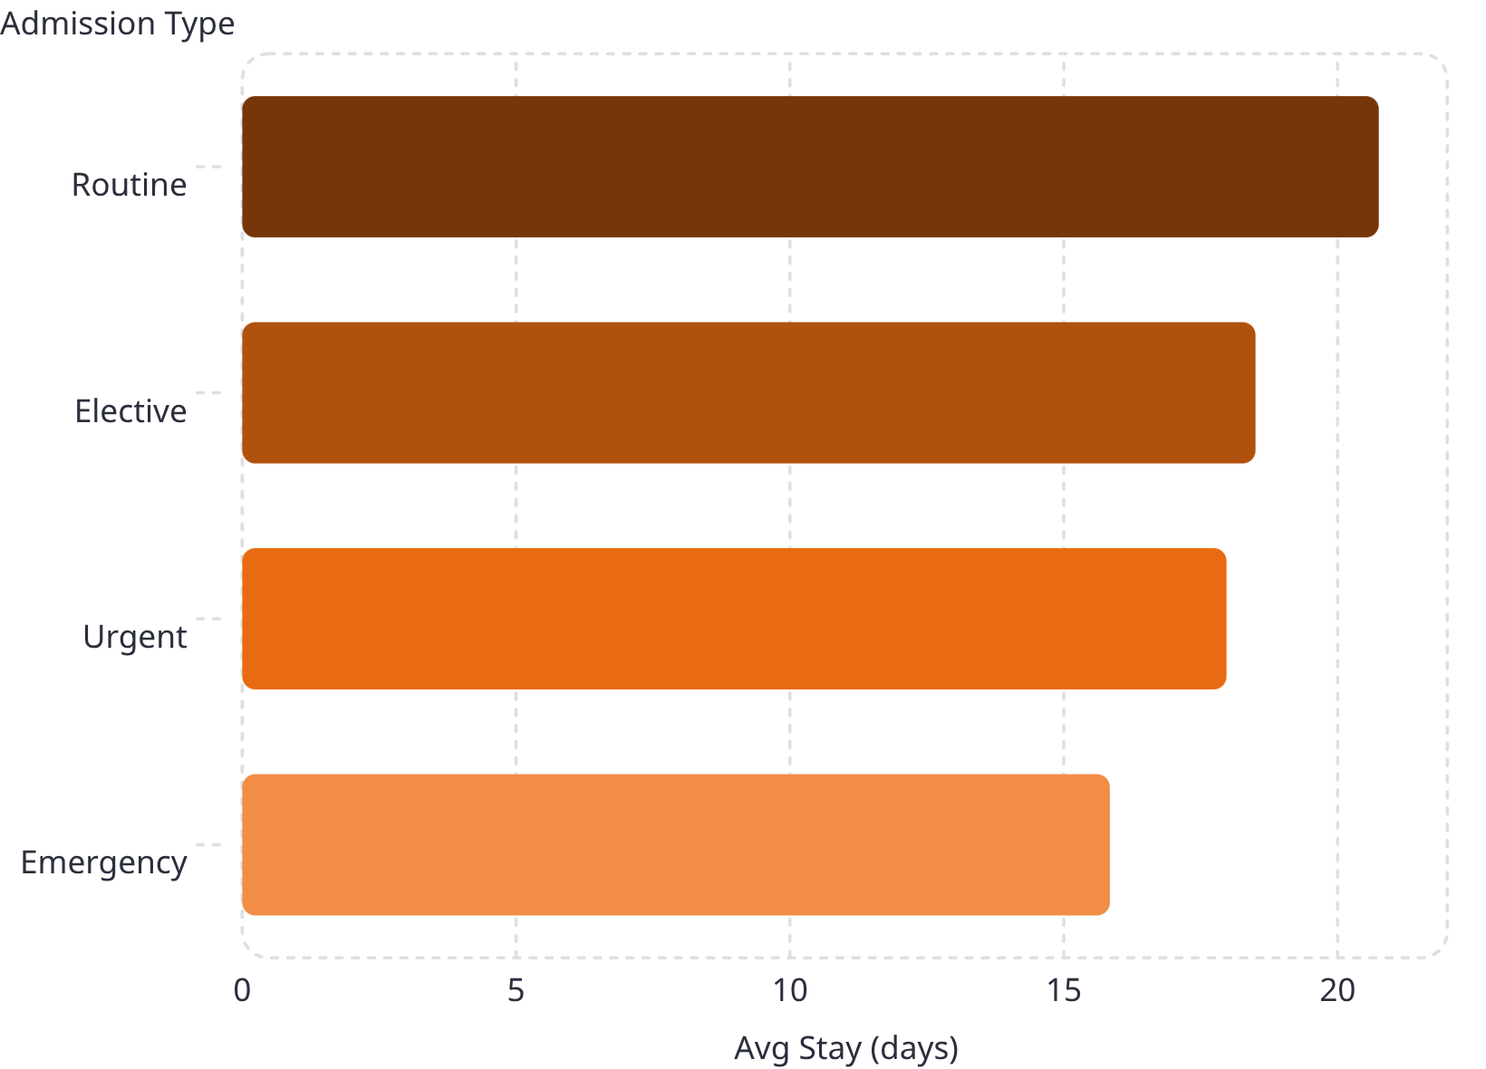
Length of Stay & Admissions
Notable Patterns
Alzheimer patients average 54+ days stay
Emergency admissions: 36.22% of all cases
Routine admissions have the longest average stay

Slide 8
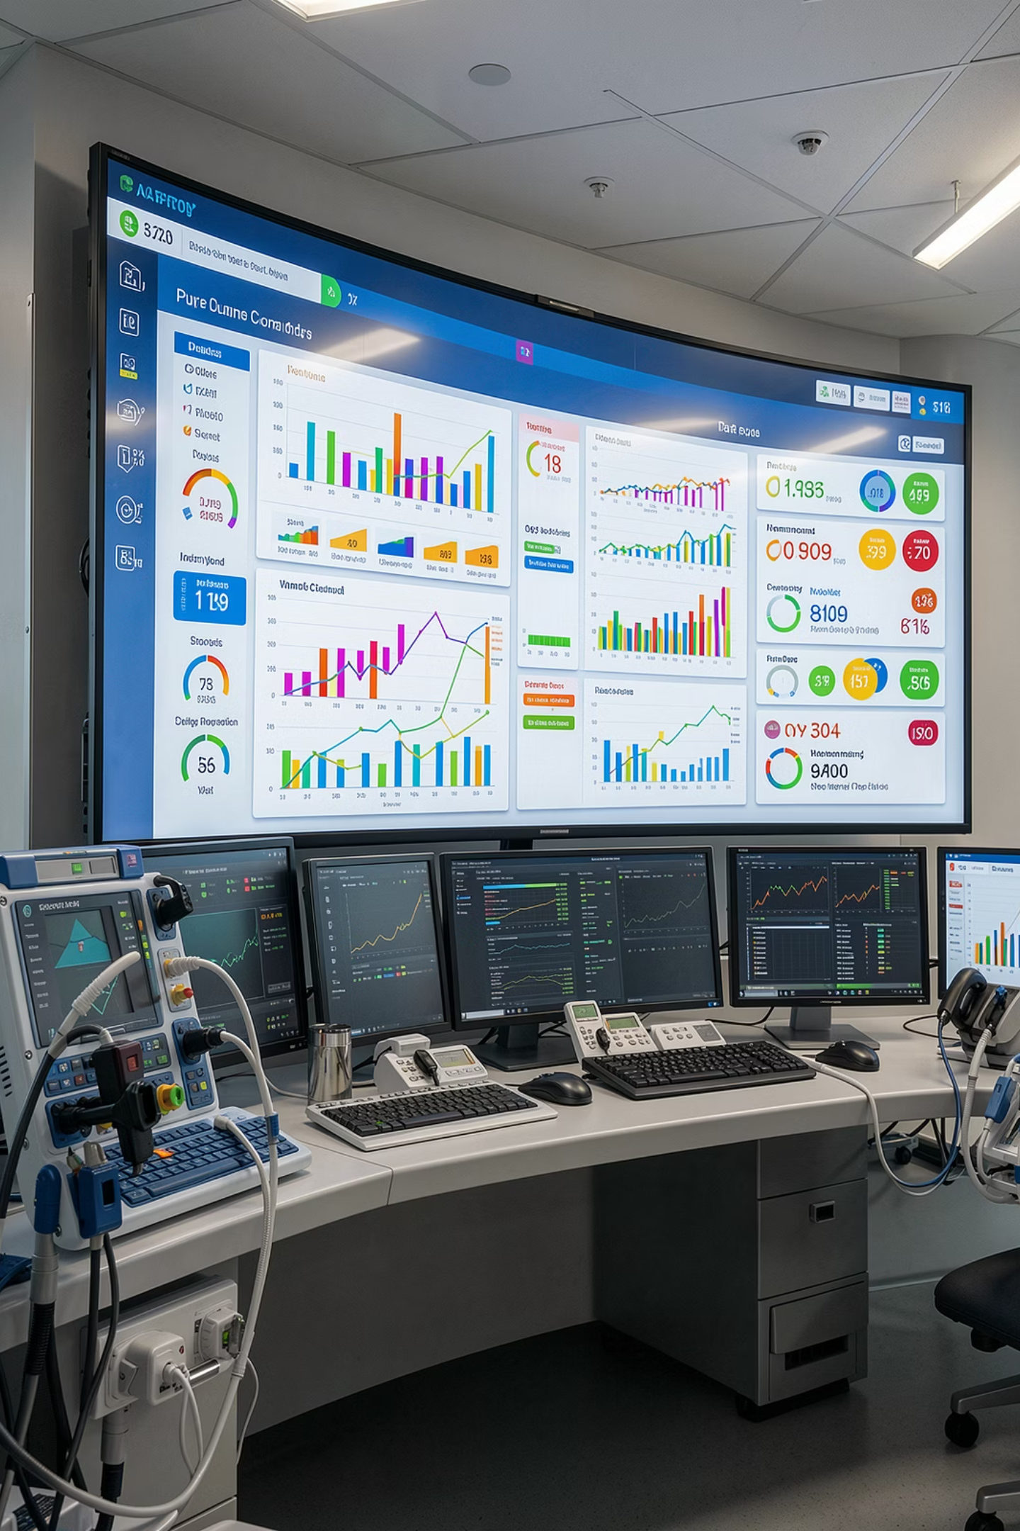
Power BI Dashboard
Financial KPIs
Total Revenue $1.21B · Avg Billing $21.84K
Hospital Performance
Revenue by hospital · Occupancy trends · Emergency rates
Patient Analysis
Age groups · Disease distribution · Gender trends
Clinical Metrics
Test result distribution · Risk categories · Stay duration

Slide 9
Key Findings
Cost Concentration
Age Risk Gap
Cancer, Heart Disease & Alzheimer drive ~80% of total billing
Elderly account for 58% of all critical cases
Emergency Volume
Diagnostic Gaps
36.22% of admissions are emergency — straining resources
UChicago & Northwestern lead in inconclusive test results

Slide 10
Business Recommendations
01
02
Preventive Care
Resource Optimization
Early detection for high-cost conditions
Align staffing with admission patterns
03
04
Insurance Partnerships
Reduce Length of Stay
Collaborate on high-cost categories
Care pathways for extended hospitalization
05
06
Diagnostic Accuracy
Monitor Critical Segments
Improve processes at high inconclusive-rate hospitals
Targeted programs for high-risk age groups

