Slide 1
CSCE315-Project 3
Database Management System
Team 5: Richard, Jared, Mishael, Xiaoda

Slide 2
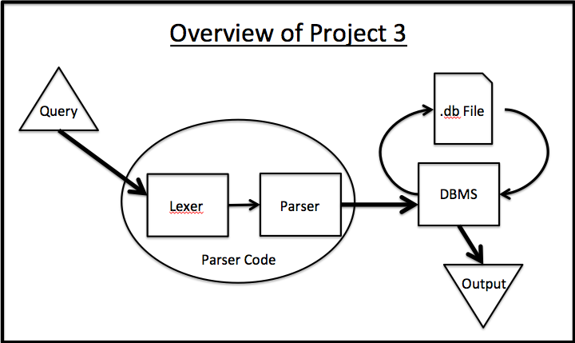
Overview

Slide 3
AGILE Development
Two Sprints
  Product Backlog
  Burndown Lists
Daily Scrums
  Byte sized pieces
  Constant feedback

Slide 4
SCRUM Process
Duration:
1 day
Scrum
Meeting
Begin
Sprint
7 days
End
Sprint #1
7 days
Sprint
Backlog
End
Sprint #2
Backlog
Product
Backlog
Sprint
Retrospective
New
Functionality

Slide 5
Sprint #1
Sprint #2
Notes:
Tried to squeeze time from the beginning of the timeframe to make sure the software can be delivered on time. From the second half of the time, Actural remaining and ideal remaining stay tend to end at the same point.

Slide 6
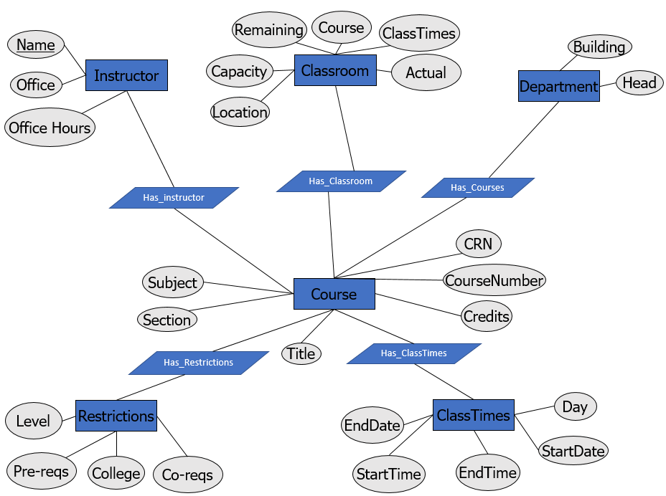
Parser Code
Entity Relation Diagram
6

Slide 7
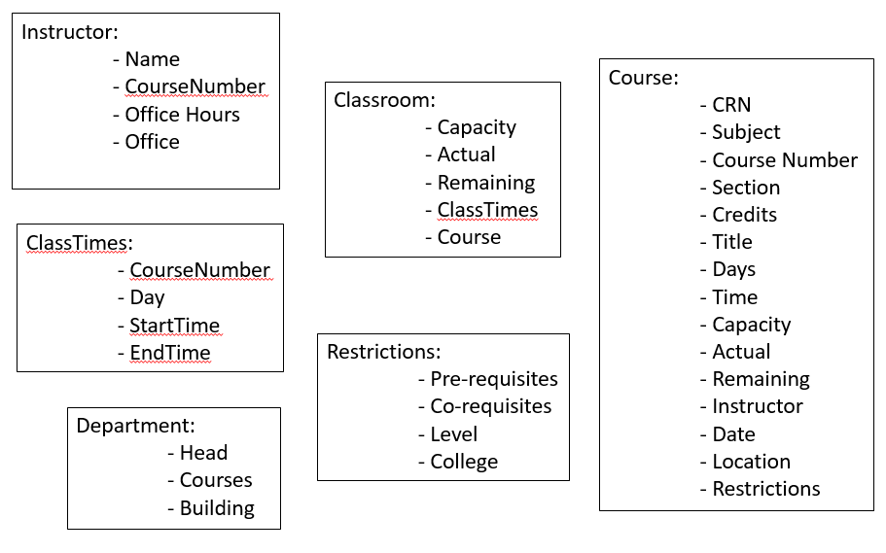
Database
Relation Schema

Slide 8
Demo

Slide 9

Questions?

