Slide 1
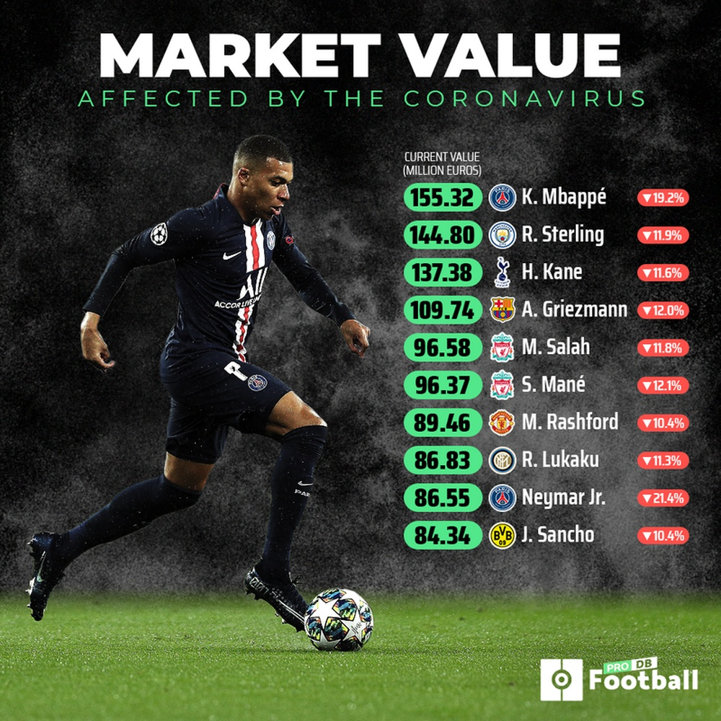
The market value of footballers.
By Eng.Musa Ghazwani

Slide 2
Introduction
Market value of a soccer player is his potential transfer cost.
Market value is dependent on several factors.
Predict market value based on skills and age.
Web scraped about 20,000 players from FIFA Index.

Slide 3
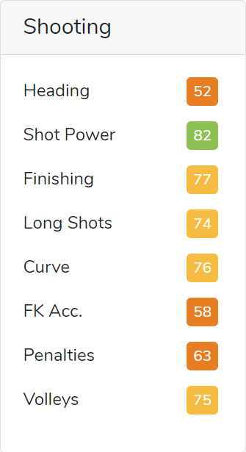
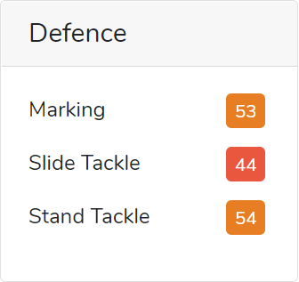
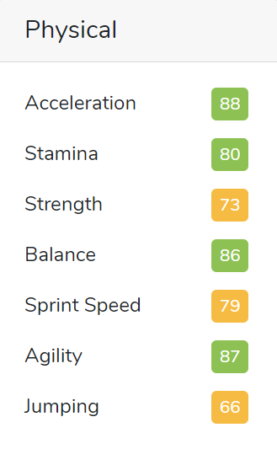
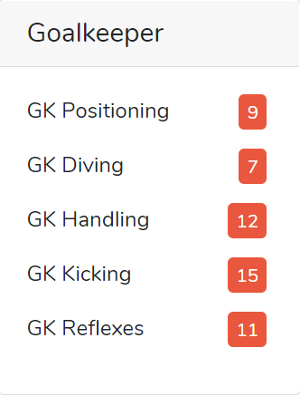
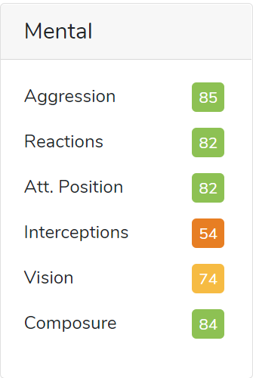
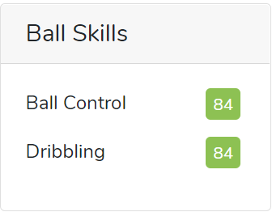
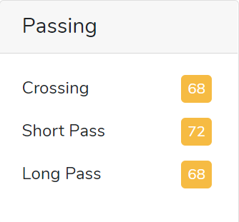
Introduction – Skill Ratings

Slide 4
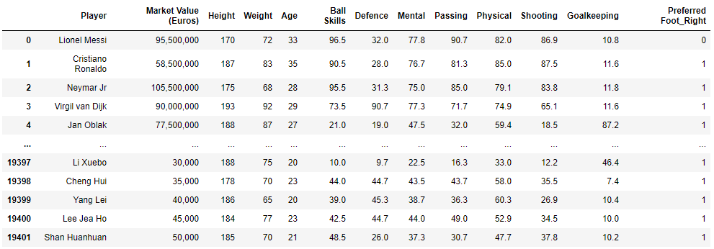
Exploratory Data Analysis

Slide 5
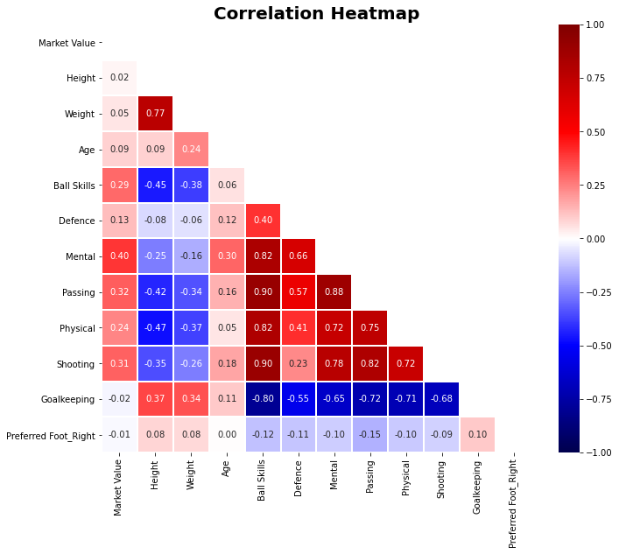
Exploratory Data Analysis
Height, Weight, Age, Preferred Foot and Goalkeeping seems to be uncorrelated with target variable.
Should we remove them?

Slide 6
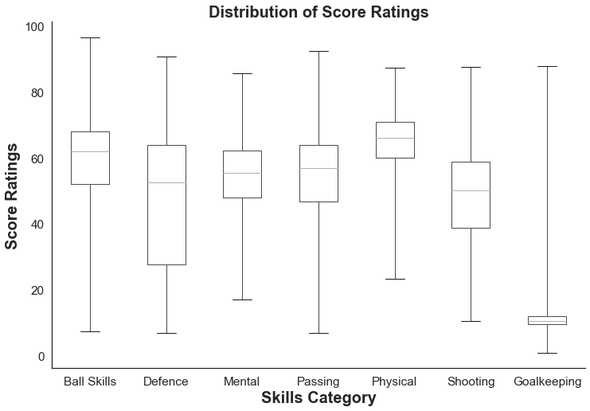
Exploratory Data Analysis
Several goalkeepers enjoy high market value.
Goalkeeping scores are inversely proportional to other scores.
Context is important.

Slide 7
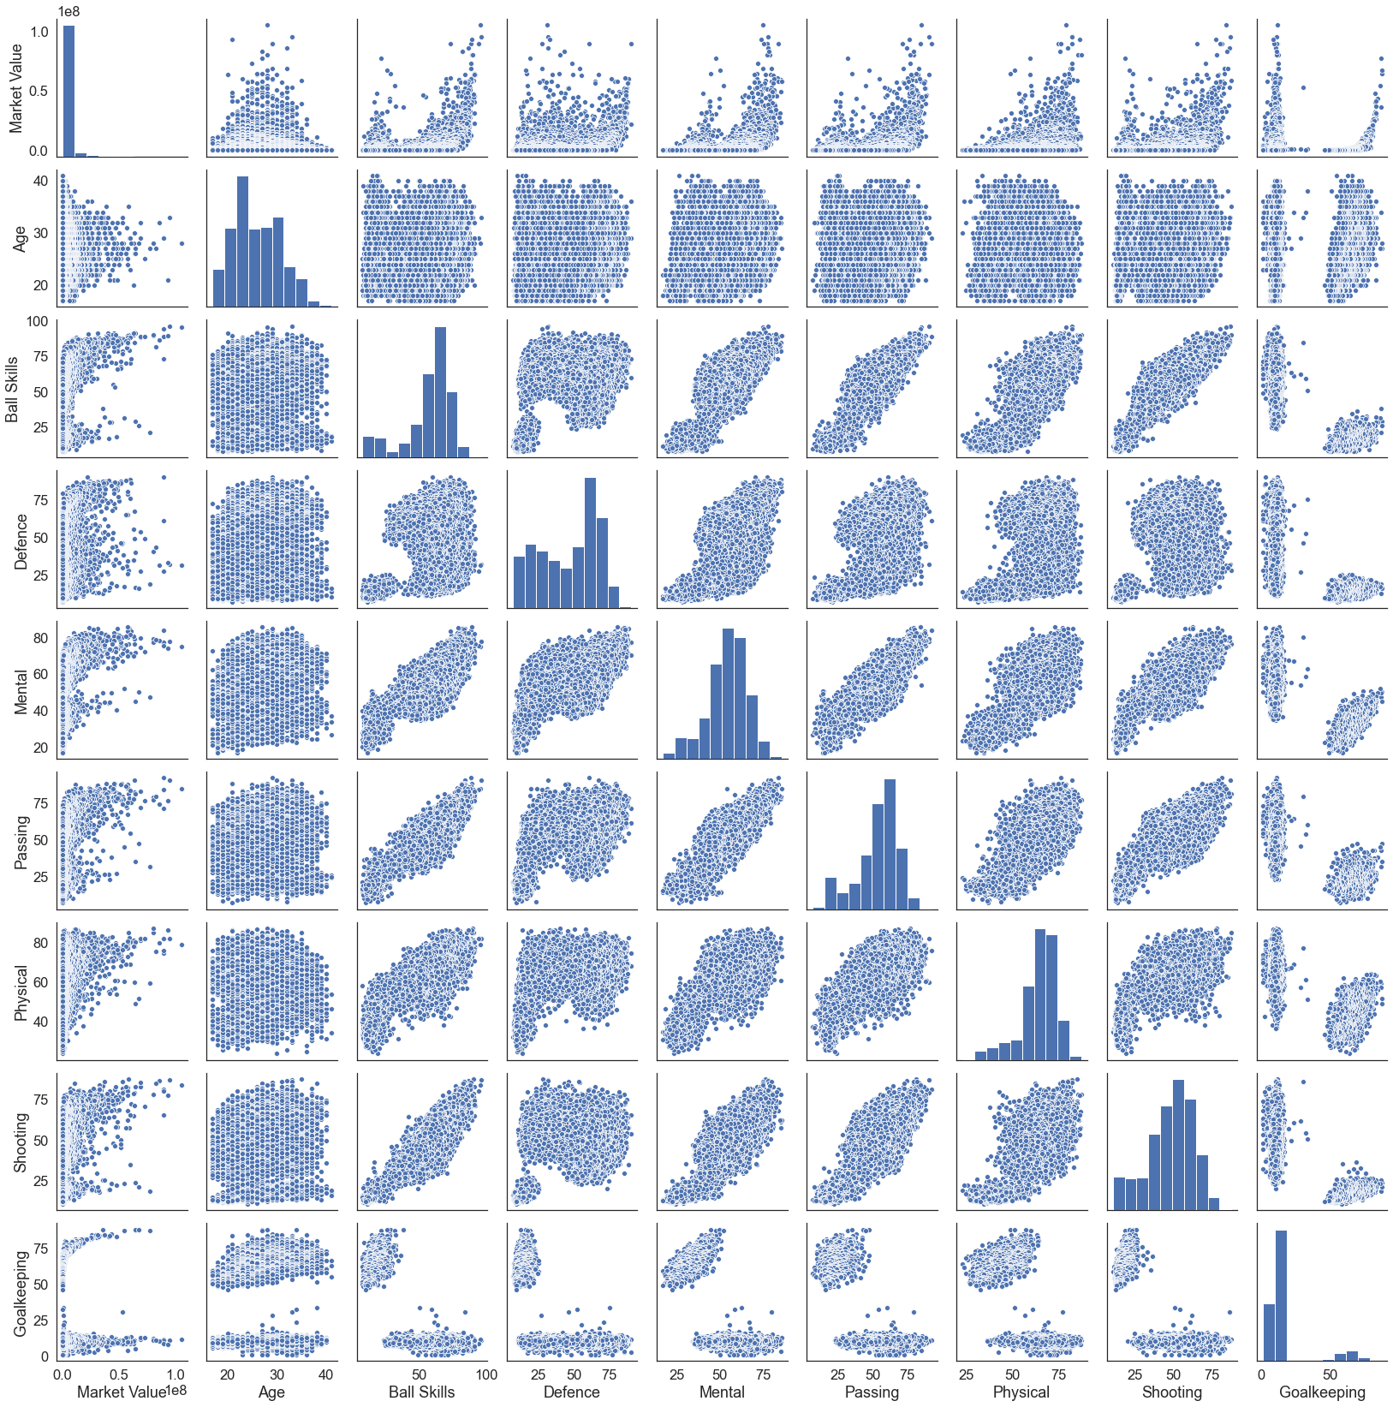
Exploratory Data Analysis
Distribution of Market Value is exponential.
A high score in a single skill category does not guarantee high market value.

Slide 8
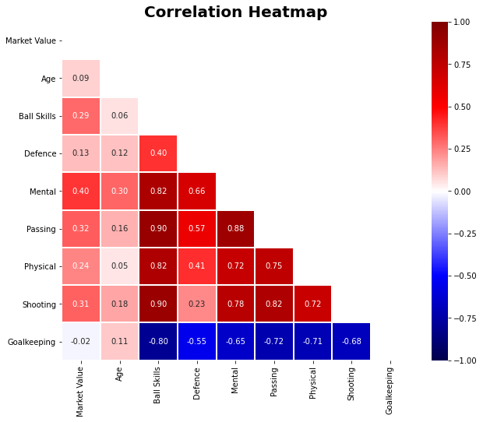
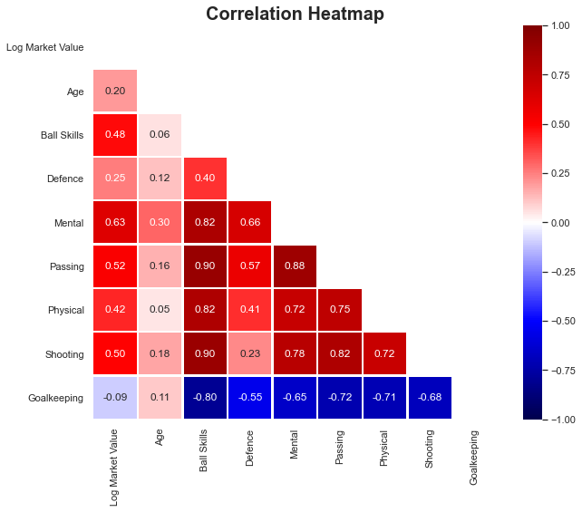
Feature Selection and Engineering

Slide 9
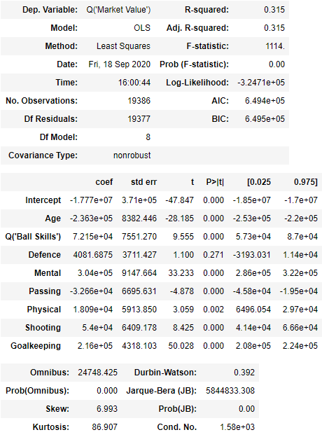
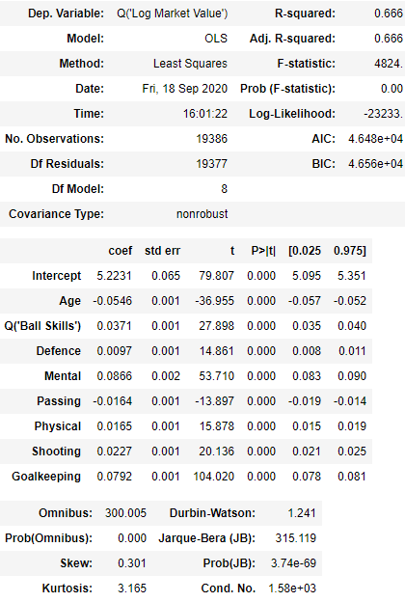
Feature Selection and Engineering

Slide 10
Model Selection
Determining Regularization Hyperparameter by 5-Fold CV:
Training Set (5-Fold CV)
Test Set
16% | 16% | 16% | 16% | 16% | 20%
- Optimum Alpha for LASSO regression: Approx. 0
- Optimum Alpha for Ridge regression: 0.93
- Optimum Alpha for Elastic Net regression: Approx. 0
- Optimum degree for Polynomial regression: Degree 4

Slide 11

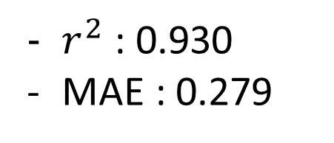
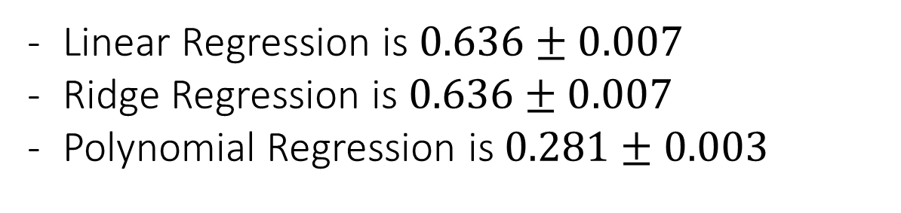
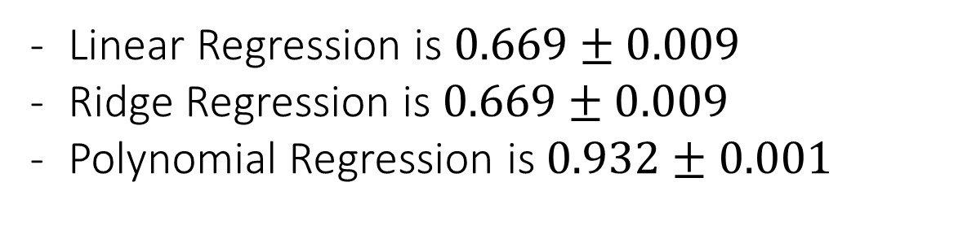
Model Selection
Mean $r^{2}$ for :
Linear Regression is $0.669±0.009$
Ridge Regression is $0.669±0.009$
Polynomial Regression is $0.932±0.001$
Final CV
Mean MAE for :
Linear Regression is $0.636±0.007$
Ridge Regression is $0.636±0.007$
Polynomial Regression is $0.281±0.003$
Scoring on Test Set for Polynomial Regression:
$r^{2}$ : 0.930
MAE : 0.279

Slide 12
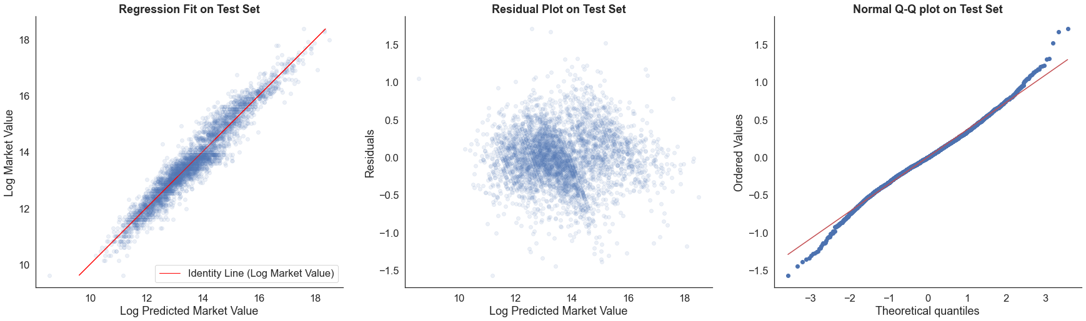
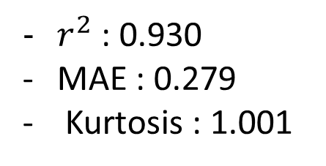
Model Evaluation
Scoring on Test Set for Log Market Value:
$r^{2}$ : 0.930
MAE : 0.279
Kurtosis : 1.001

Slide 13
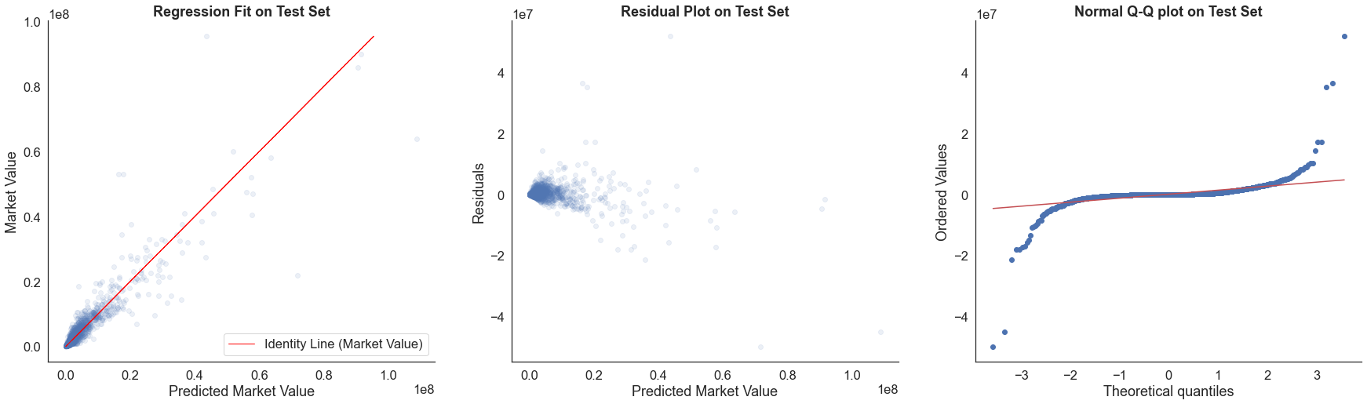
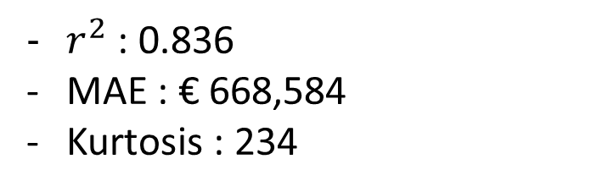
Model Evaluation
Scoring on Test Set for Market Value:
$r^{2}$ : 0.836
MAE : € 668,584
Kurtosis : 234

Slide 14
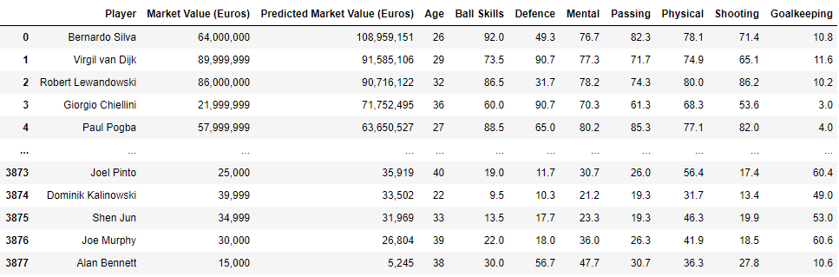
Model Evaluation

Slide 15
Conclusion
Taking logarithm of target variable is not an ideal.
Possible to explore more feature engineering.
Polynomial Regression can be a very effective model.
Market Value could be dependent on other important features.
Consider data collection from other sources.

Slide 16
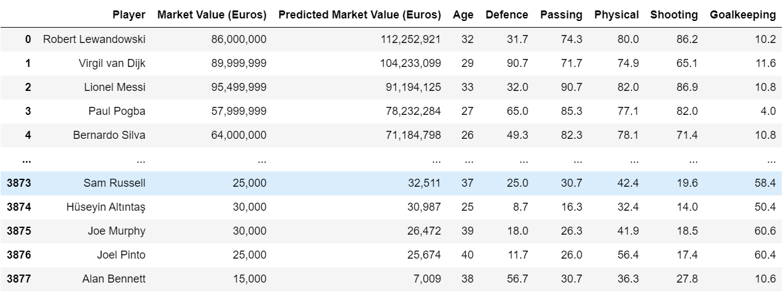
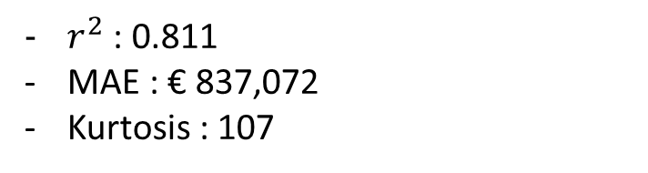
Appendix – Removing Ball Skills and Mental
Scoring on Test Set for Market Value:
$r^{2}$ : 0.811
MAE : € 837,072
Kurtosis : 107

Slide 17
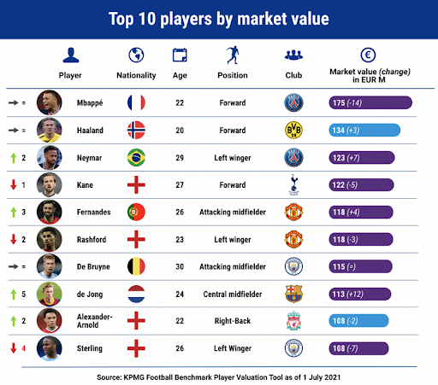
Thank You!

