Slide 1
Sports Analysis in Football
By Eng. Musa Ghazwani

Slide 2
1
2
why is data science important?
The Data Science Workflow
Collect and clean data
Exploratory data analysis (EDA)
3
Models & algorithms
4
Communicate results
5

Slide 3
why is data science important?
The importance of data Science brings together the domain expertise from programming, mathematics, and statistics to create a vision and make sense of data.
Data science is high in demand and explains how digital data is transforming businesses and helping them make sharper and critical decisions.
In fact, Really Data science plays a great role
in our life today

Slide 4
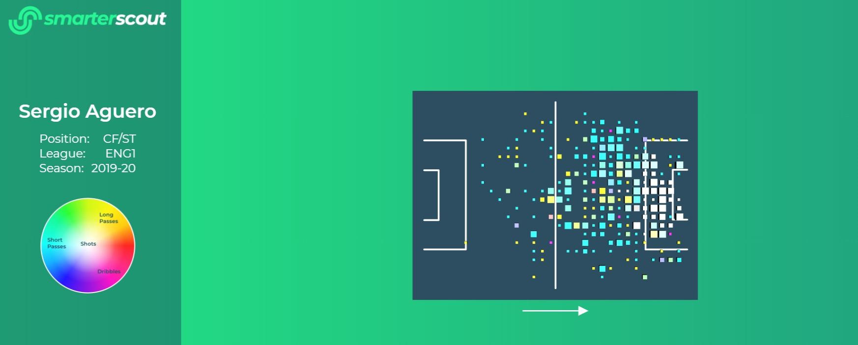
introduction
Football analytics is attracting increasing interest in academia and sports, thanks to the availability of technologies that provide
high-quality data streams for every match and league.
containing all the events (passes, shots, fouls, etc.)
Each match event contains information about its position, time, outcome, player and team.

Slide 5
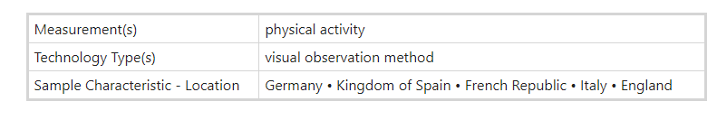
Collect and clean data
This is a data file describing the data from this website
https://doi.org/10.6084/m9.figshare.9711164

Slide 6
Exploratory data analysis (EDA)
Performance analysis
Football can be used to design algorithms for relevant problems such as the evaluation of performance and the discovery of tactics.
The problem of performance evaluation is crucial for many actors in the sports industry.

Slide 7
Complex systems analysis
In football, two teams in a match represent a complex system whose global behavior depends in skillful ways on the dynamics of the inter-actions between the players..

Slide 8
Science of success
also creates the chance to explore the relationship between performance and success,
where a team’s success can be intended as its outcome in a competition and the player’s as their popularity or market value.

Slide 9
1
Methods
Setting formations
The data described in this data have been collected,
a quick review of complex events in a match consists of three main steps.
Event tagging
2
Quality control
3

Slide 10
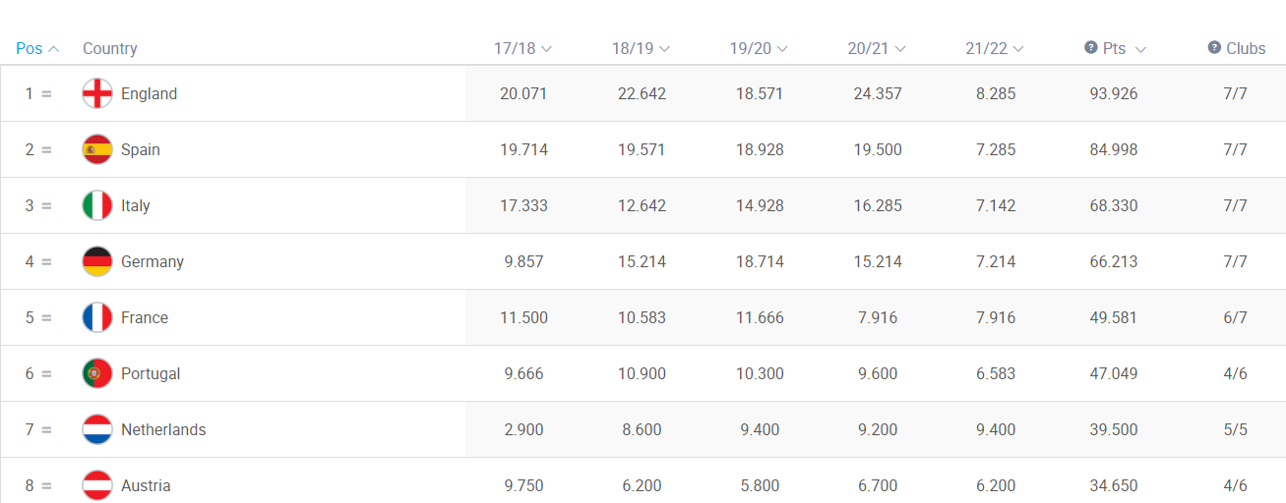
Data Records

Slide 11
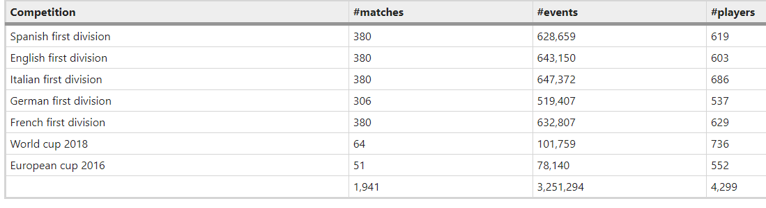
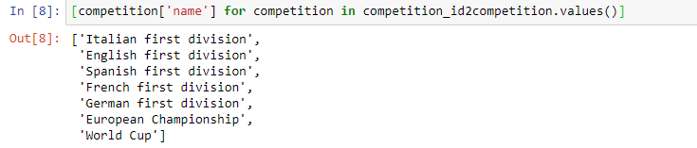
Data Records

Slide 12
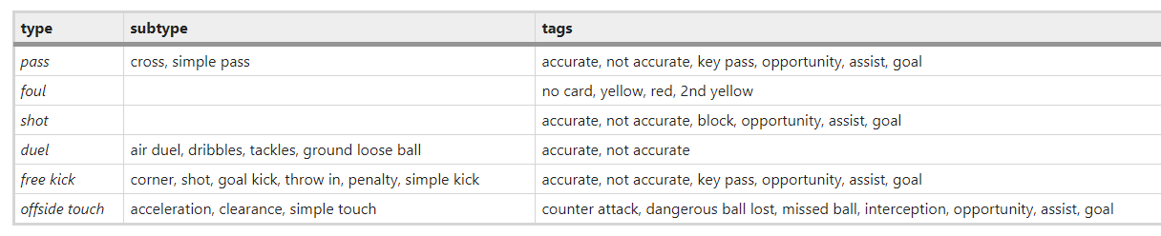
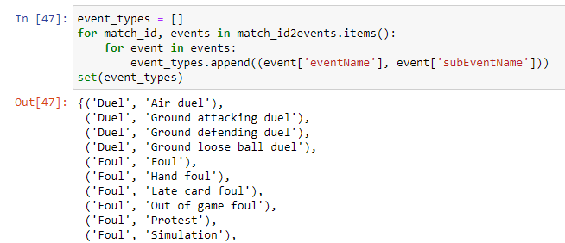
Data Records

Slide 13
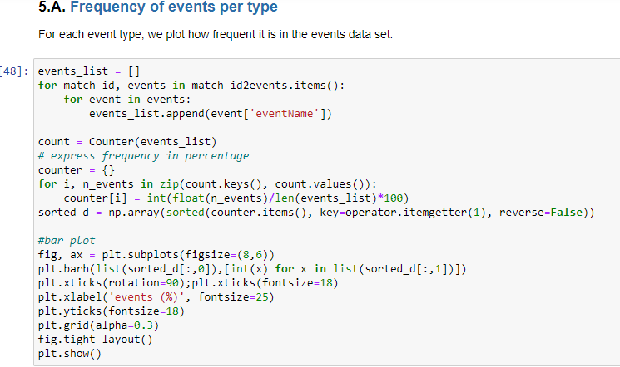
Results or Technical Validation
In general, based on the events data set,
a soccer match consists of an average of 1,682 ± 101 events
with an inter-time between two events of 3.59 ± 7.42 seconds.

Slide 14
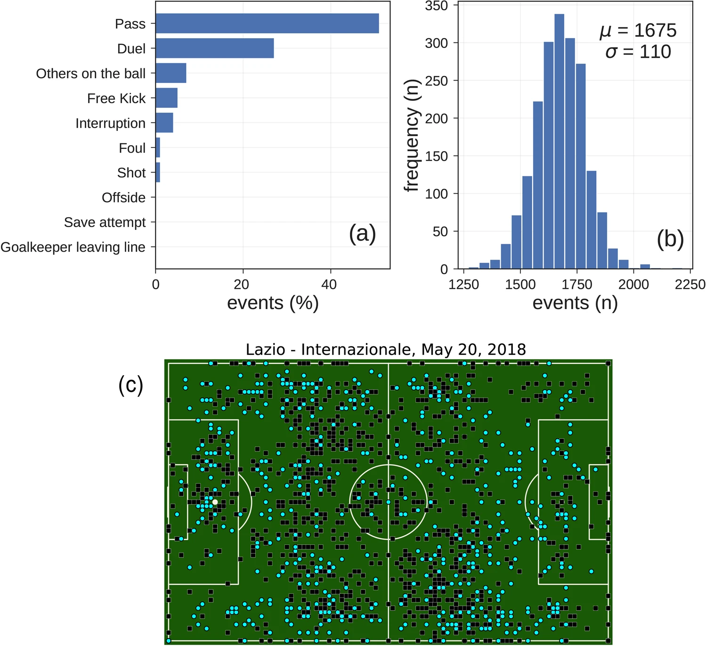
Statistics of the events data set.
(a) Frequency of events per type.
(b) Distribution of the number of events in soccer matches.
(c) Events produced by the two teams in the match Lazio
(cyan points) vs. Internazionale
(black squares).
The events are plotted on the position of the field where they occurred.

Slide 15

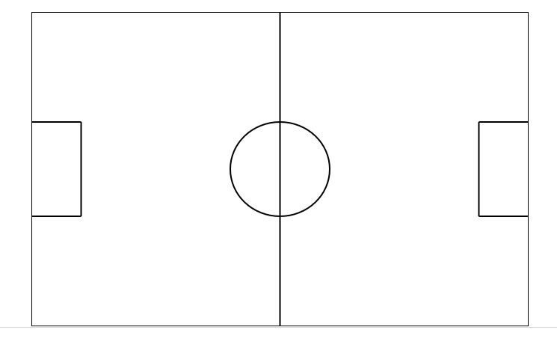
Spatial dimension 'Area'
By looking at the position of the field where the events occur,
we can interesting aspects of a match

Slide 16
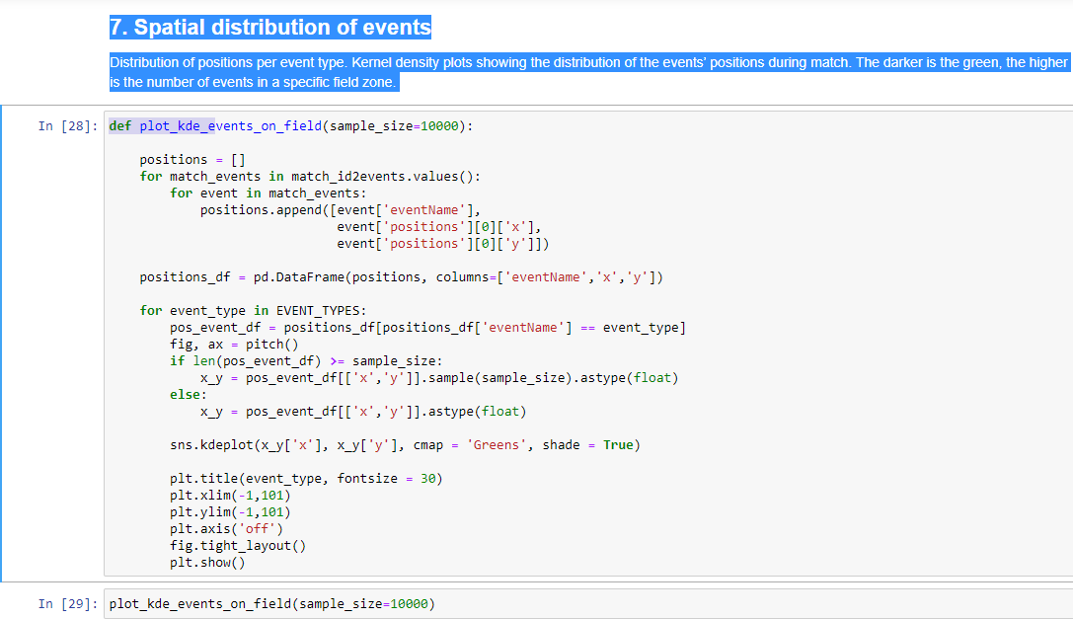

Slide 17
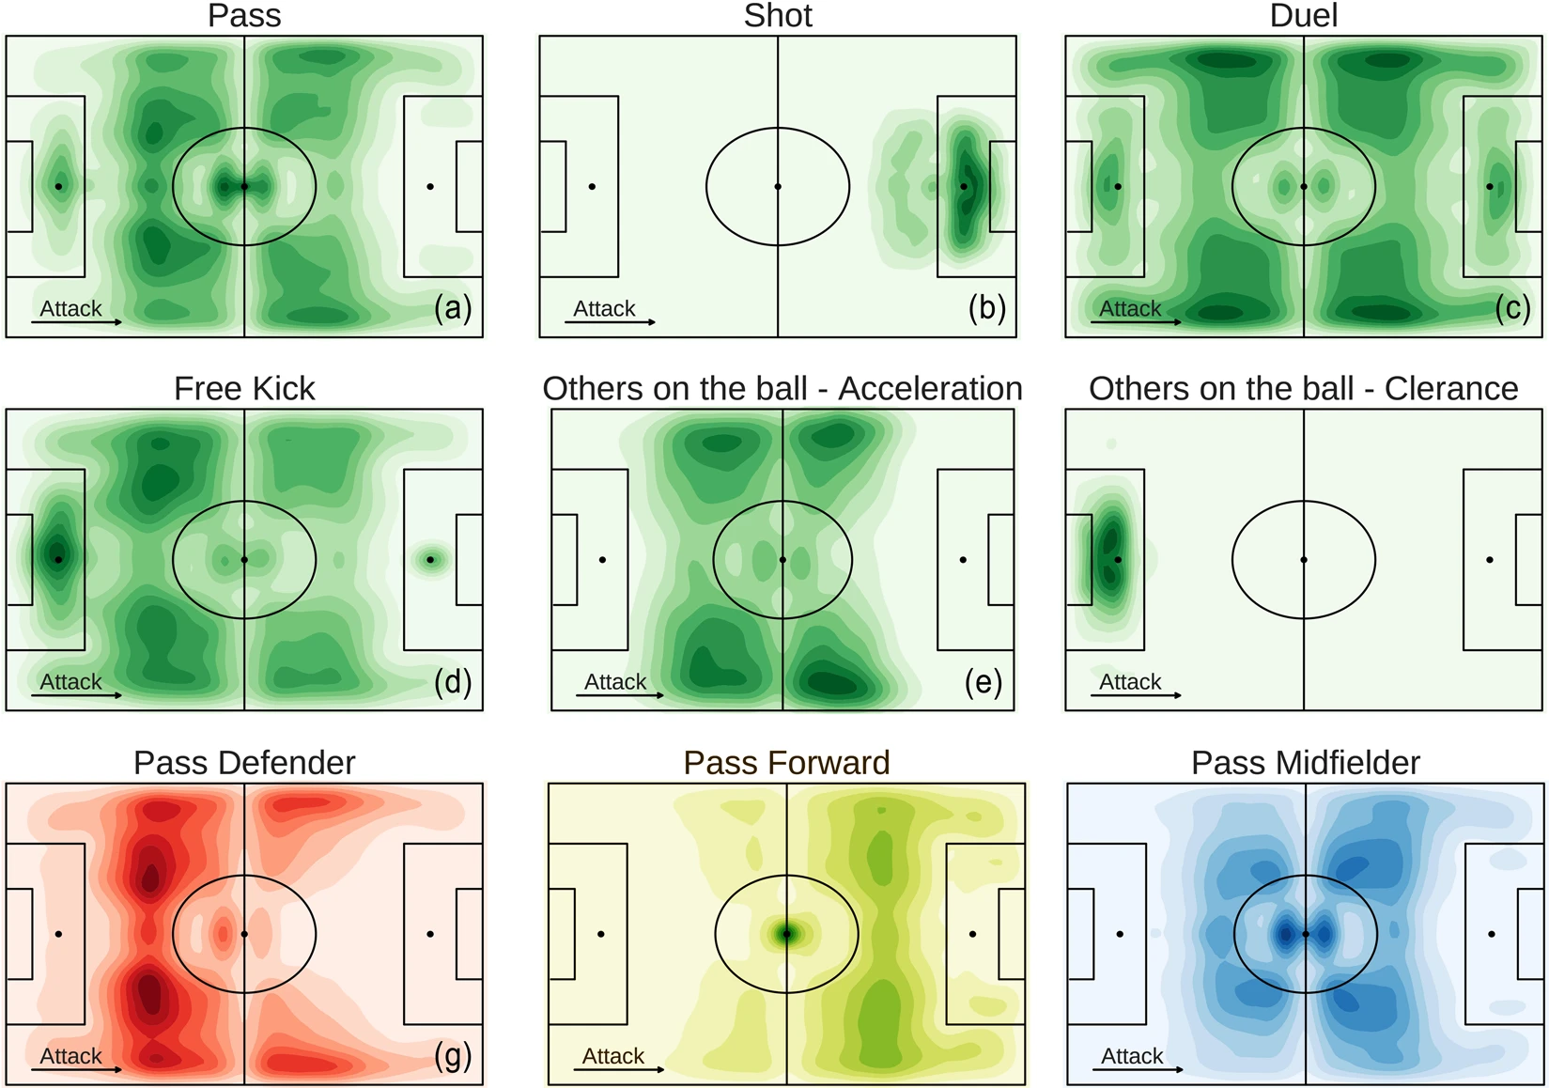

Slide 18
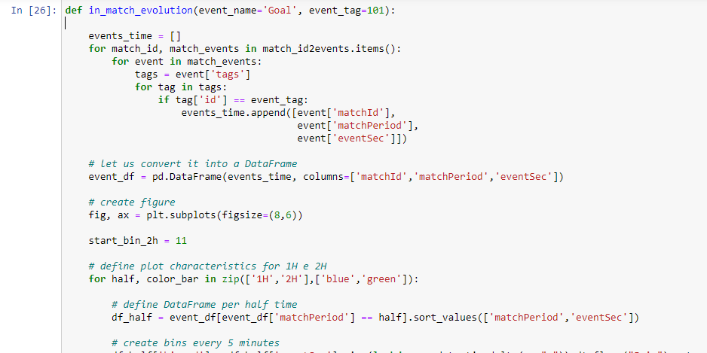
Temporal dimension “Time”
By looking at when the events occur during a game,
we can interesting dynamics of teams and players

Slide 19
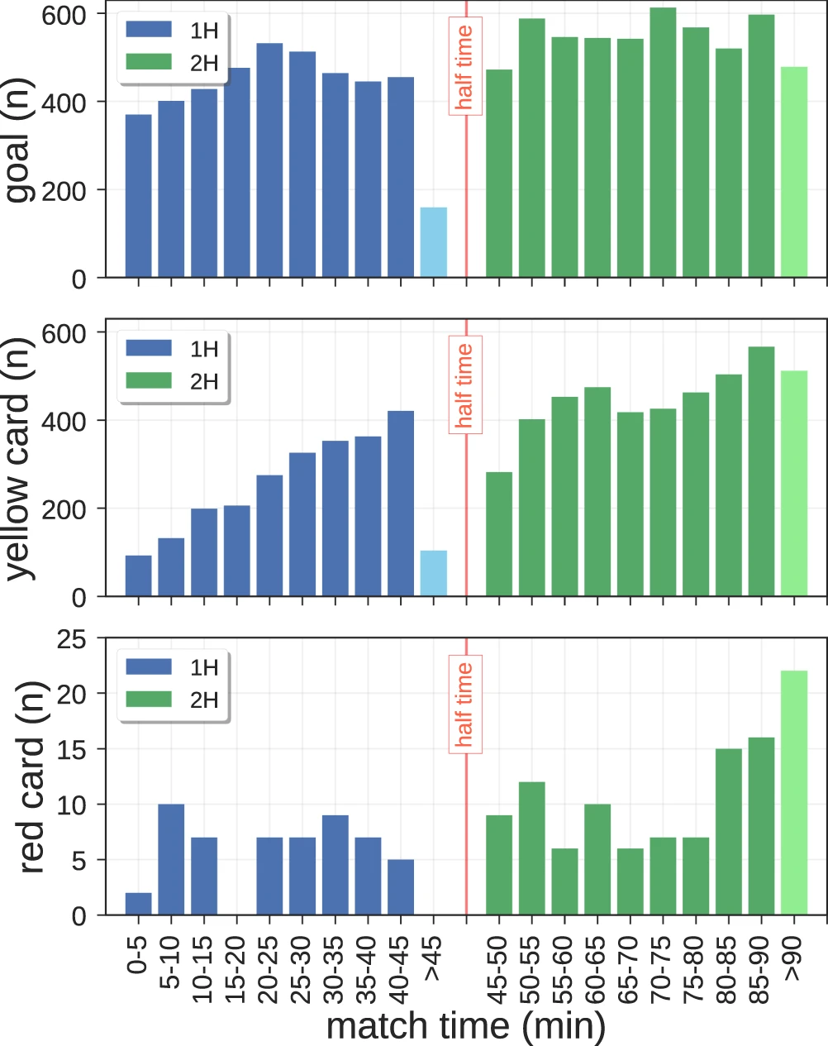

Slide 20
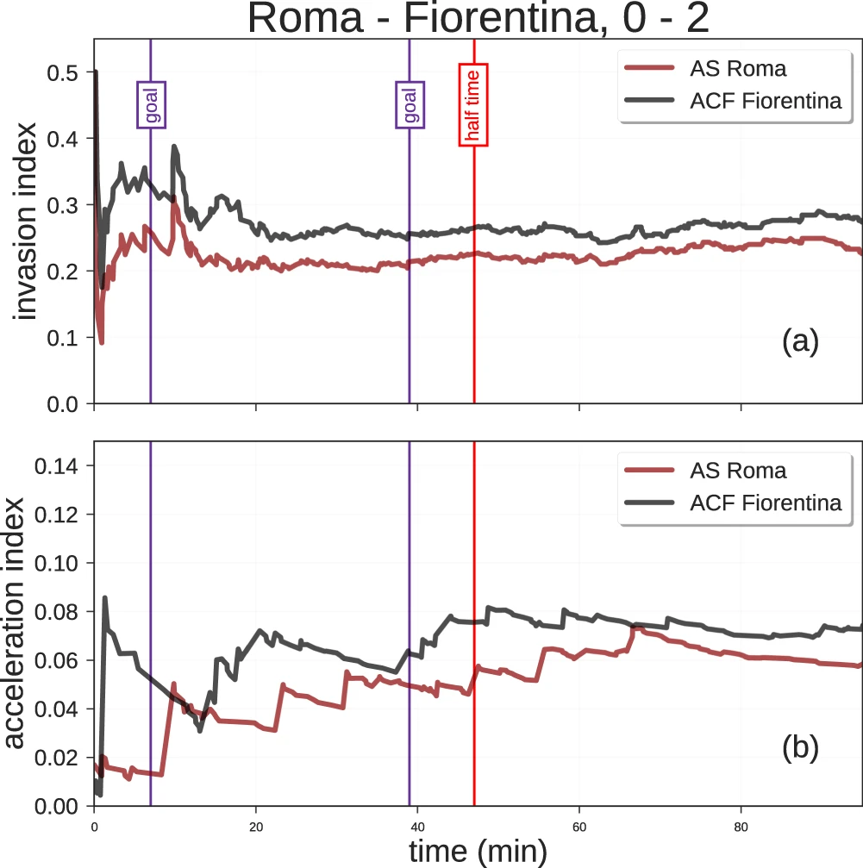
Comparison
Invasion index and acceleration index for a game in the match data set.
Bold lines represent the rolling mean of, respectively, invasion index (a) and acceleration index (b), while thin lines represent the individual values computed for each possession phase of each team. Purple vertical lines refer to the two-goal scored by Fiorentina during the match, while the red vertical line indicates the halftime of the match.

Slide 21
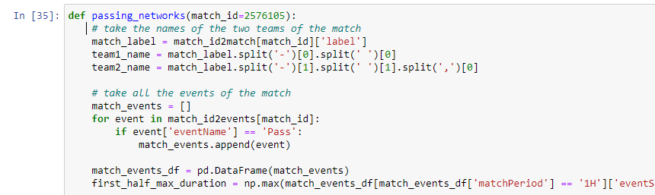
Team analysis
enable the analysis of the interactions between players through a team’s passing network
the ones having more connections to the teammates or a high passing activity.

Slide 22
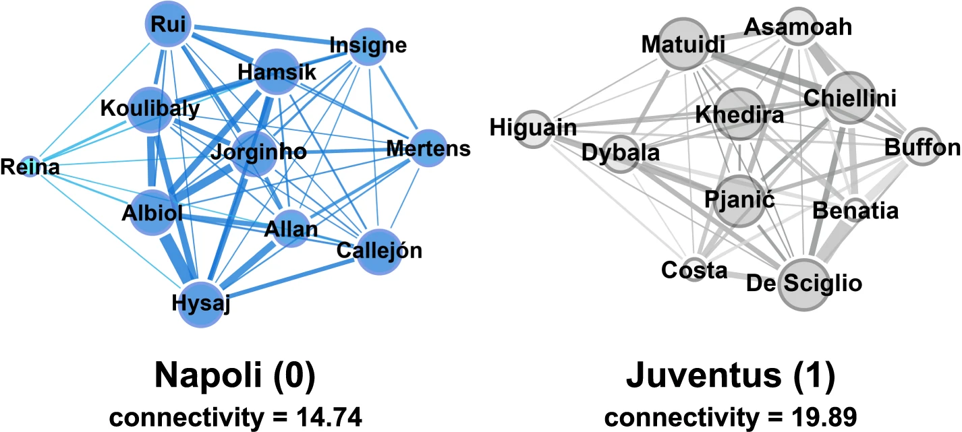

Slide 23

Player analysis
can be used to compare the performance of players and track their evolution in time.
Example,
We compare three forwards with different teams
L. Messi (FC Barcelona),
C. Ronaldo (Juventus FC)
and M. Salah (Liverpool).

Slide 24
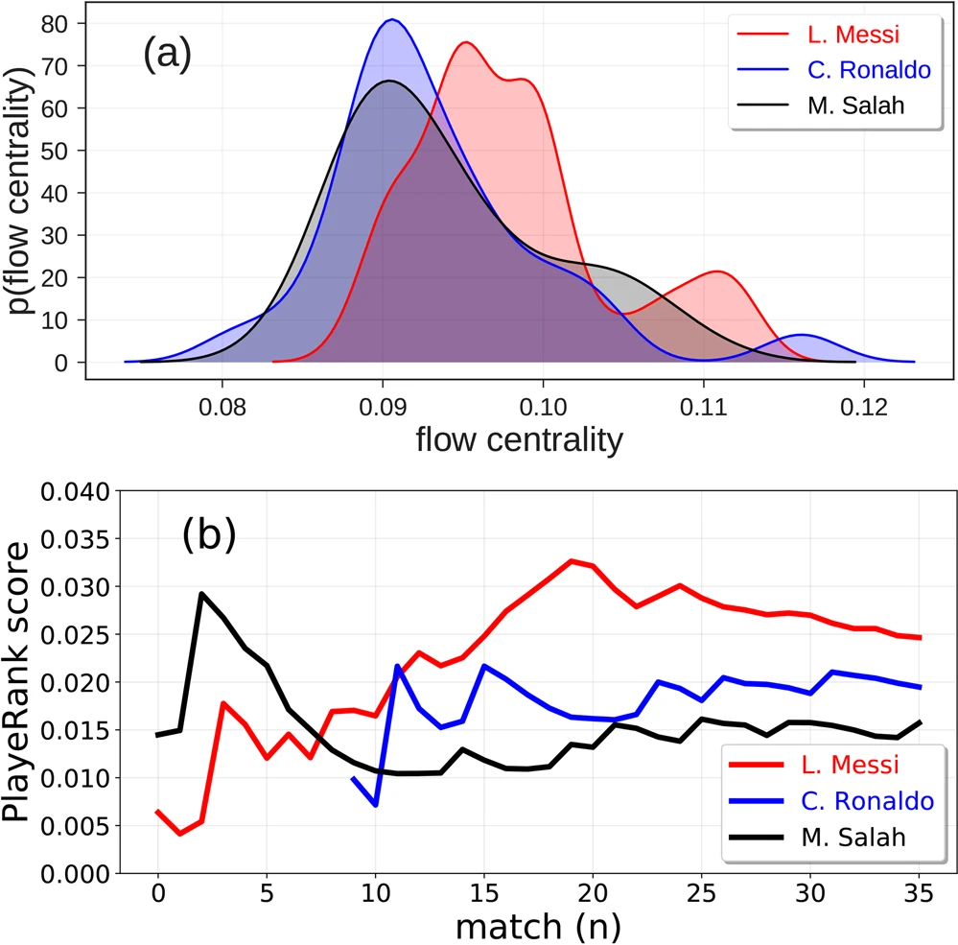
Distribution of flow centrality and PlayRank score for three top players.
(a) Distribution of the flow centrality of
L. Messi (red line),
C. Ronaldo (blue line)
M. Salah (black line)
during the soccer season 2017/2018. (b) Performance quality calculated as the PlayeRank score of
L. Messi (red line),
C. Ronaldo (blue line),
M. Salah (black line)

Slide 25


Slide 26
References:
http://footballphilosophy.org/
https://www.fingent.com/blog/why-sports-analytics-is-a-crucial-ingredient-in-todays-match-winning-formula//
https://programs.online.american.edu/mssam/sports-management-masters

