Slide 1

Version Control with Git

Slide 2
What is Github?
GitHub is a code hosting platform for version control and collaboration. It lets you and others work together on projects from anywhere. This tutorial teaches you GitHub essentials like repositories, branches, commits, and pull requests.
GitHub is a for-profit company that offers a cloud-based Git repository hosting service. Essentially, it makes it a lot easier for individuals and teams to use Git for version control and collaboration.
GitHub’s interface is user-friendly enough so even novice coders can take advantage of Git. Without GitHub, using Git generally requires a bit more technical savvy and use of the command line.

Slide 3
Why Git?
Git :most commonly used software for tracking changes in any set of files, usually used for coordinating work among programmers collaboratively developing source code during software development.
Git has many advantages over earlier systems such as CVS and Subversion
Git supports features of CVS and subversion and many more features
Git

Slide 4
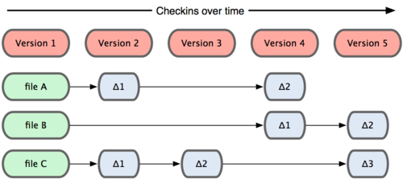
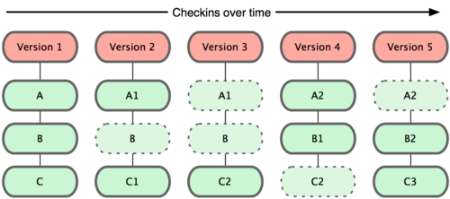

Slide 5
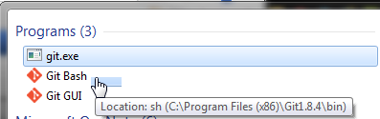
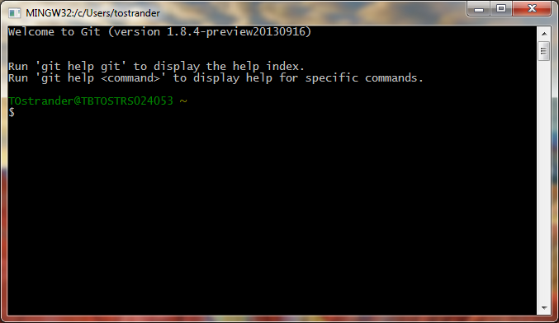
Download and install Git
Here’s the standard one: http://git-scm.com/downloads
Open Git Bash

Slide 6
Configure Git
Configure username
Configure password
Everything else is just the same!
$ git config --global user.name "Joe Shmo"
$ git config --global user.email "jshmo@highline.edu"
This creates two key-value pairs, used for tracking commits.

Slide 7
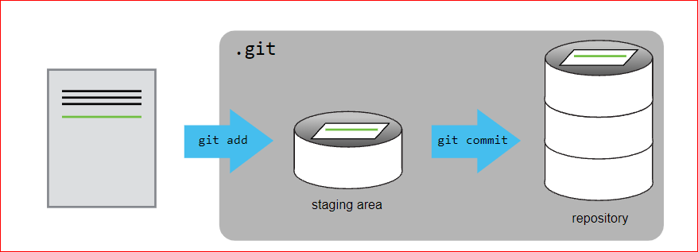
Create a Project from Scratch
Example
$ git init project1
*** create file1.txt ***
$ cd project1
$ git add file1.txt
$ git commit -m "Committing project 1"
git init project -> creates a project directory
git add -> adds files to the directory
git commit –m"message" -> commits the changes

Slide 8
Create a Project from an Existing Directory
git init . initializes the current directory
git add * adds all files in the directory
git commit –m"message" commits the changes
Create a projects/project2 directory, and create a file in that directory called file2.txt
$ cd ../projects/project2
$ git init .
$ git add *
$ git commit -m "Committing project 2"

Slide 9
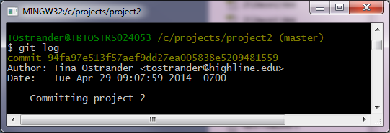
View your Commit Logs
git log displays your log history

Slide 10
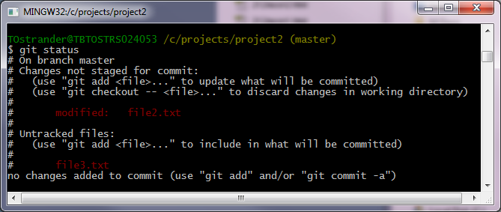
Check your Status
git status displays the status of the repo
In the projects/project2 directory, modify file2.txt and create a file called file3.txt
modified file
new file

Slide 11
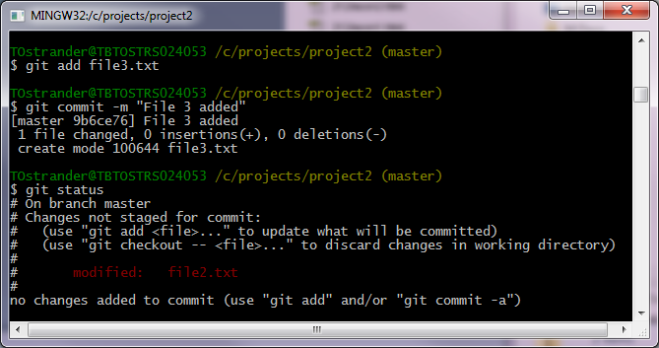
Update your repo
add the file
commit the changes
check the status

Slide 12
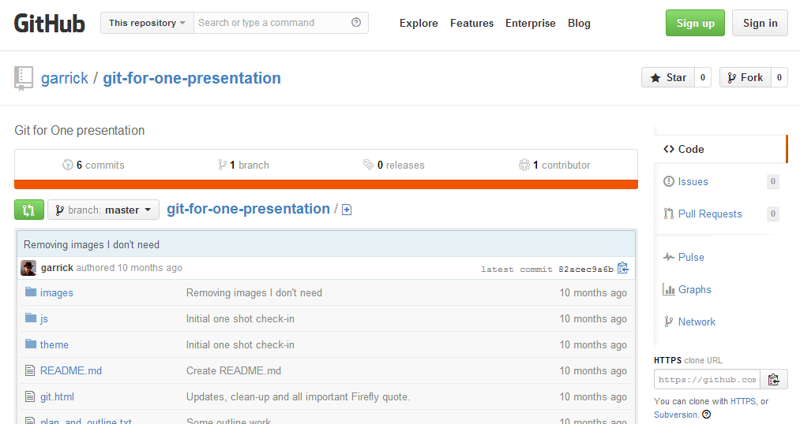
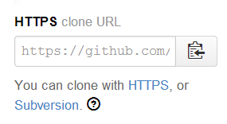
Access a Git Project from GitHub
Most open source projects have a read-only Git URL
Visit github.com 🡪 Explore
git clone https://... copies repository content to your system

Slide 13
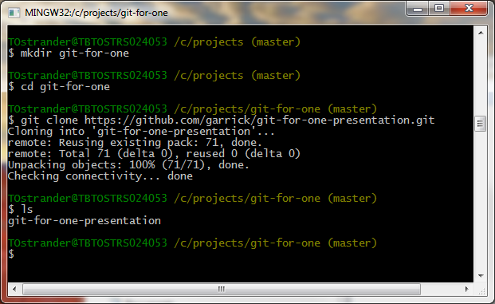
Access a Git project
Right click here to Edit 🡪 Paste, or press the Insert key on the keyboard
🡪 Create a new folder from the command line
🡪 Change to the new folder
Pull down a copy of a github project
🡪 Display directory contents
URL -- https://github.com/garrick/git-for-one-presentation.git

Slide 14
Keep Current
git pull will bring down latest content
If you've made conflicting changes, this may not work easily
You can always delete the directory contents and pull down a fresh copy

Slide 15
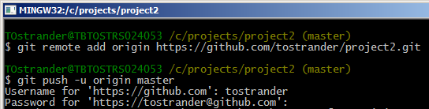
Push to GitHub
$git push -u origin master
Copies your project to GitHub
Enter your credentials
You should only have to do this once!
"Origin" is GitHub
"Master" is local copy

Slide 16
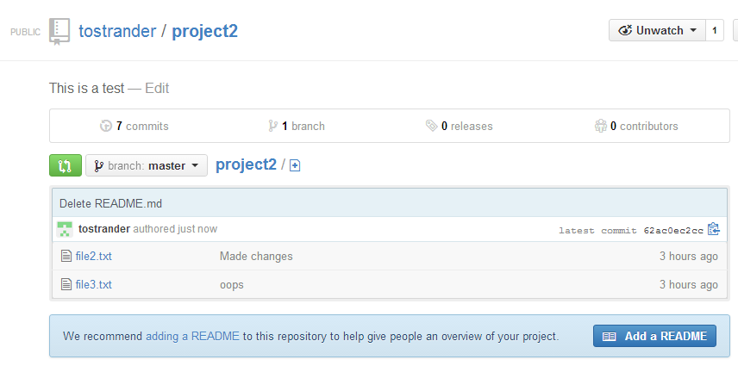
Congrats File Uploaded

Slide 17
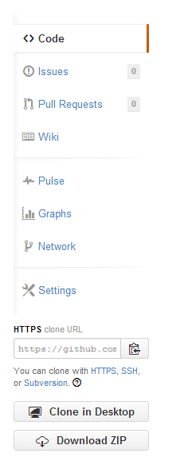
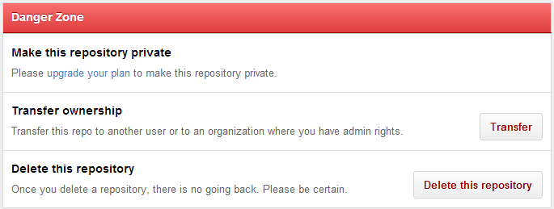
Deleting a Repo from GitHub
Select the Repository
Click Settings
Click "Delete this repository "under Danger Zone
This cannot be undone!

Slide 18
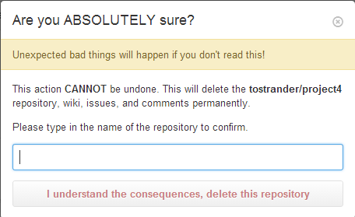
Type the name of the repository to confirm

Slide 19
Summary
Initialize a project
git init projectName
git init .
Add a file
git add fileName
git add *
Commit changes
git commit -m "remark"
View the log
git log
Check status
git status
Add a remote location to upload files
git remote add origin url
Push changes from local to remote
git push -u origin master
Pull changes from remote to local
git pull url

Slide 20
Git Isn't Just for Code
You can commit anything to a Git repository
Pictures
Word docs
PowerPoint presentations
Videos
Music
etc.

Slide 21
THANK YOU

