Slide 1
Introduction to Linux/Unix Environment

Slide 2
Operating Systems
operating system: Manages activities and resources of a computer.
software that acts as an interface between hardware and user
provides a layer of abstraction for application developers
features provided by an operating system:
ability to execute programs (and multi-tasking)
memory management (and virtual memory)
file systems, disk and network access
an interface to communicate with hardware
a user interface (often graphical)
kernel: The lowest-level core of an operating system.
Notes:
‹#›

Slide 3
Unix: brief history
Multics (1964) for mainframes
Unix (1969)
K&R
Linus Torvalds and Linux (1992)
Notes:
‹#›

Slide 4
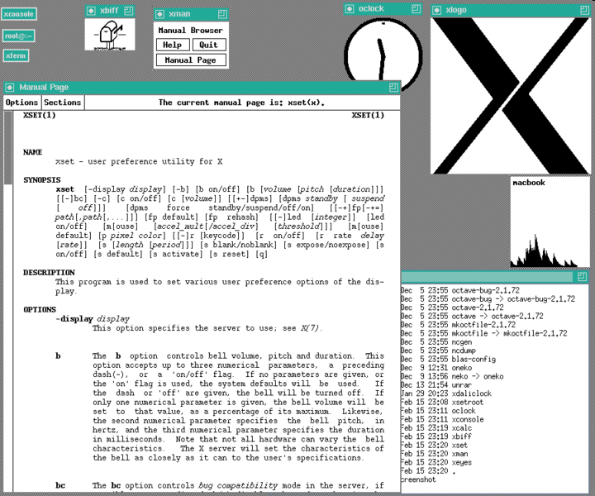

Slide 5
Unix
key Unix ideas:
written in a high-level language (C)
virtual memory
hierarchical file system; "everything" is a file
lots of small programs that work together to solve larger problems
security, users, access, and groups
human-readable documentation included

Slide 6

Linux
Linux: A kernel for a Unix-like operating system.
commonly seen/used today in servers, mobile/embedded devices, ...
GNU: A "free software" implementation of many Unix-like tools
many GNU tools are distributed with the Linux kernel
distribution: A pre-packaged set of Linux software.
examples: Ubuntu, Fedora
Notes:
‹#›

Slide 7
Features of Linux
X-windows
window managers
desktop environments
Gnome
KDE
How can I try out Linux?
Computer Labs @ IITBh (109?)
at home (install Linux via Live CD, etc.)
virtual machine: Virtualbox, VMware
Notes:
attu shared server
‹#›

Slide 8
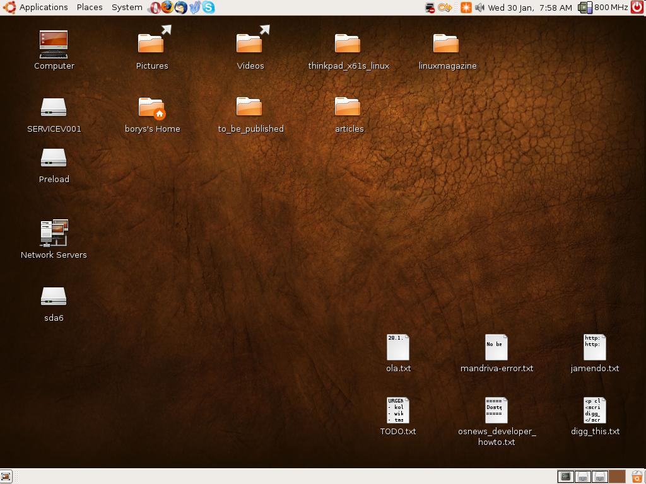

Slide 9
Shell
shell: An interactive program that uses user input to manage the execution of other programs.
bash : the default shell program on most Linux/Unix systems
Why should I learn to use a shell when GUIs exist?
Notes:
‹#›

Slide 10
Shell
Why should I learn to use a shell when GUIs exist?
faster
programmable
customizable
repeatable
input, output, and errors
directories: working/current directory, home directory
Notes:
‹#›

Slide 11
Shell commands
command | description
exit | logs out of the shell
ls | lists files in a directory
pwd | outputs the current working directory
cd | changes the working directory
man | brings up the manual for a command
Notes:
‹#›

Slide 12
Relative directories
directory | description
. | the directory you are in ("working directory")
.. | the parent of the working directory (../.. is grandparent, etc.)
~ | your home directory (on many systems, this is /home/username )
~username | username's home directory
~/Desktop | your desktop
Notes:
‹#›

Slide 13
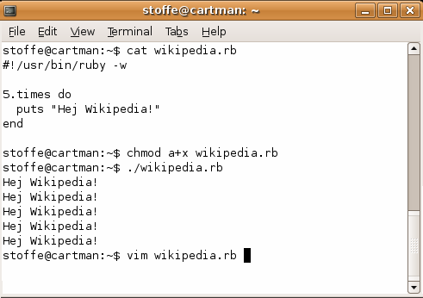
Shell commands
many accept arguments or parameters
example: cp (copy) accepts a source and destination file path
a program uses 3 streams of information:
stdin, stdout, stderr (standard in, out, error)
input: comes from user's keyboard
output: goes to console
errors can also be printed (by default, sent to console like output)
Notes:
‹#›

Slide 14
Directory commands
some commands (cd, exit) are part of the shell ("builtins")
others (ls, mkdir) are separate programs the shell runs
command | description
ls | list files in a directory
pwd | output the current working directory
cd | change the working directory
mkdir | create a new directory
rmdir | delete a directory (must be empty)
Notes:
‹#›

Slide 15
Shell/system commands
command | description
man or info | get help on a command
clear | clears out the output from the console
exit | exits and logs out of the shell
command | description
date | output the system date
cal | output a text calendar
uname | print information about the current system
Notes:
‹#›

Slide 16
Shell/system commands
NOTE
"man pages" are a very important way to learn new commands
man ls
man man

Slide 17
File commands
command | description
cp | copy a file
mv | move or rename a file
rm | delete a file
touch | create a new empty file, or update its last-modified time stamp
Notes:
‹#›

Slide 18

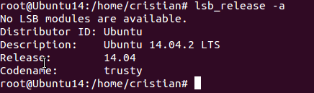
System information
uname – prints the name, version and other details about the current machine and the operating system running on it.
lsb_release -a - prints Distribution information.

Slide 19
Copying, renaming and deleting files
Make a copy of a file using the cp command.
cp source_file destination_file
Renaming a file with the mv command:
mv old_file new_file
Delete one or multiple files with rm:
rm filename1
rm filename1 filename2 filename3 //multiple files
rm –r –f /home/cristian/* // deletes all files in /home/Cristian without confirmation
rm *.txt ./ //deletes all .txt files in the current directory

Slide 20
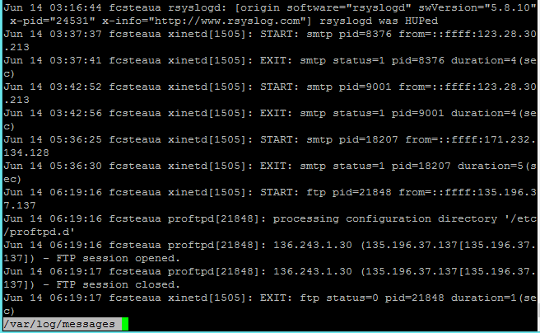
Control the output with more & less
more - is a filter for paging through text one screenful at a time
less - is a program similar to more (1), but which allows backward movement in the file as well as forward movement.
The syntax:
more /my/log/file
less /my/log/file

Slide 21
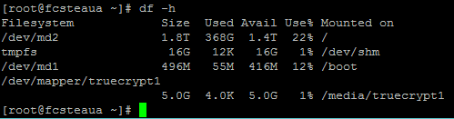

Server load (I)
Hard drive usage:
-> df - displays the amount of disk space available on the file system
-> du - estimates and displays the disk space used by files and directories

Slide 22
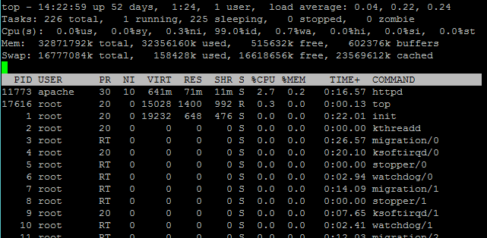
Server load (II)
Processor, memory, general server load
top - provides a dynamic real-time view of a running system. It can display system summary information, as well as a list of processes or threads currently being managed by the kernel

Slide 23
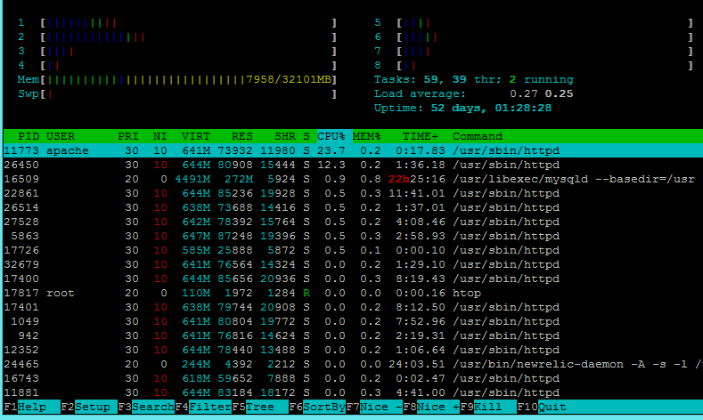
Server load (II)
Processor, memory, general server load
htop – similar to top, but with more details and fancier colors

Slide 24
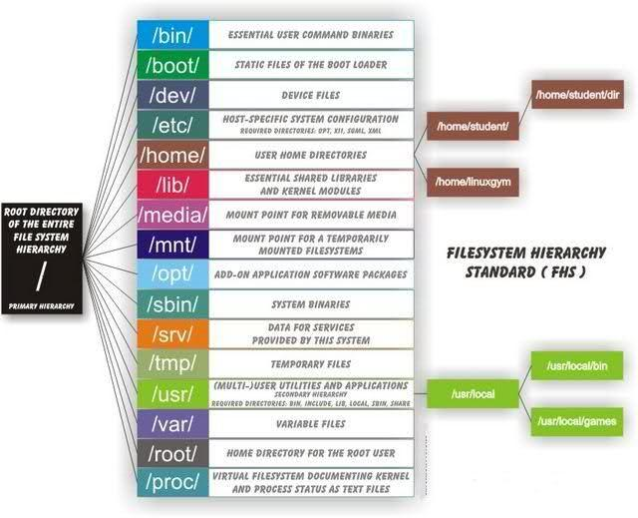
Linux directory hierarchy
In Windows we call them folders, in Linux the term used is directory/directories.

Slide 25
Linux directory hierarchy
The equivalent of the “C:\” partition in Windows is referred in Linux as “/” – also called “root directory”, or “slash”.
The Linux filesystem has the root directory at the top of the directory tree.
The following list of directories are subdirectories of the root directory.
/bin: These programs are designed to make the system usable.
/etc Contains configuration files which are local to the machine.
/home Contains user account directories.

Slide 26
Linux directory hierarchy
/mnt Used for mounting temporary file systems.
/opt Used for storing random data that has no other logical destination.
/proc Provides information about running processes and the kernel.
/root This is the home directory for the super user (root).
/tmp This directory is used for temporary storage space.

Slide 27
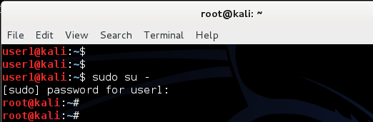
Users and groups
Similar to Windows:
Linux has limited access users and, by default, one administrator (called “root”)
root is the user name or account that by default has access to all commands and files on Linux.
It is also referred to as the root account, root user and the superuser.
You can grant root like access to limited users using sudo (see “Run as Administrator in Windows”)

Slide 28

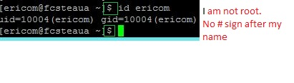
Users and groups
With sudo, as a limited permissions user, you can be granted, temporarily, administrator/root access to execute commands usually restricted to only the root user.
sudo is used in Linux Debian derivatives distros (Ubuntu, SteamOS from Valve, Kali Linux, etc) – but not limited to only Debian
Not every user can use sudo. That user must be present in the /etc/sudoers file

Slide 29

Users and groups
All users have:
user IDs (uid), group IDs (gid).
The uid and gid are always decimal numbers and start from 1000 or 10000
The root superuser usually has uid and gid 0 (zero)
A specific user can be member of multiple groups.
The id command show all the information you need to know about a user
Try issuing the id root command and see what happens

Slide 30


Users and groups
How do I add a new user via the linux shell?
useradd Cristian –p test123
The command above created a new user called ericom with the password test123
How do I assign a user to another group?
usermod –G root cristian
I added the user Cristian to the root group.
Create a new group:
Delete a group:

Slide 31
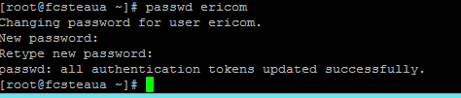
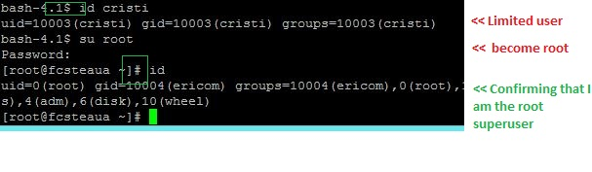
Users and groups
Change the password of a user with the passwd command:
Login as root if you are changing a password for an account different than yours
If you are logged in with a limited user account, use the su command or sudo su to login as root

Slide 32
Permissions system in Linux
Each file and directory has three user based permission groups:
owner - The Owner permissions apply only the owner of the file or directory, they will not impact the actions of other users.
group - The Group permissions apply only to the group that has been assigned to the file or directory, they will not effect the actions of other users.
all users - The All Users permissions apply to all other users on the system, this is the permission group that you want to watch the most.

Slide 33
Permissions system in Linux
Permission Types
Each file or directory has three basic permission types:
The read permission grants the ability to read a file. When set for a directory, this permission grants the ability to read the names of files in the directory.
The write permission grants the ability to modify a file.
The execute permission grants the ability to execute a file. This permission must be set for executable programs, including shell scripts, in order to allow the operating system to run them.

Slide 34
Permissions system in Linux
View the permissions:
ls is the utility you need
Is the equivalent of dir in Windows
Standard usage is ls –lh (list, show permissions and display them in human readable format)
Any file or folder that starts with a dot character (for example, /home/user/.config), commonly called a dot file or dotfile, is hidden.

Slide 35
Permissions system in Linux
Reading the file and directory permissions
-rw-r--r-- 1 root ericom 0 Jun 12 16:02 file.txt
The first character (-) indicates the file type and is not related to permissions. The remaining nine characters are in three sets, each representing a class of permissions as three characters:
The first set represents the user class.
The second set represents the group class.
The third set represents the others class.
Each of the three characters represent the read, write, and execute permissions:
r if reading is permitted, - if it is not.
w if writing is permitted, - if it is not.
x if execution is permitted, - if it is not.

Slide 36
Permissions system in Linux
In our example, -rw-r--r-- root ericom means:
rw- | r-- | r--
The owner (root) can read and write the file | The users in the ericom group can read the file | Everyone else can read the file

Slide 37
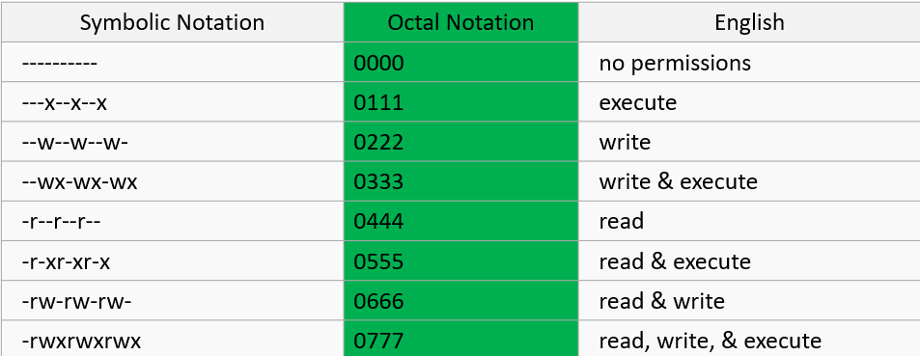
Permissions system in Linux
The alternative to the symbolic (rwx) permission system:
Meet the octal notation:

Slide 38
Permissions system in Linux
Modify the permissions with chmod
When you:
grant permission you use the plus sign “+”
take permission away you will use the minus sign “-”
Example 1:
Grant permission for read, write and execute to the file owner
chmod u+rwx file.txt //in octal: chmod 700 file.txt
Example 2:
Take away all privileges from user eircom for file.txt
chmod u-rwx file.txt

Slide 39
How do I install software by compiling from the source
Example. Install pidgin from source code in Ubuntu.
sudo apt-get install build-essential // this will install the compiler and other required libraries
Now you’ll need your desired application’s source code. These packages are usually in compressed files with the .tar.gz or .tar.bz2 file extensions.
wget http://downloads.sourceforge.net/project/pidgin/Pidgin/2.10.11/pidgin-2.10.11.tar.bz2
tar -xjvf pidgin-2.10.11.tar.bz2 // extract the content of the archive

Slide 40
How do I install software by compiling from the source
cd pidgin-2.10.11 // navigate to the new created directory
./configure // configure the new install
make // compile the program
make install // install the software on your system

Slide 41
Known Linux server applications
HTTP server:
Apache (httpd), nginx
SQL:
Mysql (mysqld), SQLite, postgresql
FTP servers:
Proftpd, Pure-FTPd, vsFTPd, Filezilla
DNS servers (Bind),
Firewall (iptables, ipchains)

Slide 42
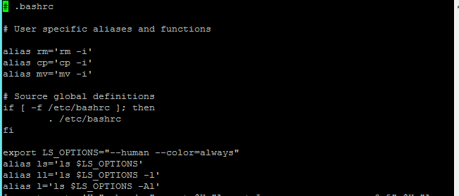
Known Linux applications
Text editors
vi
Vi is a powerful text editor included with most Linux systems, even embedded ones. Sometimes you'll have to edit a text file on a system that doesn't include a friendlier text editor, so knowing Vi is essential.

Slide 43
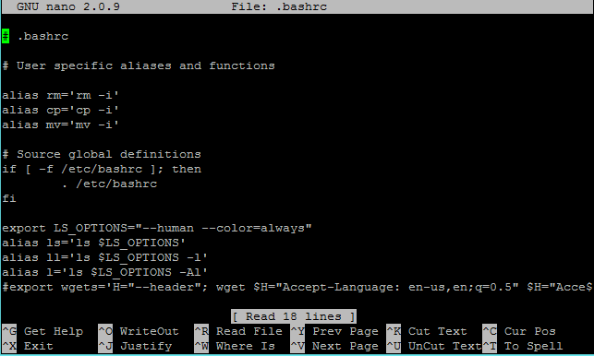
Known Linux applications
Text editors
nano
nano is a small and friendly text editor. Besides basic text editing, nano offers many extra features like an interactive search and replace, go to line and column number.

Slide 44
Creating and Extracting archives
Most seen file extensions are .tar.gz and .tar.bz2 which is a tar archive further compressed using gzip or bzip algorithms respectively.
Create archives
tar -cvf mynewarchive.tar /var/www
(will create mynewarchive.tar with the content of /var/www)
Extract a tar.gz archive:
tar -xvzf tarfile.tar.gz
Extract tar.bz2/bzip archives
tar -xvjf archivefile.tar.bz2

Slide 45
Creating and Extracting archives
Extract files to a specific directory or path
tar -xvzf abc.tar.gz -C /opt/folder/
Extract a single file
tar -xz -f archive.tar.gz "./new/file.txt"
Extract multiple files
tar -xv -f abc.tar.gz "./new/cde.txt" "./new/abc.txt“
Extract multiple files using wildcards
tar -xv -f abc.tar.gz --wildcards "*.txt“

Slide 46
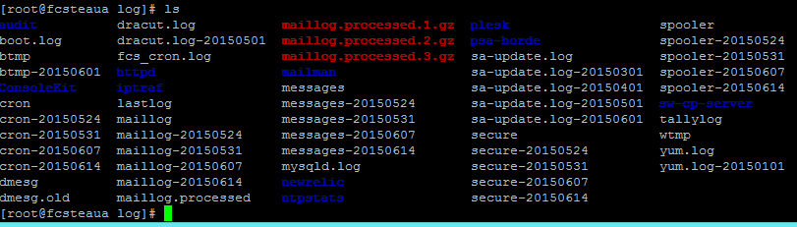
The logs
The default log folder in Linux is /var/log
How do I view log files on Linux?
Go to /var/log directory using the following cd command:
# cd /var/log
To list files use the following ls command:
# ls or ls -lh

Slide 47
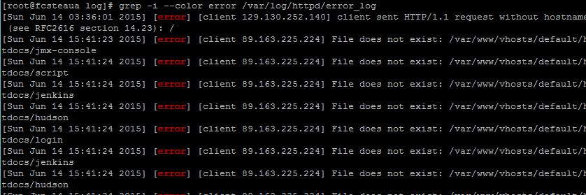
The logs
Common logs and their location in Linux:
/var/log/messages : General message and system related stuff
/var/log/auth.log : Authenication logs
/var/log/kern.log : Kernel logs
Display a specific log file:
# less /var/log/messages # more -f /var/log/messages # cat /var/log/messages

Slide 48
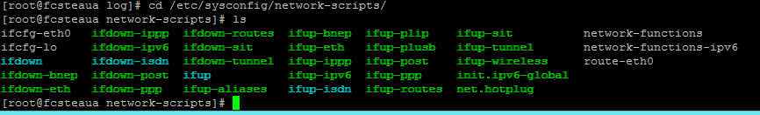
Networking in Linux
The is no “Local area connection”
Naming convention is:
eth0
eth1, etc
Subinterfaces/virtual network cards are noted with “.”
eth0.1, eth0.2,
eth 1.1, eth1.2, etc
Networking config files are in /etc/sysconfig/network-scripts/

Slide 49

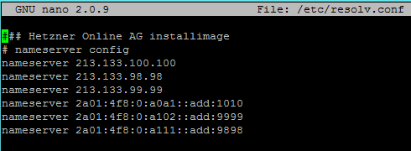
Networking in Linux
Modify DNS servers:
/etc/resolv.conf - is the file you need
List it’s contents with
cat /etc/resolv.conf
Add or delete existent DNS servers, just edit /etc/resolv.conf with a text editor (vi, nano, etc)

Slide 50
Running Python Programs
In general
% python ./myprogram.py
Can also create executable scripts
Compose the code in an editor like vi/emacs
% vi ./myprogram.py # Python scripts with the suffix .py.
Then you can just type the script name to execute
% python ./myprogram.py

Slide 51
Running Python Programs
The first line of the program tells the OS how to execute it:
#! /afs/isis/pkg/isis/bin/python
Make the file executable:
% chmod +x ./myprogram.py
Then you can just type the script name to execute
% ./myprogram.py

Slide 52
Exercises
Install Linux and boot it up successfully.
Load the course web site in Linux.
Install a new game on Linux and play it.
Get Linux to play an MP3.
Notes:
‹#›

Slide 53
References: Linux
Sources used in creating these slides
Other directly relevant sources

Slide 54
References: Git
Sources used in creating these slides
Other directly relevant sources

Slide 55

Scripting: Using .sh files

Slide 56
What is shell scripting?
Shell Scripting is an open-source computer program designed to be run by the Unix/Linux shell. Shell Scripting is a program to write a series of commands for the shell to execute. It can combine lengthy and repetitive sequences of commands into a single and simple script that can be stored and executed anytime which, reduces programming efforts.

Slide 57
Why Use a Shell Script?
Simplicity : The shell is a high-level language; you can express complex operations clearly and simply using it.
Ease of development: You can often write a powerful, useful script in little time.

Slide 58
What is Shell?
Shell is a UNIX term for an interface between a user and an operating system service. Shell provides users with an interface and accepts human-readable commands into the system and executes those commands which can run automatically and give the program’s output in a shell script.

Slide 59
What is Shell?
A shell in a Linux operating system takes input from you in the form of commands, processes it, and then gives an output. It is the interface through which a user works on the programs, commands, and scripts. A shell is accessed by a terminal which runs it.

Slide 60
Writing Shell Script in Linux
Create a file using a vi editor(or any other editor). Name script file with extension .sh
Start the script with #! /bin/sh
Write some code.
Save the script file as filename.sh
For executing the script type bash filename.sh

Slide 61
What is VI editor?
The VI editor is the most popular and classic text editor in the Linux family. Below, are some reasons which make it a widely used editor –
1) It is available in almost all Linux Distributions
2) It works the same across different platforms and Distributions
3) It is user-friendly. Hence, millions of Linux users love it and use it for their editing needs

Slide 62
Creating a script file
Open the terminal and write the below line to create a new file:
vi filename.sh

Slide 63
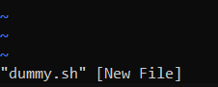
vi editor opens in command mode
~ shows unused lines

Slide 64
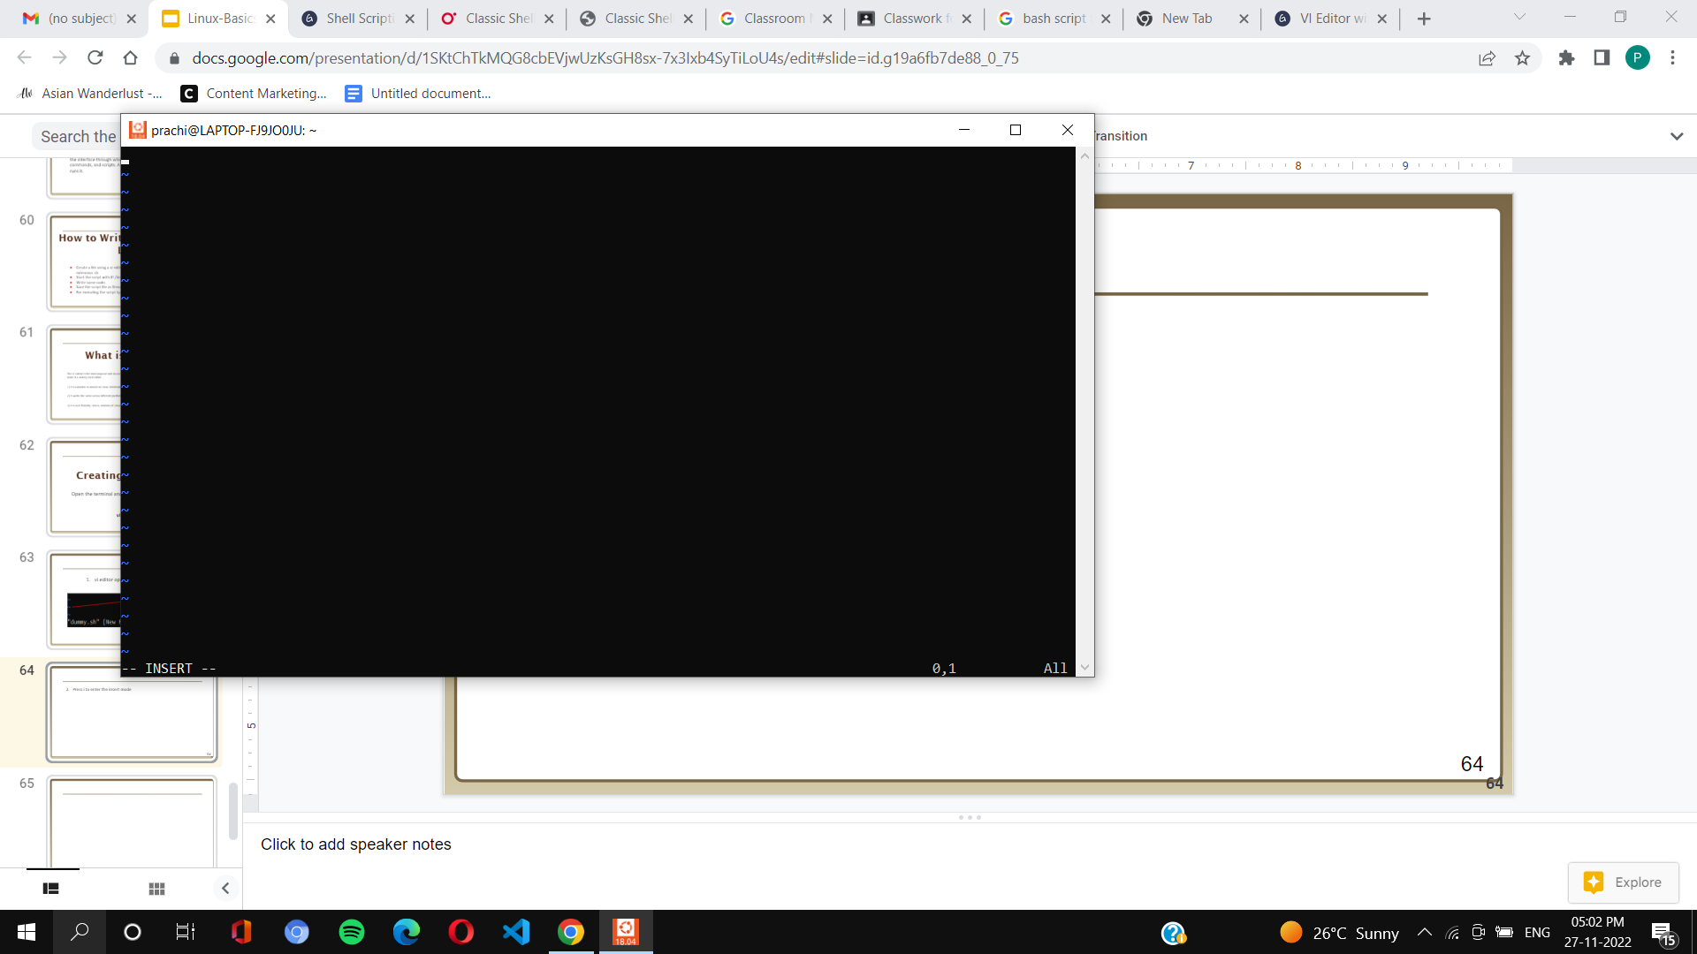
2. Press i to enter the insert mode

Slide 65
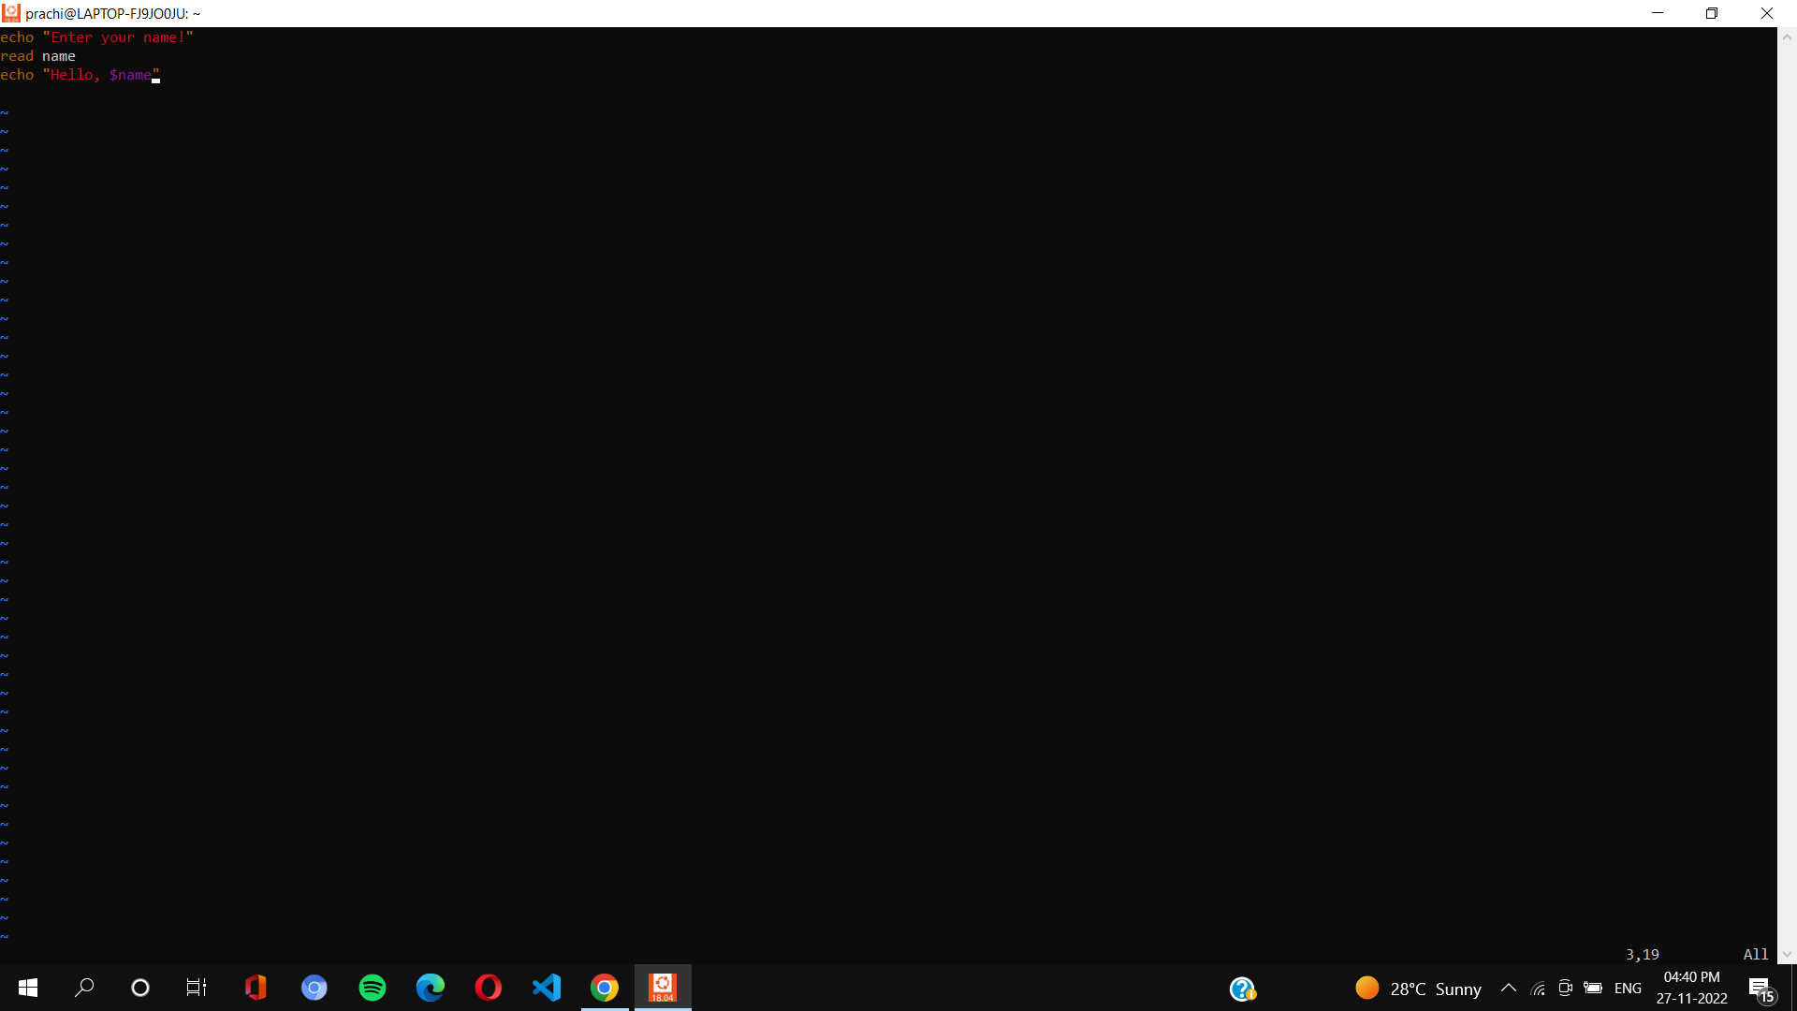
3. Add content in your file

Slide 66
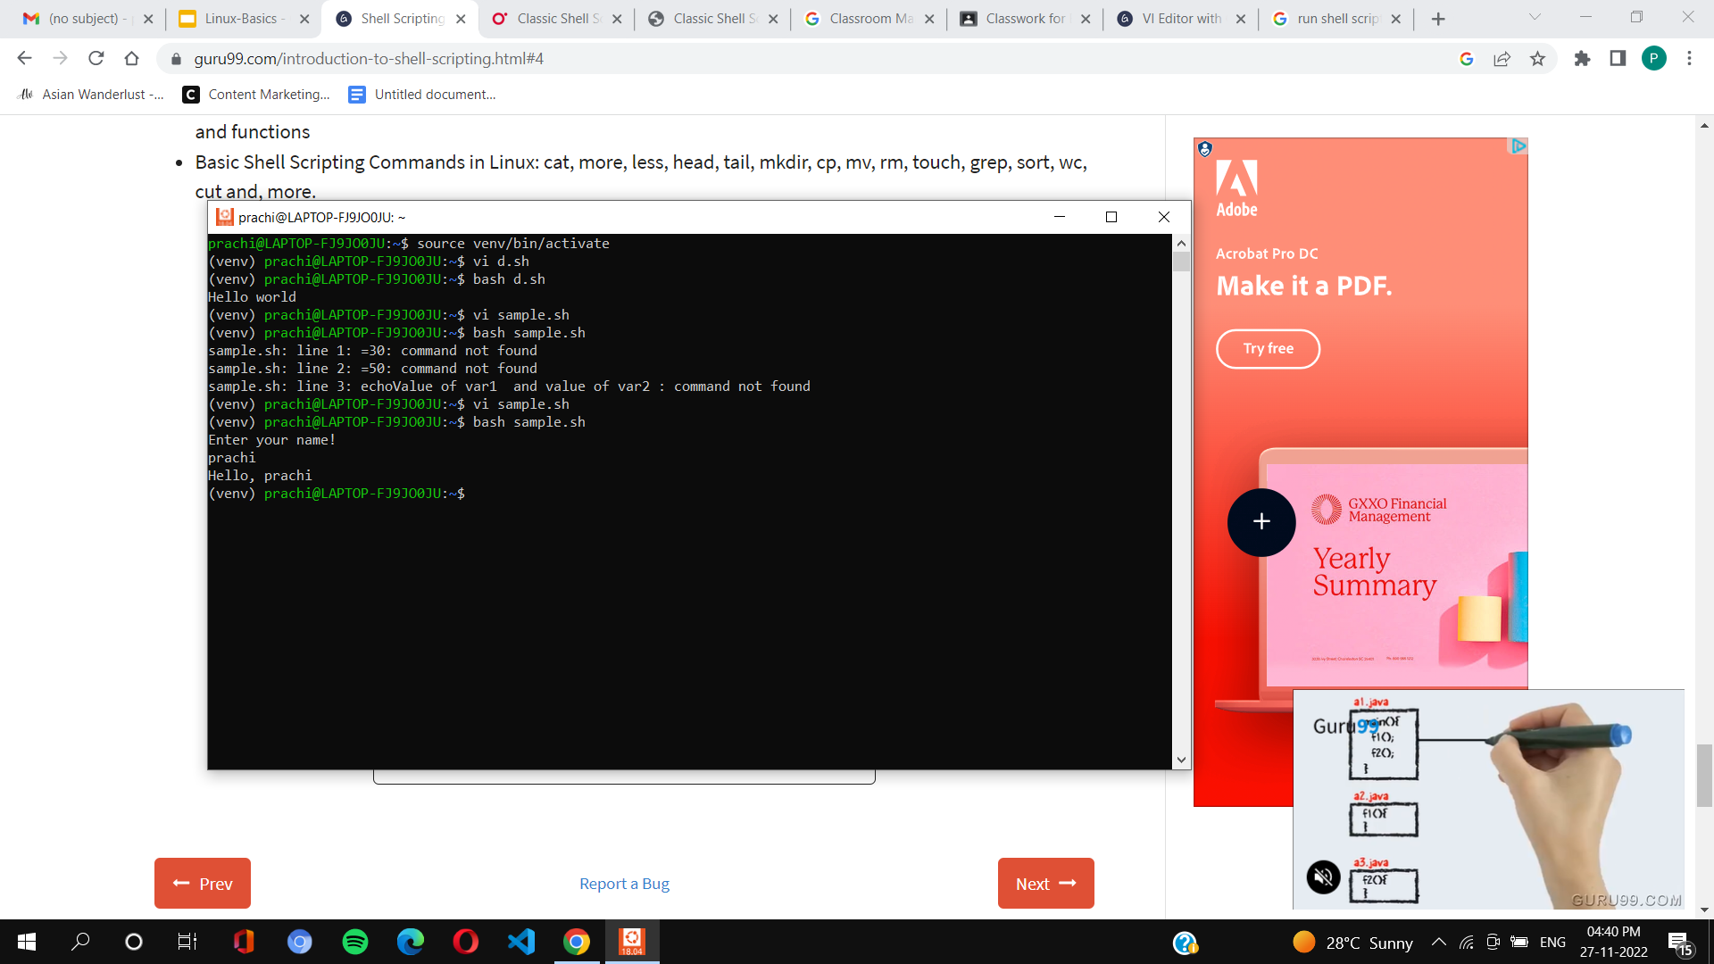
4. After completing the writing, enter esc key and type ‘:wq’ to come outside of editor
5. Now, run your file as follows:

Slide 67
How to execute .sh file
The procedure to run the .sh file shell script on Linux is as follows:
Open the Terminal application on Linux or Unix
Create a new script file with .sh extension using a text editor
Write the script file using nano script-name-here.sh
Set execute permission on your script using chmod command : chmod +x script-name-here.sh
To run your script : ./script-name-here.sh Another option is as follows to execute shell script: sh script-name-here.sh OR bash script-name-here.sh

Slide 68
References: .sh
TGAC The Genome Analysis Centre (Introduction to Linux )
http://nixware.net

