Slide 1
UNIT-I
Introduction to Java: Object Oriented Programming, History and Evolution of java, Java’s magic: The byte code, Java Buzzwords, Java Keywords, The Java class Libraries.
Data Types, Operators and Control Statements: Java Data Types, Variables and Constants, Naming Conventions, Type conversion and casting, Arrays, Operators & Expressions, Java Control Statements.
Introducing Classes and Methods: Classes and Objects, Introducing Methods, Constructors, this Keyword, Garbage Collection. Overloading Methods and Constructors, Argument passing, Recursion, Introducing Access Control, understanding static, Command Line Arguments, Exploring the String class.

Slide 2
Object Oriented Programming
OOPS stands for object-oriented programming. All modern programming languages are based on the OOPS concept. Older programming languages like PASCAL, FORTRAN, C, etc., are not obsessed with objects. They are somewhat procedural programming languages.
Objects Oriented Programming is a programming style based on the idea of objects and classes to represent the Data. JAVA is based on object-oriented programming.
Class is not a real-world entity but a template or prototype. In Computer memory, Class doesn't occupy memory, but it imparts an idea about the features of objects. Objects, on the other hand, are the instances of the Class. An object is an actual entity that occupies space in the memory.
OOPS moves around its four most important pillars. These are; Inheritance, Polymorphism, Abstraction, and Encapsulation.

Slide 3
History of java
Java is invented by James Gosling, Patrick Naughton, Chris Warth, Ed Frank, and Mike Sheridan at Sun Microsystems, Inc. in 1991.
Java is related to C++ (Bjarne Stroustrup in 1979), which is inherited from the language C.
C was the result of a development process that started with an older language called BCPL (Basic Combined Programming Language“), developed by Martin Richards. BCPL influenced a language called B, invented by Ken Thompson, which led to the development of C in the 1970s.
The characters of Java is inherited from C and C++ language. It was first named as “Oak” but was renamed as “Java” in 1995. It is publicly announced in the spring of 1995.
The basic idea behind creating this language is to create a platform-independent language that is used to develop software for consumer electronic devices such as microwave ovens, remote controls, etc. Initially, it was not designed for Internet applications.

Slide 4
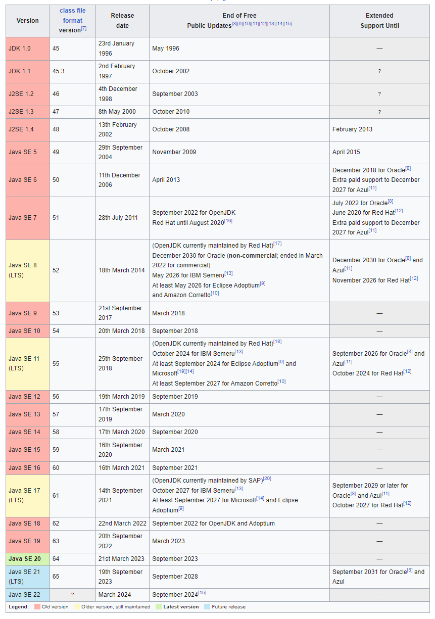
Evolution of java

Slide 5
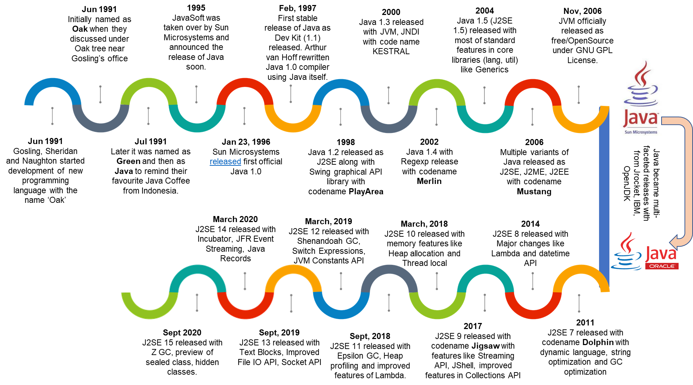
Evolution of java

Slide 6
Java’s magic: The byte code

Slide 7
Java Buzzwords

Slide 8
Java Keywords

Slide 9
The Java class Libraries

Slide 10
Java Data Types

Slide 11
Variables and Constants

Slide 12
Naming Conventions

Slide 13
Type conversion and casting

Slide 14
Arrays

Slide 15
Operators & Expressions

Slide 16
Java Control Statements

