Slide 1
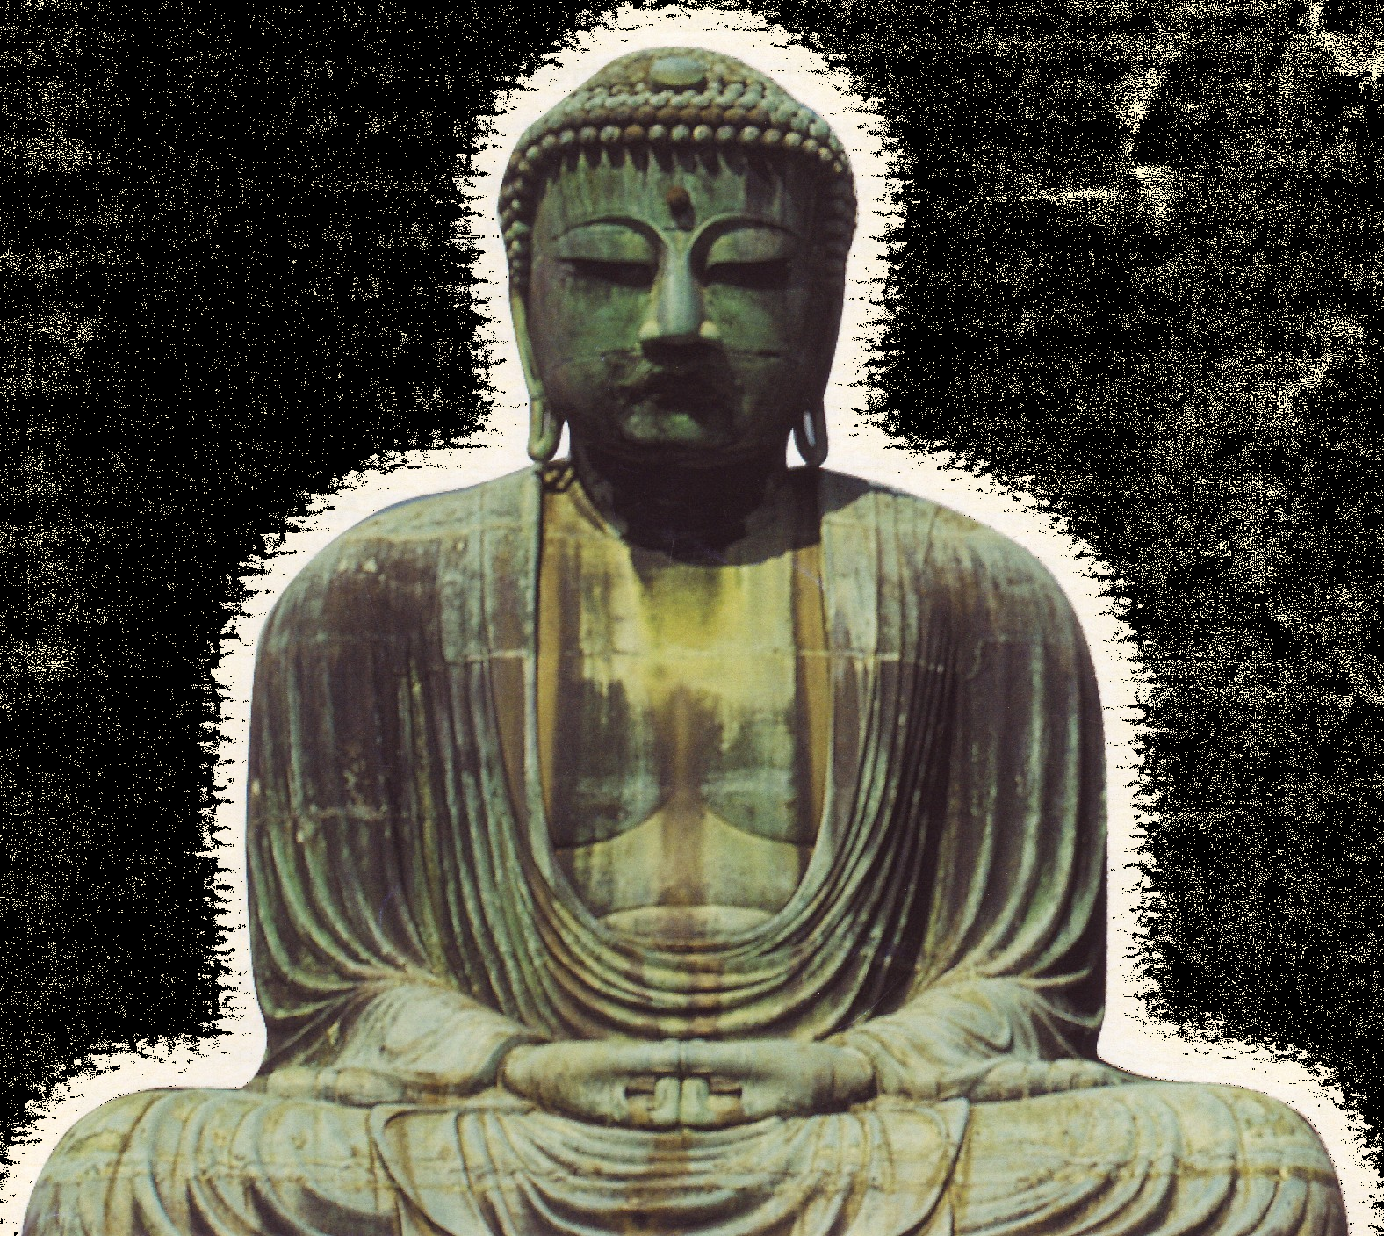

First Announcement
The 13th Kamakura Live
Demonstration Course 2006
Featured on the Trans-Radial Coronary Intervention
December 15, 16, 17, 2006 Yokohama, Japan
Venue:
Main Hall: HAMAGIN HALL “ VIA MARE”
Sub Hall: LANDMARK HALL
JSIC認定医・指導医資格更新ライブ単位3点取得
日本心血管カテーテル治療学会(JACCT)推薦ライブ単位2点取得
Fighting Radialist: Shigeru Saito, M.D., FACC, FSCAI, FJCC
Course Director / Operator
Shonan Kamakura General Hospital
Get free high-speed DICOM Viewer from http://www.kamakuralive.net/ !!
ホームページにアクセスすれば無料で高速DICOM Viewerが手に入ります!!
NPO International TRI Network
特定非営利活動法人ティー・アール・アイ国際ネットワーク
URL http://www.tri-international.org/
Notes:
13回鎌倉ライブ 表紙色⑥

Slide 2
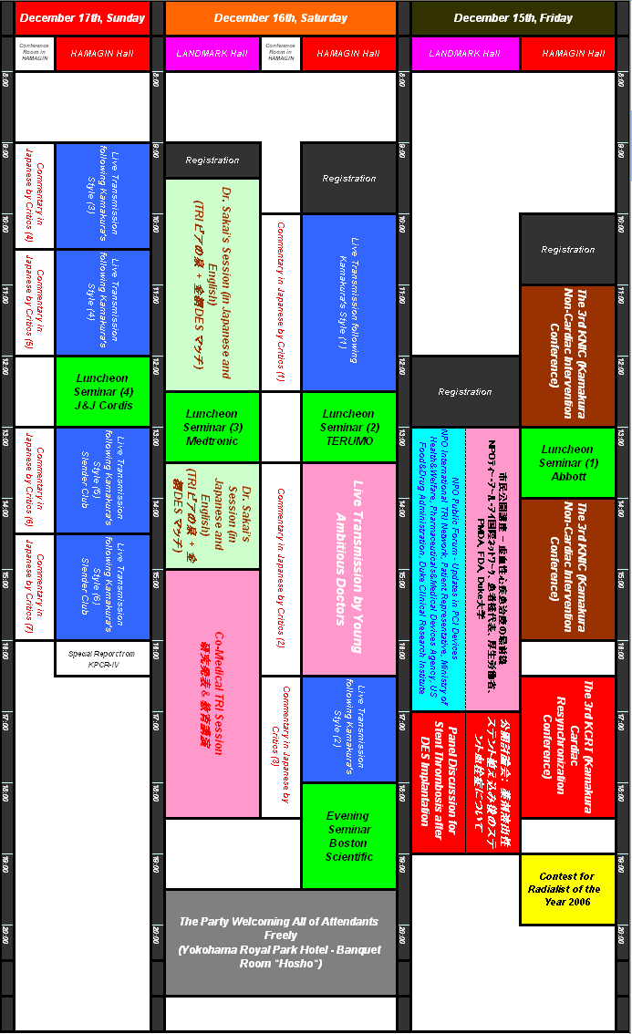

Slide 3

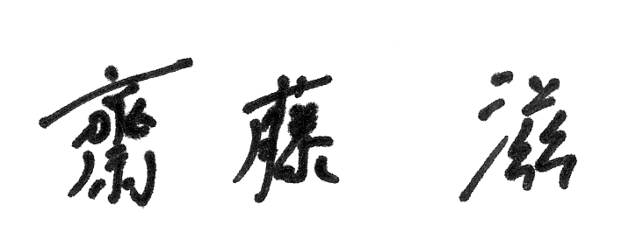
Welcome Address
Dear Colleagues and Friends:
On behalf of the organizing committee and NPO International TRI Network,
I would like to welcome you to the 13th Kamakura Live Demonstration Course
2006 in Yokohama, Japan. The Kamakura Live Demonstration Course makes a
feature of Trans-Radial Intervention (TRI). We believe that we could have
share our knowledge and development about TRI and updated our professional
skills each other during this meeting.
14 years have already passed since Dr.Kiemeneij first introduced TRI in the
world, and 11 years have passed since Dr.Saito introduced TRI in Japan.
During these 14 years, TRI has already established its most important position
in the recent advance in percutaneous coronary intervention. However, on the
other hand, there are many physicians emerging who are not promoting from
their heart but only utilizing TRI for themselves. Here, Dr.Saito would like to
declare that he would be not false Radialist but be true fighting Radialist.
This course has definitely continued to contribute to the spread of TRI in
Asian countries, especially in Japan. This year, we decided not only to introduce
the advanced techniques of TRI but also to come back again to the beginning
of TRI.
I would like to characterize the Kamakura Live Demonstration Course as with
last year by including a special session named “Dr.Sakai’s View on TRA and TRI”,
“Young Ambitious Doctor’s Live Demonstration” and Co-Medical Session named
“Come Come Club”. During these special sessions, we hope that we could
encourage young physicians and Co-Medicals to share their knowledge about
TRA and TRI, to promote and / or start TRA and TRI.
I believe that all of the attendants would find the 13th Kamakura Live
Demonstration Course as the most informative and worthwhile educational
experiences.
I would like to express our sincere thanks for your participation and hope you
are encouraged to share your clinical experiences each other.
Looking forward to collaborating with you on this fruitful time.
Shigeru Saito, M.D., FACC
President, NPO International TRI Network
Notes:
Welcome address 毎年同じ

Slide 4
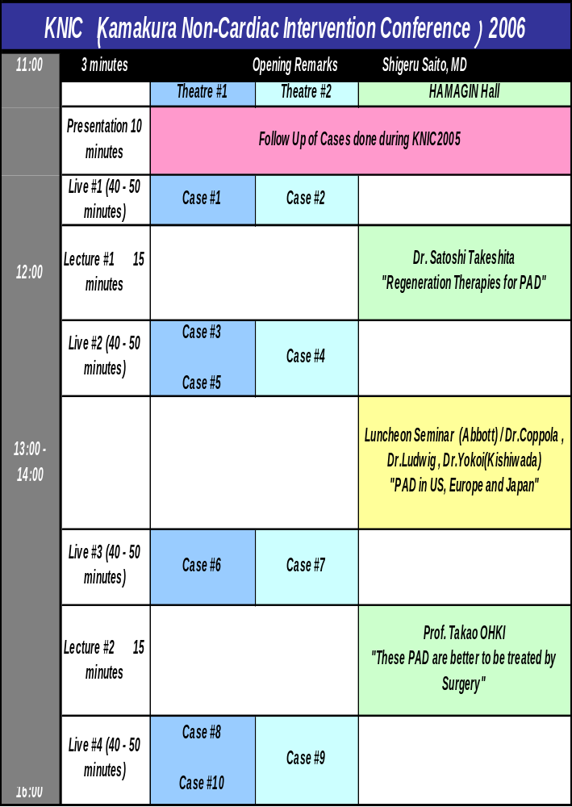

Slide 5
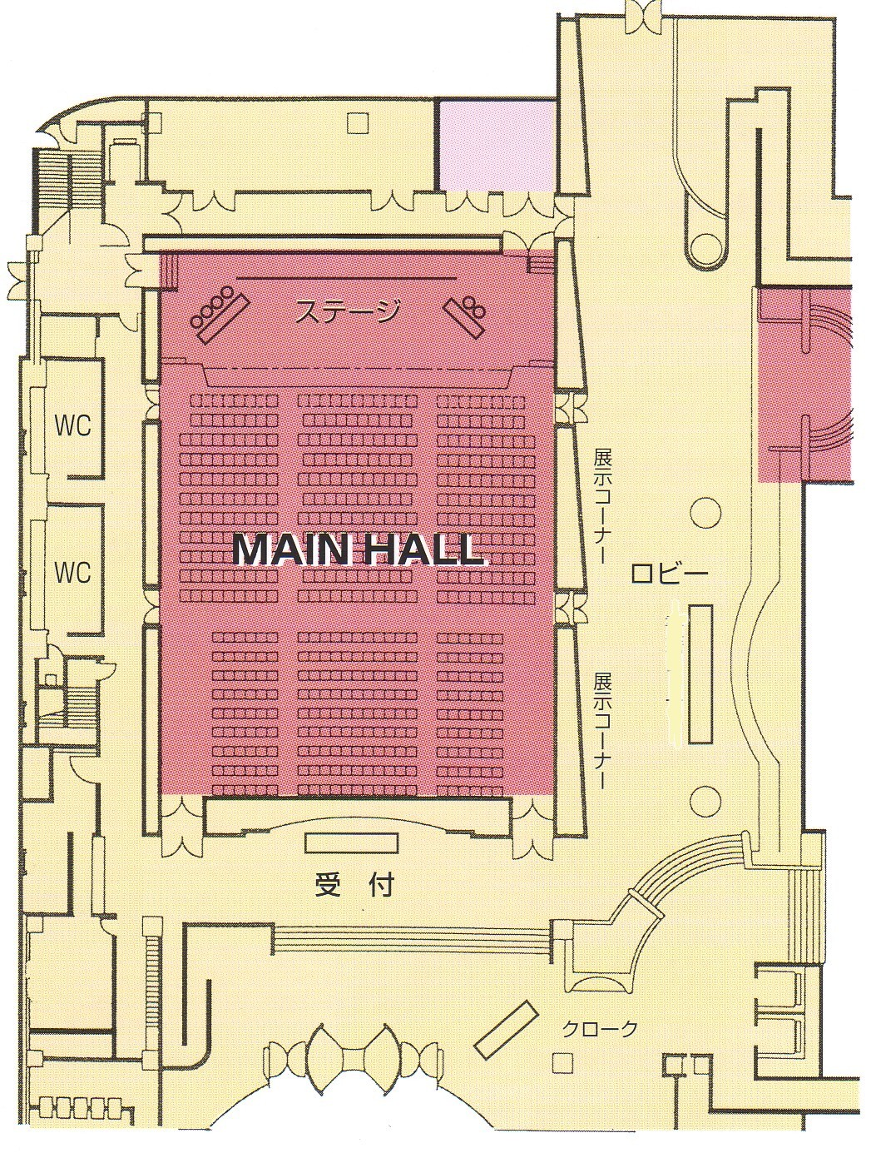
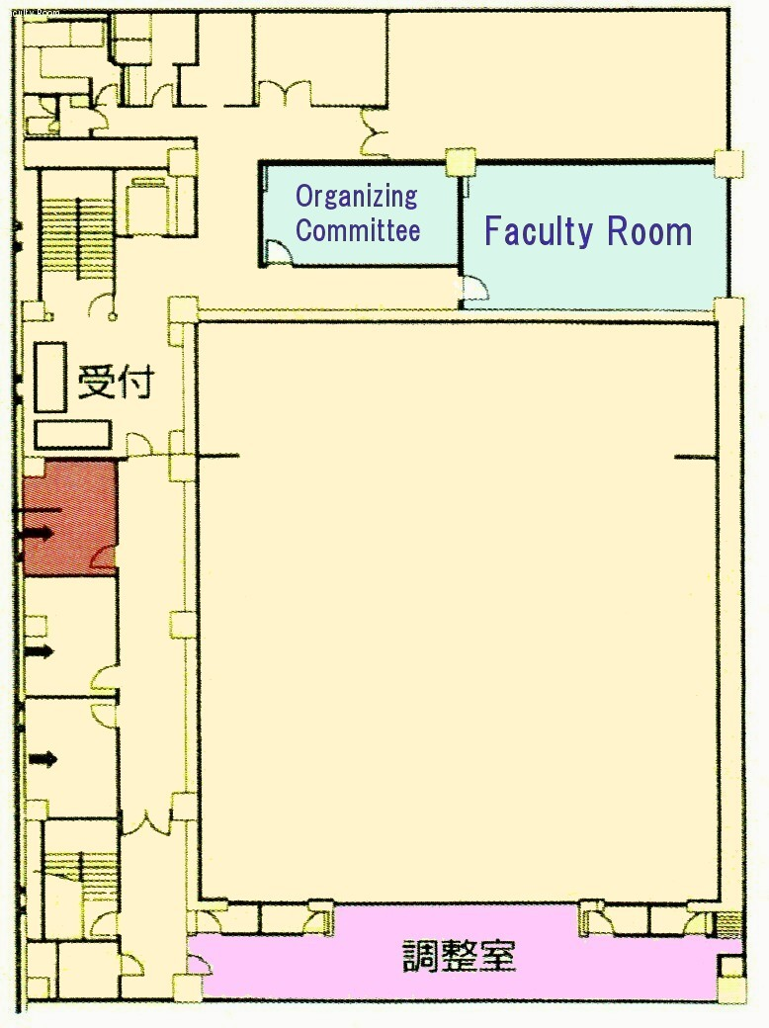
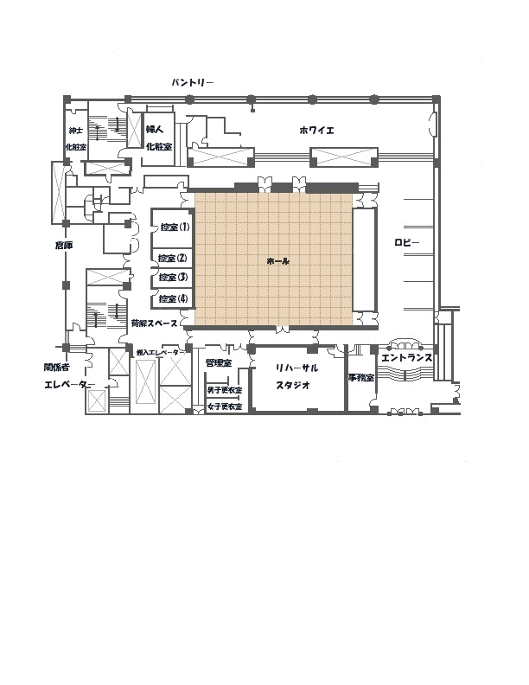
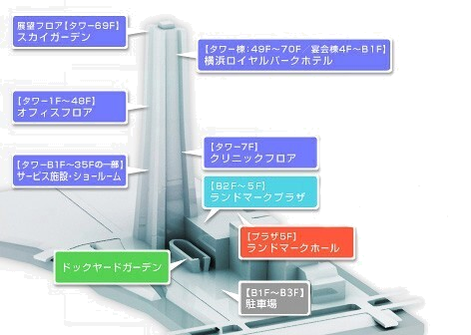
HAMAGIN HALL “ VIA MARE”
1F
M2F
Conference
Room
LANDMARK HALL
5F
プレゼンテーションにおける注意事項
●演題発表はPC Presentationのみ受け付けます。 スライドは受け付けません。
●プレゼンテーションデータの使用ソフトはMicrosoft PowerPointのみとさせていただきます。ご了承下さい。
●プレゼンテーションの内容は鎌倉ライブデモンストレーション運営委員会に帰属します。
●プレゼンテーションファイルに画像ファイルへのリンクをされている演題の場合、プレゼンテーションをされる前に
そのディスク上で動作を必ずご確認下さい。
Notes:
2nd~Final Programme用

Slide 6
Upcoming Kamakura Live Programs
1. Live Demonstration Following Kamakura’s Style
Live Demonstration By Young Ambitious Doctors
Kamakura Non-Cardiac Intervention Conference (KNIC)
Kamakura Cardiac Resynchronization Therapy (KCRT)
Radialist of the Year 2006
The 6th Dr.Sakai’s View on TRA / TRI Session
Co-Medical TRI Session Ⅴ
International Guest Faculty
Jang-Ho Bae, M.D.
KonYang University Hospital,
Korea
John T. Coppola, M.D.
Saint Vincent’s Hospital & Medical Center, USA
Runlin Gao, M.D.
Cardiovascular Institute & Fu Wai Hospital,
China
Eulogio Garcia, M.D.
Jefe de Cardiologia Intervensionista Hospital
General Universitario Gregorio Maranon,
Spain
Hyeon-Cheol Gwon, M.D.
Samsung Medical Center,
Korea
Kyoo-Rok Han, M.D.
Hallym Kangdong Sacred Heart Hospital,
Korea
Taek-Jong Hong, M.D.
Busan National University Hospital,
Korea
Fumiaki Ikeno, M.D.
Stanford University,
USA
Myung-Ho Jeong, M.D.
Chonnam National University Hospital,
Korea
Yuan Jinqing, M.D.
Cardiovascular Institute & Fu Wai Hospital,
China
Ferdinand Kiemeneij, M.D.
Amsterdam Department of Interventional
Cardiology, Onze Lieve Vrouwe Gasthuis,
Netherlands,
The Netherlands
Kee-Sik Kim, M.D.
Daegu Catholic University Medical Center,
Korea
Weon Kim, M.D.
Gwangju Veterans Hospital,
Korea
Mitchell W. Krucoff, M.D.
Duke Clinical Research Institute,
USA
Yean Teng Lim, M.D.
National University Hospital,
Singapore
Yves Louvard, M.D.
Institut Hospitalier Jacques Cartier
Institut Cardiovasculaire Paris Sud Massy,
France
Josef Ludwig, M.D.
University of Erlangen-Nurnberg,
Germany
Tejas Madhusudan Patel, M.D.
Sterling Hospital,
India
Rurus Suryawan, M.D.
Dr. Soetomo General Hospital,
Indonesia
Seung-Jea Tahk, M.D.
Ajou University Medical Center,
Korea
Wasan Udayachalerm, M.D.
King Chulalongkorn Memorial Hospital,
Thailand
Chiung Jen Wu, M.D.
Chang Gung Memorial Hospital,
Taiwan
Jung-Han Yoon, M.D.
Yonsei University, Wonju College of Medicine,
Korea
Lu Shu Zheng, M.D.
Beijing Anzhen Hospital,
China
Japanese Guest Faculty
Osamu Arasaki, M.D.
Tomishiro Central Hospital
Yutaka Hikichi, M.D.
Saga University Hospital
Junko Honye, M.D.
Nihon University School of Medicine
Honin Kanaya, M.D.
Ishikawa Prefectural Central Hospital
Takaaki Katsuki, M.D.
Jichi Medical School
Noriko Makiguchi, M.D.
National Obihiro Hospital
Kazuaki Mitsudo, M.D.
Kurashiki Central Hospital
Toshiyuki Matsumura, M.D.
Kumamoto Rosai Hospital
Sunao Nakamura, M.D.
Shin Tokyo Hospital
Shinsuke Nanto, M.D.
Kansai Rosai Hospital
Kazuyoshi Ohata, M.D.
Kofu Kyoritsu Hospital
Satoru Sumitsuji, M.D.
Nagoya Tokushukai Hospital
Takashi Uchiyama, M.D.
Takase Clinic
Kenji Wagatsuma, M.D.
Division of Interventional Cardiology
Toho University Omori Medical Center
Yoshiaki Yokoi, M.D.
Kishiwada Tokushukai Hospital

Slide 7
公募
Radialistの積極的な参加を期待いたします。 演題登録応募締切：2006年11月20日
URL http://www.kamakuralive.net/
Kamakura Live TRA/TRI 入門編 演題一般公募(日本語)のご案内
The 6th Dr.Sakai’s View on TRA/TRI Session
-TRIビアの泉-
“TRA/TRIに関するすべて”について基礎的内容からハイパーテクニックまで幅広い内容を
1発表10分間厳守、日本語で一般公募いたします。
発表はPCのみで、演題の作成は英語にて作成して下さい。
コメディカルによるコメディカルの為の
TRA/TRI教育セッション5(コメ・コメ・倶楽部5)
1発表10分間までのTRA/TRIのコ･メディカルの役割についての演題を日本語で一般公募いたします。
Kamakura Live Operator 一般公募のご案内
The 4th Kamakura Live Young Ambitious
Operator’s Session
術者は原則公募とします。
経験、新たな工夫、学会・論文発表、TRIに対する想いなどを要求します。
http://www.kamakuralive.net/にアクセスして下さい。
応募人数が多い場合には、一定の基準で選別します。
38歳未満で公募します。
既経験症例数(Operatorとして)については100例以上を必須とします。
原則として英語を用います。(通訳に関しては齋藤 滋が責任を持ちます)
倫理的・法律的な責任は齋藤 滋が負います。
応募方法
ホームページ上の演題登録フォームに記入後、FAXにてお申し込み下さい。
受付後、演題受付をEメールにてお知らせします。
採用された演題の演者のRegistration Feeは免除とさせて頂きます。
注意事項
Kamakura Live TRA/TRI 入門編/コメ・コメ・倶楽部
演題発表はPC Presentation のみ受け付けます。スライドは受け付けません。
プレゼンテーションデータの使用ソフトはMicrosoft PowerPointのみとさせていただきます。
プレゼンテーションの内容は鎌倉ライブデモンストレーション運営委員会に帰属します。
Kamakura Live Operator
手技の収録内容は鎌倉ライブデモンストレーション運営委員会に帰属します。

Slide 8
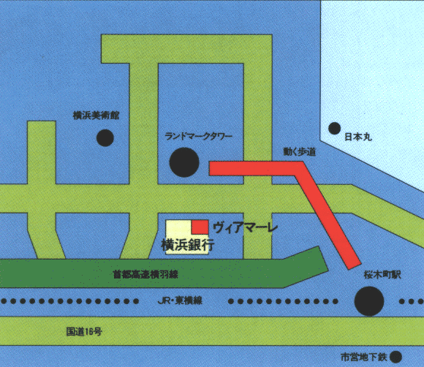
Registration Fee
-Full Member of NPO International TRI Network-
Medical Doctor: US$100.00 / JP\12,000
Co-Medical: FREE
-Non Full Member & Supporting Member-
Medical Doctor: US$130.00 / JP\15,000
Co-Medical: US$30.00 / JP\3,000
Company: US$130.00 / JP\15,000
Full Member : NPO法人 正会員
Supporting Member : NPO法人 賛助会員
NPO International TRI Network / Kamakura Live Demonstration Course Organizing Committee
Director of Organizing Committee: Shigeru Saito, M.D.
Shonan Kamakura General Hospital
Naoto Aoki, M.D.
Yamato Seiwa Hospital
Takashi Ashikaga, M.D.
Yokohama Minami Kyosai Hospital
Naoya Fujita, M.D.
Eastern Japan Medical Center
Naoto Fukuda, M.D.
Minami Machida Hospital
Nobuyuki Hashimoto, M.D.
St.Marianna University Hospital
Tetsuya Hata, M.D.
Kyoto Kujo Hospital
Kiyoshi Hibi, M.D.
Yokohama City University
School Medical Center
Kazuhira Hibiya, M.D.
Sekishindou Hospital
Yuji Ikari, M.D.
Tokai University School of Medicine
Yoshifumi Kan, M.D.
Shin-Yukuhashi Hospital
Ken-ichi Kato, M.D.
Yokohama Rosai Hospital
Kazuo Kimura, M.D.
Yokohama City University
School Medical Center
Toshiro Kurosawa, M.D.
Machida Municipal Hospital
Motomaru Masutani, M.D.
Hyogo College of Medicine
Ichiro Michishita, M.D.
Yokohama Sakae Kyosai Hospital
Yusuke Miyashita, M.D.
Shonan Kamakura General Hospital
Akira Miyamoto, M.D.
Kikuna Memorial Hospital
Yasuyuki Mochida, M.D.
Omori Red Cross Hospital
Takahiro Nishida, M.D.
Odawara Cardiovascular Hospital
Hiroshi Ohta, M.D.
Itabashi Central Hospital
Kazuhiro Oyamada, M.D.
Keiyu Hospital
Hideaki Sakai, M.D.
Nagasaki Heart Clinic
Masayoshi Sakakibara, M.D.
Shin-Katsushika Hospital
Katsuhiko Sato, M.D.
Tokeidai Memorial Hospital
Akihiko Takahashi, M.D.
Takahashi Hospital
Hideyuki Takahashi, M.D.
Kotobukikai Tominaga Hospital
Saeko Takahashi, M.D.
Shonan Kamakura General Hospital
Satoshi Takeshita, M.D.
National Cardiovascular Center
Shinji Tanaka, M.D.
Shonan Atsugi Hospital
Shin-ichi Tohyama, M.D.
Kanagawa Cardiovascular and Respiratory Center
Fuminobu Yoshimachi, M.D.
Aomori Prefectural Central Hospital
Venue
Main Hall: HAMAGIN HALL “Via Mare”
3-1-1 Minatomirai, Nishi-ku, Yokohama, Kanagawa
TEL: 045-225-2173
SubHall: LANDMARK HALL
Located in the 5th floor of “The Landmark Tower Bldg”
2-2-1 Minatomirai Nishi-ku, Yokohama, Kanagawa
TEL:045-222-5015
By Train: Can be access by JR train at Sakuragicho -Sta.
(Keihin-Tohoku Line:3min) or by Subway (Minato Mirai
Line at Minato Mirai Sta:5min) over the moving walkway.
By Car: There is NO PARKING LOT in this Hall.
NPO / Conference Secretariat
Shonan Kamakura General Hospital Research Center
Division of Cardiology & Catheterization Laboratories
1202-1 Yamazaki, Kamakura, Kanagawa, 247-8533 JAPAN
TEL: +81-467-461717 FAX: +81-467-461907 E-mail address: saito@shonankamakura.or.jp
Notes:
1st announcement用

