Slide 1
Face Detection and Gender Recognition
EE368 Project Report
Michael Bax
Chunlei Liu
Ping Li
28 May 2003

Slide 2


Colour Spaces

Slide 3
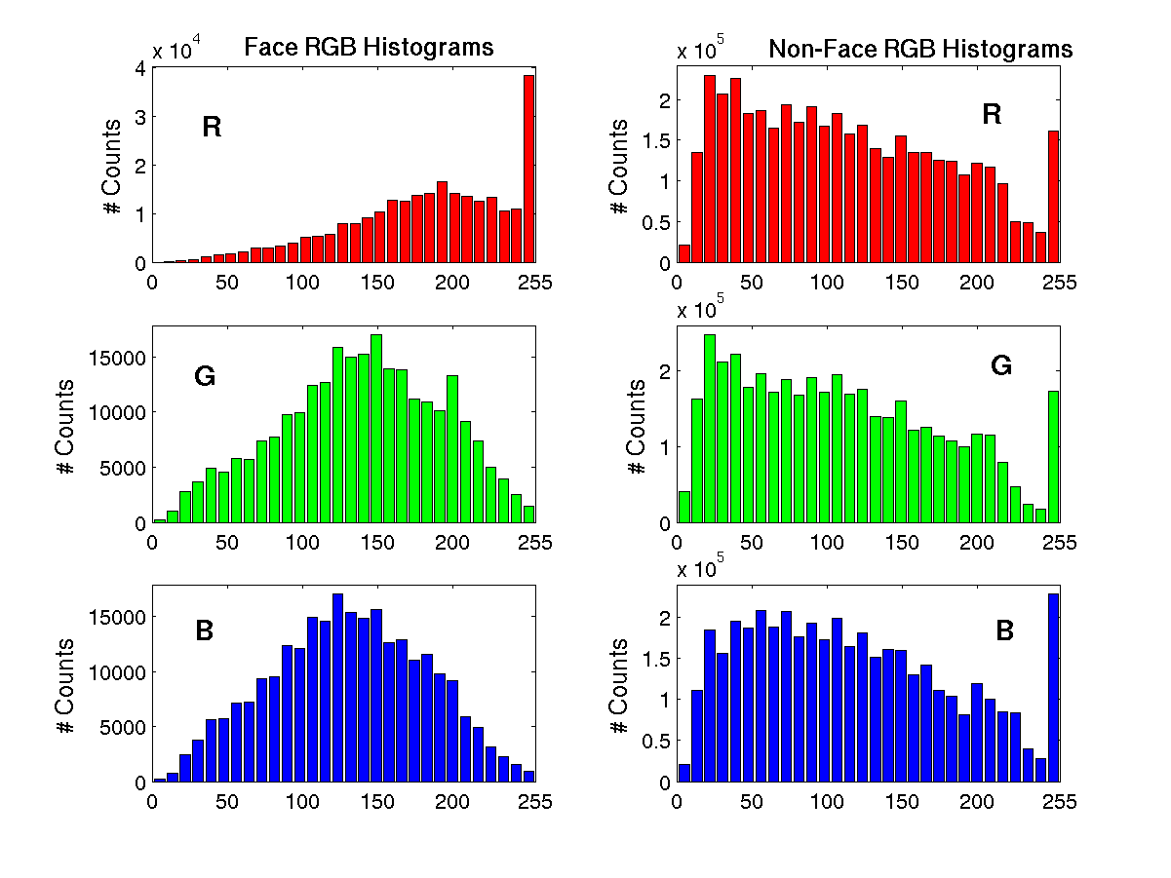
RGB Colour-Space Histograms

Slide 4
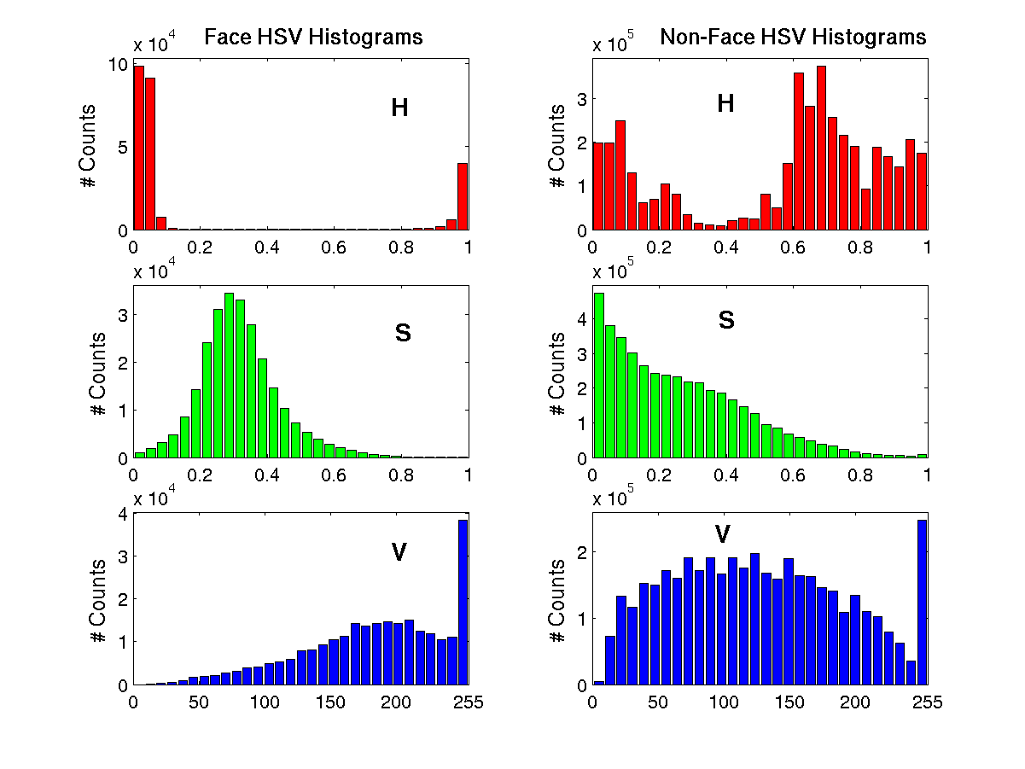
HSV Colour-Space Histograms

Slide 5
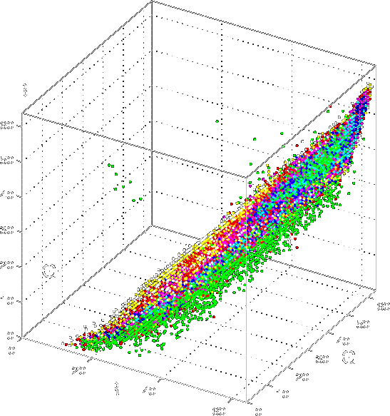
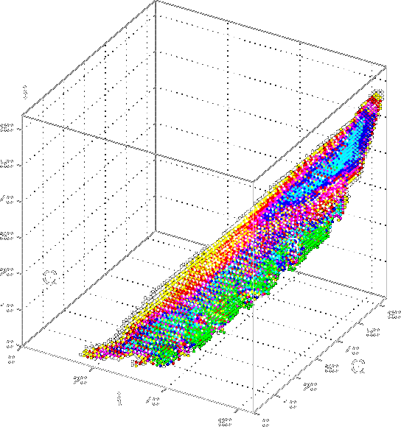
Empirical PDF Approximation

Slide 6
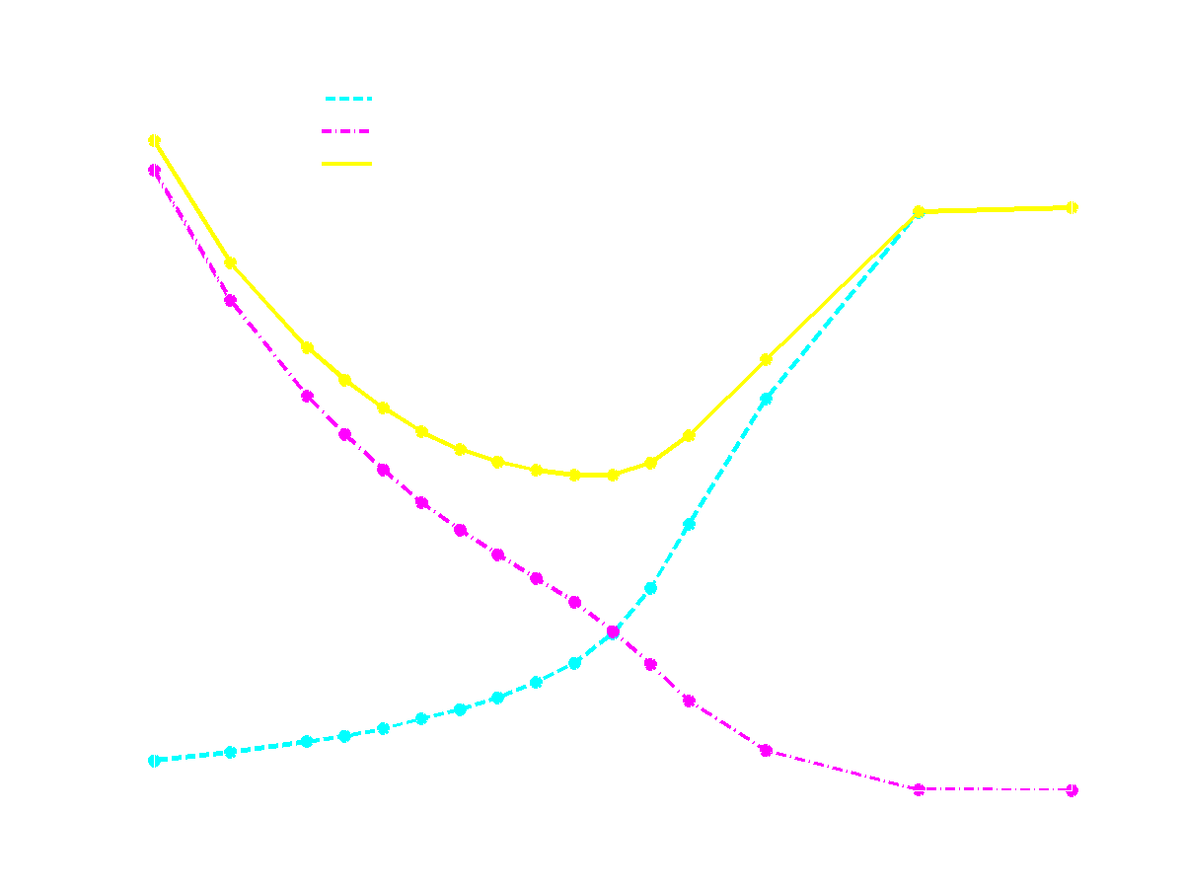
Pixel Classification Error (RGB)

Slide 7
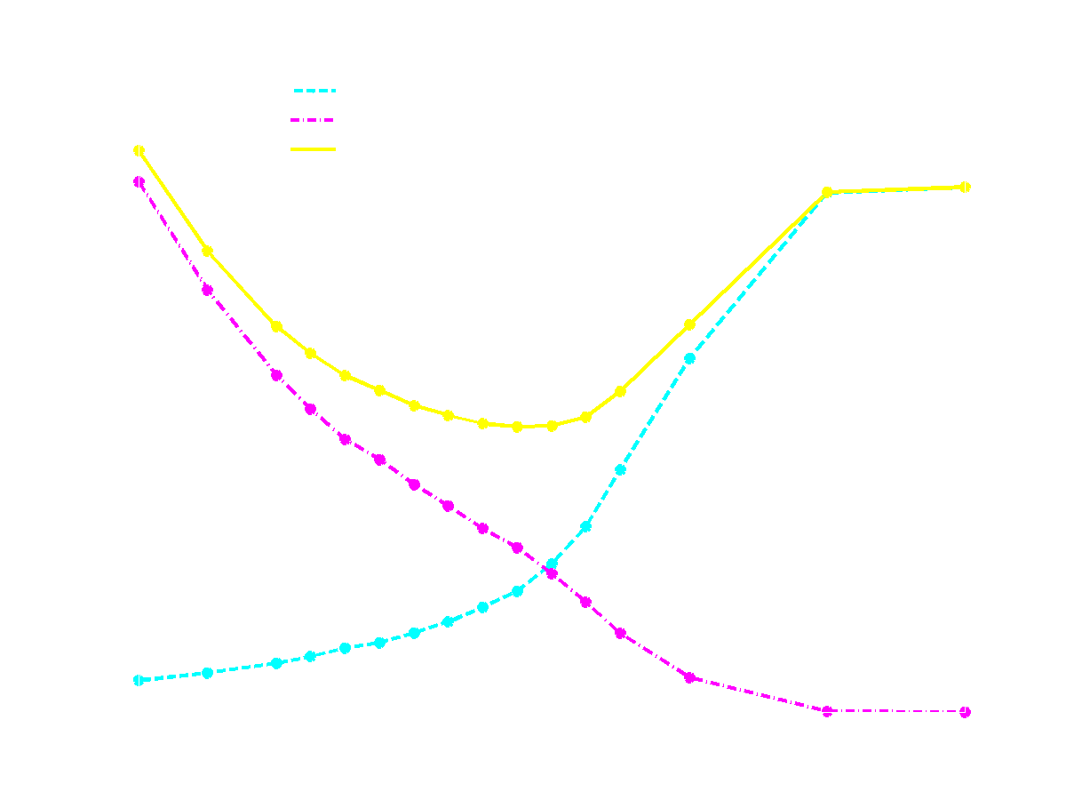
Pixel Classification Error (HSV)

Slide 8
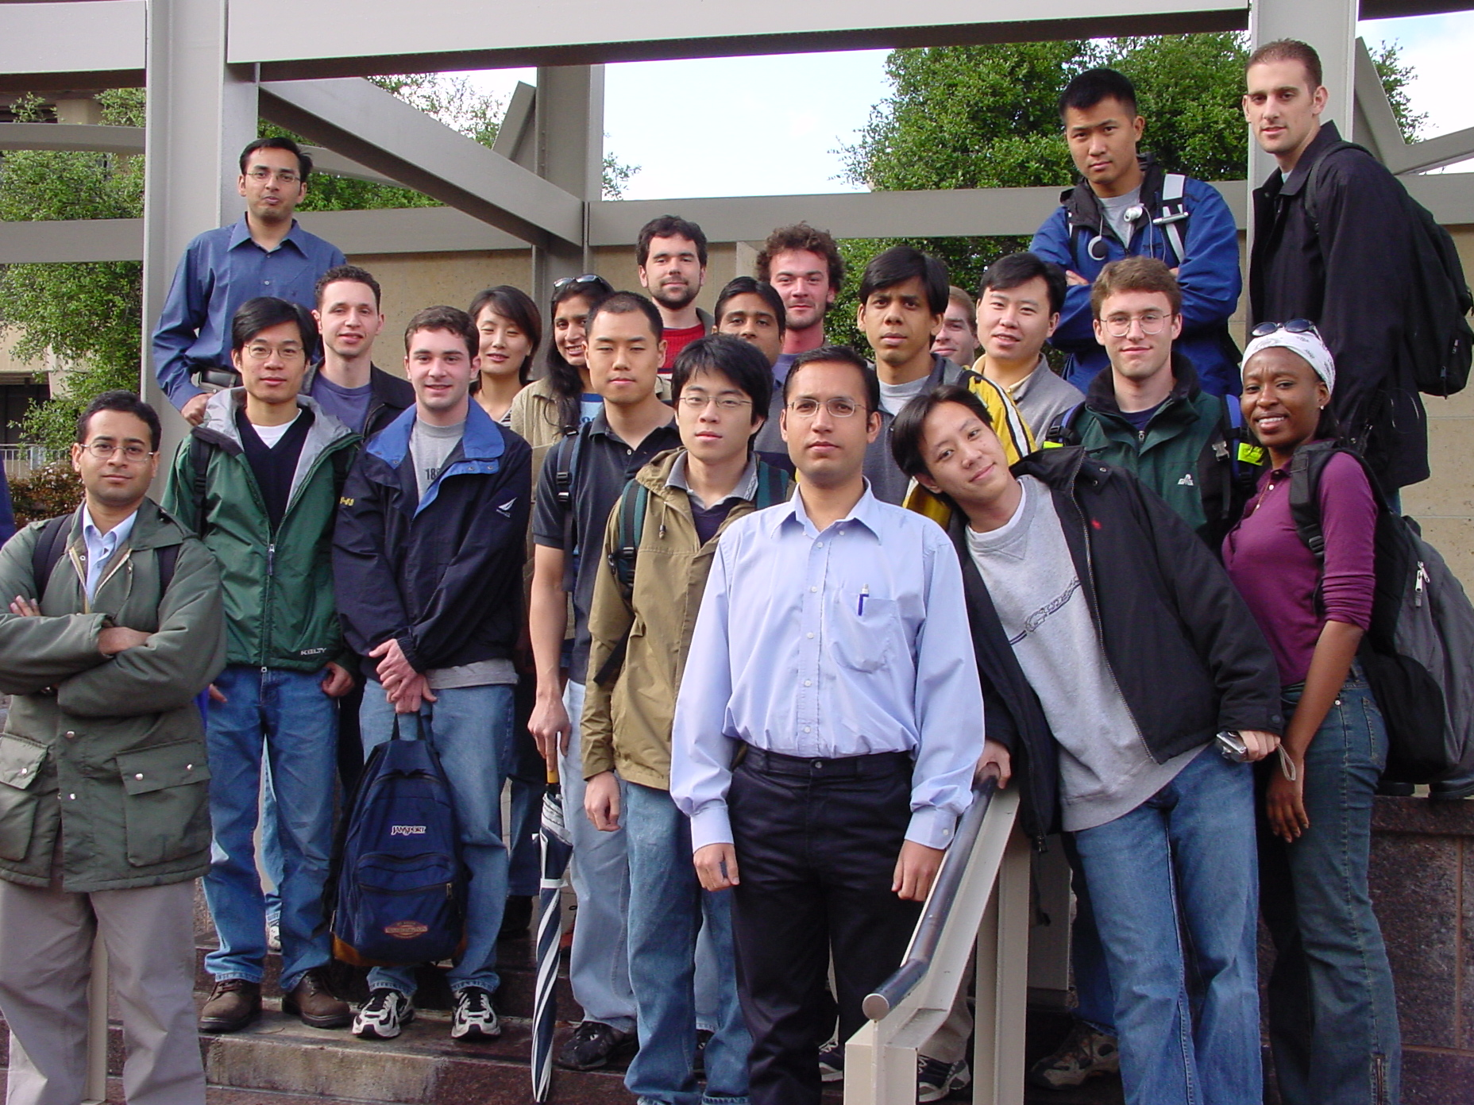
Input Image

Slide 9
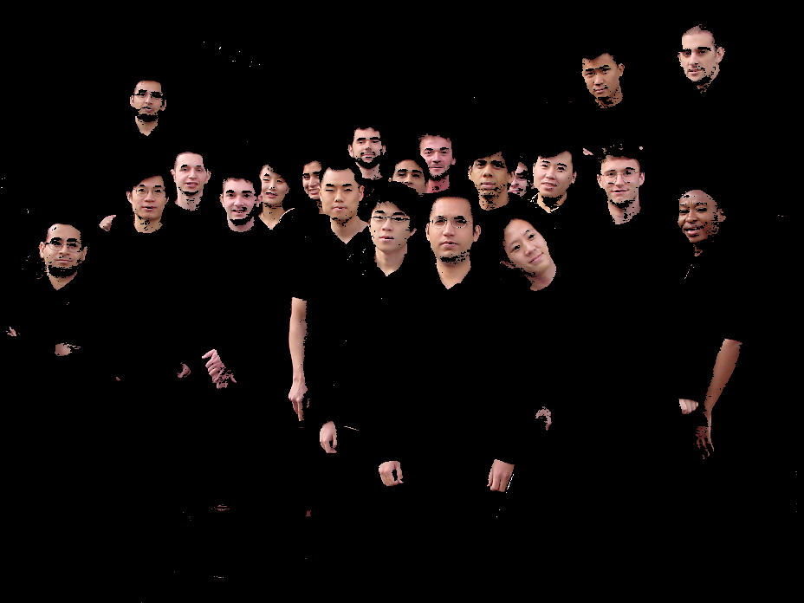
Pixel Segmentation
Using the RGB Pixel PDF

Slide 10
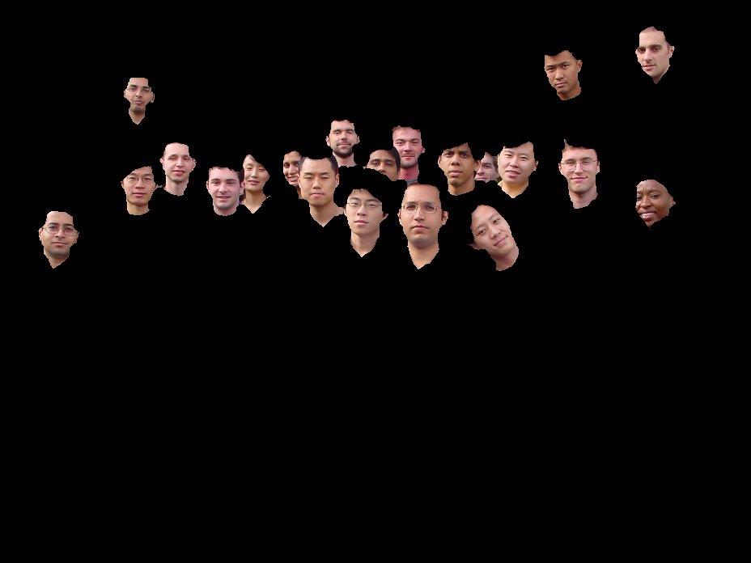
Non-Face Object Removal

Slide 11
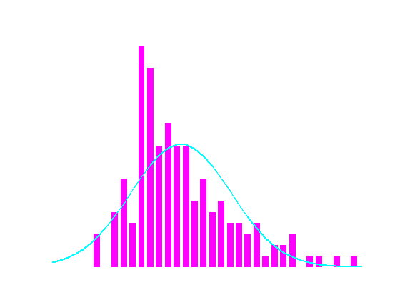
Size-based
Non-Face Object Removal

Slide 12
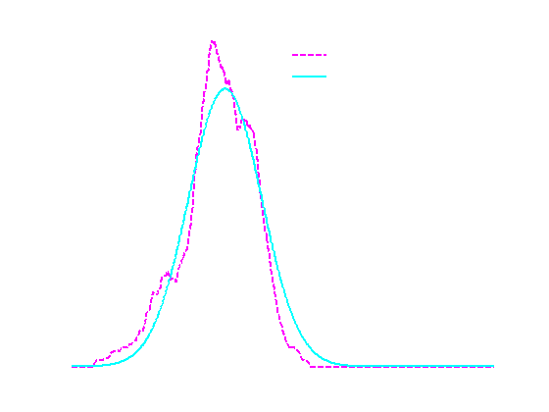
Location-based
Non-Face Object Removal

Slide 13
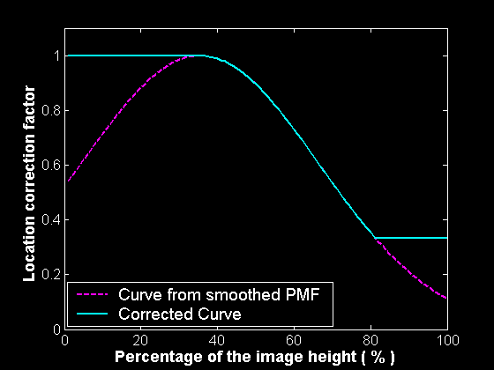
Object Size Threshold Correction

Slide 14

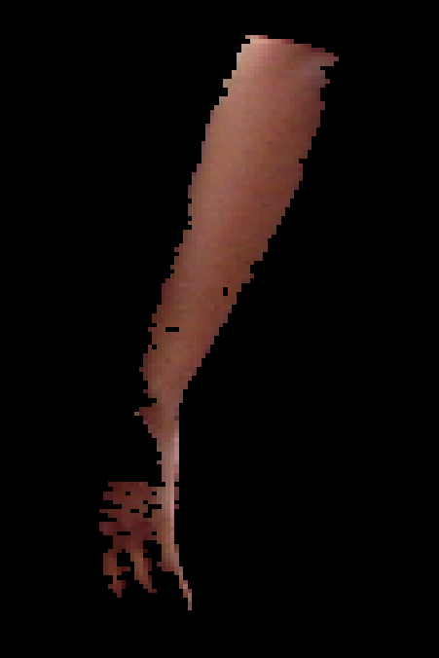
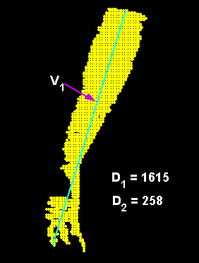
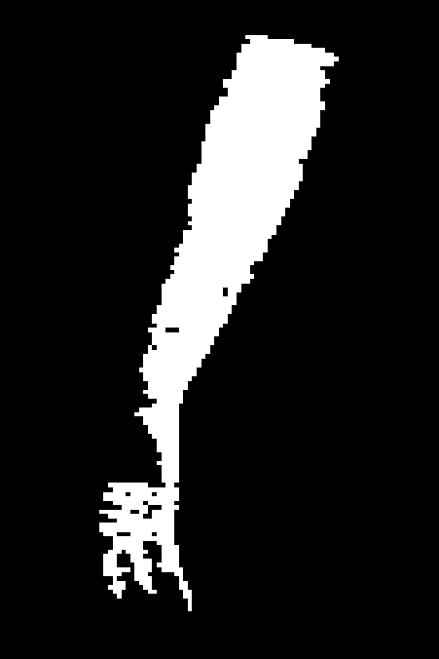
PCA-based
Non-Face Object Removal

Slide 15
Connected Component Analysis
Preprocessing
Low pass filtering, hole filling and background rejection
Identification of connected faces based on statistical analysis
Iterative separation of connected regions
Connected faces identification
Face separation

Slide 16
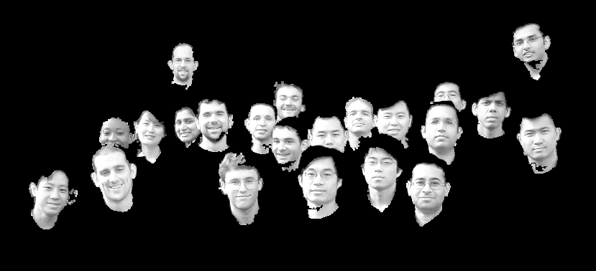
Connected Components

Slide 17


Component Separation

Slide 18
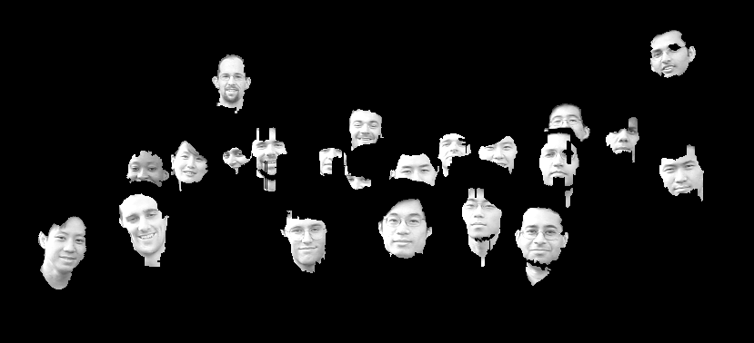
Separated Components

Slide 19


Component Identification
Template matching and peak thresholding to remove remaining non-face objects
Removal of repeated faces segments using a distance constraint

Slide 20
Face Position Refinement
The face centre is located at the bridge of the nose
The centroid of the segmented face is somewhat inaccurate in finding face centres
Multi-scale, high threshold template matching finds centres more accurately
Use centroid for remaining faces

Slide 21
Image Pyramid-based
Template Matching
Training face preprocessing
  Training faces were rotation compensated, registered, and resampled in greyscale
  Resampled faces were averaged and masked
Greyscale input image pyramid composition
  20% scale increments
Normalized cross-correlation with nose bridge-centred average face template

Slide 22
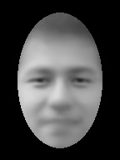
Finding Faces with Template Matching
High threshold for accurate centre location
Moderate threshold for robust backup face location
  if morphological subsystem gives unexpected results

Slide 23
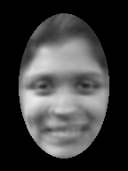
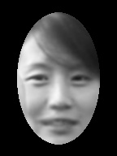

Gender Detection
Mean intensity
Template matching using average of each female face
Biased towards missing female faces to avoid false-positive penalty (9:1)

Slide 24
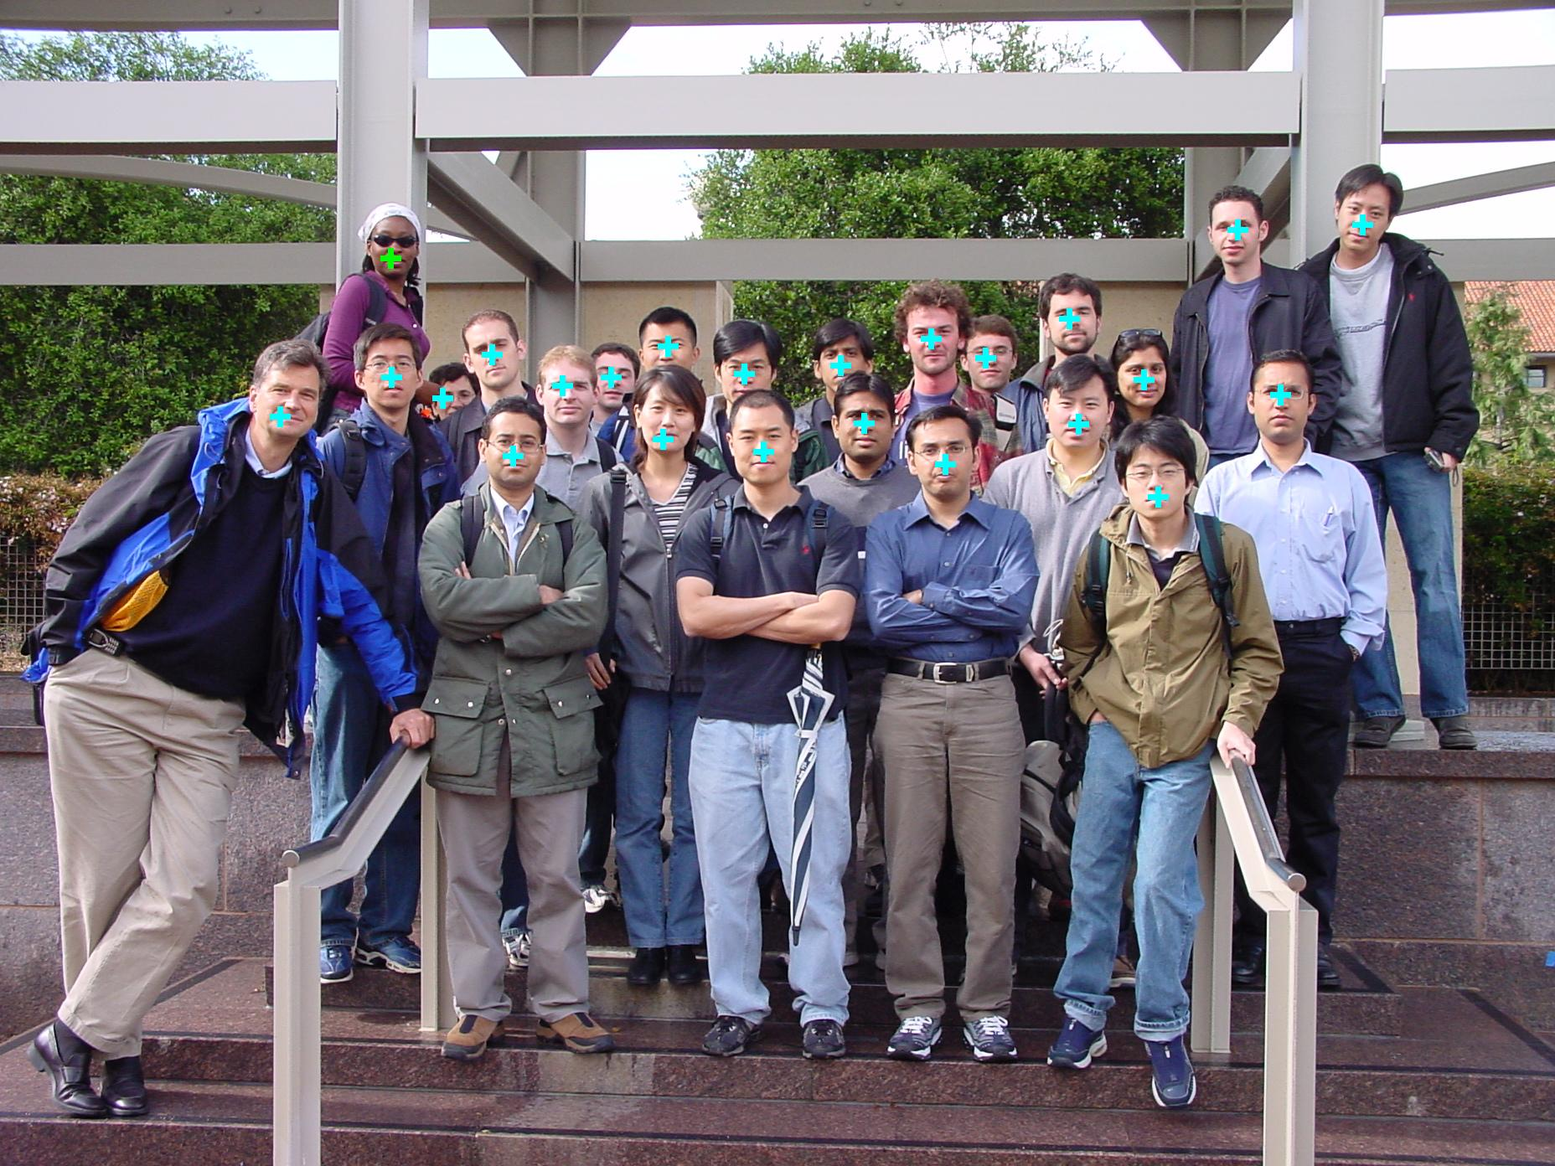
Face Detection Results

Slide 25
Results Statistics
Image | Hits | Repeated | False Hits | Distance | Time (s) | Bonus
1 | 21 | 0 | 0 | 11.1 | 91 | 2
2 | 24 | 0 | 0 | 15.6 | 90 | 2
3 | 25 | 0 | 0 | 10.5 | 97 | 0
4 | 24 | 0 | 0 | 11.8 | 97 | 1
5 | 24 | 0 | 0 | 10.7 | 103 | 0
6 | 24 | 0 | 0 | 9.6 | 94 | 0
7 | 22 | 0 | 0 | 11.2 | 88 | 1
Average | 23.4 | 0 | 0 | 11.5 | 94 | 0.86

Slide 26
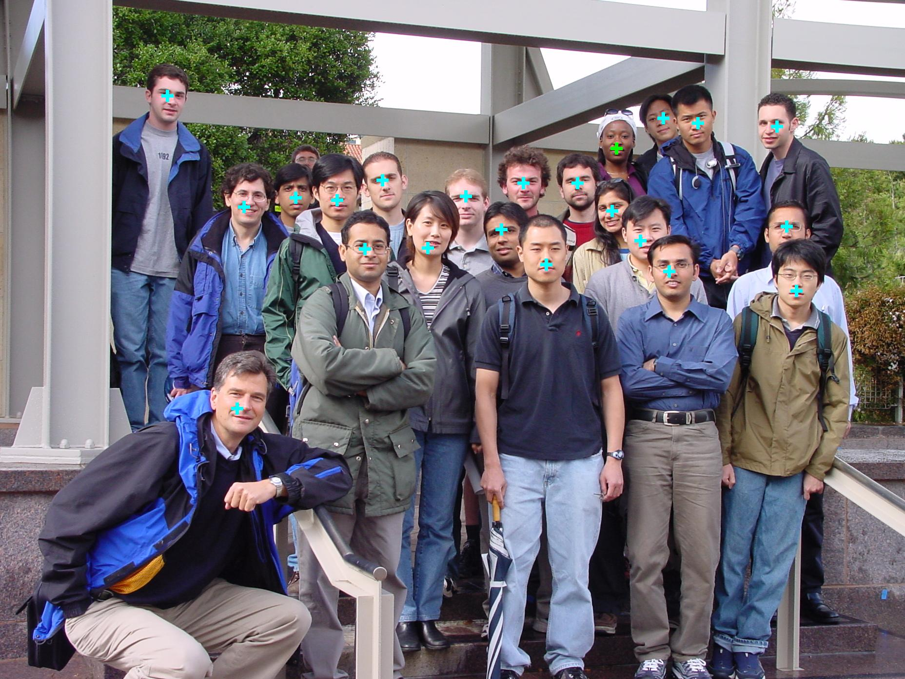

Slide 27
