Slide 1
A Statistical Analysis of Mental Health Resources and Global Suicide Rates
Pablo Salcedo, MD
Kelly Epley, PhD

Slide 2
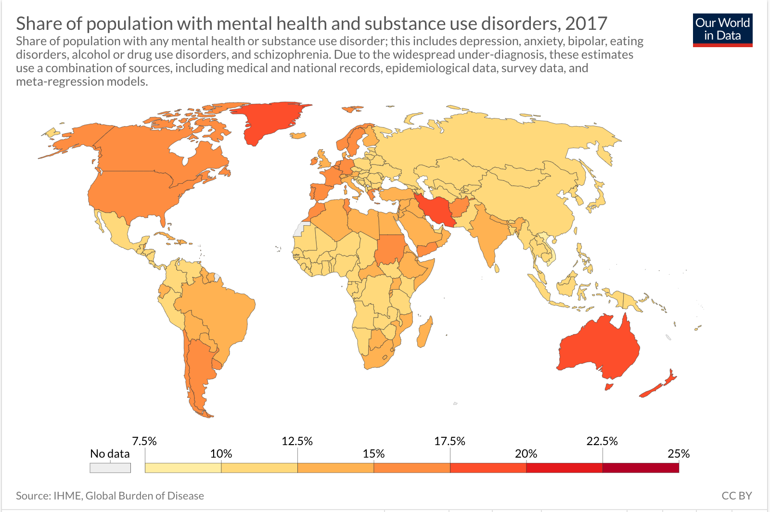

Slide 3
Methodology
High Resource Country Group
Test 2
Males of High Resource Country Group
Test 3
Low Resource Country Group
Males of Low Resource Country Group
Females of Low Resource Country Group
Females of High Resource Country Group
Test 1

Slide 4
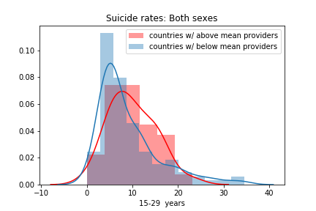
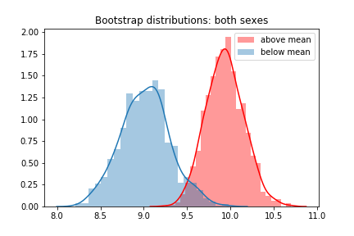
Results
High Resource Country Group
Test 1
Low Resource CountryGroupTest 2

Slide 5
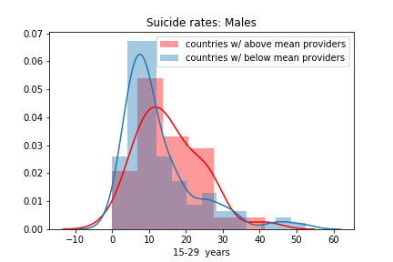
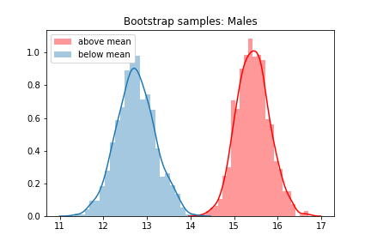
Results
Test 2
Males of High Resource Country Group
Males of Low Resource Country Group

Slide 6
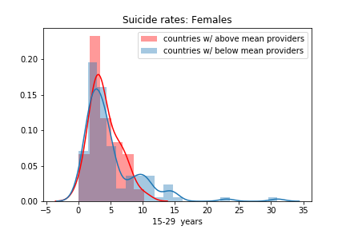
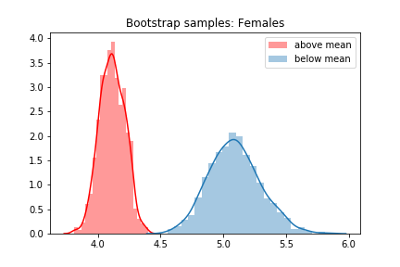
Results
Test 3
Females of High Resource Country Group
Females of Low Resource Country Group

Slide 7

Discussion
Test 1
observed a higher mean distribution of suicide rates in high resource countries and a lower mean distribution of suicide rates in low resource country
using suicide rate as a proxy for mental health resource effectiveness
the broad scope of mental health illnesses encompassed by the WHO's ICD-10
suicide reporting not being standardized across all countries
legality and socio-demographic trends

Slide 8

Discussion
Test 2 and 3
higher mean distribution of male suicide rates in high resource countries and a lower mean distribution of male suicide rates in low resource country
lower mean distribution of female suicide rates in high resource countries and a higher mean distribution of female suicide rates in low resource countries
differences between female and male suicide methods
Time allowed for intervention

Slide 9
Recommendations and Applications
Research
Further comparative research analyses on the predictive factors influencing mental health in low and middle income countries
Business
Effective allocation of resources toward mental health illness for increased well- being and productivity
Policy
Standardized and uniform data collection and classification system for mental health illness

Slide 10

Sources
World Health Organization's "Global Health Observatory Data Repository"
Hannah Ritchie and Max Roser (2019) - "Mental Health". Published online at OurWorldInData.org. Retrieved from: 'https://ourworldindata.org/mental-health' [Online Resource]

Slide 11

Thank you for your attention
Questions?

