Slide 1
A Statistical Analysis of Mental Health Resources and Global Suicide Rates
Pablo Salcedo, MD
Kelly Epley, PhD

Slide 2
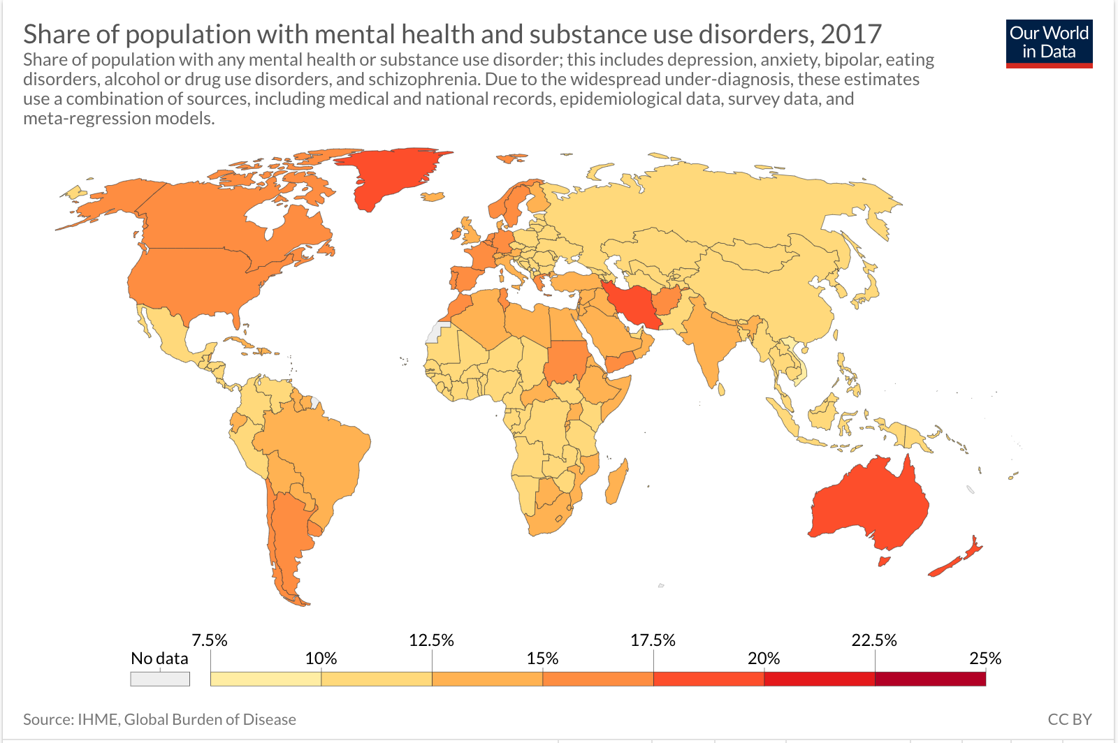

Slide 3
Methodology
Countries with Higher Resources Group
Test 2
Males of High Resource Countries Group
Test 3
Countries with Lower Resources Group
Males of Low Resource Countries Group
Females of Low Resource Countries Group
Females of High Resource Countries Group
Test 1

Slide 4
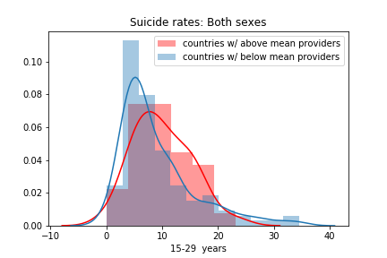
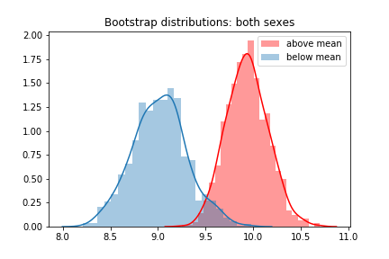
Results
Countries with Higher Resources Group
Test 1
Countries with Lower Resources Group

Slide 5
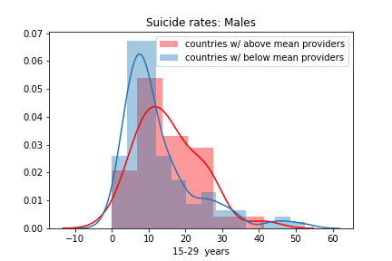
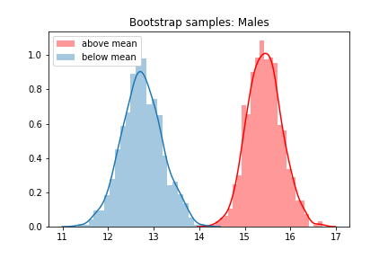
Results
Test 2
Males of High Resource Country Group
Males of Low Resource Country Group

Slide 6
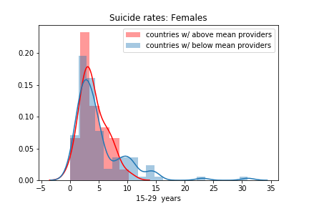
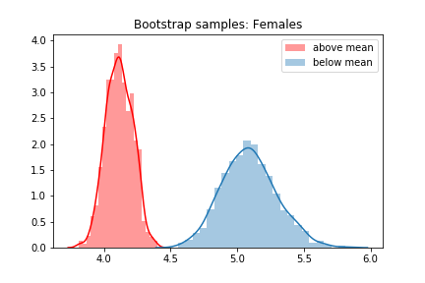
Results
Test 3
Females of High Resource Countries Group
Females of Low Resource Countries Group

Slide 7

Discussion
Test 1
observed a higher mean distribution of suicide rates in high resource countries and a lower mean distribution of suicide rates in low resource countries
using suicide rate as a proxy for mental health resource effectiveness
the broad scope of mental health illnesses encompassed by the WHO's ICD-10
suicide reporting not being standardized across all countries
legality and socio-demographic trends

Slide 8

Discussion
Test 2 and 3
higher mean distribution of male suicide rates in high resource countries
lower mean distribution of female suicide rates in high resource countries
differences between female and male suicide methods
time allowed for intervention

Slide 9
Recommendations and Applications
Research
Further comparative research analyses on the predictive factors influencing mental health in low and middle income countries
Business
Implementing early screening modalities to make the most use of intervention methods (which are time dependent)
Policy
Standardized and uniform data collection and classification system for mental health illness

Slide 10

Sources
World Health Organization's "Global Health Observatory Data Repository"
Hannah Ritchie and Max Roser (2019) - "Mental Health". Published online at OurWorldInData.org. Retrieved from: 'https://ourworldindata.org/mental-health' [Online Resource]

Slide 11

Thank you for your attention
Questions?

