Slide 1
REIT Return Sensitivity to Interest Rate Policy
Final Investment Memo Presentation
Team: Josh Love, Brody Duffel, Tallulah Pascucci
Main idea: higher rates tend to pressure REIT returns, but the evidence is not strong enough for a bold trade.

Slide 2
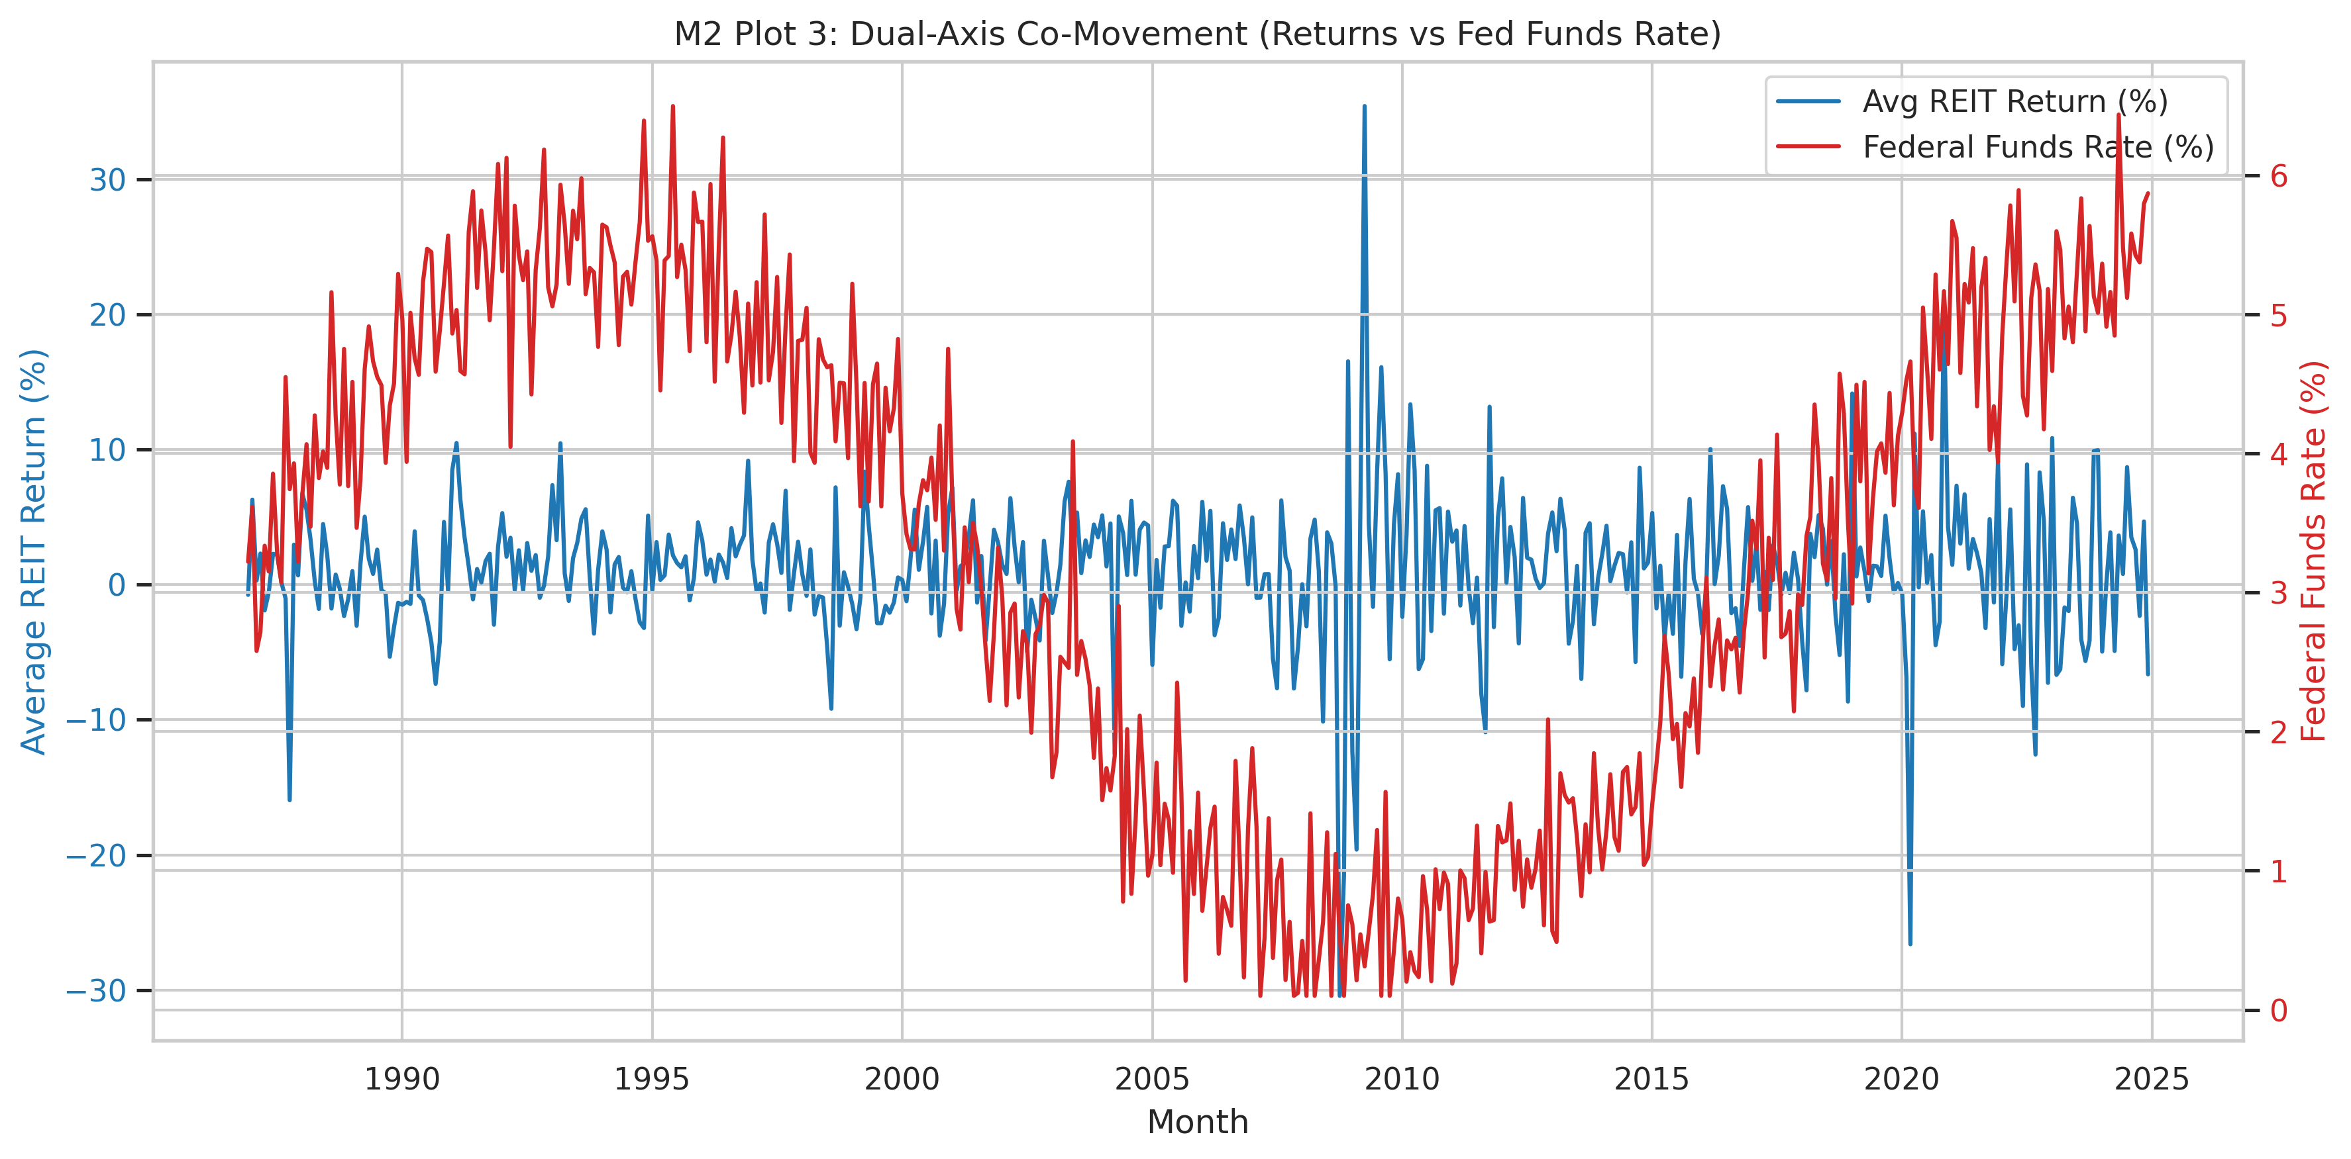
What We Studied
367 REITs
Monthly data from 1986 to 2024
Main driver: Federal Funds Rate
Main outcome: monthly REIT return
We also checked a more complex prediction model

Slide 3
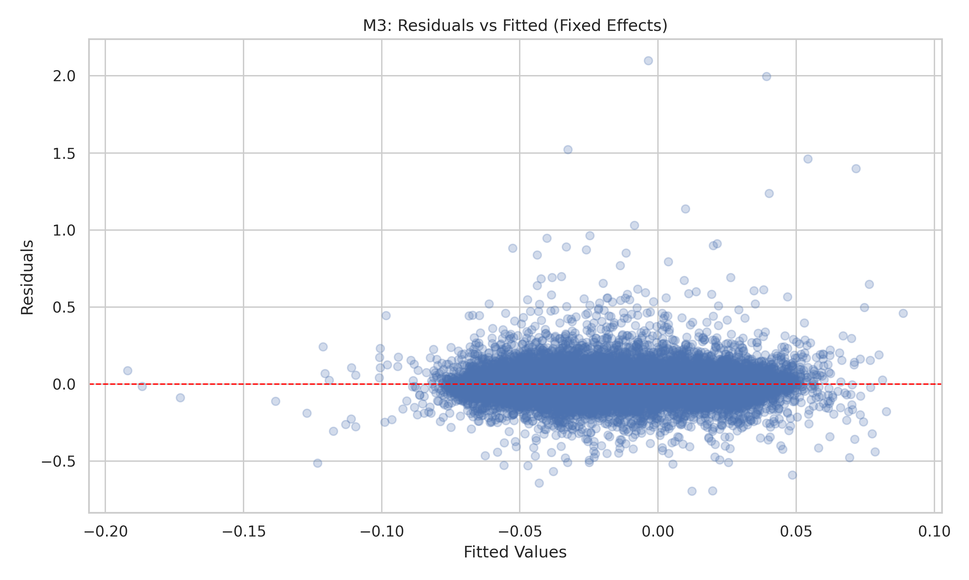
Main Result
A 1 percentage point increase in the Federal Funds Rate is linked to about a 1.34 percentage point drop in REIT returns after a 12-month lag.
When we use clustered standard errors, the effect is not statistically strong enough to call it a firm result.
Bottom line: the direction makes sense, but we should not overstate it.

Slide 4
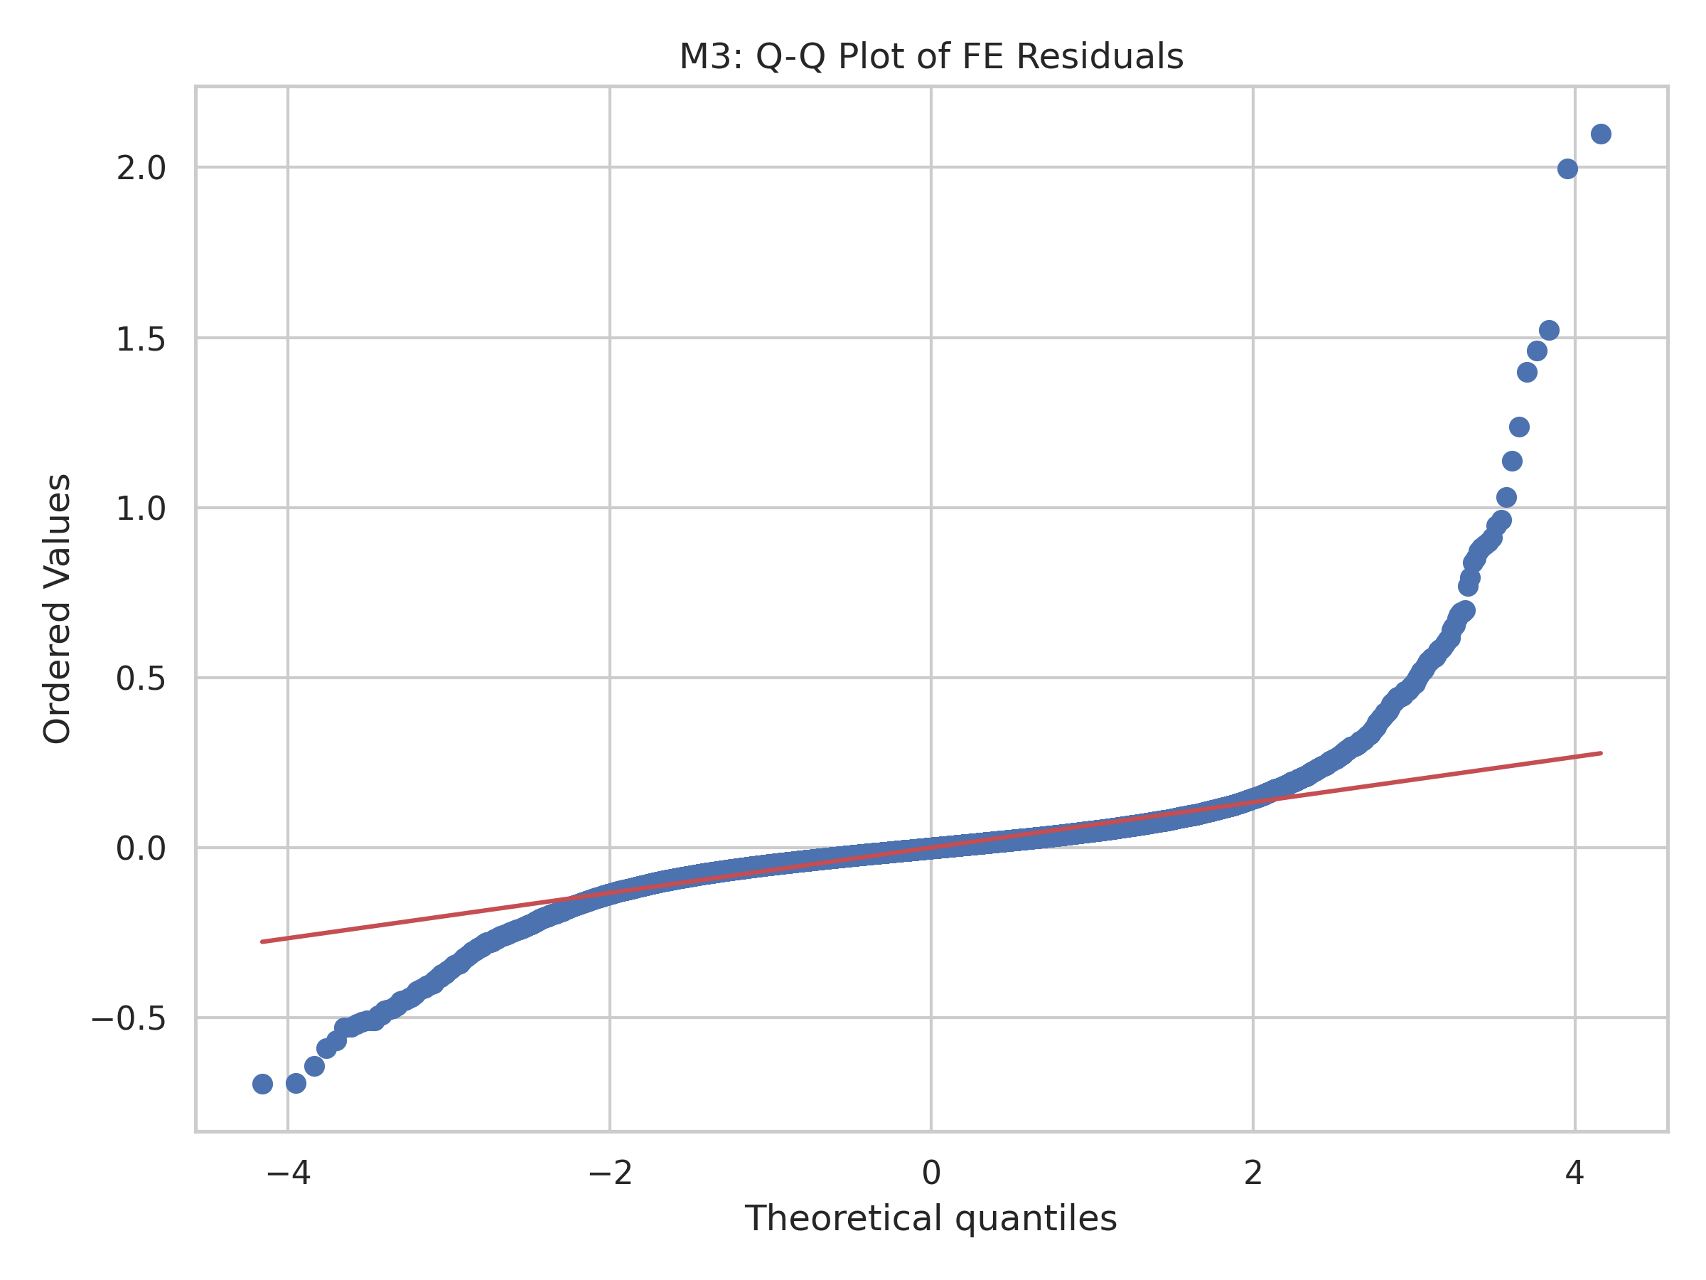
Why This Makes Sense
Leverage channel: borrowing becomes more expensive.
Discount-rate channel: future cash flows are worth less.
Demand channel: tighter policy can slow the property market.

Slide 5
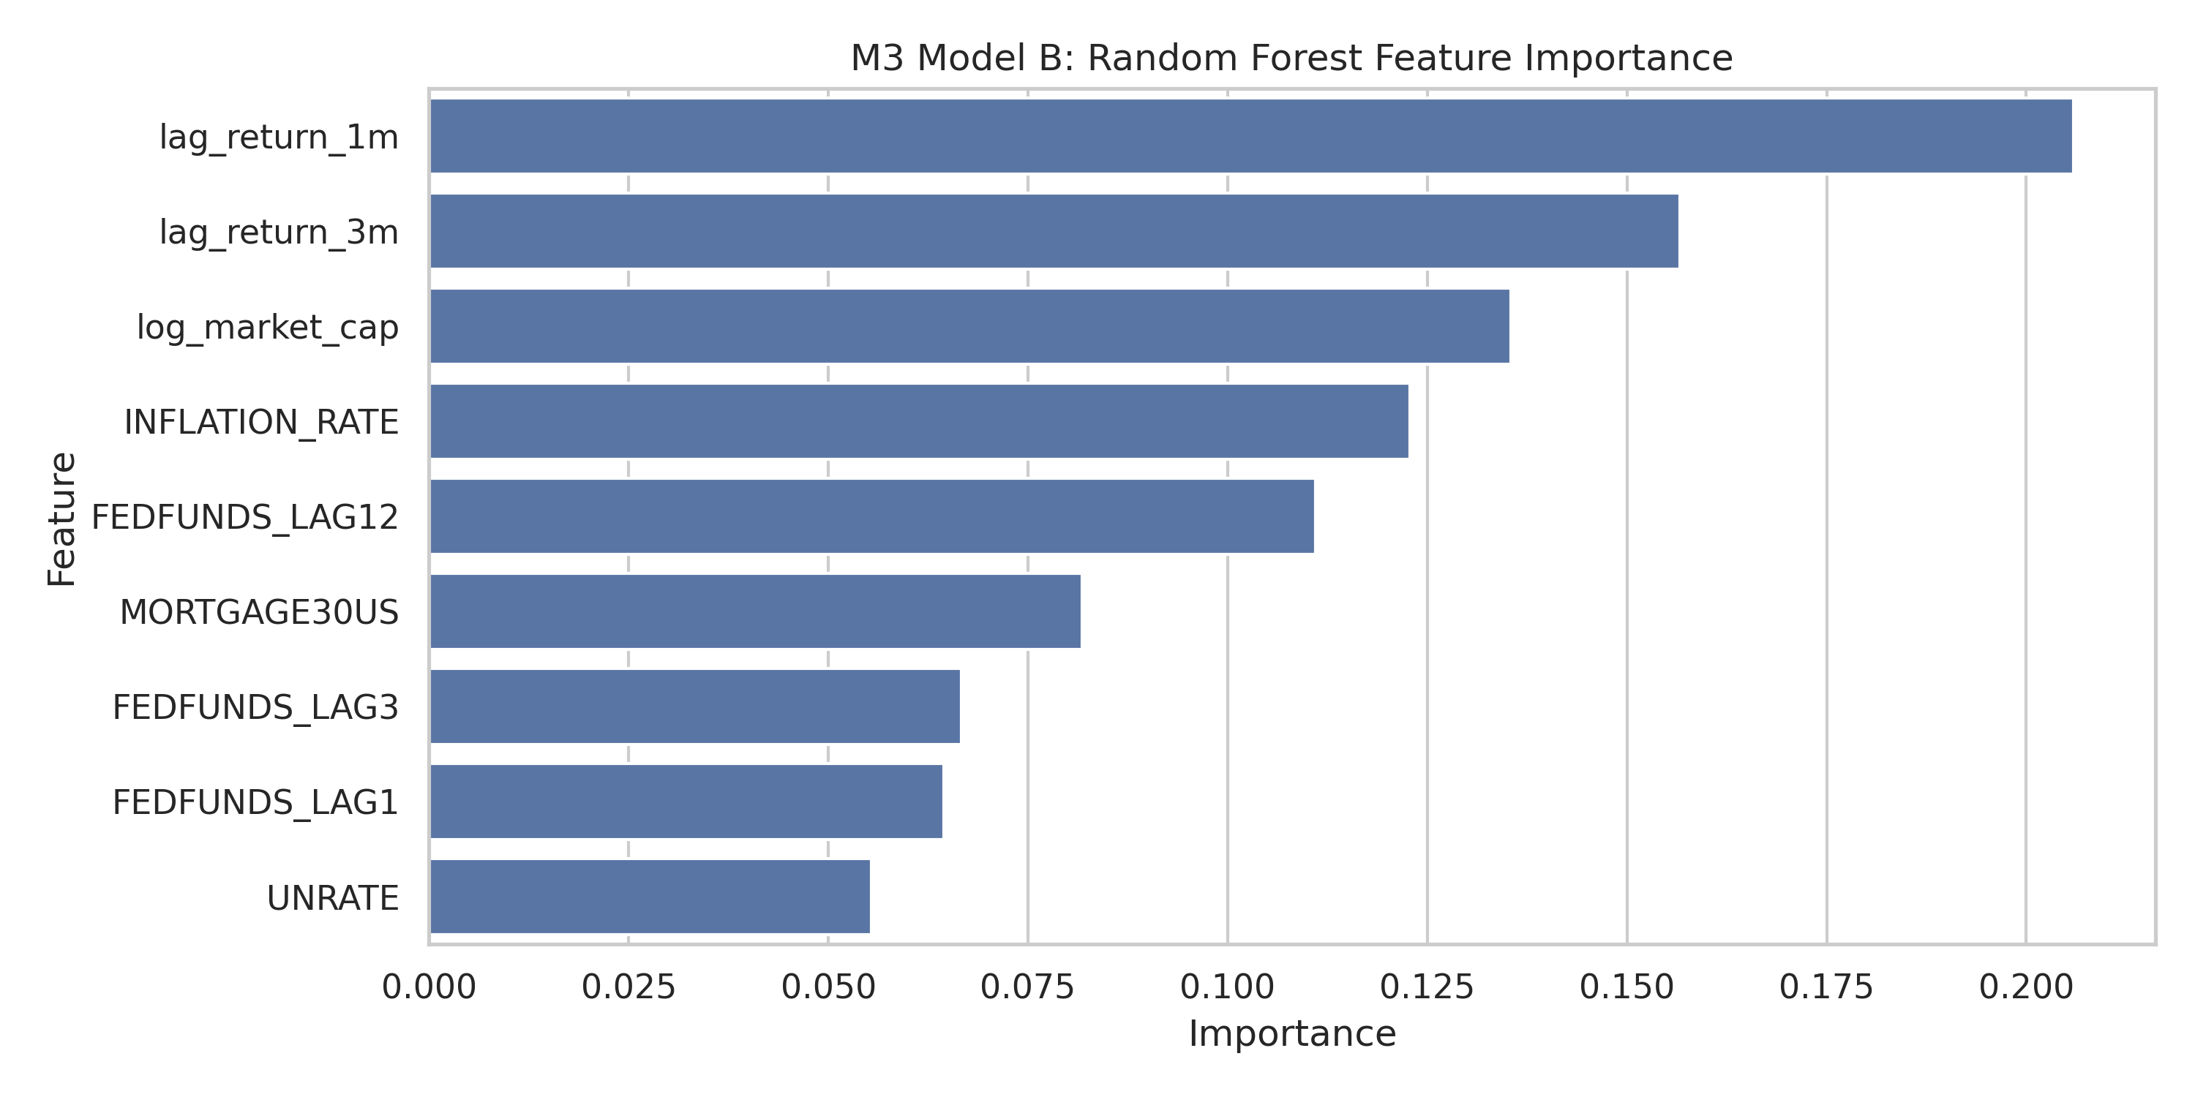
Did the Model Hold Up?
We found heteroskedasticity, so clustered standard errors were the right choice.
The macro variables are somewhat related, so we kept the model simple.
Different lags and crisis-period checks gave the same broad message: negative sign, weak precision.

Slide 6
Prediction Check
We compared OLS with Random Forest.
OLS did better out of sample.
That means the simple regression is the better story here.
OLS test R2: 0.0032 RMSE: 0.1029 Random Forest test R2: -0.0788 RMSE: 0.1070

Slide 7
Recommendation and Risks
Keep a neutral REIT stance.
Tilt slightly toward larger, lower-leverage names.
Do not make a huge portfolio move based only on short-term Fed changes.
Be honest about limits: other shocks matter, and sector variation is limited.
Bottom line: Higher rates and REIT returns move in opposite directions, but the evidence is not strong enough to support a dramatic trade.

