Slide 1
REIT Return Sensitivity to Interest Rate Policy
Final Investment Memo Presentation
Main message
Team
Higher interest rates tend to pressure REIT returns, but the evidence is not strong enough for a bold trade.
Josh Love Brody Duffel Tallulah Pascucci
May 1, 2026

Slide 2
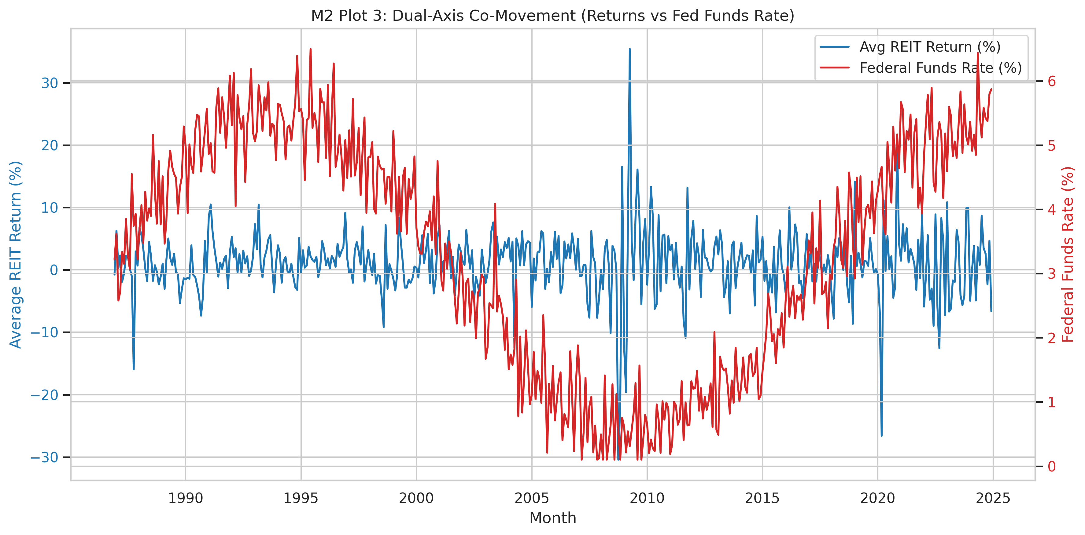
What We Studied
Monthly REIT returns, the Federal Funds Rate, and a simple question: do higher rates hurt REITs?
367 REITs
47,695 monthly observations
Time period: 1986-2024
Main driver: Federal Funds Rate
Main outcome: monthly REIT return
We also checked whether a more complex prediction model helped
REIT returns and rates move in opposite directions, but the pattern is noisy.

Slide 3
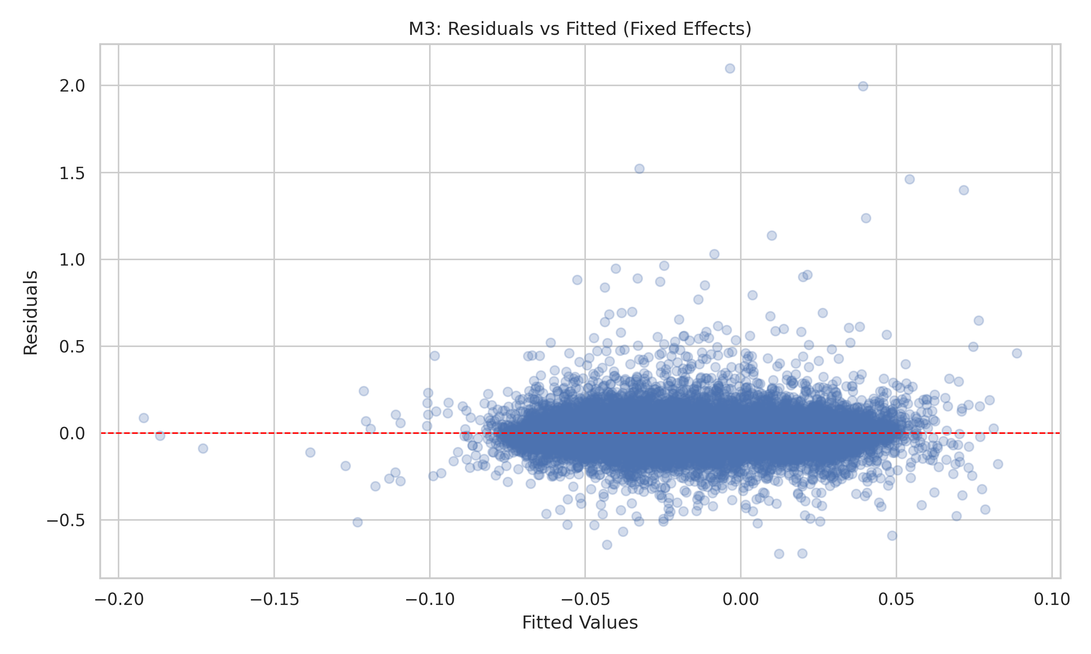
Main Result
The sign is negative, but the clustered estimate is too imprecise to be a strong trading signal.
1 percentage point higher Fed Funds Rate
about 1.34 percentage points lower REIT return
with a 12-month lag, but not statistically strong after clustered standard errors
Residuals are noisy, which is common for return data.

Slide 4
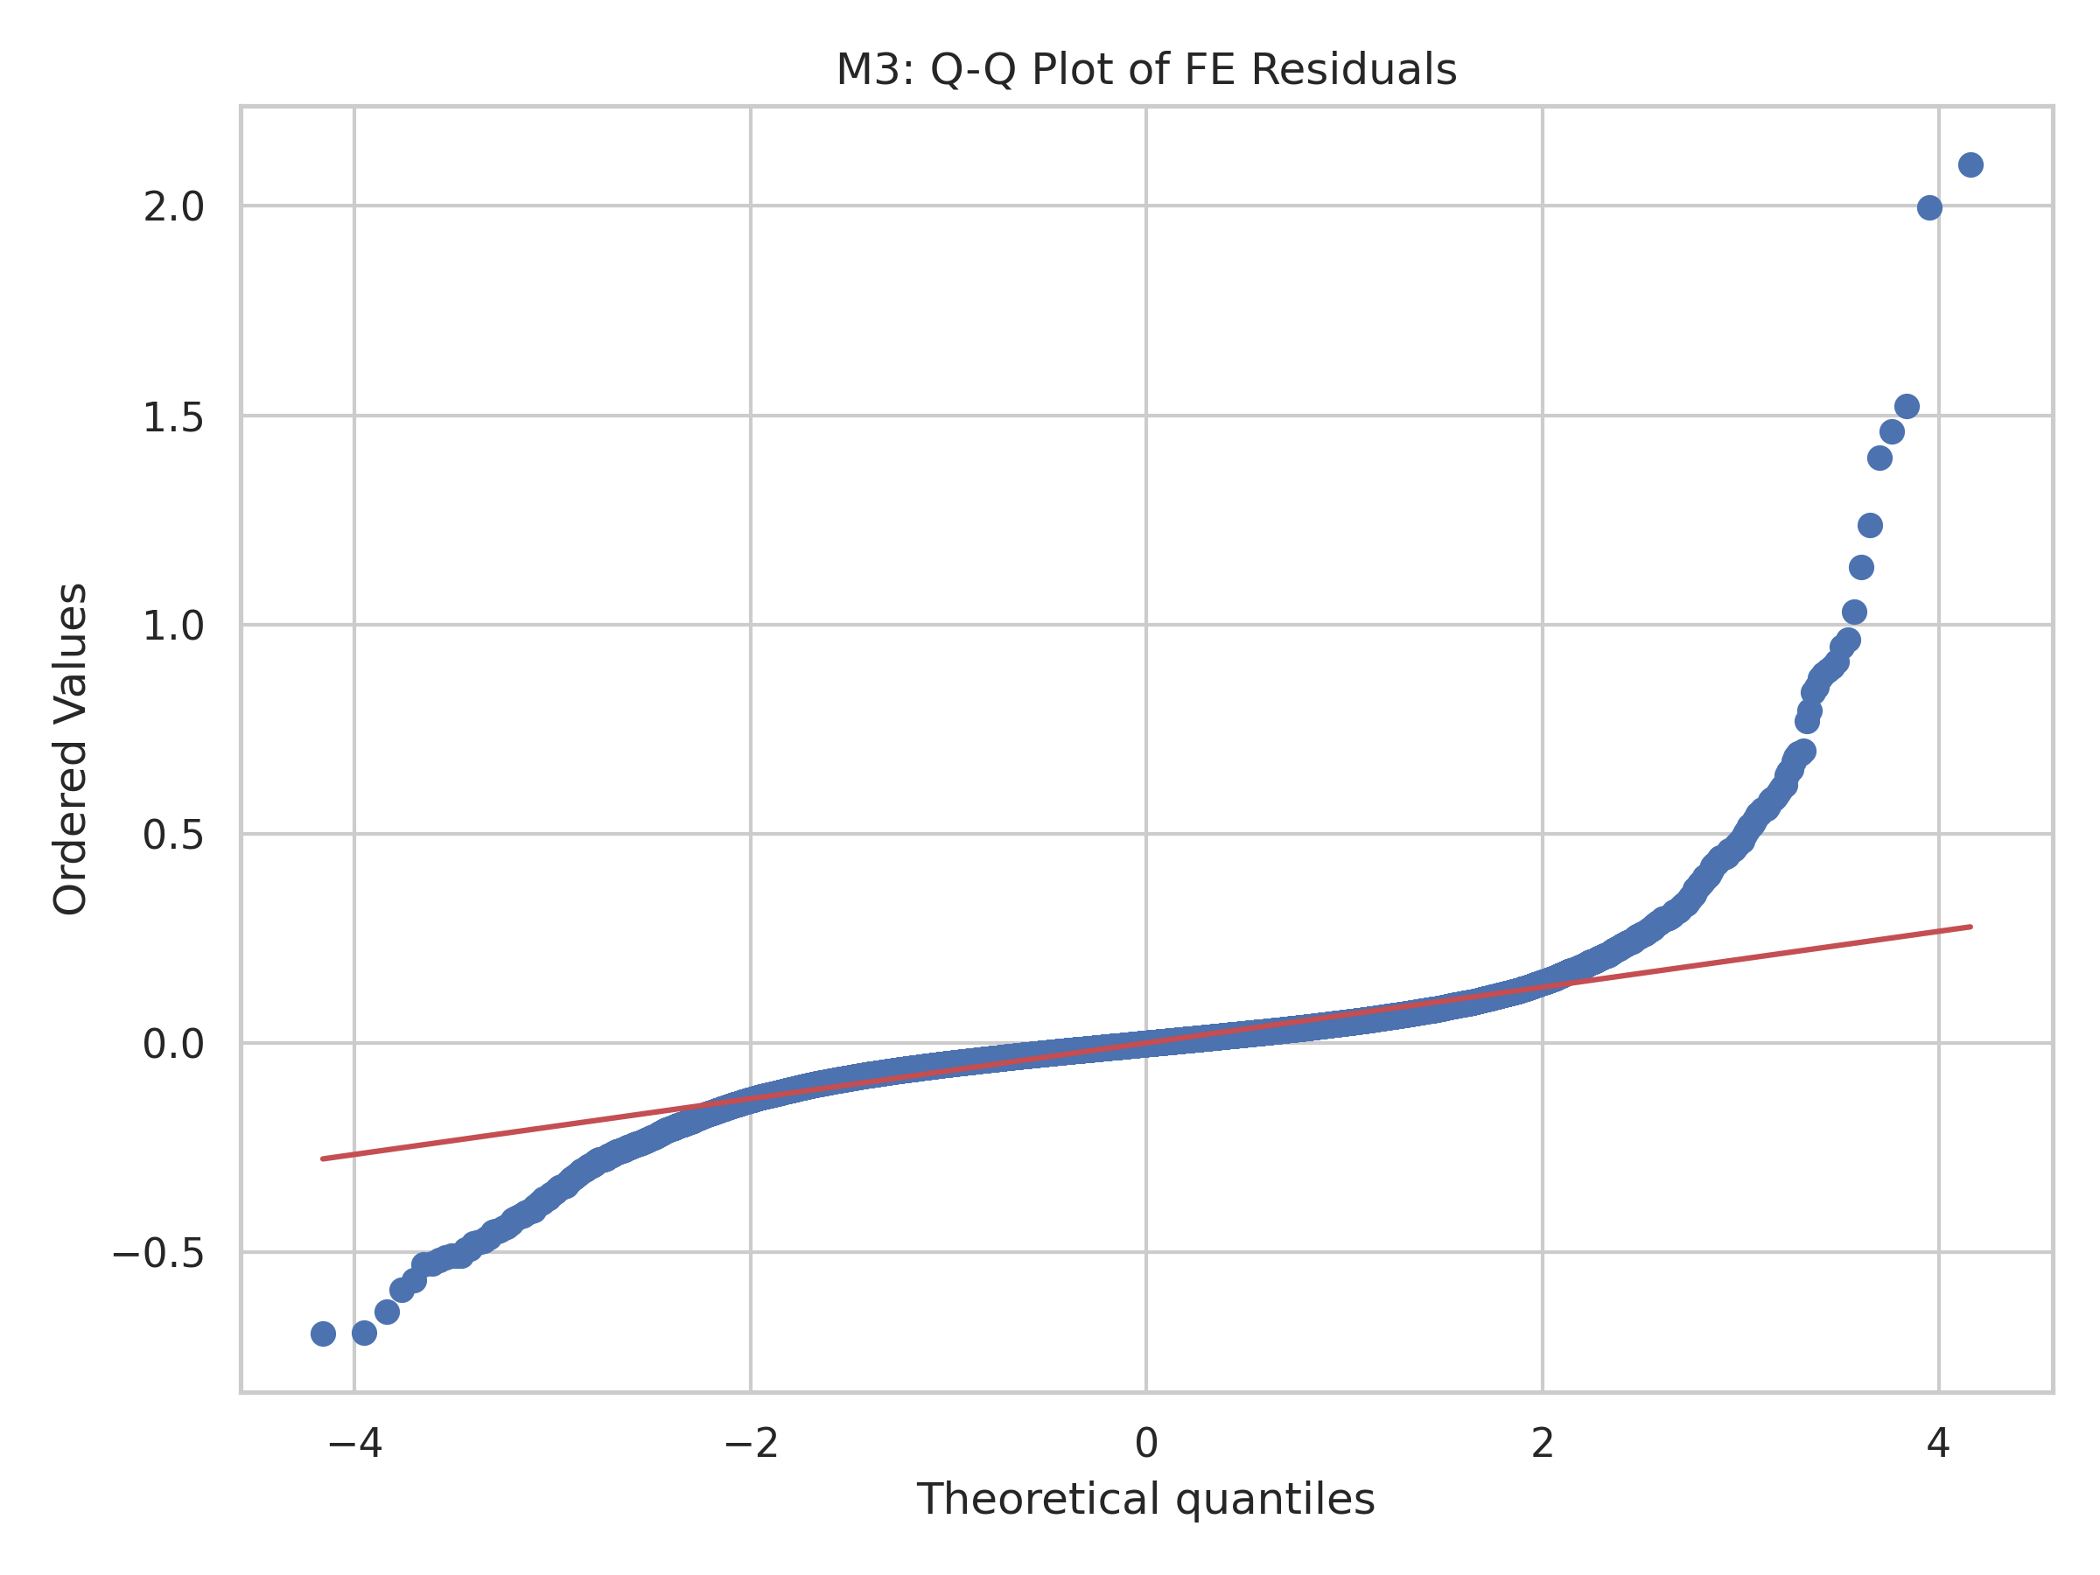
Why This Makes Sense
The result matches three simple economic channels.
Leverage
Discount rate
Demand
Borrowing costs go up when rates rise.
Future cash flows are worth less.
Tighter policy can slow the property market.
The error pattern is not perfectly normal, so we rely on robust inference.

Slide 5
Did the Model Hold Up?
We checked the main problems a panel model can have.
We found heteroskedasticity, so clustered standard errors were the right choice.
The macro variables are somewhat related, so we kept the model simple.
Different lags and crisis-period checks gave the same broad message: negative sign, weak precision.
Breusch-Pagan
p-value ~ 5.0e-126
Max VIF
8.40 for UNRATE
That means the macro controls are somewhat collinear, so simpler is better.

Slide 6
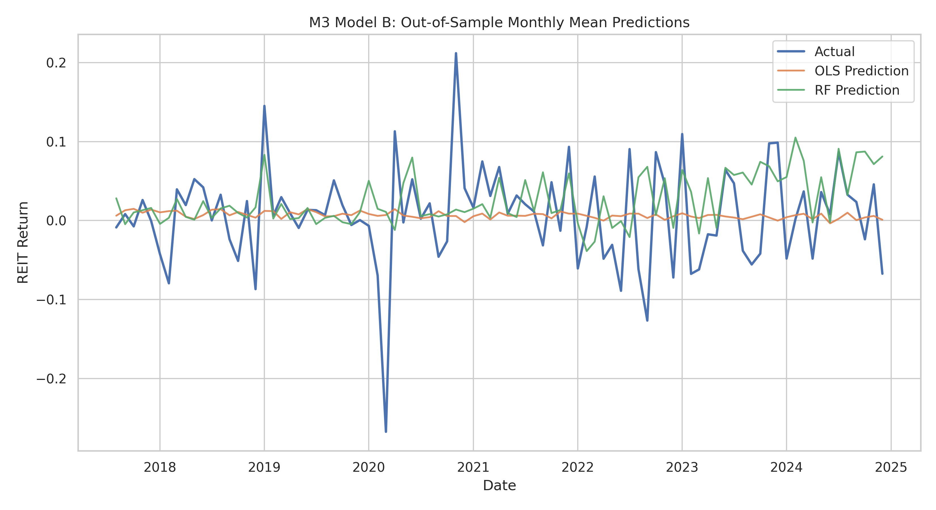
Prediction Check
A more complex model did not improve out-of-sample prediction.
We compared OLS with Random Forest.
OLS did better out of sample.
Random Forest did not improve prediction.
OLS
R² = 0.0032 RMSE = 0.1029
Random Forest
R² = -0.0788 RMSE = 0.1070
The simple model is still the better story.

Slide 7
Recommendation and Risks
Stay cautious, selective, and honest about what the data can and cannot show.
Keep a neutral REIT stance.
Tilt slightly toward larger, lower-leverage names.
Do not make a huge portfolio move based only on short-term Fed changes.
Be honest about limits: other shocks matter, and sector variation is limited.
Bottom line: higher rates and REIT returns move in opposite directions, but the evidence is not strong enough to support a dramatic trade.
If rates fall
REITs could recover somewhat. We treat that as a scenario, not a sure forecast.
Action: stay neutral and focus on quality.

