Slide 1
Lobbying and Firm Profitability
A Panel-Data Research Synthesis (2010-2020)
QM 2023 Capstone Team
Alycia Reji • Gracie Vivion • Shelby Howard • Daniz Mammadova
Research deck generated from project outputs in this repository

Slide 2
Agenda
1. Research question and hypotheses
2. Data pipeline, coverage, and quality
3. EDA insights: correlation, lag structure, and heterogeneity
4. Econometric design: two-way fixed effects + robustness
5. Diagnostics, forecast benchmark, and interpretation
6. Conclusions, limitations, and next steps
Theme: midnight executive (navy + ice blue)

Slide 3
Research Question and Testable Hypotheses
What is the relationship between firm lobbying expenditures and subsequent profitability?
H1: Higher lobbying spend is associated with higher subsequent performance.
H2: Effects appear with 1-2 year lags rather than contemporaneously.
H3a: Effect magnitude differs by firm size.
H3b: Effects are stronger in policy-exposed industries.
H4: Positive relationship should survive log-scaling/outlier robustness.
H5: Controls should attenuate, not fully erase, the lobbying coefficient.
Hypothesis set compiled from EDA and M3 interpretation docs

Slide 4
Data Pipeline and Coverage Snapshot
Financials
Lobbying
Merged panel
Balanced panel
4,932 rows 1,375 firms SEC 10-K (2010-2020)
11,619 rows 1,534 firms Senate filings
5,099 rows 1,375 firms firm-year panel
836 rows 66 firms strict 2010-2020
Crosswalk coverage is the key bottleneck: 1,428 rows map to gvkey; 3,671 do not.
Only 245 merged rows contain non-missing lobbying spend (4.8% of merged panel).
Balanced panel improves temporal consistency but removes 83.6% of rows.
Interpret estimates with explicit attention to sparse treatment support.
Source: quality_report.md

Slide 5
Data Quality Risks and Mitigations
Main Risks
• Missing lobbying spend: 95.2% of merged rows
• ROA distribution has extreme tails (mean unstable)
• Crosswalk incompleteness limits merged support
• Potential omitted-variable and timing bias
Practical Implication
Need robust inference, outlier checks, lag tests, and cautious causal language.
What We Did
• Two-way fixed effects (firm + year)
• Clustered SE at firm level
• Lag structure comparison (t-1, t-2, t-3)
• Placebo lead test for timing/reverse causality
• Excluding 2020 shock-year robustness
• Size-based heterogeneity splits
• Bootstrap interval for lobbying effect
Risk framing: association-first, causality guarded

Slide 6
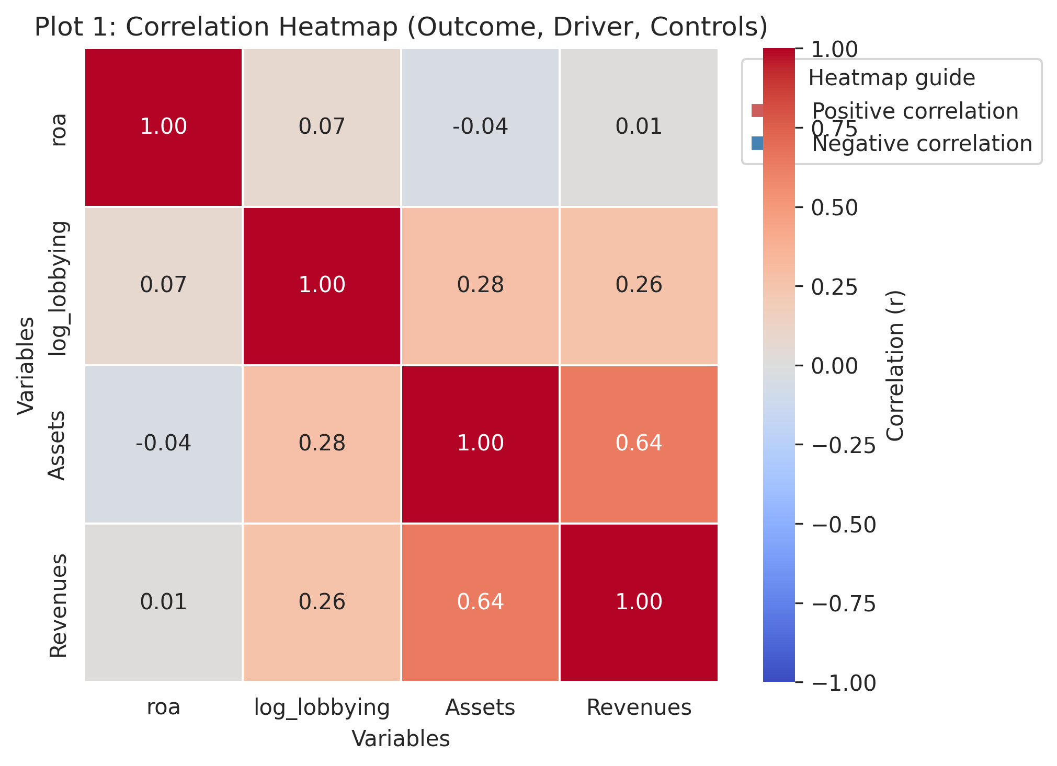
EDA Signal: Positive Co-Movement, Moderate Strength
Evidence Summary
• Lobbying and firm performance move together positively in raw data.
• Relationship is moderate, not overwhelming.
• Control additions attenuate coefficients but often preserve directional signal.
• Outliers amplify magnitude in levels; sign tends to persist under robust checks.
Interpretation
Data is consistent with a selection-plus-impact narrative: stronger firms lobby more, and lobbying may add incremental association.
Figure: M2 plot1_correlation_heatmap.png

Slide 7
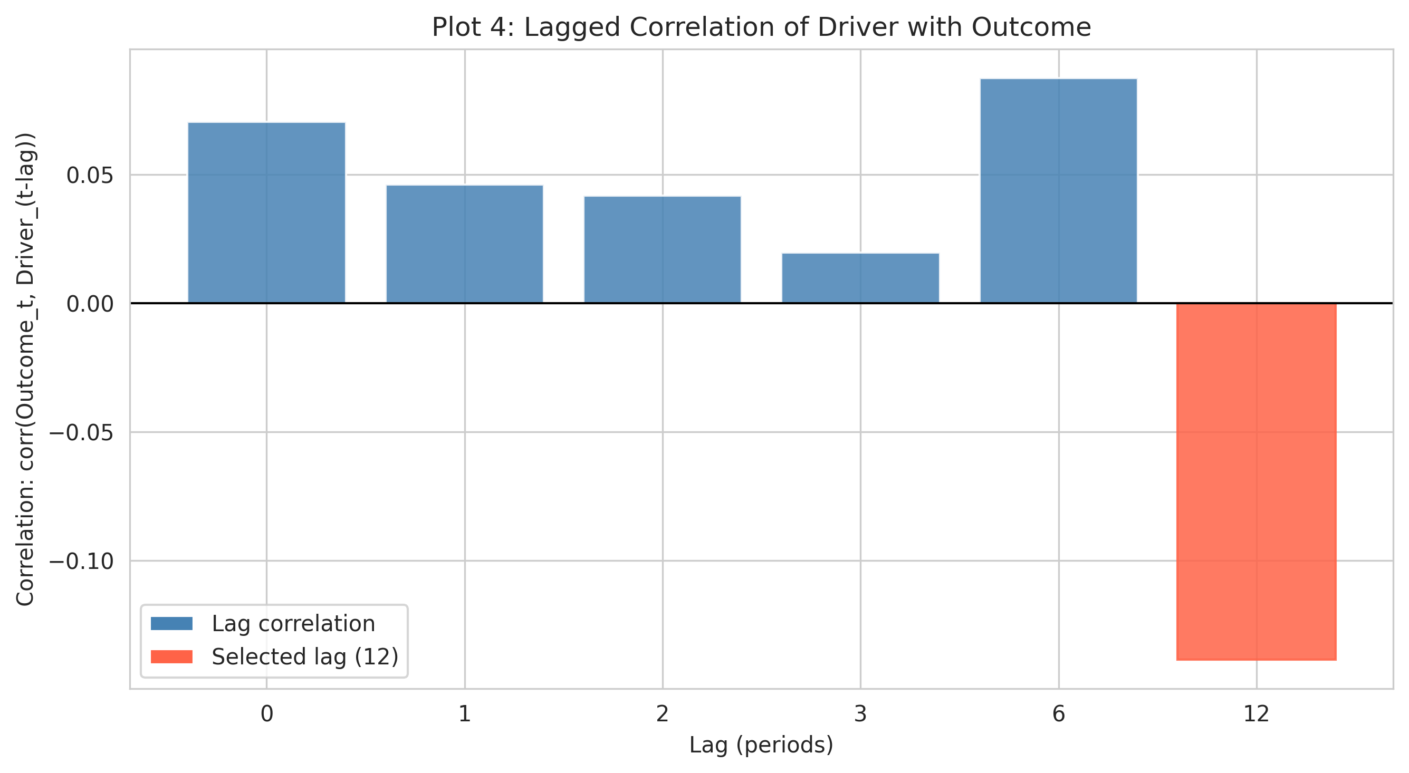
Lag Dynamics: Effects Emerge Over Time
Model Evidence
Lag 1: -174.6 (p=0.135, clustered)
Lag 2: -95.3 (p=0.272)
Lag 3: 38.5 (p=0.648)
Lead 1 placebo: -302.7 (p=0.069)
Takeaway
Timing patterns are not cleanly causal; lead effect suggests potential anticipation or reverse-causality dynamics.
Lag and lead metrics from M3 robustness table

Slide 8
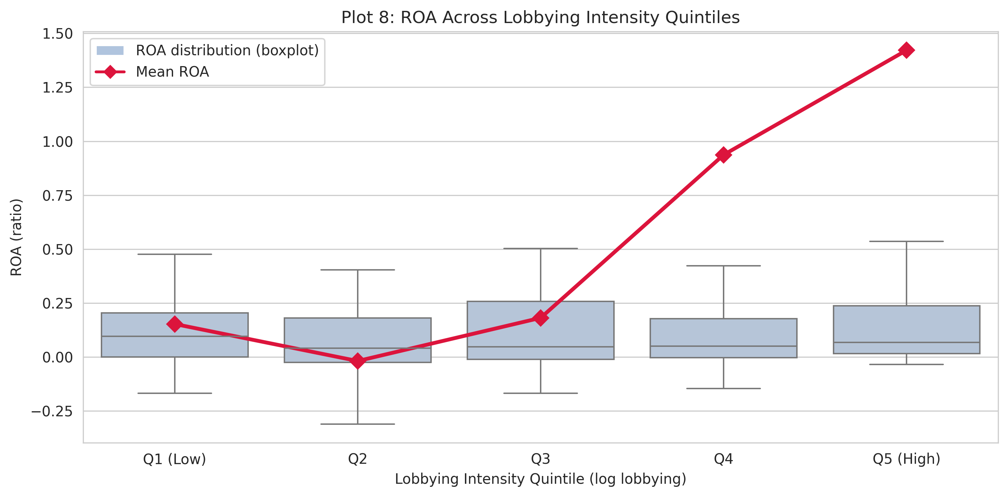
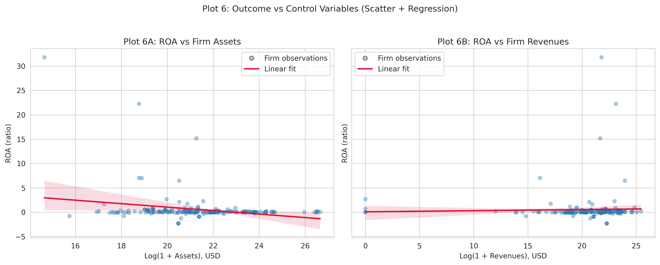
Heterogeneity and Leverage
• Group sensitivity: association appears stronger for larger and policy-exposed firms in EDA narrative.
• FE heterogeneity split: small firms beta=-5753.9 (p=0.156, imprecise) vs large firms beta=-24.1 (p<0.001).
• Outlier influence: extreme spenders/very large firms materially affect slope magnitude in levels.
• Robust interpretation: concentration at the top changes effect size more than directional pattern in many checks.
Figures: M2 plot8 and plot6

Slide 9
Econometric Design
ROA_it = beta*Lobbying_{i,t-1} + theta1*log(Assets_it) + theta2*log(Revenues_it) + alpha_i + gamma_t + epsilon_it
Identification Features
• Firm fixed effects remove time-invariant heterogeneity.
• Year fixed effects absorb macro shocks.
• Lagged lobbying reduces contemporaneous simultaneity.
• Clustered SEs handle within-firm dependence.
Threats to Causal Interpretation
• Lead placebo signal implies timing concern.
• Sparse non-missing lobbying reduces support.
• Unobserved time-varying strategy may remain.
• Results should be framed as association-first.
Model A: two-way FE panel with firm-clustered inference

Slide 10
Main Results: FE Coefficients and Precision
Specification | Lobbying Coef | Std. Err | p-value | N
Lag 1 FE (clustered) | -174.6 | 116.9 | 0.135 | 2125
Lag 2 FE (clustered) | -95.3 | 86.7 | 0.272 | 1700
Lag 3 FE (clustered) | 38.5 | 84.3 | 0.648 | 1372
Exclude 2020 | -109.2 | 72.2 | 0.131 | 1911
Interpretation
Point estimates are often negative, but statistical precision is limited in most specifications.
The lead-placebo and instability across lags reinforce an association-based, non-causal reading.
Coefficient movement with specification changes is economically meaningful.
Tabulated from M3 robustness outputs

Slide 11
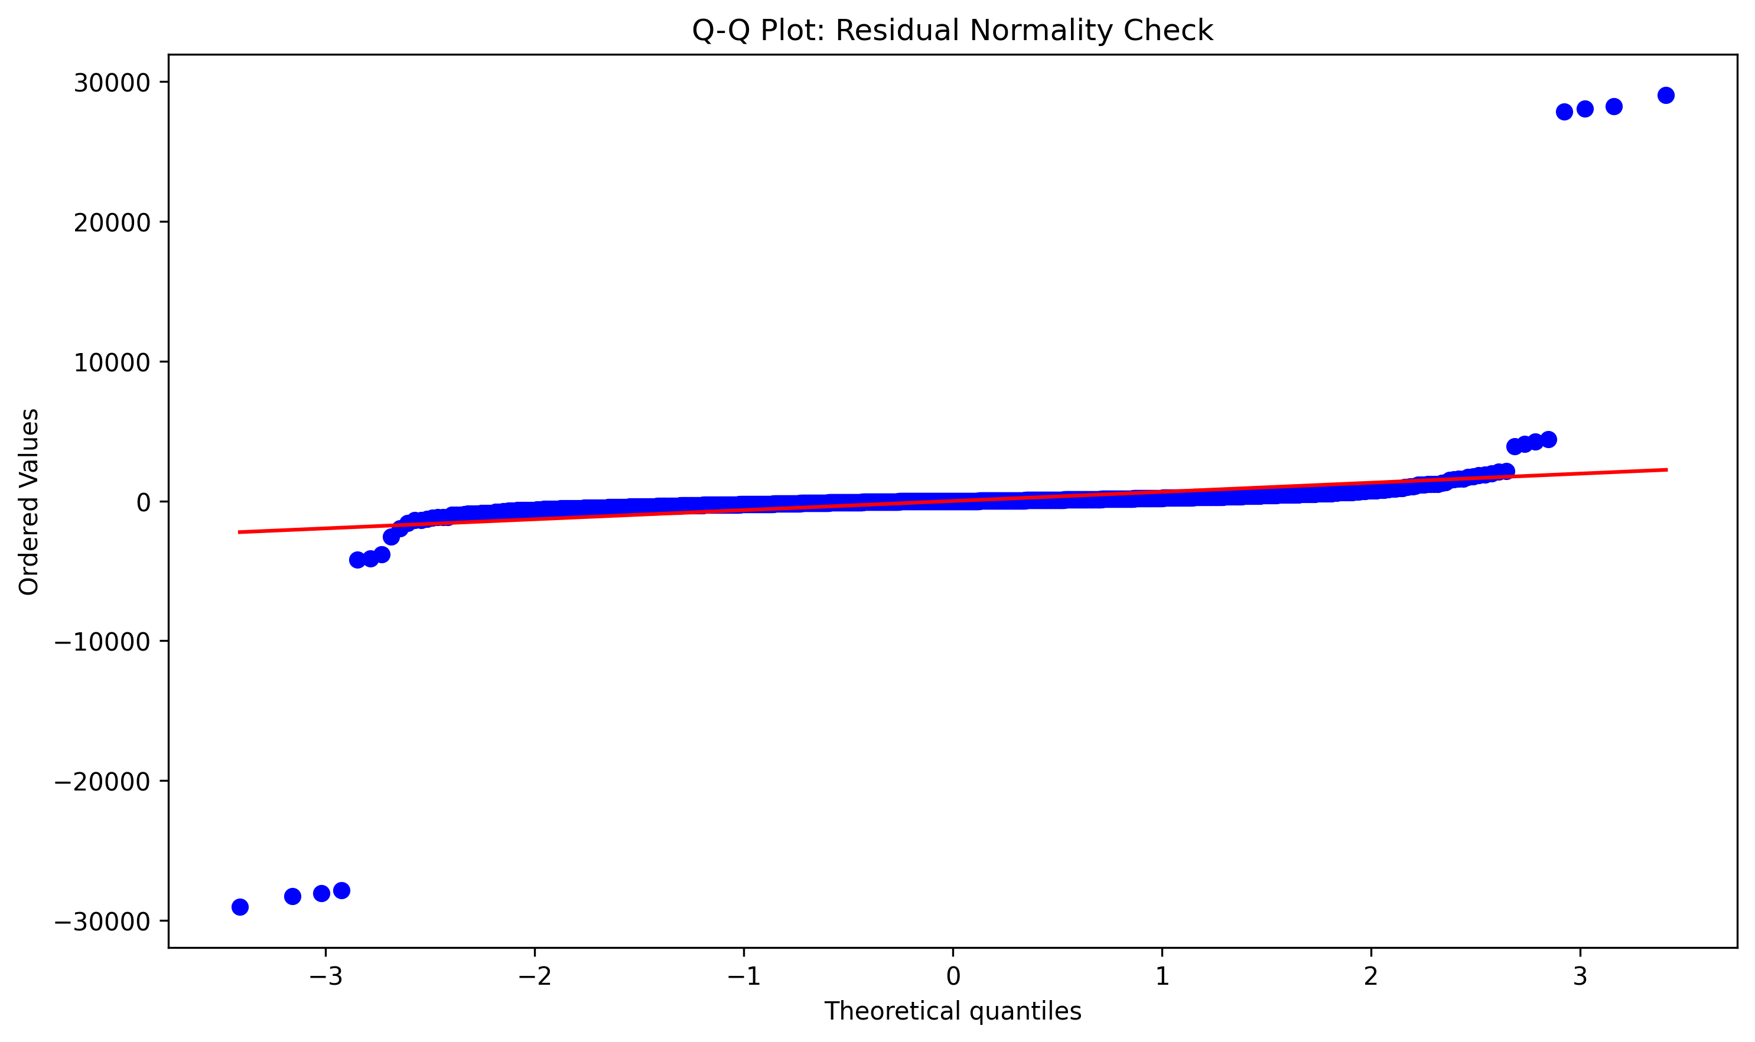
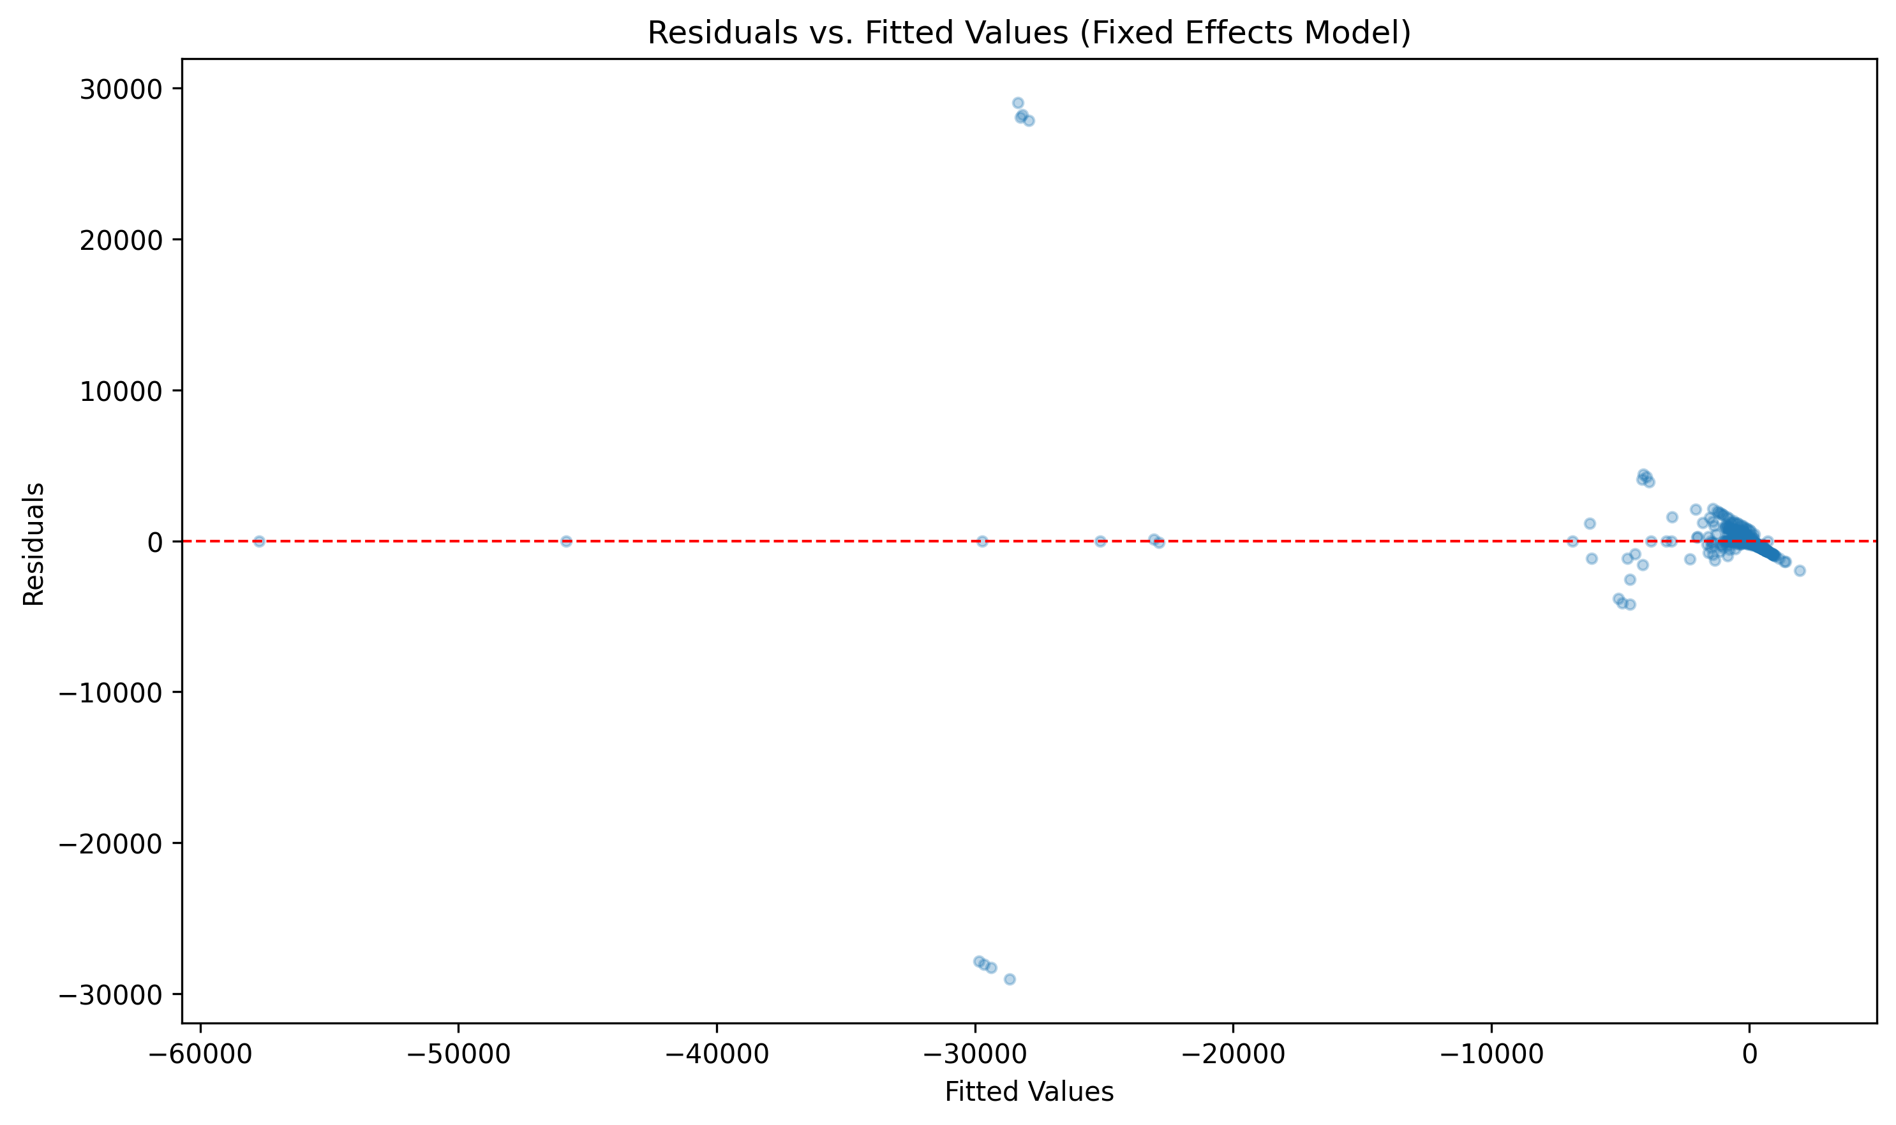
Diagnostics and Inference
• Breusch-Pagan p-value = 0.0000: heteroskedasticity present, so robust/clustered inference is required.
• Max VIF = 2.74: no serious multicollinearity among key regressors.
• Residual diagnostics indicate non-ideal shape, consistent with sparse and heterogeneous panel structure.
• Conclusion: standard FE estimates are informative, but robust uncertainty treatment is essential.
Figures: M3 diagnostic plots and diagnostics summary

Slide 12
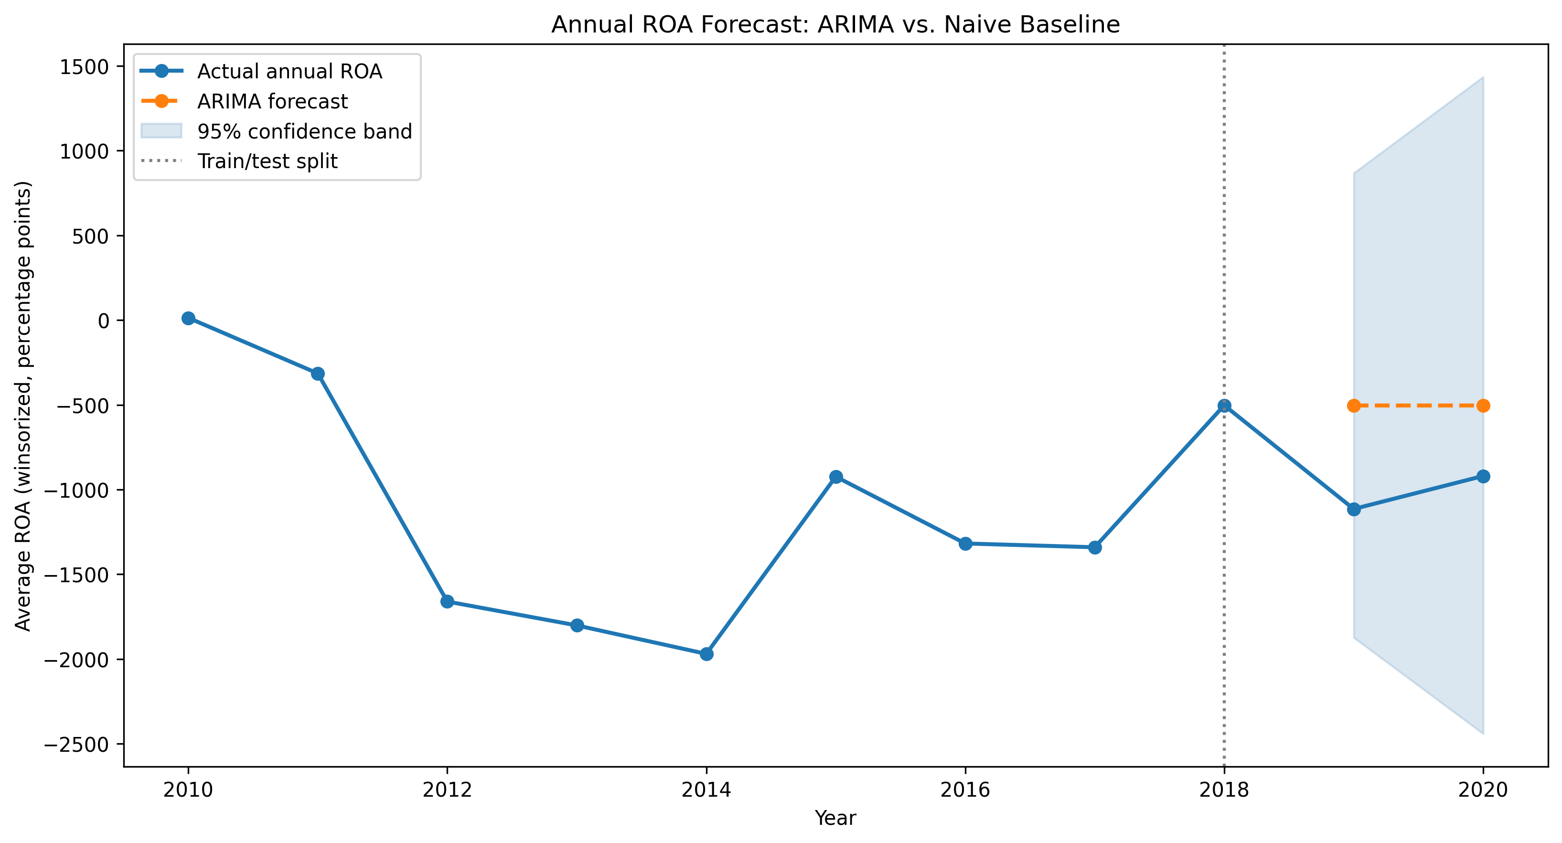
Forecast Benchmark (ARIMA)
ARIMA Detail
Order: (0,1,0)
ADF p-value: 0.229
ARIMA RMSE: 523.53
Naive RMSE: 523.53
Result
ARIMA does not outperform naive baseline in this annual sample.
ARIMA included as predictive benchmark, not identification strategy

Slide 13
Conclusions and Strategic Next Steps
Key Conclusions
• Evidence supports a meaningful lobbying-profitability association, but not a clean causal claim.
• Coefficients are sensitive to timing and sample support, with lead effects raising endogeneity concerns.
• Diagnostic and robustness layers improve credibility, yet sparse lobbying coverage remains the core constraint.
Next Steps
• Improve identifier mapping and expand policy-exposure controls.
• Test alternative outcomes (ROE, margins, valuation) and dynamic panel estimators.
• Explore quasi-experimental variation for stronger causal leverage.
Thank you
QM 2023 Capstone | Lobbying and Firm Profitability

