Slide 1
Corporate Lobbying and
Firm Profitability
Today's flow
1) Research question and hypothesis
2) Three data sources
3) Methodology
4) Findings with graphs
5) Thank you and Q&A
Capstone Presentation
2010-2020 Panel Analysis
Notes:
Hi everyone, and thank you for being here. Today we will walk through one simple question: does spending more money on lobbying help a company become more profitable later? I will keep this presentation in simple language. We will cover our question, our hypothesis, our data, our method, and then our findings with graphs. At the end, we will leave time for questions.

Slide 2
SLIDE 2
Research Question and Hypothesis
Research question
Do firms that spend more on lobbying in one year show higher profitability in the following year?
Hypothesis
Our hypothesis was: more lobbying expenditures would result in higher profitability.
In plain terms: we expected that money spent on policy influence would help business outcomes later.
Notes:
This is our core question and our original expectation. Our hypothesis was straightforward: if a company spends more on lobbying, then later profitability should go up. The reason is that firms may gain policy advantages, avoid costly rules, or reduce uncertainty. So, before seeing the results, we expected a positive relationship.

Slide 3
SLIDE 3
Our Three Data Sources (Including Crosswalk)
1) Financial Data
2) Lobbying Data
3) Crosswalk File
Source: SEC XBRL 10-K filings
We used firm financials like assets, revenue, and net income to build profitability measures.
Source: Senate disclosures via LobbyView
We used annual lobbying spending by firm to track political activity over time.
Source: CIK-GVKEY crosswalk
This file links firm IDs across datasets so we can correctly merge financial and lobbying records.
Why this matters: without the crosswalk, we would be matching the wrong firms and our analysis would not be valid.
Files used: data/processed/financials_clean.csv, data/processed/lobbying_clean.csv, and data/processed/cik_gvkey_crosswalk.csv.
Notes:
Here are our three data sources. First, we use SEC financial data for company performance. Second, we use lobbying spending data from Senate disclosures through LobbyView. Third, and very important, we use a crosswalk file that connects company IDs between those two sources. That crosswalk is what makes a clean merge possible. Without it, we risk comparing data from different firms by mistake.

Slide 4
SLIDE 4
Methodology
Step-by-step process
Model summary
1) Cleaned each dataset
2) Merged using the crosswalk
3) Built a firm-year panel from 2010 to 2020
4) Tested how next-year profitability changes with prior-year lobbying spend
5) Added firm and year controls to reduce bias
Outcome: ROA (profitability)
Main predictor: lobbying spend from the previous year
Controls: firm size and year effects
Uncertainty: clustered standard errors at firm level
Simple equation idea:
Profitability today = lobbying last year + company factors + year factors
Plain English: we compare each firm mostly to itself over time.
Notes:
This slide explains how we did the analysis. First, we cleaned and merged the data. Then we created a panel across years for each firm. Our main test asks: if lobbying goes up this year, what happens to profitability next year? We use controls and firm-level clustering so our estimate is more stable and less likely to be driven by simple noise. In simple terms, we are not just comparing different firms to each other. We are mostly tracking changes within the same firm over time.

Slide 5
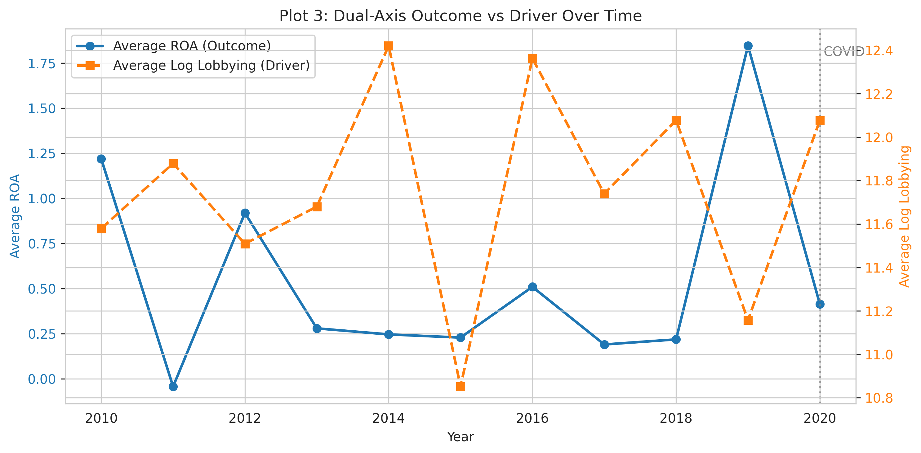
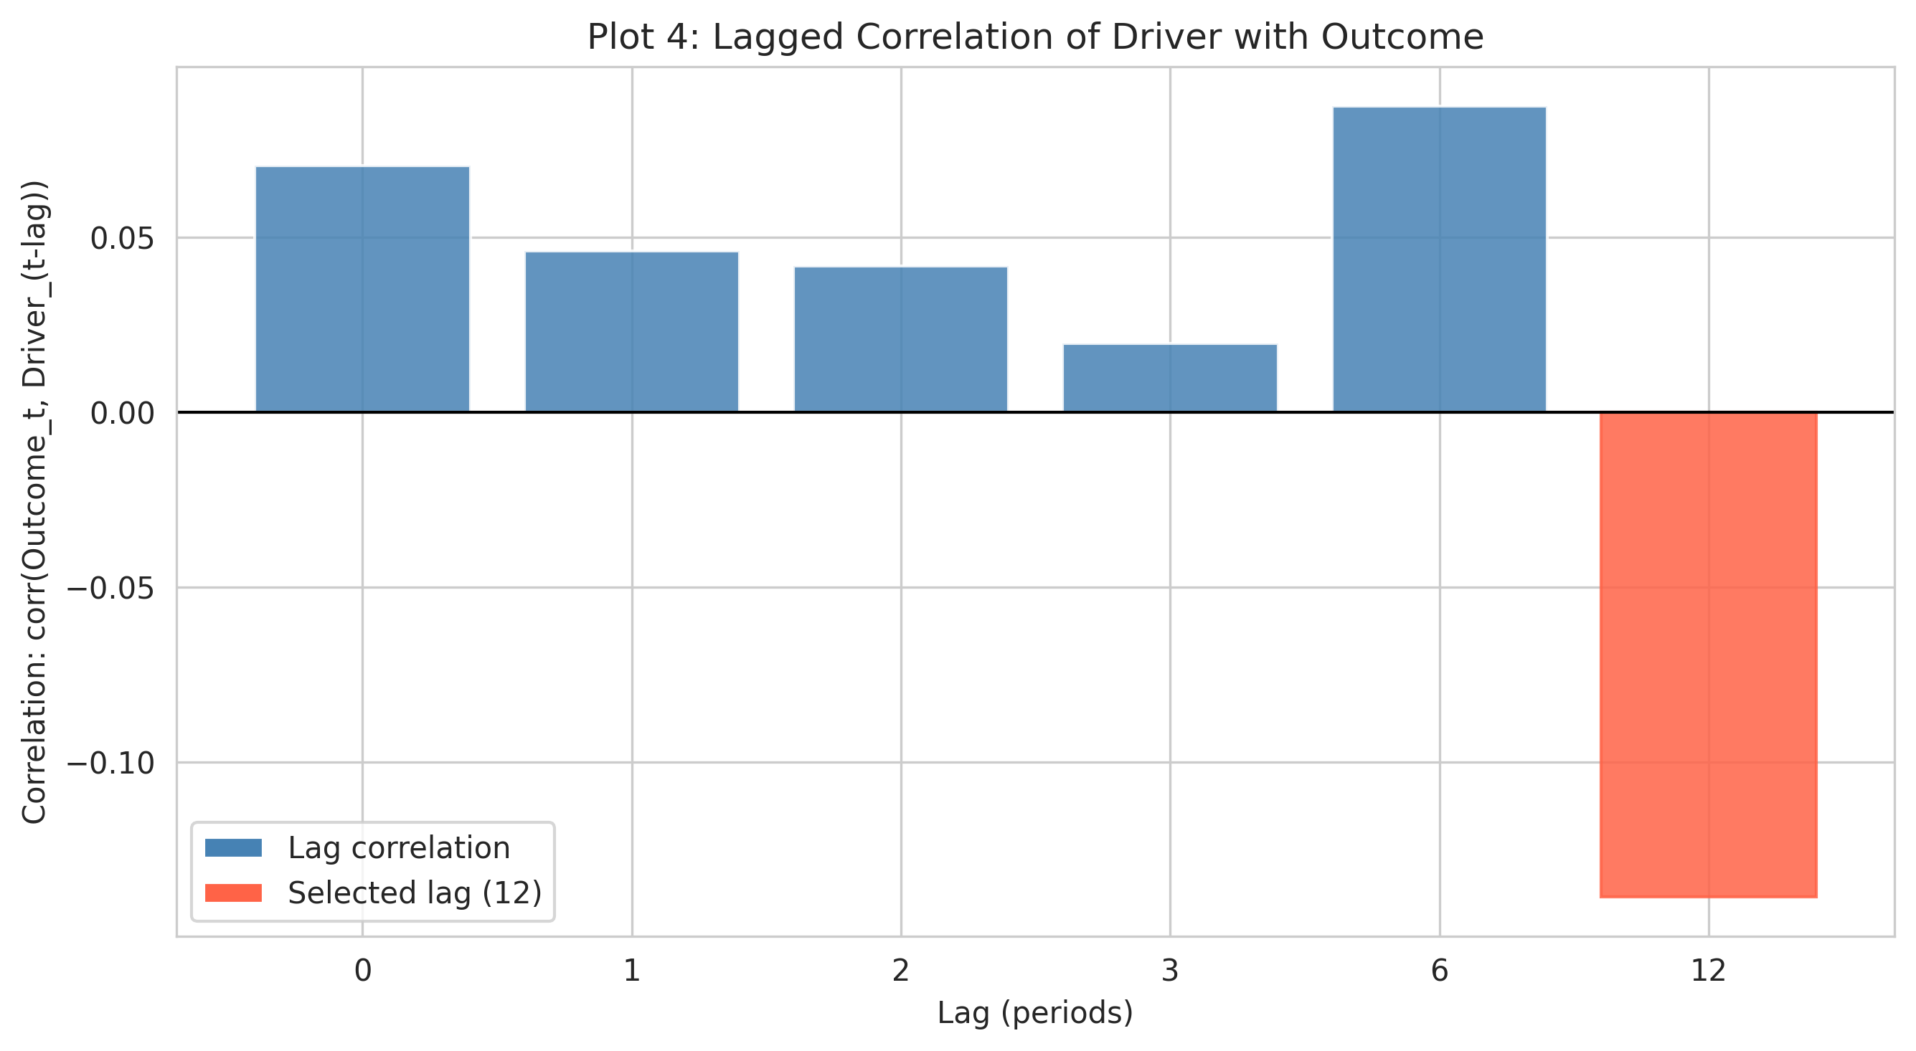
SLIDE 5
Findings (With Graphs)
Figure 1: Outcome vs. driver over time
Figure 2: Lagged relationship analysis
Main findings in simple terms
Our main model did not confirm our original hypothesis. Instead of higher profitability, the estimated relationship was negative and not statistically strong. In plain terms: spending more on lobbying did not reliably predict better profits in the following year in our sample.
Graph paths: ../figures/M2/plot3_dual_axis_outcome_driver.png and ../figures/M2/plot4_lagged_effect_analysis.png
Notes:
Now for our findings. The key takeaway is that our original hypothesis was not supported by the main model. We expected a positive relationship, but the estimated relationship was negative and not statistically strong. That means we should be careful: we cannot say lobbying spending clearly causes higher profitability in this dataset. The graphs help show the pattern and timing, but the model uncertainty is still important.

Slide 6
Quick recap
Thank You
We tested whether more lobbying spending leads to higher profitability. Using merged firm data and a panel model, we found that this effect was not clearly positive in our sample.
Questions?
Notes:
Thank you for listening. To summarize one last time: we tested whether higher lobbying spending leads to higher profitability, and we did not find strong evidence for that in this sample. We are happy to answer questions about the data, method, or interpretation.

